Slide 1
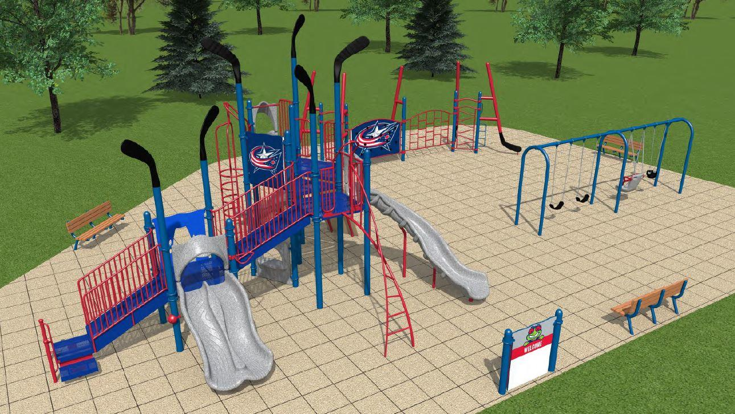
What are the next steps for the convection playground?

Slide 2
Discussed at Delft meeting
Interface to test convective parameterizations in diff ways.
Easy to find definition of cases.
Diff groups run diff cases and download same platform.
LES and CRM outputs for reference.
Useful obs.
Info on existing data and how to access.
Systematic comparison of models with refence simulations/ obs.
Accessible to anyone that wants to analyse.
Voluntary participation.

Slide 3
Since Delft

Slide 4
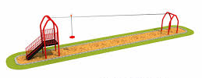
Equipment?
Relatively quick and easy framework
Standardise input format so easy to run different cases.
Functions of height?
Some standard analysis/plotting scripts
Open or fenced?
Make parameterization code available?
Ability to plug into other models?
Documentation.
Playground -
All in one place
Surface?
Where host and what format.
Wiki with info and links
Git repository (or similar)
Gatekeeper?
What range of equipment?
What cases to use? Is the original data still accessible?
Output format
Variables
What already exists? Lists test cases? Format of other projects e.g. RCEMIP
CCPP in US?
Interactive environment/ message board. Data/ model errors and issues

Slide 5
Next steps?
Email list of participants – at least one from each modelling group.
Synthesise all existing initiatives (e.g. GASS, RCEMIP…..)
Identify groups already working on common format for forcing files.
Converge towards international standard format (InScAPE testbed, DoE ARM)
Dedicated meeting during the High-tune conference (Toulouse, June 2020)
Formulise playground content:
List of 1D cases, realistic and idealised
3D experiments
What data to keep?
Model documentation
Output comparisons
Data storage/repository

