Slide 1
On improving microphysics in convection parametrizations
and elsewhere!
Richard Forbes and Alan Geer
Thanks to Maike Ahlgrimm*, Peter Bechtold, Katrin Lonitz
European Centre for Medium-range Weather Forecasts (ECMWF)
richard.forbes-at-ecmwf.int
Convection Parametrization Workshop, Exeter, July 2019
* funded by the U.S. Department of Energy's Office of Science Atmospheric System Research (ASR) program under Grant DE-SC0005259.

Slide 2
Microphysics in NWP/climate models – the Three Amigos!
Convection parametrization
“Grid-scale” cloud and precipitation
Observation operator

Slide 3
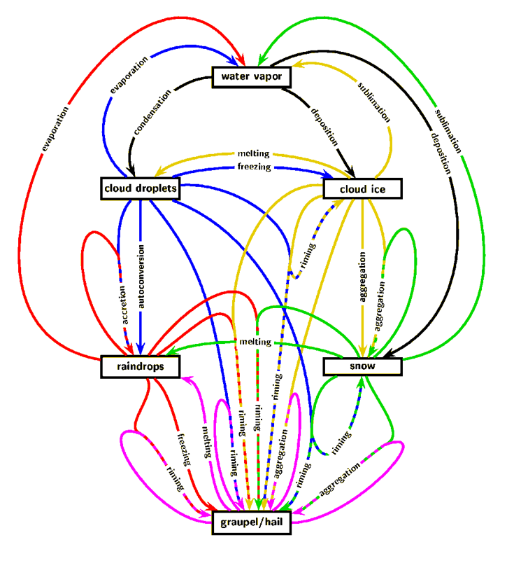
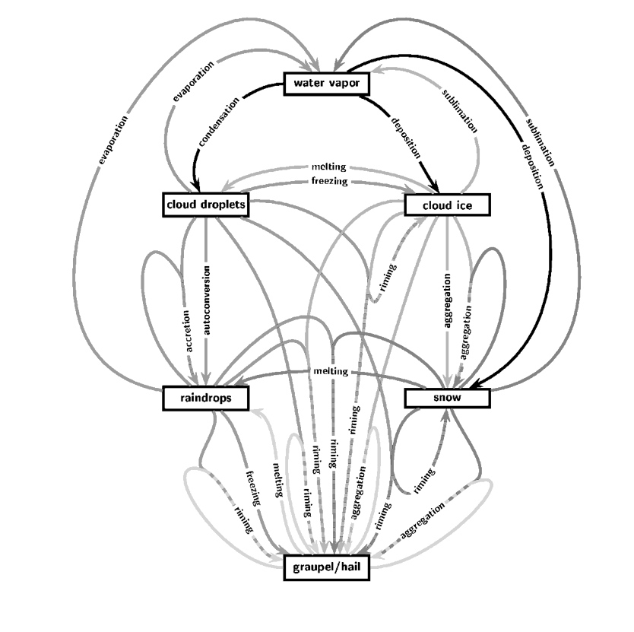
Microphysics in NWP/climate models
Usually simple microphysics
saturation adjustment
autoconversion/accretion
precipitation evaporation
diagnostic T-dependent phase
Although not all (e.g. 3MT approach)
“Grid-scale” microphysics evolving with increasing complexity (S-M, D-M, P3…)
Uses “grid-scale” and convective scheme outputs but often different assumptions
(particle properties, sizes)
Convection parametrization
“Grid-scale” cloud and precipitation
Observation operator
Images courtesy of Axel Seifert

Slide 4
Motivation for more consistent microphysics
Into the deep convective “grey zone” - handover from convection to “grid-scale”
Systematic errors due to “simplified” convective microphysics can be significant
Closer representation of the observations for evaluation (e.g. COSP), or for all-sky assimilation, will help to constrain the microphysics and improve the model

Slide 5
2. An example
of a regime-dependent
systematic error due to
mixed-phase convective
cloud

Slide 6
Systematic errors from “simplified” convective microphysics can be significant Mixed-phase convective clouds: from the Tropics to the storm-tracks
Modelled liquid/ice phase for saturation adjustment,
condensate and precipitation
-40°C
New: Deep
New: Shallow
-23°C
Autoconversion/ accretion
Ice/mixed-phase microphysics
Orig: deep + shallow
0°C
0
1
Temperature-dependent
liquid phase fraction
Rain evaporation

Slide 7
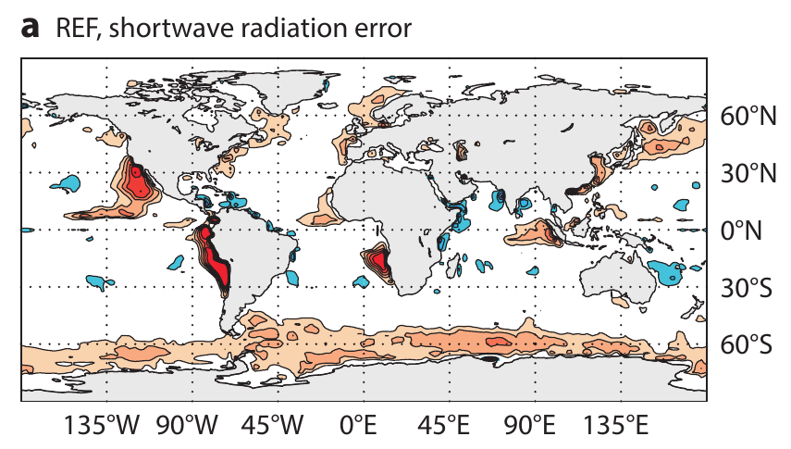
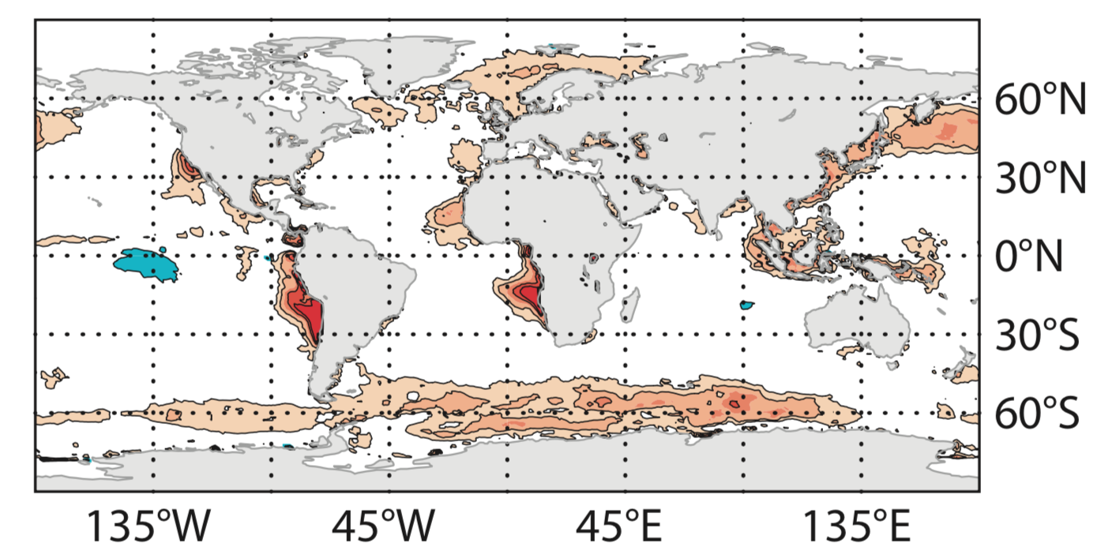
Systematic errors from “simplified” convective microphysics can be significant Example: Some errors are present across forecast lead time and spatial scale
Annual mean net top-of-atmosphere shortwave radiation bias: IFS 40r1 vs CERES
1 year ”forecast” low res (80km) “model climate ” forecast
24 hour forecast operational high res (9km)
albedo too high
albedo too low
Forbes et al. (2015)
(ECMWF Newsletter 146)

Slide 8
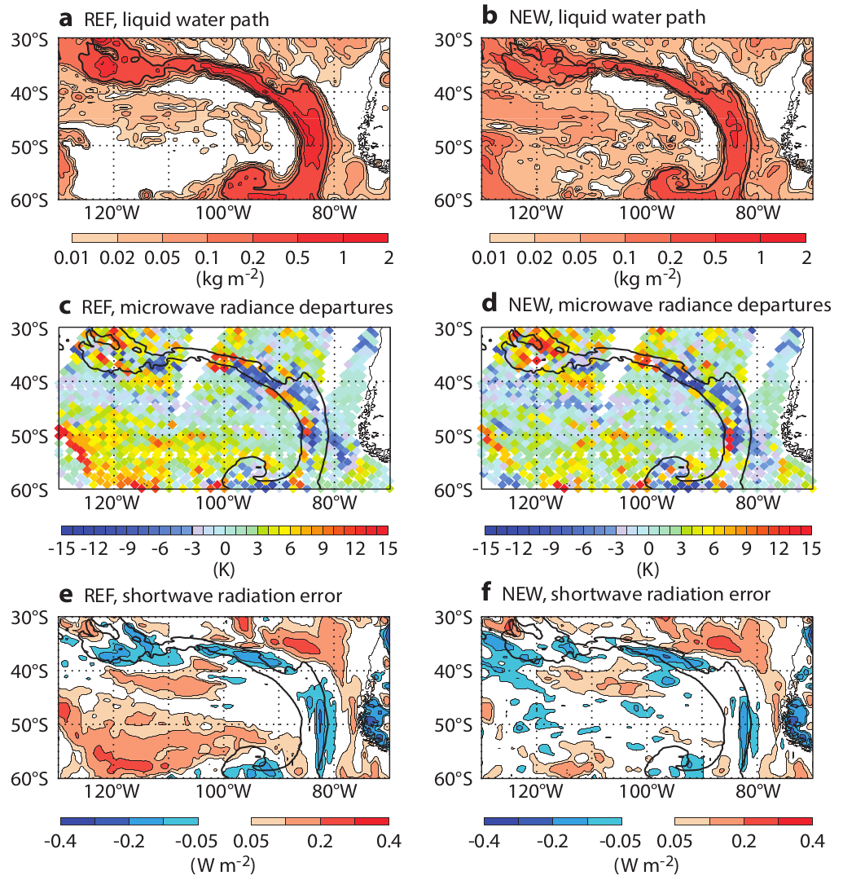
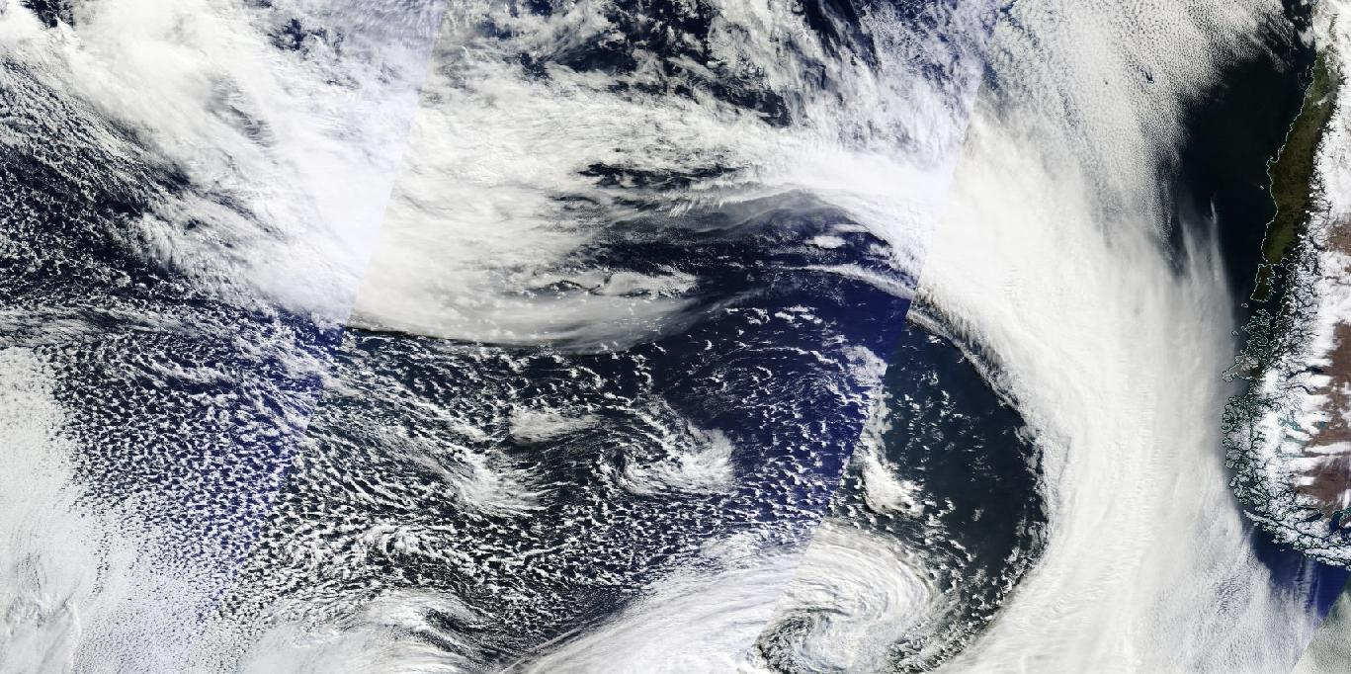
Systematic errors from “simplified” convective microphysics can be significant Example: Using microwave radiance assimilation to constrain liquid water path
Increased supercooled liquid water in convective cold-air outbreaks (all liquid if cloud top < 600hPa)
Reduced first-guess microwave radiance departures in all-sky assimilation
Reduced SW error versus CERES
Forbes et al. (2015)
(ECMWF Newsletter 146)

Slide 9
Systematic errors from “simplified” convective microphysics can be significant
Example: Using microwave radiance assimilation to constrain liquid water path
➔ reduced SW error over SHem and NHem oceans
…but still a diagnostic temperature-dependent liquid/ice phase function.
Current IFS has much improved SW bias, but via some compensation of errors. Better physics..?
Annual mean net TOA SW radiation bias in 1 year low-res “climate” IFS-CERES
Forbes et al. (2015)
(ECMWF Newsletter 146)
albedo too high
albedo too low

Slide 10
3. Constraining
grid-scale and
convective microphysics
from all-sky assimilation?

Slide 11
The rising importance of cloud-affected (all-sky) satellite observations!
Observation impact on 24h forecast error reduction (FSOI) at ECMWF 2012-2018
Satellite microwave radiances sensitive to water vapour, cloud and precipitation
Increasing impact
Satellite infrared radiances sensitive to water vapour, currently assimilated in clear-sky and overcast situations only
Incorrect results
2013
2014
2015
2016
2017
2018
Geer et al. (2017)
(QJRMS & ECMWF TechMemo)

Slide 12
Multi-frequency satellite channels provide information on surface properties, water vapour, cloud and precipitation
Increasing frequency [GHz]
Observed TB [K]
Hydrometeor effect: TB - TBclear [K]
Rain (absorption, increases TB)
Snow/graupel/hail (scattering, decreases TB)
Cloud (absorption, increases TB)

Slide 13
Disentangling information from multi-frequency background departures Model error (coverage/frequency/hydrometeor content) or observation operator error? Is more complex microphysics required (size distributions, ice particle densities, shapes)?
Multi-frequency background departures (obs-model)
All-sky microwave (SSMIS) 150 GHz
All-sky infrared (IASI) 871 cm⁻¹
(obs – model) [K] Mean, 1-20 June 2017
Example: “convection” in the maritime ITCZ? Coverage, frequency, condensate, particle size/shape?

Slide 14
Satellite frequencies and clouds/precipitation – potential for assimilation?
1. Microwave
2. Active
radar
6. Broad-band
SW/LW
5. Solar
Lidar
low-
high-freq.
Precip.
3. Sub-mm
4. Infrared
T-sounding
Cloud
Cloud particles, lighter precip.
Cloud ice water
Cloud fraction, cloud top height, multiple layers
Ice particle size, shape, orientation
Vertically resolved
Larger frozen particles, particle size and shape
Vertically resolved
Cloud particle size and number
Size of water cloud particles
Cloud liquid water
9. Lightning
Melting particles
Cloud cover
Sub-FOV heterogeneity & structure
Rain, including particle size
Alan Geer
7. Rain gauge
8. Ground radar

Slide 15
Conclusions
NWP/climate models have widely varying microphysics complexities and assumptions in grid-scale cloud/precip, convection parametrization and observation operators
Increasing use of “cloud-sensitive” observations in NWP assimilation will provide more comprehensive global constraints for the microphysics than ever before.
Converging towards a justifiable complexity of microphysics that can be consistently represented across all three areas could bring benefits for:
Consistency for the “grey zone” resolutions
Better use of observations to constrain parametrization assumptions (offline or all-sky assimilation)
Reduction of regime-dependent systematic errors and improvements in the analysis and forecast

Slide 16
Microphysics in a global NWP/climate model – the Three Amigos!
“Grid-scale” cloud and precipitation
Convection parametrization
Observation operator

Slide 17
Thank you!
Questions?

