Slide 1
Biases in the diurnal cycle of convection in convection permitting configurations of the UM in different parts of the world.
Humphrey Lean, Kirsty Hanley, Stuart Webster, Will Keat, Thorwald Stein, Todd Lane, Martin Jucker, Elizabeth Kendon and Giorgia Fosser

Slide 2
Introduction
Met Office has run 1.5km UK version of Unified Model for about 10 years (UKV).
Numerous other instances of convection permitting UM configurations around world run by UM Partners or for specific projects at various gridlengths from 1.5km to ~4km.
Current configurations run without any convection parameterisation. Older UK/Europe configurations ran with CAPE dependent CAPE closure version of mass flux convection scheme (Nigel Roberts).
Although these models provided a “step change” improvement over the previous generation of O(10km) models they do have a number of biases one of which is issues with initiation/diurnal cycle.

Slide 3
RA Configurations
RMED in Met Office maintains “Regional Atmosphere” (RA) configurations.
Two flavours M and T (Midlatitude and Tropical).
Differences in configuration between M and T:
Diffusion changes – smaller in M
Stochastic perturbations – only in M.
Different vertical levels - higher in T.
Difference cloud scheme - PC2 in T, Smith in M.
First two of these mitigate towards less smoothing in midlatitudes.
A key driver for these differences is convection being under-resolved in midlattitudes.

Slide 4
Average cell diameter (km) (averaged over 22 convective cases over UK)
Threshold (mm/hr) | Radar | UKV (1.5km model).
0.125 | 7.81 | 16.04
0.25 | 6.32 | 13.21
0.5 | 5.58 | 11.71
1.0 | 4.42 | 9.93
2.0 | 3.28 | 7.95
4.0 | 2.57 | 5.96
16.0 | 2.13 | 3.37
This is as measured by surface rainrate, even worse for updrafts, turbulence etc.
Emilie Carter

Slide 5
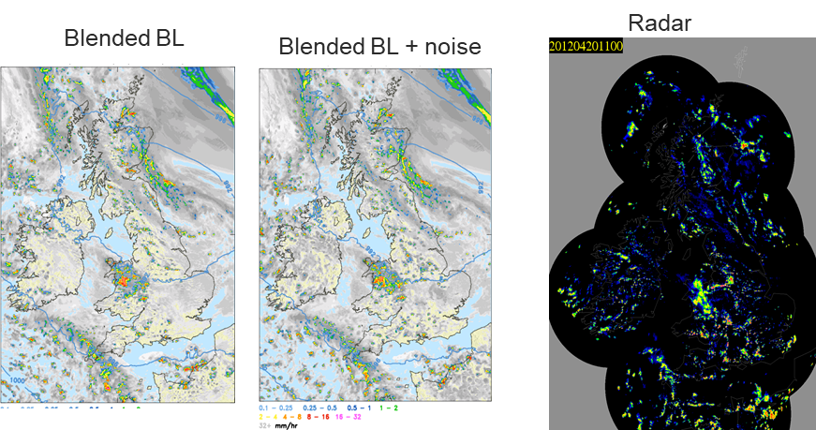
RA Configurations
T configuration struggles to initiate convection in UK when small, scattered showers.
A Lock
Conversely in tropics M configuration gives too fragmented convection and very early initiation.
Aspiration to unify configurations. Likely to involve scale aware convection scheme to represent small showers that shouldn’t be explicitly resolved.

Slide 6
Forecasting problems
Issues relating to convection are often highlighted when UM partners are asked about what model problems concern them:
Top Model Issues | Specifics
Convective Initiation | Convective Initiation – timing Lack of rain over the ocean Delayed initiation Early initiation over land Incapability to predict the correct location and timing of localised light rainfall events Mid-level convection
Structure of convection Rainfall characteristics | Structure of convection – too many cells if resolved, too few if under resolved, lack of stratiform cloud/rain. Light rain. Over-prediction of peak rainfall for organised convective events + warm rain Hailstorms and lack of hail at the surface Spottiness, absence of cumulus congestus Blobbiness, the spread of light/mod ppn
Mike Bush

Slide 7
Initiation of convection
Expect km scale models, if all else is equal*, to initiate late due to finite size of gridbox not allowing initial plumes to be resolved.
Dependence of initiation time with anything that makes changes smoothness of field (resolution, diffusion, adding stochastic perturbations) usually is as expected from this simple picture. i.e. smoother fields lead to later initiation.
However initiation is often observed to be early in tropics (and also in UK with newer versions of model).
Situation complicated by many exceptions to simple picture hence need to know what is representative.
*Lots of things!! Cloud, radiation, land surface etc etc

Slide 8
UM Partnership Convection Working Group
Group of UM Partners and some academic institutions who use UM at km scales.
Carried out exercise of pooling datasets from different partners to try to understand consistent initiation/diurnal cycle and rain amount biases in UM.
Concentrate on datasets where there is more than one case (ideally a long period) and there are good observations for comparison.
Issues with quality of obs and how much to stratify data.

Slide 9
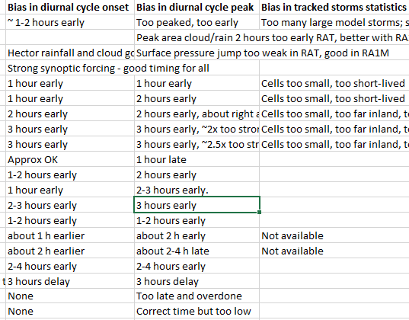
Example part of of initiation spreadsheet…..
About right in M, late in T
4km PS35 UKCP
Thought to be due to cold SST bias
GPM obs?
GPM obs?

Slide 10
Results of pooling exercise
Tropical models mostly initiate early.
Diurnal Peak also early
Same is true of UK models with recent configuration (as seen in UKCP18). Need to verify this in current UKV configuration.
Consistent signal that storms grow too rapidly once they have initiated (diurnal peak often more early than initiation).
Older models initiate later over UK (UKCP18 and UKV)

Slide 11
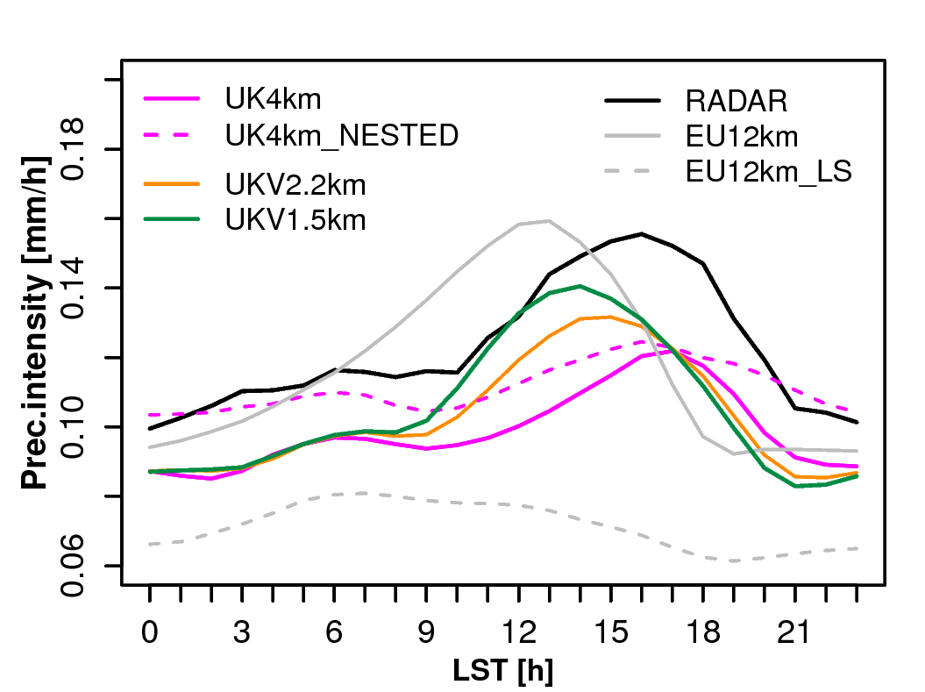
UKCP diurnal cycle (OS35)
JJA Mar 1996 – Jun 2008
Fosser

Slide 12
Reasons for early initiation
Could be many!
Too strong stochastic perturbations
Have focussed so far on lack of CIN.

Slide 13
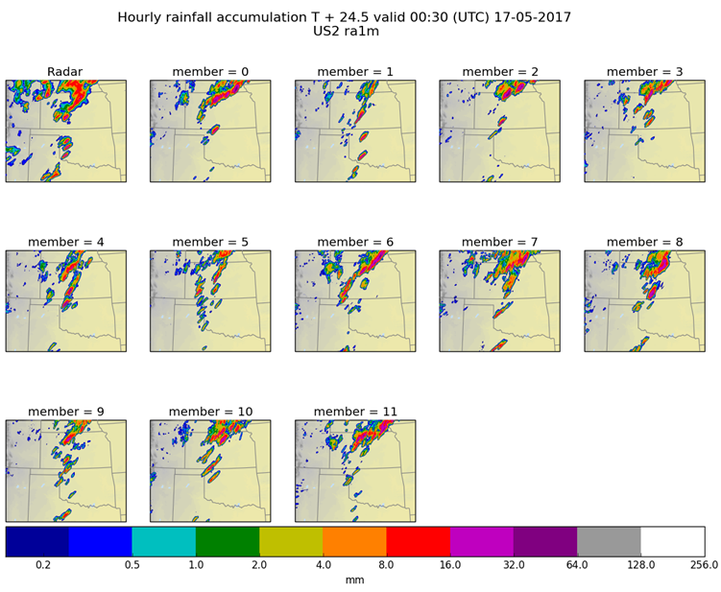
16th May 2017 HWT ensemble case study
Member 1 has best representation of supercells (size, location and timing) in both RA1M and T
Kirsty Hanley

Slide 14
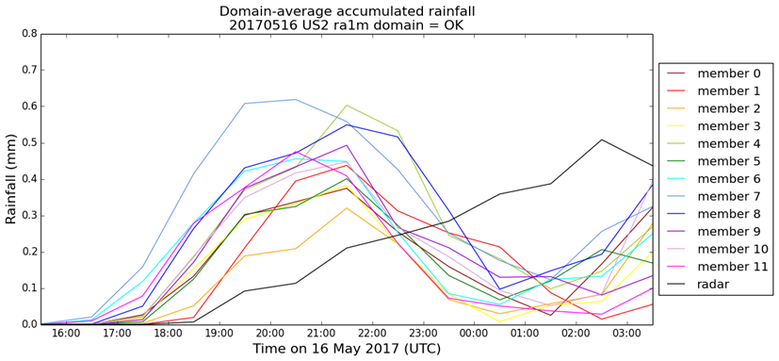
Convective Initiation ensemble study:
Case from 2017 HWT found that RA1-M configuration ensemble had most members initiating too early.
Kirsty Hanley

Slide 15
16th May 2017 HWT ensemble case study
RA1-M initiates too early in most ensemble members (too late in RA1-T).
Compared to observed soundings CIN too small in all members.
CIN similar in RA1-M/T and in global which implies not related to configuration of regional models.
The best RA1-M member in terms of initiation time was too warm and dry compared to mesonet obs – compensated for lack of CIN.
Hanley and Lean 2019 in preparation
Kirsty Hanley

Slide 16
Overarching conclusions from HWT Studies.
Compensating errors a big issue. The best looking member was too warm and dry which compensated for lack of CIN. Danger of “tuning” model concentrating just on one thing (rainfall) and without understanding of what the real issues are.
Driving model very important for performance of regional model. Lack of CIN seems to be, at least in part, inherited from global model. Depends how regional model is initiated. Stable layers often can be traced back a long way (multiscale nature of issue).
Won’t solve problems by changing regional model alone (e.g. by fiddling with stochastic noise, diffusion etc). Danger with too many “knobs” to turn!!

Slide 17
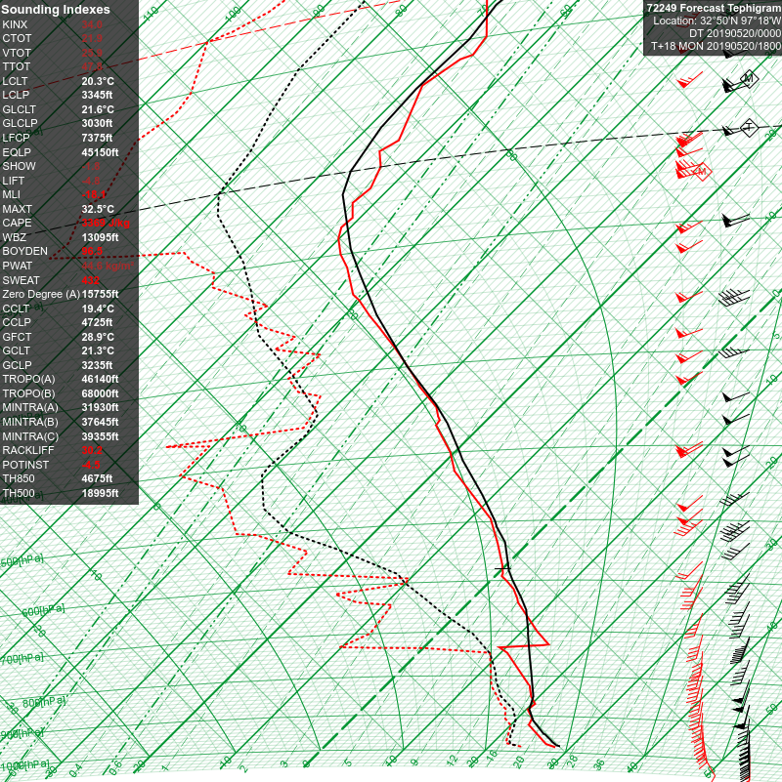
Not as bad as expected case from 2019 HWT: Fort Worth 18z 20/05/2019
Observations
Global Model(s)
In this case global model originally had inversion where it originated over Mexico but lost as it evolved and moved north.
Matt Lewis

Slide 18
Overarching conclusions from HWT Studies.
Compensating errors a big issue. The best looking member was too warm and dry which compensated for lack of CIN. Danger of “tuning” model concentrating just on one thing (rainfall) and without understanding of what the real issues are.
Driving model very important for performance of regional model. Lack of CIN seems to be, at least in part, inherited from global model. Depends how regional model is initiated. Stable layers often can be traced back a long way (multiscale nature of issue).
Won’t solve problems by changing regional model alone (e.g. by fiddling with stochastic noise, diffusion etc). Danger with too many “knobs” to turn!!

Slide 19
Other diurnal cycle issues.
Too rapid initiation of rain after cloud/too rapid rise in rainrate a common theme. (Picked out in pooling by diurnal cycle peak being relatively earlier than initiation).
Need more detailed analysis to understand this including lifecycle analysis and idealised modelling.
Possible that issue is related to incorrect structure of updrafts in model c.f. yesterdays discussion of plumes (Morrison, Till).

Slide 20
Other diurnal cycle issues.
Cell tracks for cells exceeding 90th percentile of cell-mean rain
(AKA strongest cells)
Strongest cells are long-lived in reality – short-lived in model
T Lane, M Jucker

Slide 21
Conclusions
Different RA configurations for tropics and midlatitudes related to convection being under-resolved in midlatitudes.
Systematic errors in diurnal cycle seen with km scale models using RA configurations have been elucidated by UM Partnership Convection WG.
Main signals are early initiation and peak of convection (esp in tropics) and too rapid growth of convection after initiation.
Early initiation speculated to be due to lack of CIN or too strong stochastic perturbations. Evidence for former from individual cases e.g. HWT 2017 – need more robust analysis of pre-convective environment (HWT 2019, UKCP18?).
Evidence that larger scale errors from global model has strong influence on regional models. Can’t solve issues in regional models in regional models alone.

