Slide 1

Using a cloud-resolving model to diagnose the effects of different wind shear profiles on deep convective cloud fields
Taken by Oliver Sievers (DWD) over tropical Atlantic on the RV Polarstern
Mark Muetzelfeldt
Supervisors: Robert Plant, Peter Clark, Steven Woolnough, Alison Stirling (Met Office CASE supervisor)

Slide 2
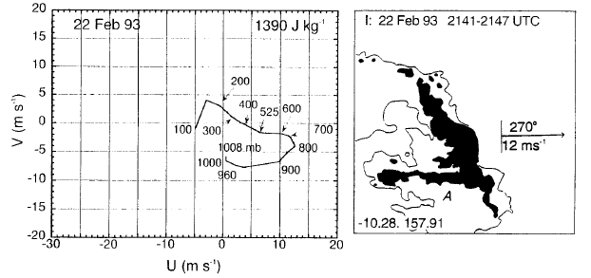
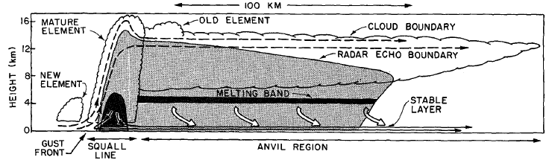
Motivation – vertical wind shear and tropical MCSs
LeMone et al. (1998)
Low-Level Shear (LLS) is an important factor in the formation of organized cloud systems such as squall lines and Mesoscale Convective Systems (MCSs)
  Rotunno et al. (1988), LeMone et al. (1998)
Precipitation from MCSs forms an important part of the total precipitation in many regions in the tropics
Extremes in precipitation are often due to MCSs
Effects of organization not well represented in climate model convection parametrization schemes
  Some notable exceptions: e.g. Mapes and Neale (2011), Willett and Whitall (2017)
Houze (1977)

Slide 3
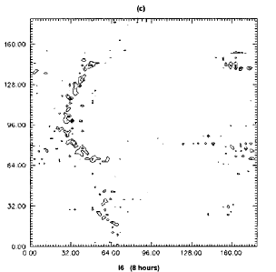
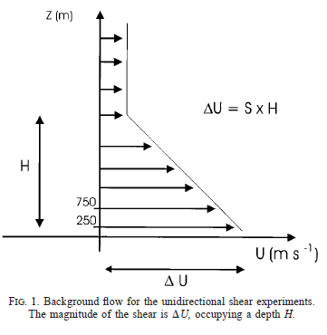
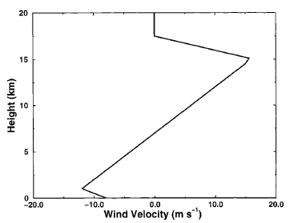
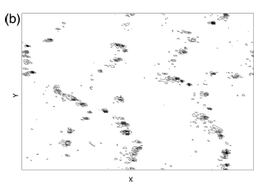
Background – RCE CRM
Modelling with LLS
Robe and Emanuel (2001)
RCE Cloud-Resolving Models: provide a means of investigating the organization of cloud fields as a function of shear in statistical equilibrium
Well suited to providing information for use in a convection parametrization scheme that uses the Quasi-Equilibrium assumption
Cohen and Craig (2006)

Slide 4
RCE CRMs – Purpose and hypotheses
Purpose: to use CRM experiments to diagnose aspects of the cloud field that are relevant to a Convection Parametrization Scheme (CPS)
  E.g. organization, cloud lifetimes, mass flux statistics and thermodynamic variables
Drive CRM experiments with different wind profiles
  Hypothesis 1: profiles with more LLS will cause more organization
  Hypothesis 2: more organization will be associated with longer cloud-cell lifetimes
Use results to design modifications to existing CPSs

Slide 5
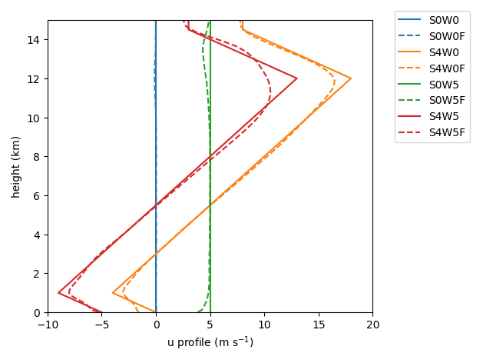
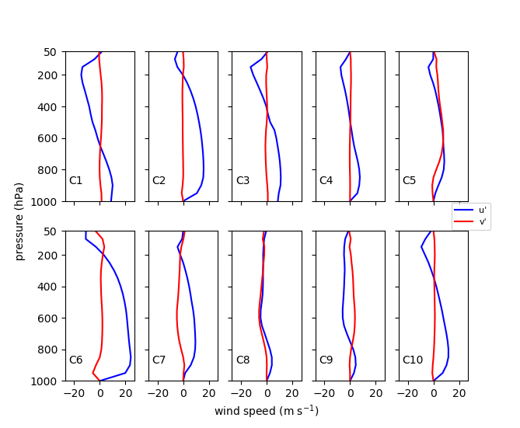
RCE CRMs – Wind profiles
Type | Name
systematic linear | S0W0F
 | S4W0F
 | S0W5F
 | S4W5F
RWP | C1
 | C2
 | C3
 | C4
 | C5
 | C6
 | C7
 | C8
 | C9
 | C10
Based on profile used in e.g. Cohen and Craig (2006)
Systematically investigate effects of shear (S0/S4) and surface wind (W0/W5)
Representative Wind Profiles (RWPs)
Represent ‘shear parameter space’ in a GCM using clustering; associated with organization of convection in the tropics
(Muetzelfeldt et al., 2019 in prep.)
Notes:
Simplify RWPs produced by clustering.

Slide 6
RCE CRMs – Model setup
Idealized UM 11.0 RCE – prescribed cooling of 1.5 K day⁻¹
Different sheared environments imposed by relaxing wind to wind profiles
No Coriolis
Constant SST of 300 K, bulk aerodynamic formulae used to calculate surface fluxes
256x256 km² domain, 1km resolution, biperiodic BCs
40 km height, 98 vertical levels (stretched - 63.3 m for lowest level, 1 km by 25 km)
20 days runtime (diagnostics taken from final 10 days)
UM 11.0 (+branch for moisture relaxation)
30 s timestep
3D Smagorinsky turbulent diffusion
No BL scheme
CASIM Microphysics
Moisture and energy conservation

Slide 7
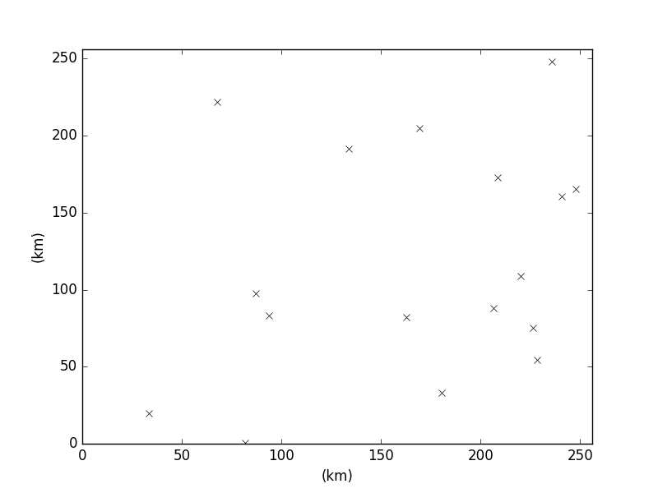
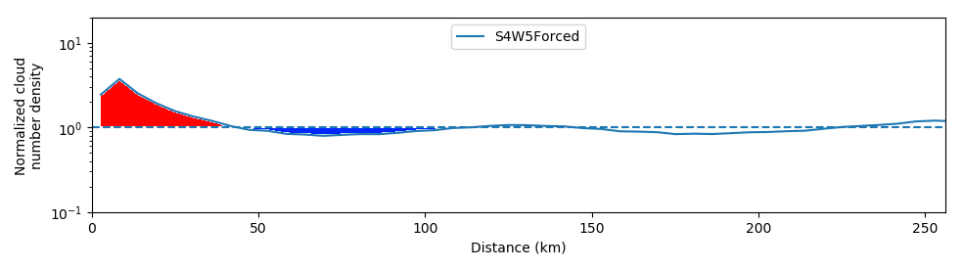
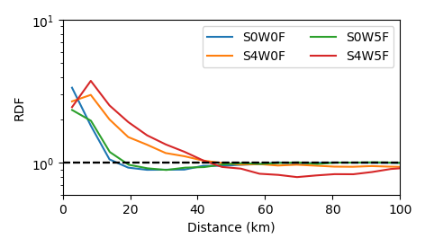
RCE CRMs – Cloud field organization
Using the Radial Distribution Function (RDF)
  Calculated using an area-weighted histogram of cloud-to-cloud distances, normalized by the total number of clouds in the domain
  Has value of 1 for all spatial scales for a randomly-distributed cloud field
  Values above 1 indicate clustering at that spatial scale
Use to define a cluster-radius, and a cluster-index
cluster-index
cluster-radius
Notes:
Radial – no info on orientation of linear features

Slide 8
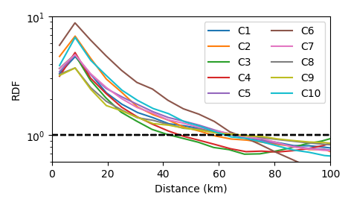
RCE CRMs – Cloud field organization
Expt | Cluster-rad (km) | Cluster-ind (km)
no shear | 16 – 19 | 10 – 11
shear | 44 – 47 | 28 – 39
systematic linear
shear
no shear
Expt | Cluster-rad (km) | Cluster-ind (km)
C1 – C10 | 43 – 70 | 44 - 153
RWPs

Slide 9
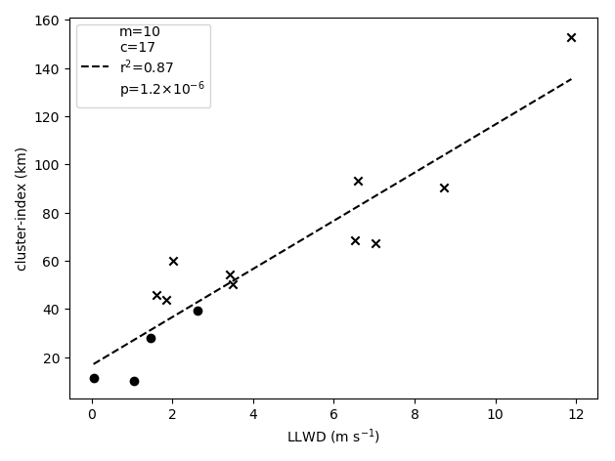
RCE CRMs – LLS vs org (hypothesis 1)

Slide 10
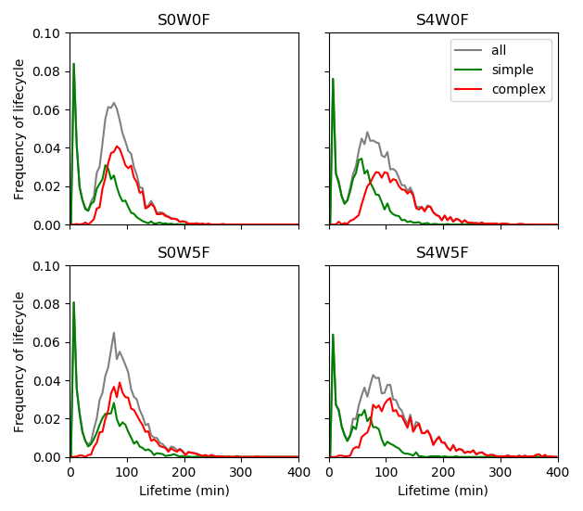
RCE CRMs – Cloud tracking to find cloud lifetimes
Uses higher temporal resolution data (5 min) to track clouds from one snapshot to the next
Use overlap of projected clouds with current clouds to match one cloud from previous to current snapshot
Handles cases such as merging and splitting
t0
t1
t2
t3
Mean lifetimes:
all: 74 min
simple: 49 min
complex: 96 min
simple
complex
Notes:
Quite a lot has to go onto this slide! Will need some time to come up with schematics of the text.

Slide 11
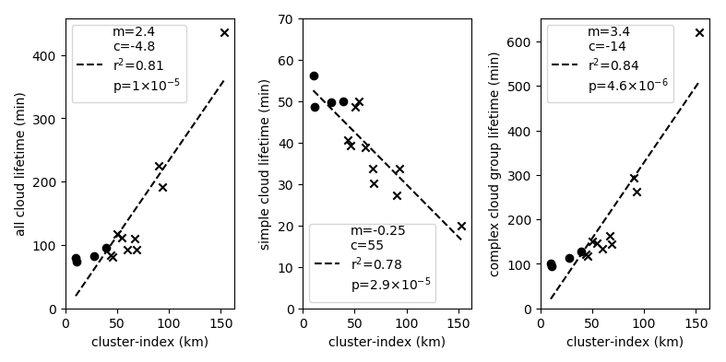
RCE CRMs – Cloud lifetimes (hypothesis 2)

Slide 12
Modifications of existing CPSs
LLS as a source of org
  Mapes and Neale (2011), Willett and Whitall (2017) represent organization of cloud field with a prognostic org field
  Previous convective activity used as a source of org
  Decreases the entrainment rate dependent on amount of org
  Meant to help with variability of convection over tropics without being detrimental to mean state
  Given relationship between LLS and cloud field organization (cluster-index), LLS could be a source of org

Slide 13
Modifications of existing CPSs
Make cloud lifetime a function of LLS
  Some convection parametrization schemes (e.g. Plant and Craig, 2008) have a parameter that represents cloud lifetime
  We have identified links between cloud lifetime and organization
  Would be possible to modify such a scheme in the presence of LLS

Slide 14
Conclusions
CRM results
Hypothesis 1: clear relationship between LLS and organization
Hypothesis 2: relationship between organization and cloud-cell lifetimes found. However, simple clouds and complex cloud groups have different sign of relationship
RWPs seen to produce organized cloud fields
Modifications to existing convection parametrization schemes
Introduce a source of org based on LLS
Make cloud lifetime a function of LLS

Slide 15
Extras

Slide 16
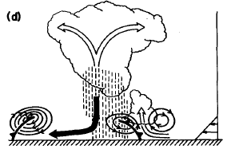
Background – Low-level shear (LLS) mechanism
downshear
According Rotunno et al. 1988 (RKW theory), LLS interacts with the cold pool generated by convection
‘optimal’ conditions for squall lines seen when vorticity of sheared background flow near surface equal and opposite to vorticity of density current from cold pool
When the environmental air mixes with the cold pool air, the vorticities cancel and an upright convective tower is formed
New cells are created on the downshear side of the convection
Supported by numerical simulations (e.g. RKW, Robe and Emanuel 2001), and observations (e.g. LeMone 1998)

Slide 17
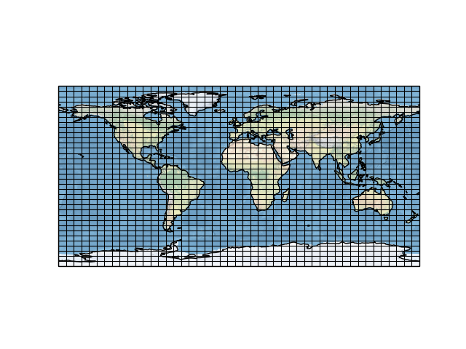
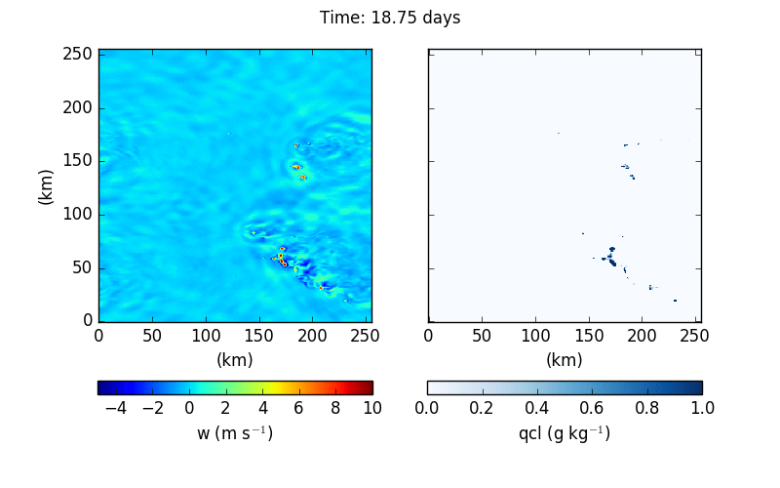
GCM
RWPs
Idealized RCE CRM simulations
Modifications to existing CPSs
Low-level shear -> org
Cloud lifetime

Slide 18
RWPs – Clustering procedure
GCM output
u, v profiles
CAPE
Pre-process
Reduce the number of profiles to analyse by filtering on CAPE and max. shear below 500 hPa
Filtering
Normalizing
Rotate profiles so wind at 850 hPa are aligned and normalize based on max. wind at each pressure level, weighting contribution from lower troposphere higher
PCA
Reduce dimensions of problem from 40 to 7, which still explain over 90 % of the variance
Clustering
Group like profiles together using K-means clustering algorithm with 10 clusters
RWPs

Slide 19
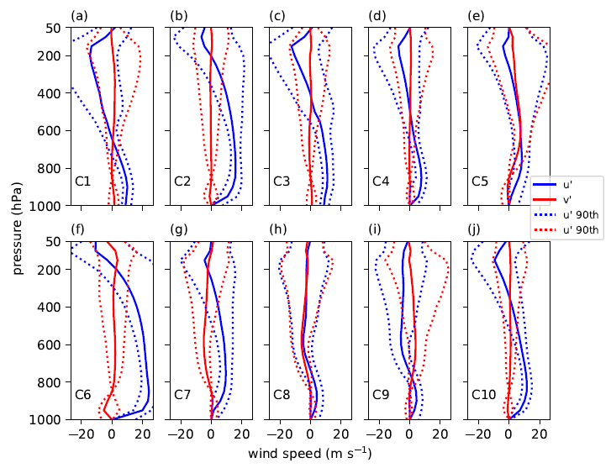
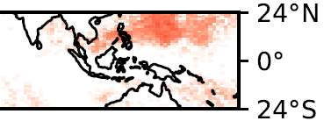
Representative Wind Profiles (RWPs)
Solid lines show median of each cluster – the RWPs
Dashed show 10th and 90th percentiles
RWP C6

Slide 20
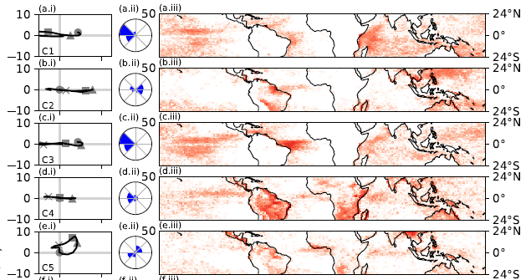



RWPs – Geographical distribution
RWP | % Land | % Sea | # prof.
C1 | 9.2 | 90.8 | 14356
C2 | 53.7 | 46.3 | 15111
C3 | 6.4 | 93.6 | 15844
C4 | 75.3 | 24.7 | 29633
C5 | 70.4 | 29.6 | 11023

Slide 21
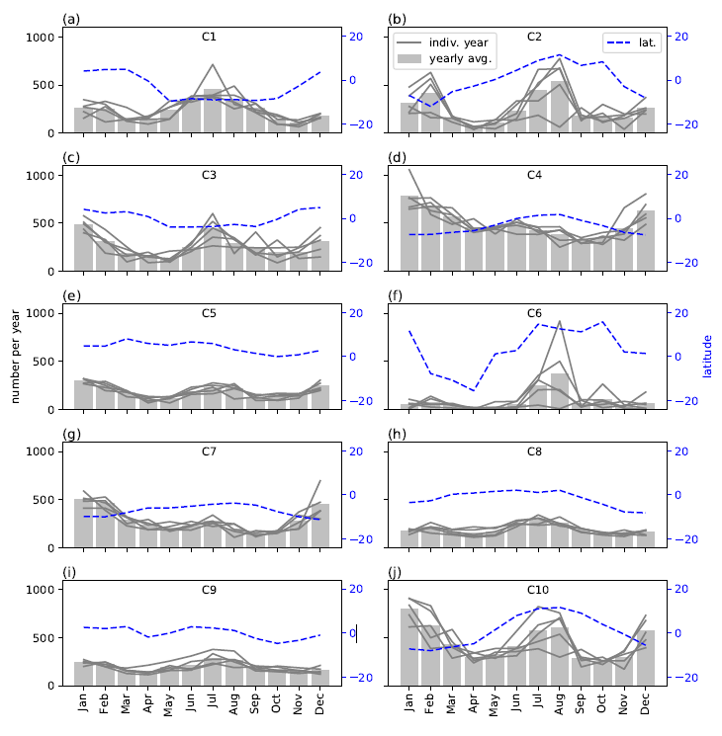
RWPs – Temporal distribution

Slide 22
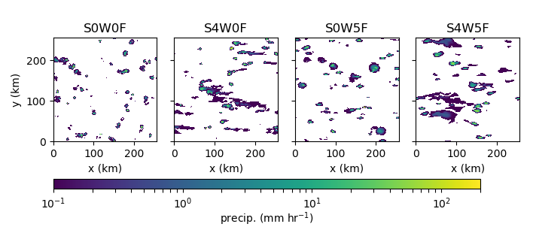
RCE CRMs – Precipitation field

Slide 23
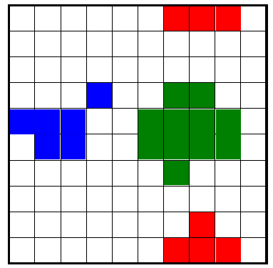
RCE CRMs – Cloud definition and analysis height
Cloudy grid-cells: defined as being a grid-cell with w > 1 m s⁻¹ and qcl > 0.005 g kg⁻¹
Clouds: defined as contiguous areas of cloudy grid-cells (including diagonals)
  Can be used to calculate centroids and cloud statistics
Analysis height: 2 km (2063 m)
  Above LCL for all experiments

Slide 24
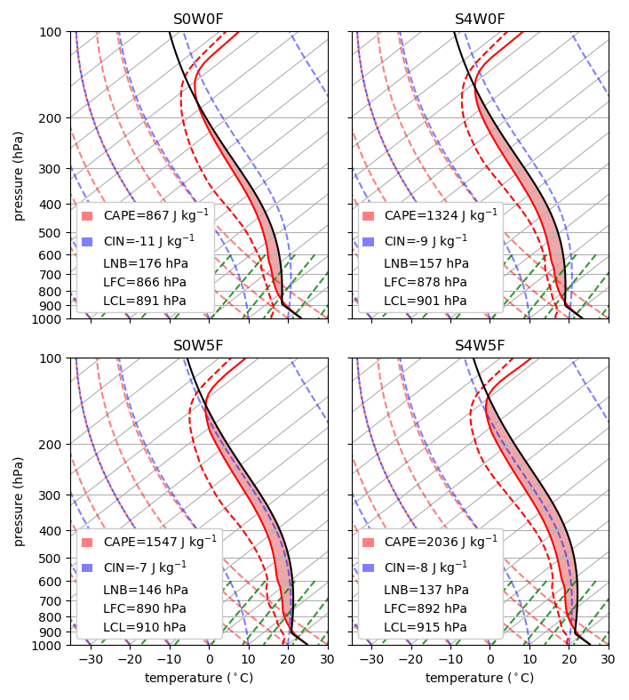
RCE CRMs – thermodynamic profiles
Expt | CAPE (J kg⁻¹)
S0W0F | 867
S4W0F | 1324
S0W5F | 1547
S4W5F | 2036

Slide 25
RCE CRMs – Cloud lifetimes
Expt | Mean simple lifetime (min) | Mean complex lifetime (min)
S0W0F | 49 | 96
S4W0F | 50 | 114
S0W5F | 56 | 106
S4W5F | 50 | 128

Slide 26
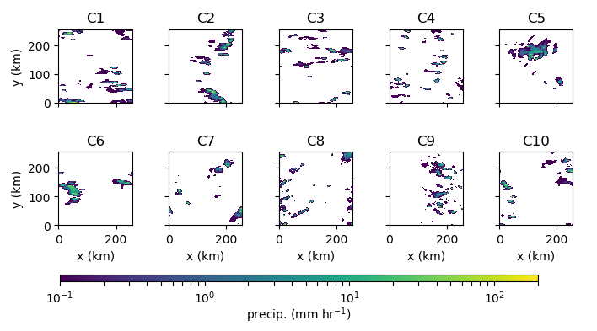
RCE CRMs – RWPs precipitation fields

Slide 27
RCE CRMs – RWPs cloud field organization
Expt | Cluster-rad (km) | Cluster-ind (km)
S4W5F | 44 | 39
C1 – C10 | 43 – 70 | 44 - 153

Slide 28
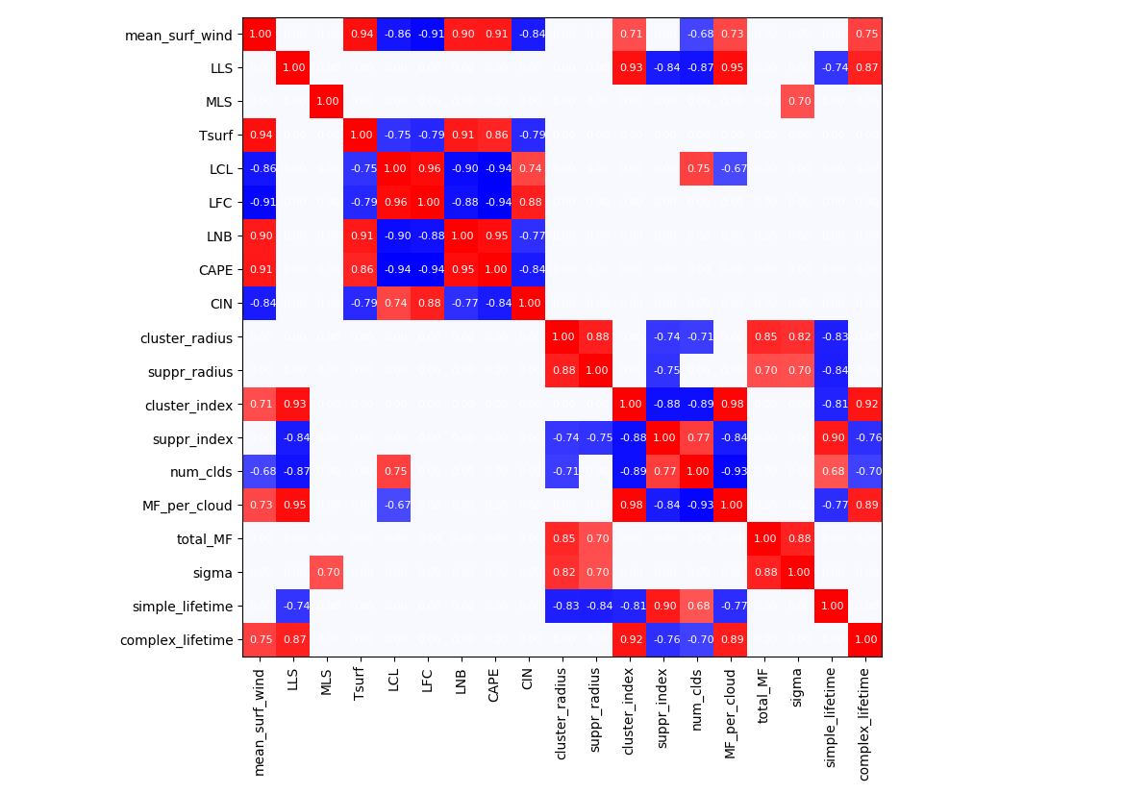
RCE CRMs – Correlation matrix
Shows only ‘robust’ correlations: p-value < 0.01
Thermodynamic variables seen to all be correlated
Most cloud field variables correlated
External variables (under our control) can describe many variables of interest
External
Thermo-dynamic
Cloud field
Lifetimes

Slide 29
Representing shear-induced cloud field organization in a convection parametrization scheme
Taken by Oliver Sievers (DWD) over tropical Atlantic on the RV Polarstern
Mark Muetzelfeldt
Supervisors: Robert Plant, Peter Clark, Steven Woolnough, Alison Stirling (Met Office CASE supervisor)

