Slide 1
Detecting thermals in deep convection
CPPC 16/07/19
Liam Till
Supervisors: Thorwald Stein, Peter Clark, Carol Halliwell

Slide 2
Background
Thermals are evident in developing stages of convection (French et al. 1999; Sherwood et al. 2013). Observed using cloud radar (Damiani et al. 2006; Damiani and Vali 2007).
Numerical simulations of cumulus congestus used to investigate thermals (Sherwood et al. 2013; Moser and Lasher-Trapp 2017; Morrison & Peters 2018).
Limited observations of thermals in deep convection using ground based radar (Yuter & Houze 1995; Hogan et al. 2008).

Slide 3
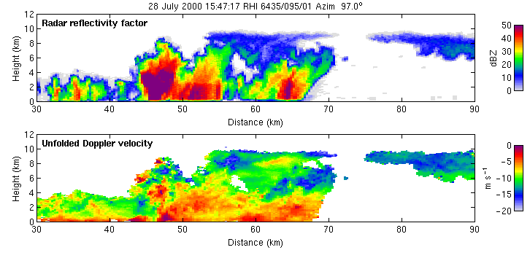
Motivation
Animation of storms over Gatwick. Courtesy of Robin Hogan. Taken from http://www.met.rdg.ac.uk/radar/overview/storms.html
Radar Reflectivity Factor (Z) $∝D^{6}$
Measure phase shift between two pulses

Slide 4
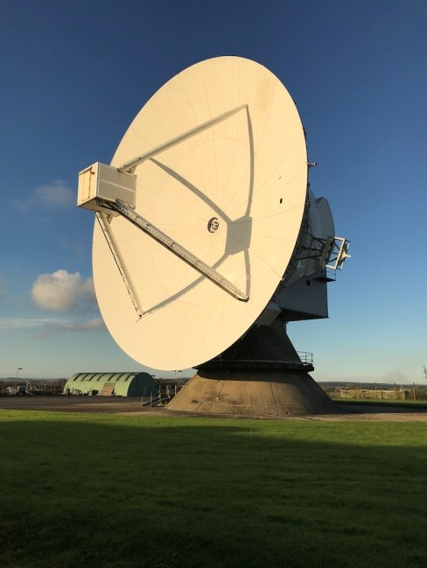
Radar Data
Chilbolton Advanced Meteorological Radar (CAMRa) -
3 GHz (10 cm) radar.
300 m range gates and 0.28° beam width.
0.4° s⁻¹ scanning rate (34 m at 50 km range) for Dynamical and Microphysical Evolution of Convective Storms (DYMECS) case.
0.5° s⁻¹ scanning rate (44 m at 50 km range) for Gatwick cases.
Doppler and dual polarisation capability.
Doppler velocity is measured between -15 and 15 m s⁻¹ with an accuracy of 0.15 m s⁻¹.
Chilbolton Advanced Meteorological Radar

Slide 5
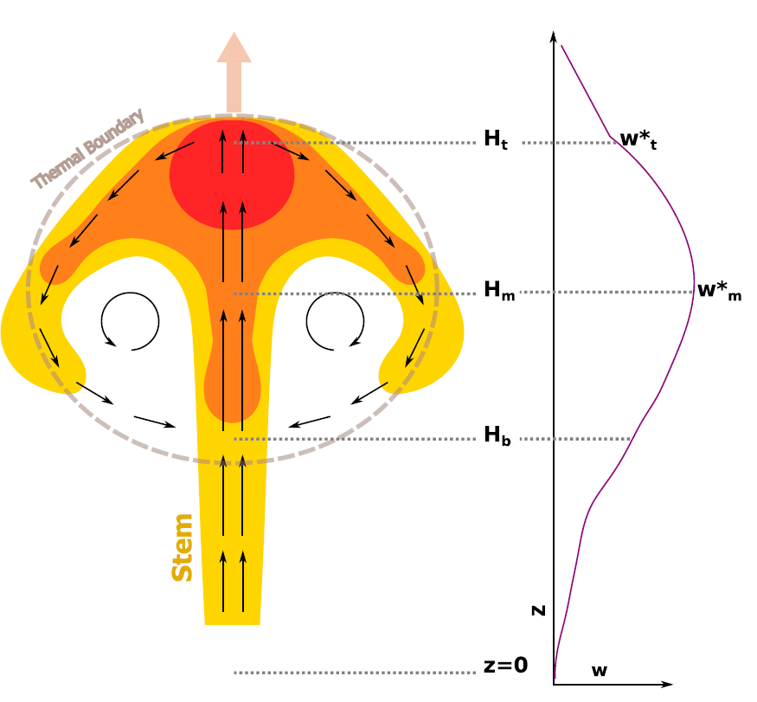
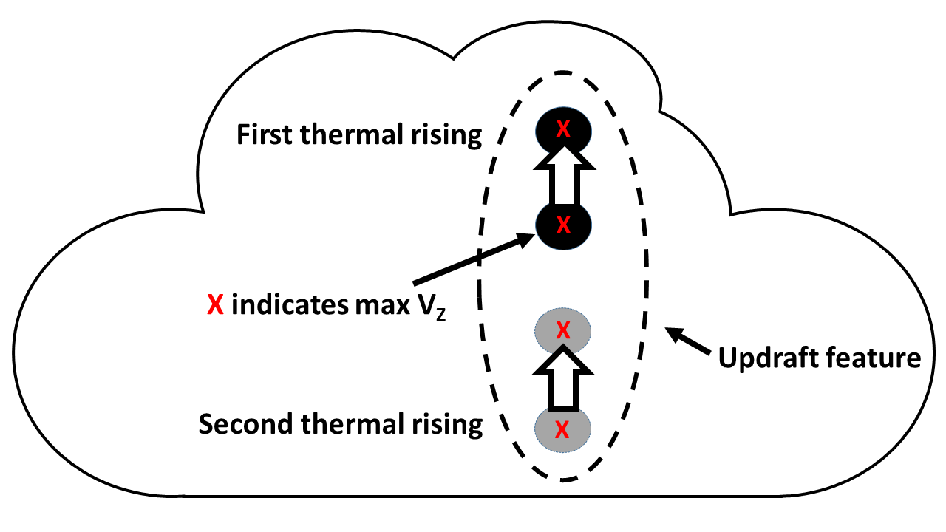
Thermals in convection
Thermals in convection can impact:
Fluxes of moisture and mass (Morrison and Peters 2018).
Hydrometeor transport (Damiani et al. 2006, 2007).
Entrainment (Blyth et al. 1988, 2005; Damiani et al. 2006, 2007; Moser and Lasher-Trapp 2017).
Therefore updraft and cloud evolution.
Conceptual diagram of thermal showing buoyancy (colors), circulations (black arrows) and velocity profile through thermal. Taken from Morrison and Peters 2018.

Slide 6
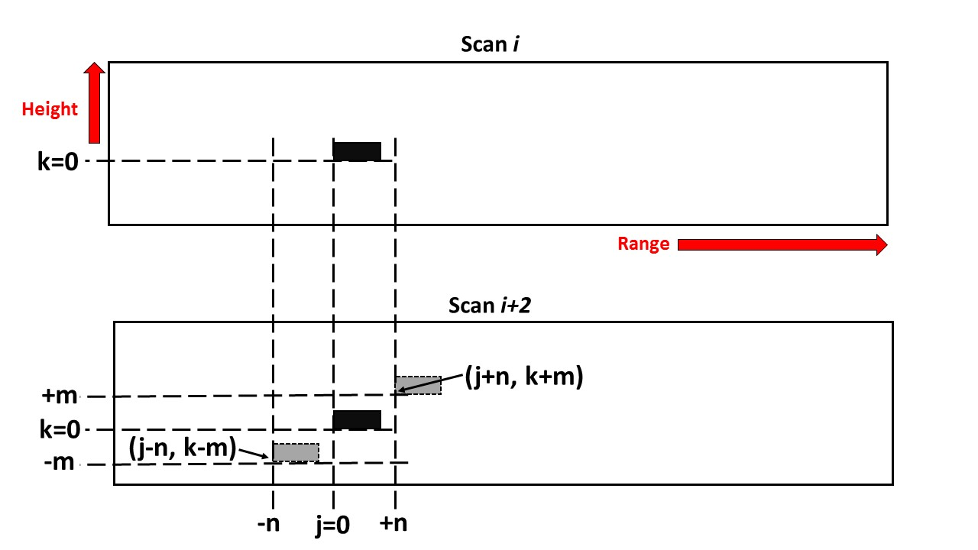
Feature tracking
Derive displacement by minimising a cost function between two scans at a particular scale (Hogan et al. (2008)).
Box of 2 km width and 1 km height.
Motion vectors calculated by dividing the displacement (black to gray box) by the time between scan i and scan i+2.

Slide 7
Retrieved motion vectors
Motion vectors in the framework of the cloud.

Slide 8
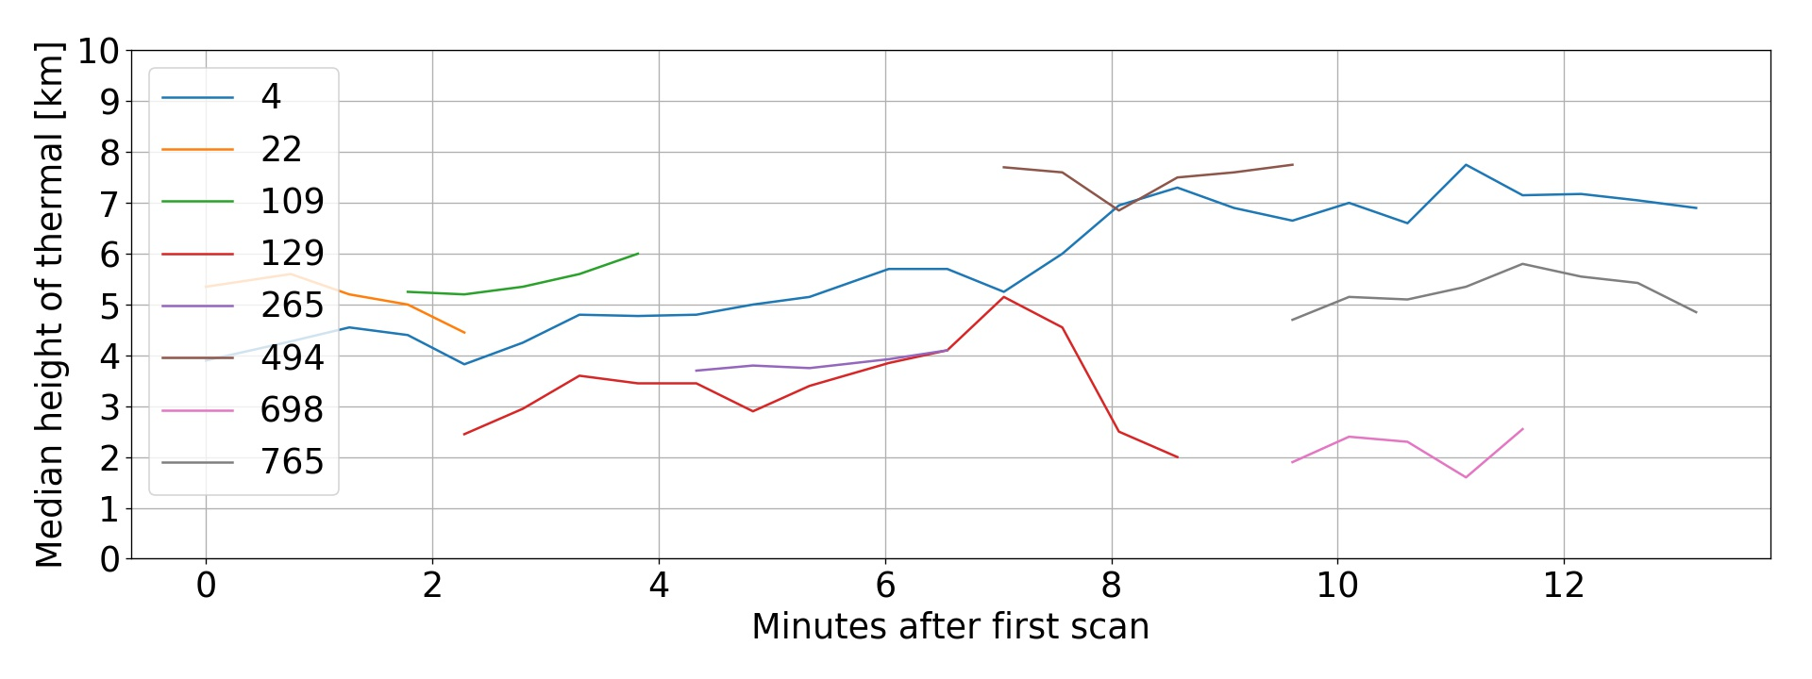
Thermal ascent
Median thermal height over time for scans starting at 15:47 on 28th July 2000.
Thermals defined as lasting longer than 2 minutes and a minimum width of 600 m and height of 250 m.
Vertical velocity greater than 4 m s⁻¹.

Slide 9
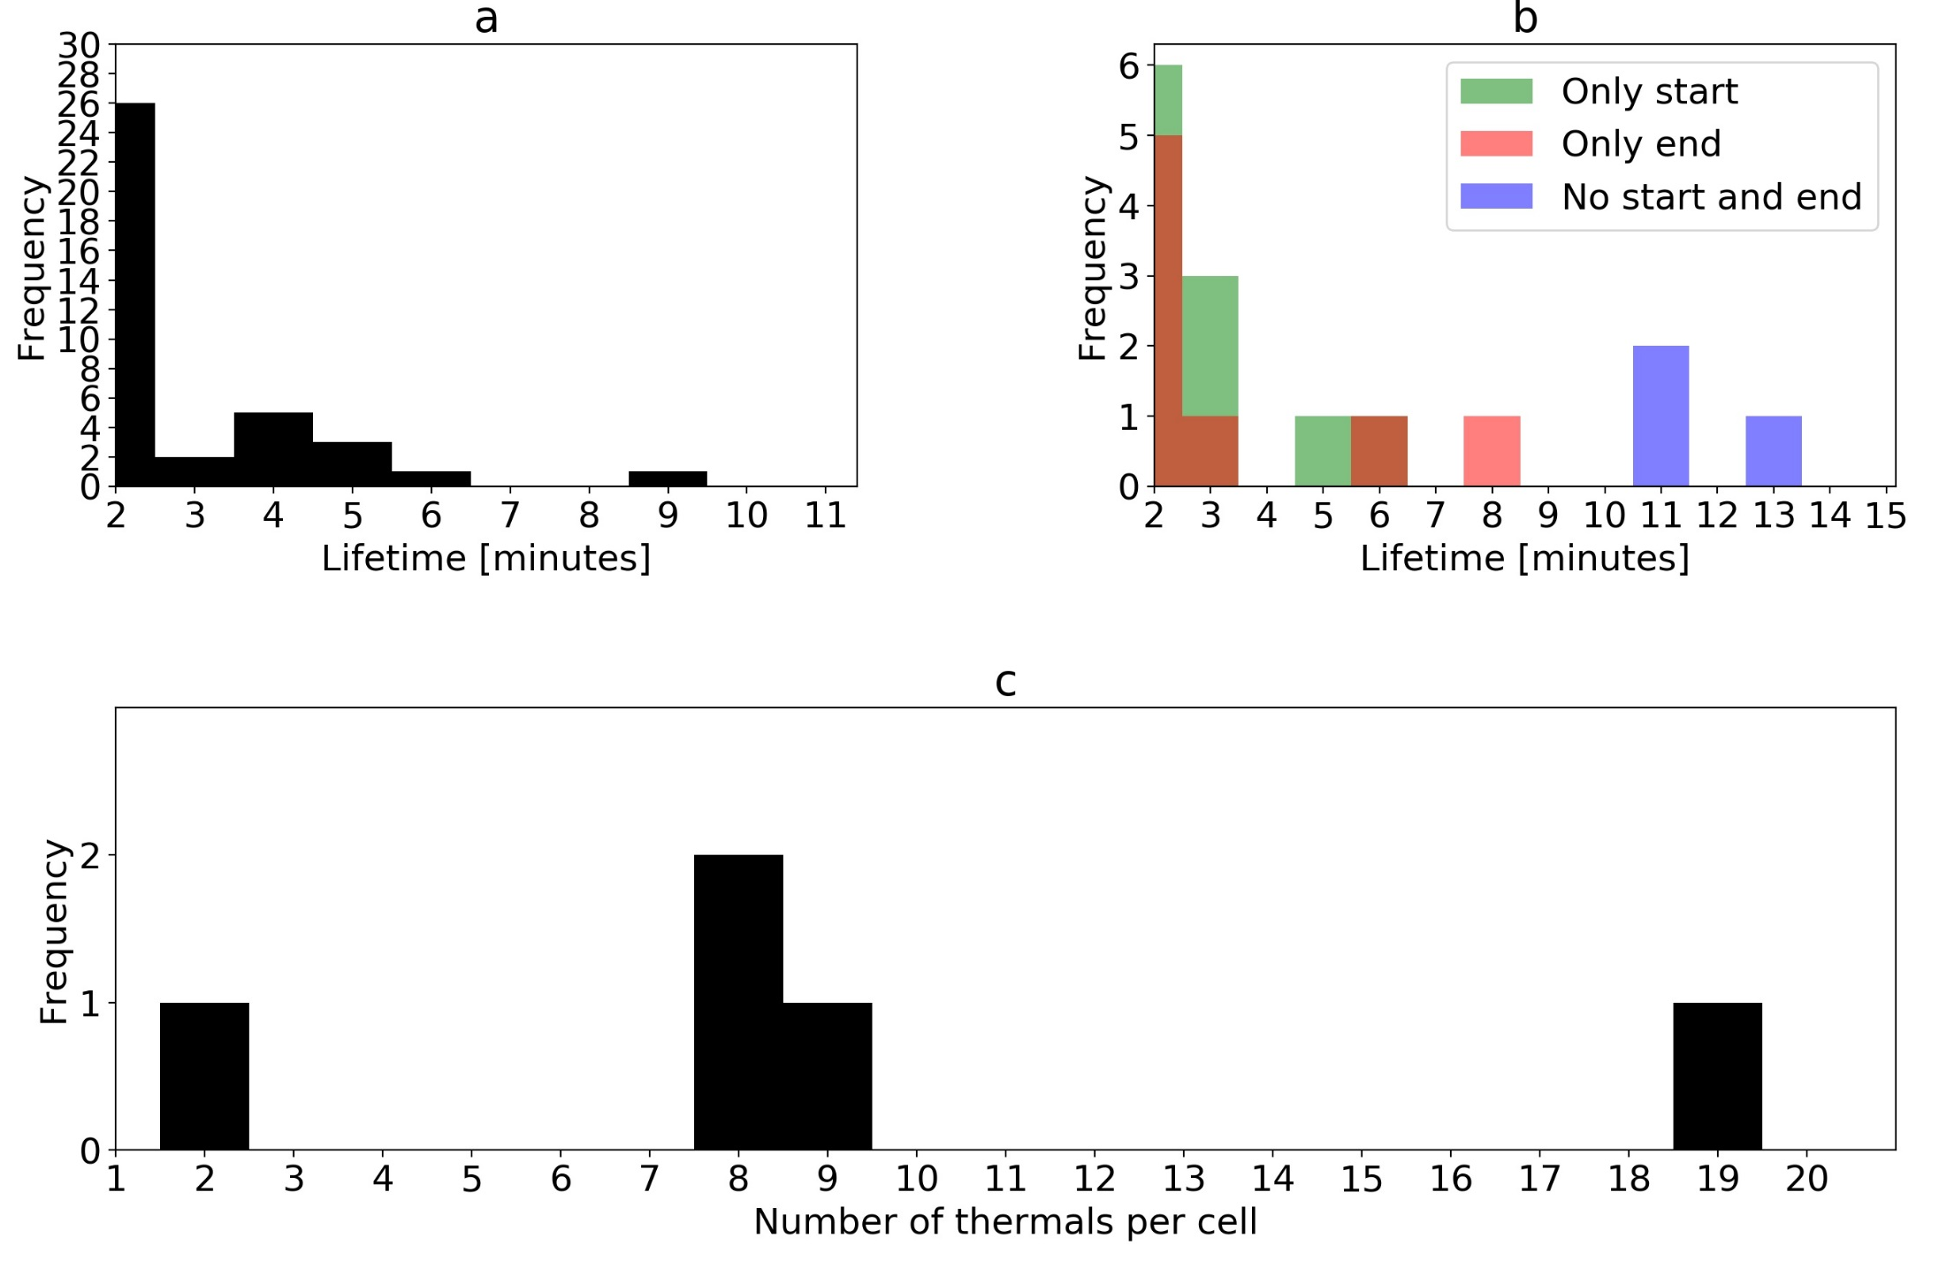
Thermal characteristics
Cell is defined as a contiguous area of rain rate greater than 4 mm h⁻¹

Slide 10
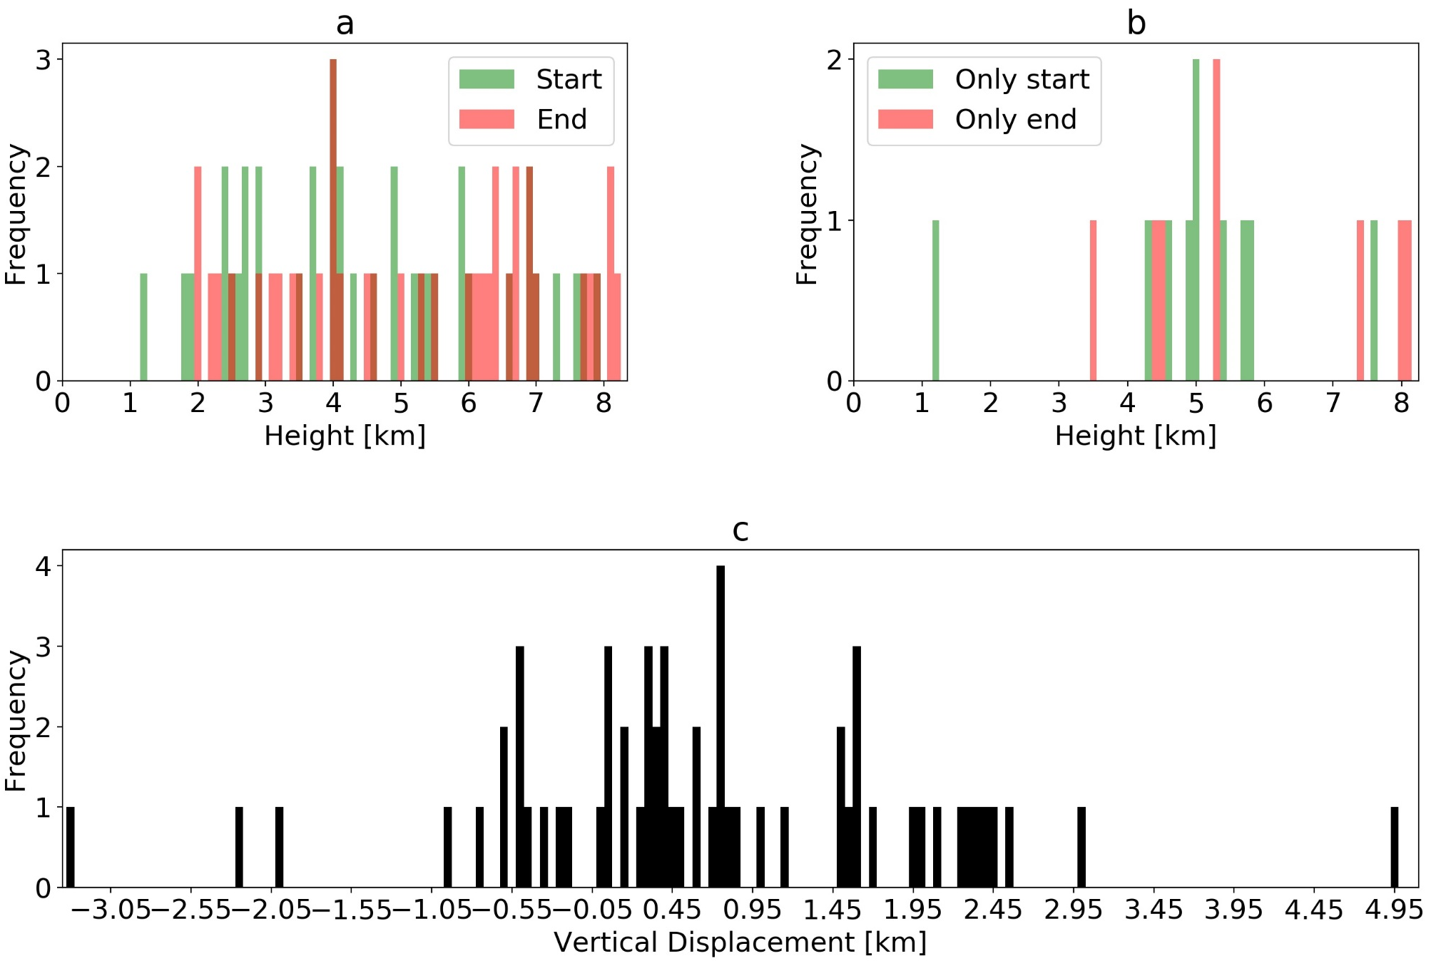
Thermal characteristics

Slide 11
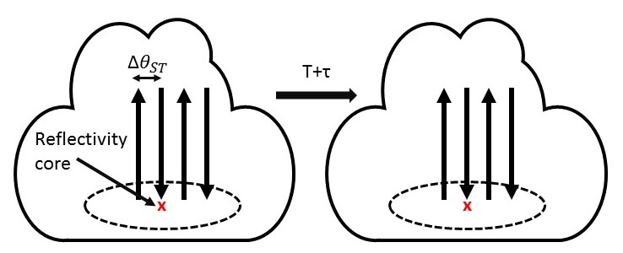
Planned observations
Collect new high resolution radar scans of convective storms at 75 m horizontal resolution.
New scanning strategy to bracket core of cells
Accounts for uncertainty in core.
Gain spatial information in cross beam direction.
Information on occurrence of thermals with distance from core.

Slide 12
Summary
Thermals are short lived and multiple thermals per cell exist.
Most only ascend a few hundred metres and originate and end at no specific region of clouds.
Identify thermals characteristics such as ascent rates and see how this compares to updraft velocity.
Collecting new high resolution radar scans to investigate if larger thermal ascent rates and thermal number lead to longer lived/more intense storms.

Slide 13
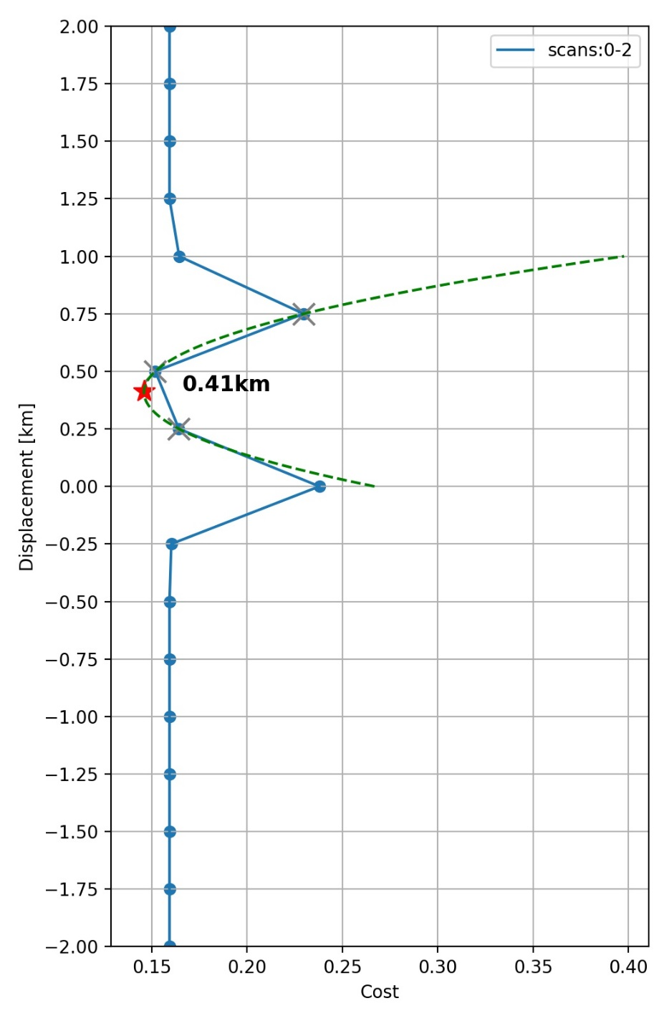
Feature tracking
Feature’s don’t always move a whole grid box amount.
Update vertical displacement by Lagrange interpolation using 3 cost points (gray crosses). One each side of the minimum.
Minimum (red star) of Lagrange curve (green dashed) is displacement best guess.

Slide 14
References
Blyth, A., W. A. Cooper, and J. B. Jensen, 1988: A study of the source of entrained air in montana cumuli. J. Atmos. Sci., 45, 3944–3964, doi:https://doi.org/10.1175/1520-0469(1988)045¡3944:ASOTSO¿2.0.CO;2.
Blyth, A. M., S. G. Lasher-Trapp, and W. A. Cooper, 2005: A study of thermal in cumulus clouds. Q. J. R. Meteorol. Soc., 131, 1171–1190, doi:10.1256/qj.03.180.
Damiani, R., G. Vali, and S. Haimov, 2006: The structure of thermal in cumulus from airborne dual-Doppler radar observations. J. Atmos. Sci., 63, 1432–1450, doi:https://doi.org/10.1175/JAS3701.1.
Damiani, R. and G. Vali, 2007: Evidence for tilted toroidal circulations in cumulus. J. Atmos. Sci., 64, 2045–2060, doi:10.1175/JAS3941.1.
Hogan, R. J., A. J. Illingworth, and K. Halladay, 2008: Estimating mass and momentum fluxes in a line of cumulonimbus using a single high-resolution Doppler radar. Q. J. R. Meteorol. Soc., 134, 1127–1141, doi:10.1002/qj.286
Moser, D. H. and S. Lasher-Trapp, 2017: The influence of successive thermal on entrainment and dilution in a simulated Cumulus congestus. J. Atmos. Sci., 74, 375–392, doi:10.1175/JAS-D-16-0144.1.
Morrison, H. and J. M. Peters, 2018: Theoretical expressions for the ascent rate of moist deep convective thermals. J. Atmos. Sci., 75, 1699–1719, doi:10.1175/JAS-D-17-0295.1.
Nicol, R. H., J., T. Stein, K. Hanley, P. Clark, C. Halliwell, H. Lean, and R. Plant, 2015: Convective updraught evaluation in high-resolution nwp simulations using single-doppler radar measurements. Quart. J. Roy. Meteor. Soc., 141, 3177–3198, doi:10.1002/qj.2602.
Sherwood, S. C., D. Hernandez-Deckers, M. Colin, and F. Robinson, 2013: Slippery thermals and the cumulus entrainment paradox. J. Atmos. Sci., 70, 2426–2442, doi:10.1175/JAS-D-12-0220.1.
Yuter, S. E. and R. A. J. Houze, 1995: Three-dimensional kinematic and microphysical evolution of Florida Cumulonimbus. part i: Spatial distribution of updrafts, downdrafts and precipitation. Mon. Wea. Rev., 123, 1921–1940, doi:https://doi.org/10.1175/1520-0493(1995)123¡1921:TDKAME¿2.0.CO;2

