Slide 1

Regional changes in land-atmosphere CO₂ exchange over recent decades using DGVMs
Stephen Sitch, Mike O’Sullivan, Cleiton Eller and TRENDY Modellers

Slide 2
Introduction (Global Carbon Project)
Trendy –DGVM Intercomparison Project
Soil Moisture & Plant Hydraulics
Drylands
Land-Use Change emissions
Regional Carbon Cycle Assessment 2
Outline

Slide 3
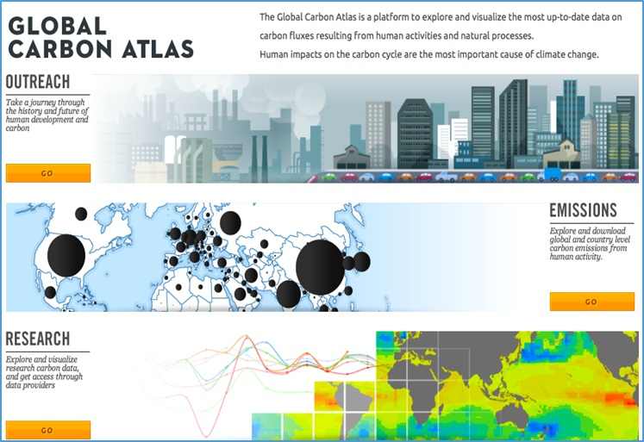
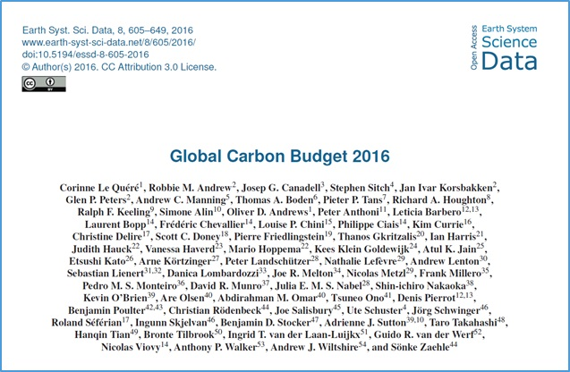
Global Carbon Budget Annual Updates
More information, data sources and data files:
www.globalcarbonproject.org
Contact: c.lequere@uea.ac.uk
More information, data sources and data files:
www.globalcarbonatlas.org
(funded in part by BNP Paribas Foundation)
Contact: philippe.ciais@lsce.ipsl.fr

Slide 4

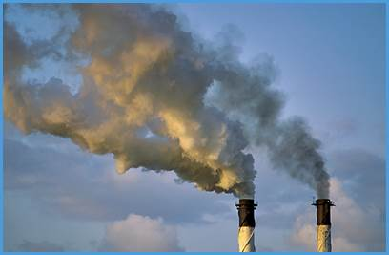
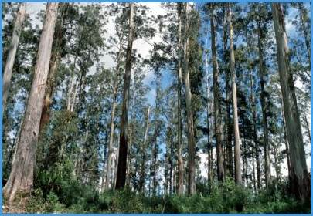
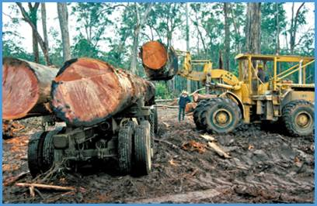

Ecosystems Mitigate Climate Change
2006-2015
16.4 GtCO₂/yr
44%
34.1 GtCO₂/yr
91%
Sources = Sinks
31%
11.6 GtCO₂/yr
9%
3.5 GtCO₂/yr
26%
9.7 GtCO₂/yr
Source: CDIAC; NOAA-ESRL; Houghton et al 2012; Giglio et al 2013; Le Quéré et al 2016; Global Carbon Budget 2016

Slide 5
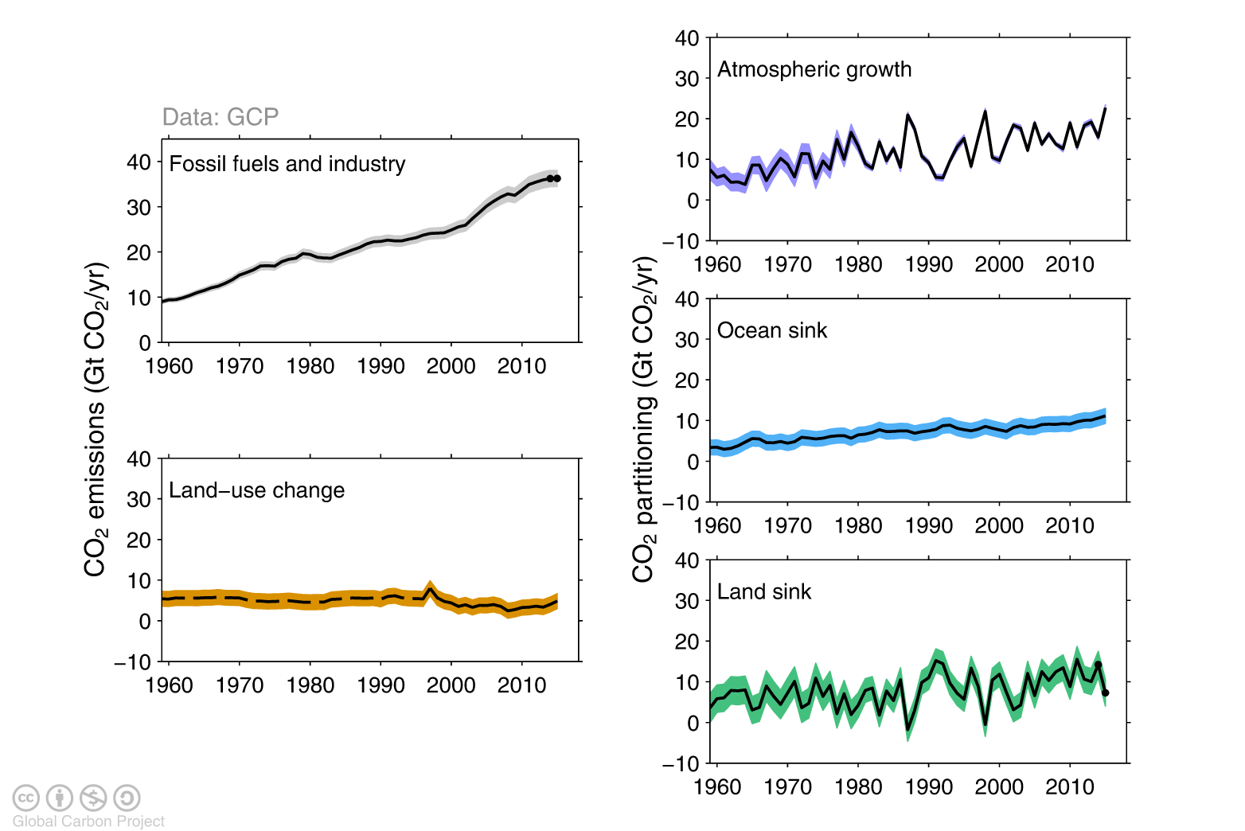
Changes in the budget over time
The sinks have continued to grow with increasing emissions, but climate change will affect carbon cycle processes in a way that will exacerbate the increase of CO₂ in the atmosphere
Source: CDIAC; NOAA-ESRL; Houghton et al 2012; Giglio et al 2013; Le Quéré et al 2016; Global Carbon Budget 2016

Slide 6
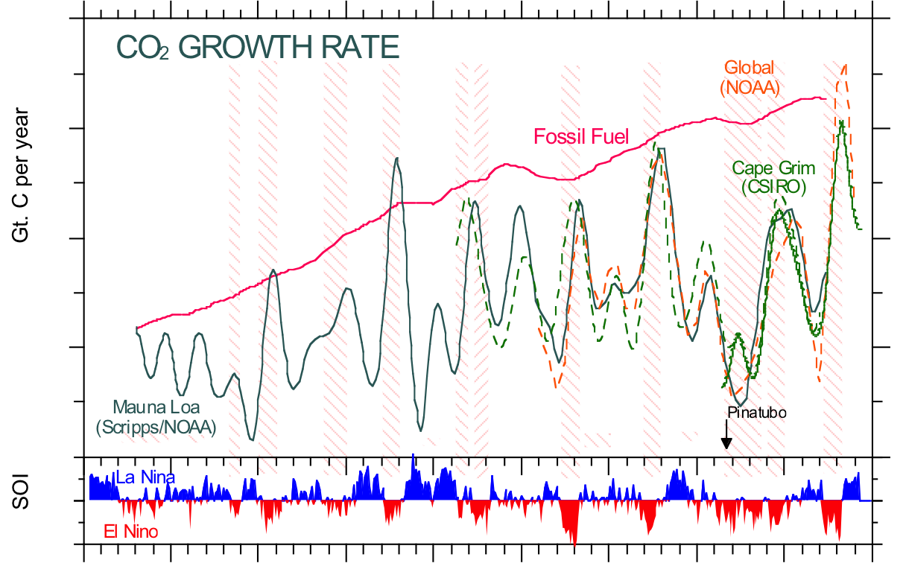
Year to year variations in CO₂ growth linked to El Niño impacts on tropical land ecosystems
1955
1960
1965
1970
1975
1980
1985
1990
1995
2000

Slide 7
Fate of anthropogenic CO₂ emissions (2006-2015)
16.4 GtCO₂/yr
44%
34.1 GtCO₂/yr
91%
Will the efficiency of land ecosystems to sequester carbon change in the future?
What will the effect of changing ecosystem structure and function have on future climate ?
Sources = Sinks
31%
11.6 GtCO₂/yr
9%
3.5 GtCO₂/yr
26%
9.7 GtCO₂/yr
Source: CDIAC; NOAA-ESRL; Houghton et al 2012; Giglio et al 2013; Le Quéré et al 2016; Global Carbon Budget 2016

Slide 8
Land Use Flux
forest regrowth
(1.6±0.5)
Houghton bookkeeping
7 Process Models
Satellite data (tropics only)
3 Model average
Net land-use change CO₂ emissions (GtC yr⁻¹)
Net emissions
(1.3±0.7)
year
gross deforestation
(2.9±0.5)
1750 – 2011 Cumulative emissions:
180 [100 to 260] GtC
Pan et al. (2011) 1990 – 2007
source: Ciais et al. 2013 IPCC AR5

Slide 9
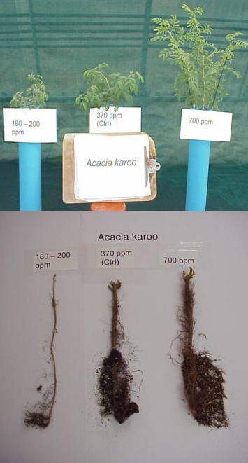
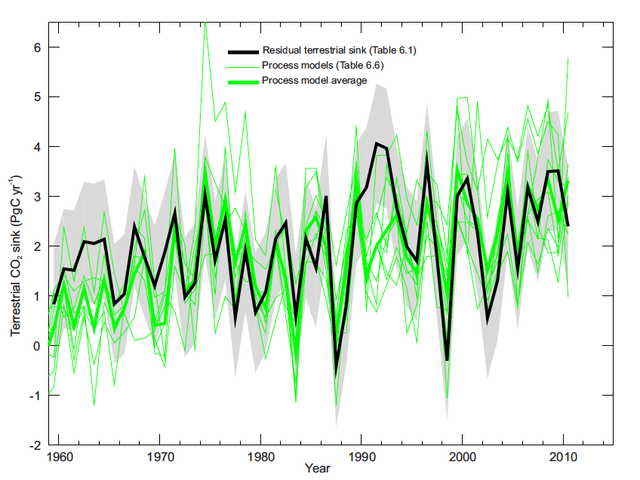
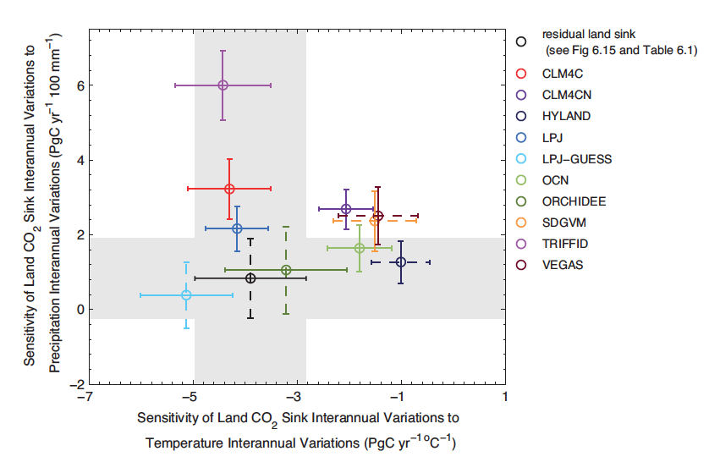
understanding the residual land sink
Credits: Guy Mingley and Barney Kgope (SANBI), William Bond (UCT)
NASA LBA-ECO Project
Notes:
Guy Mingley and Barney Kgope (SANBI), William Bond (UCT)
NASA LBA-ECO Project
Canadell & Raupach Science 2008
Photo: Timm Hoffmann , IPC, UCT
9

Slide 10
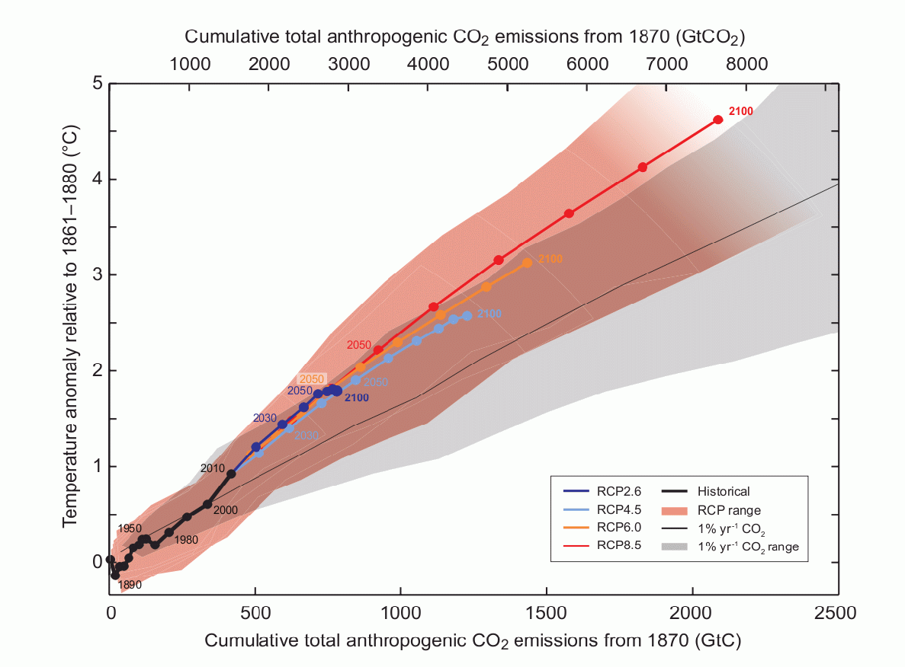
Motivation – why are carbon cycle projections important?
  Carbon cycle key new element in CMIP5 modelling
  Makes projections more relevant and useful
  But large uncertainty hinders usefulness
Cumulative CO₂ emissions for a 66% chance to remain below 2ºC
Full ESM range
~ 60 years emissions
Warming link to cumulative emissions
AR5, WG1, SPM.10

Slide 11
Trendy – Ensemble DGVM intercomparison project

Slide 13
Trendy-v6
Aim
Provide annual land –atmosphere flux and LU flux estimates to GCP, attribute regional C fluxes to processes.
Models (14 DGVMs)
CABLE, CLASS-CTEM, CLM4.5(BGC), ISAM, JSBACH, JULES, LPJ-GUESS, LPJ,
LPX-Bern, OCN, ORCHIDEE, ORCHIDEE-MICT, SDGVM, VISIT
Experiments
S1 1901-2017 CO₂ only
S2 1901-2017 CO₂ + Climate
S3 1901-2017 CO₂ + Climate + LULCC
Publications
Le Quéré et al., (2016) Global carbon budget 2017, Earth Syst. Sci. Data., 10, 405-448

Slide 14
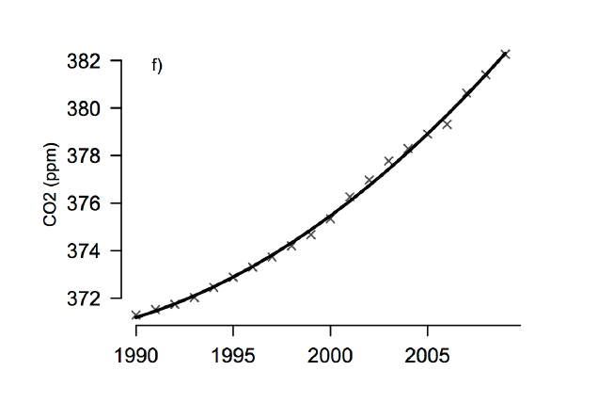
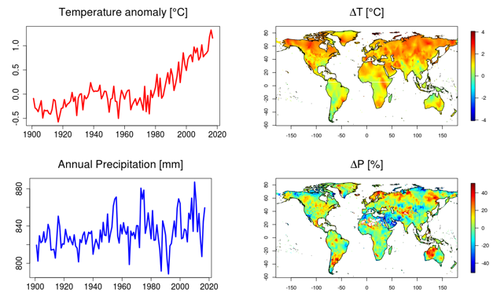
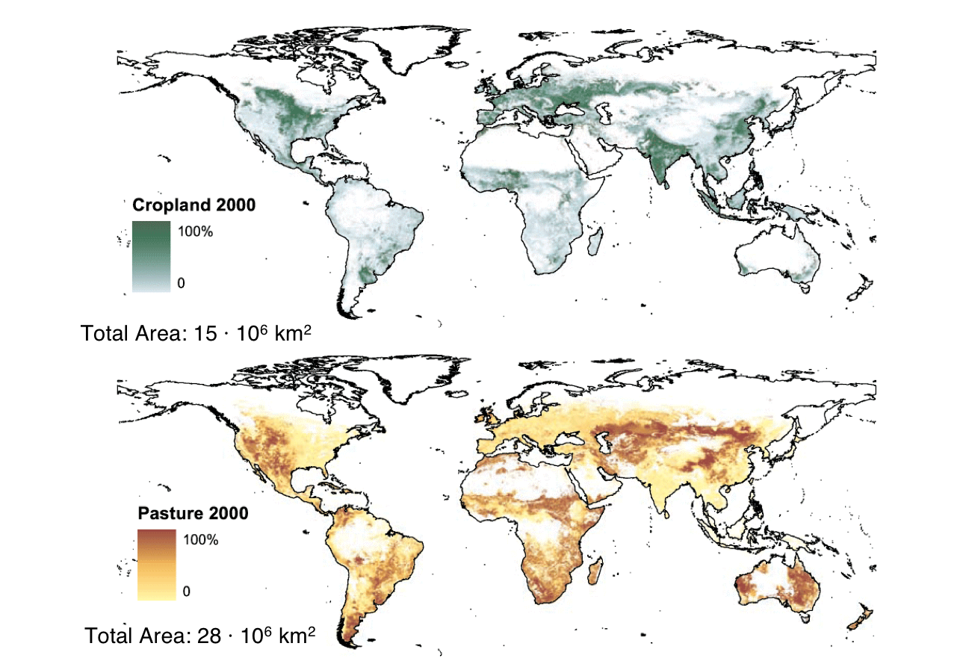
TRENDYv8 simulations
S0: Control. No forcing change (needed to diagnose any issues / drift)
S1: CO₂ (time-invariant “pre-industrial” (PI) LU mask)
S2: CO₂ and climate (time-invariant PI LU mask)
S3: CO₂, climate and land use change
S4: Land use only (time-invariant PI climate and CO₂)

Slide 15
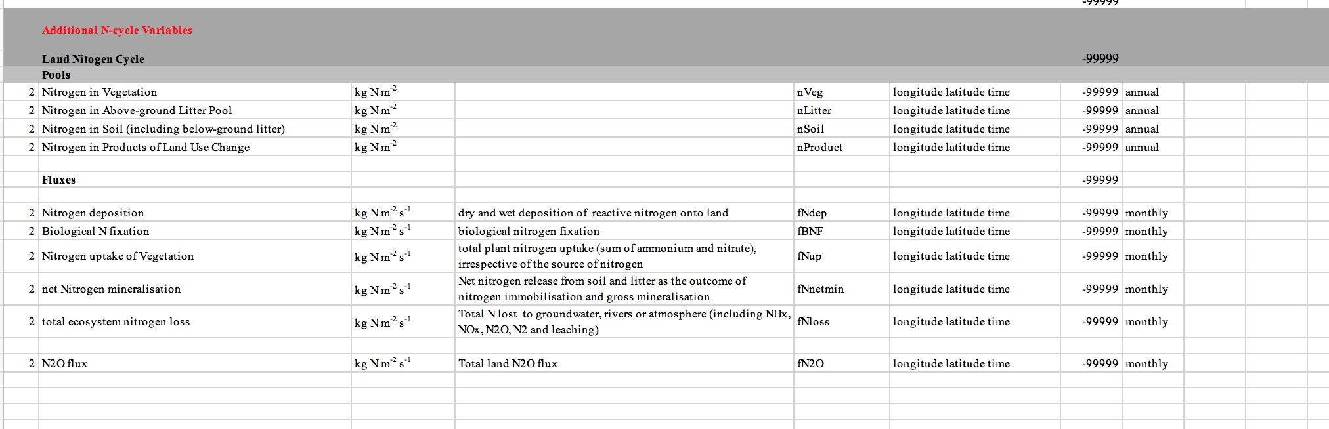
First Priority Variables (monthly)
Physical Variables
Near Surface Temp, Precipitation, shortwave Rad, Soil moisture content, Runoff, Evapotranspiration, Plant Functional Type (PFT) level data
Biogeochemical
Carbon Pools and Fluxes (GPP, NPP, Rh, wildfire flux, NBP, LU flux, PFT level fluxes)
Second Priority Variables (monthly)
Physical variables
Soil temp, interception
Biogeochemical
Carbon in leaves, roots, wood, CWD etc.

Slide 16
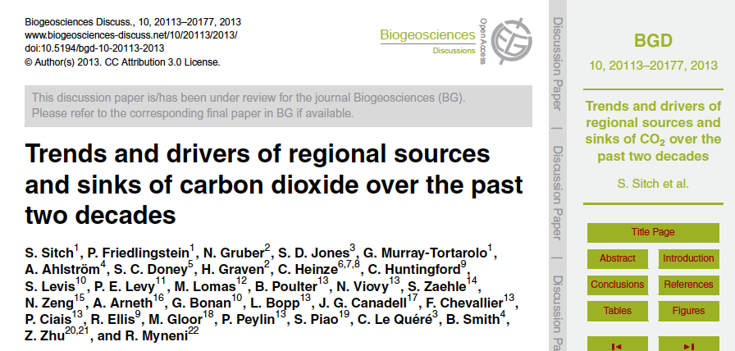
Regional Trends in the Land Carbon Cycle
Notes:
Co-authors from Terrabites across WGs (Guillermo further evaluating these results in the context of linking of C- and H2O cycles)

Slide 17
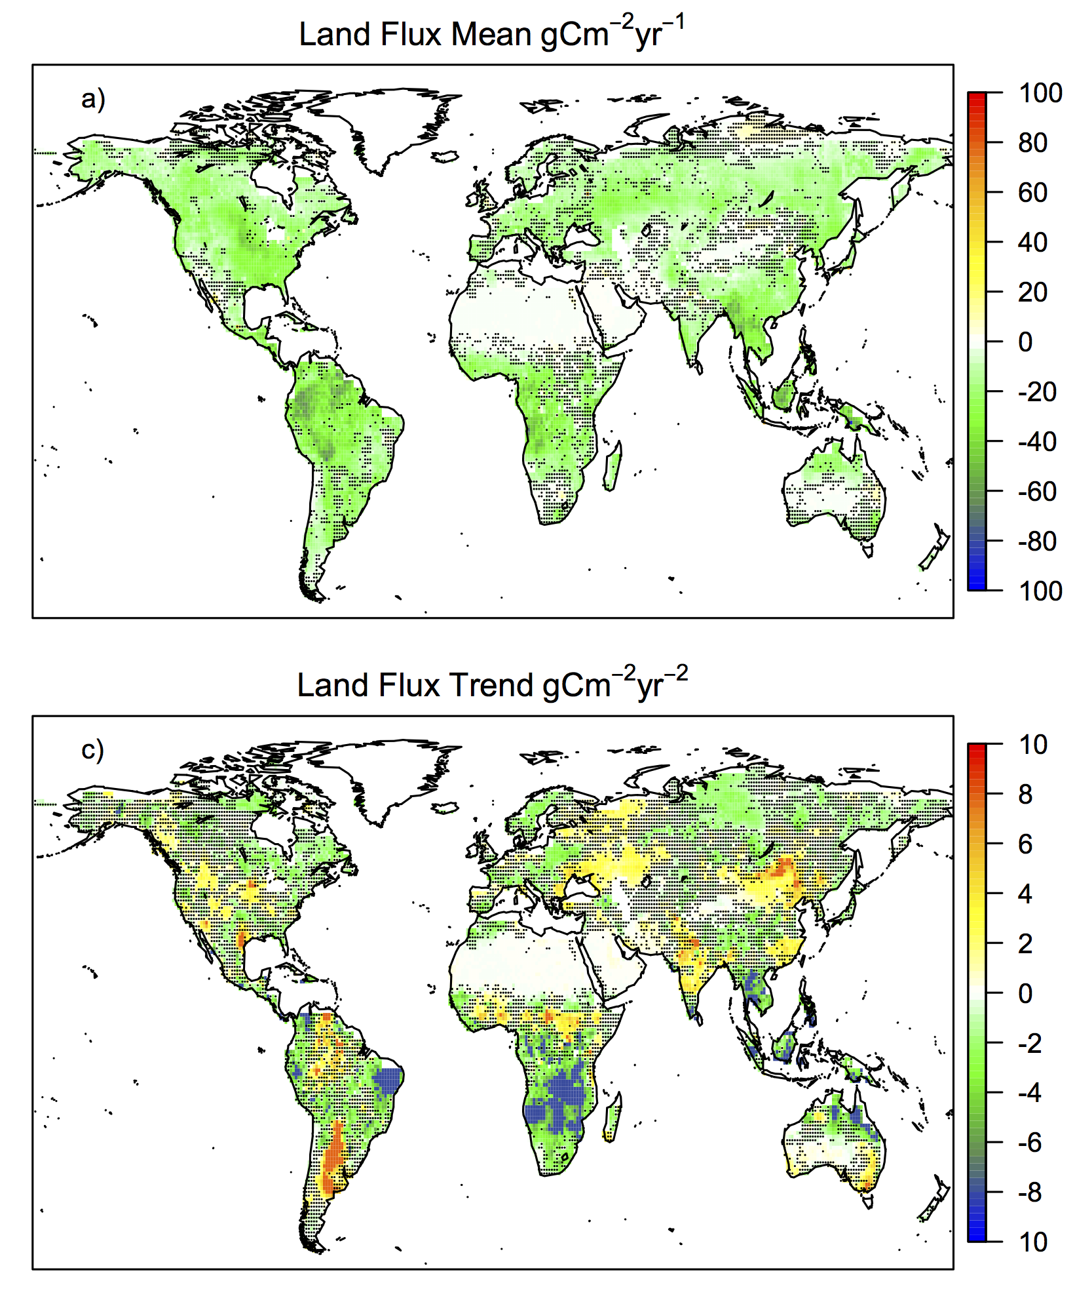
Decreasing Regional Land Carbon Sink Trends
1990-2009
Mean
Increasing Global land carbon sink
Decreasing regional C sink trends
Regional drying trends acting on plant productivity
Trend
Sitch et al., BG, 2015
Notes:
REgional Carbon Cycle Assessment Project (RECCAP) part of GCP. Time period from RECCAP

Slide 18
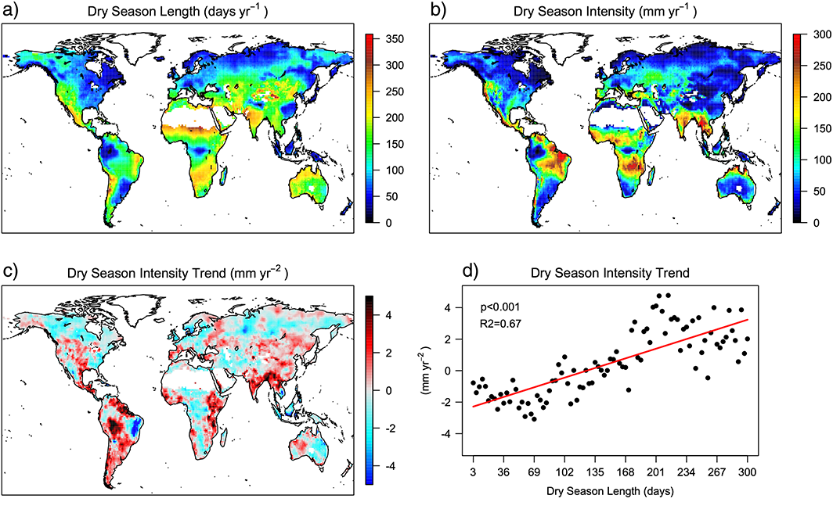
The dry season intensity as a key driver of NPP trends
Ʃ (E-P), E>P
Murray-Tortarolo et al. GRL, 2016
Notes:
Annual average (a) dry season length (d yr⁻¹) and (b) dry season intensity (mm yr⁻¹) calculated during the period 1989–2005, (c) dry season intensity trend (mm yr⁻²) during 1989–2005, (d) binned dry season intensity trend plotted against dry season length, while the red line represents the linear regression through the data (p < 0.001, r² = 0.67), and (e) median value for the regression slope of (Figure d) plus error, results from 1000 bootstrap simulations (box and whisker) for different datasets: observations, TRENDY‐DGVMs, and CMIP5 ESMs (historical, natural forcing, and two future RCPs). Green: 1989–2005, red: 1901–2005, blue: 2006–2100. In grey mean slope value for 15 year periods (last year).
We analyze the impacts of changing dry season length and intensity on vegetation productivity
and biomass. Our results show a wetness asymmetry in dry ecosystems, with dry seasons becoming drier and
wet seasons becoming wetter, likely caused by climate change. The increasingly intense dry seasons were
consistently correlated with a decreasing trend in net primary productivity (NPP) and biomass from different
products and could potentially mean a reduction of 10–13% in NPP by 2100. We found that annual NPP in dry
ecosystems is particularly sensitive to the intensity of the dry season, whereas an increase in precipitation
during the wet season has a smaller effect. We conclude that changes in water availability over the dry season
affect vegetation throughout the whole year, driving changes in regional NPP. Moreover, these results
suggest that usage of seasonal water ﬂuxes is necessary to improve our understanding of the link between
water availability and the land carbon cycle.
The first index is the dry season length (DSL), which is defined as the cumulative number of months in which E is larger than P over a year.
The second index is the dry season intensity (DSI), defined as the cumulative value of E minus P during months when E is higher than P

Slide 19
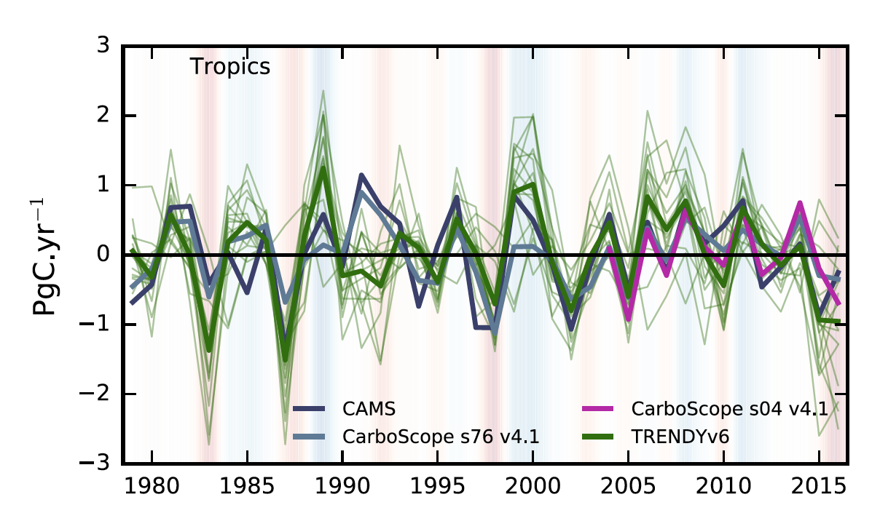
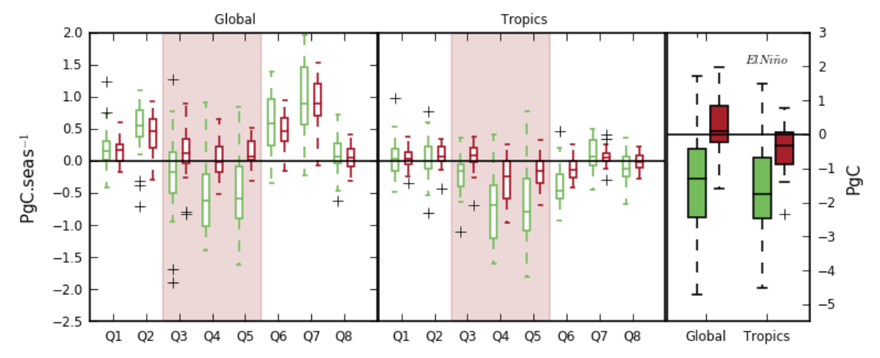
El Niño 2015-16
El Niño induced a strong 3PgC reduction of tropical land C uptake over the two years (GCP estimate from emissions, atm. increase, ocean uptake).
DGVMs can explain about 65% of this (1.8PgC for July 2015-March 2016).
Anomalies in fire emissions contribute to about 10% (0.3PgC)
According to TRENDY, this is largely due to a decrease in GPP (~5% drop across the tropics).
Sink
Source
GPP
TER
Bastos et al. Phil Trans Roy. Soc, 2018

Slide 20
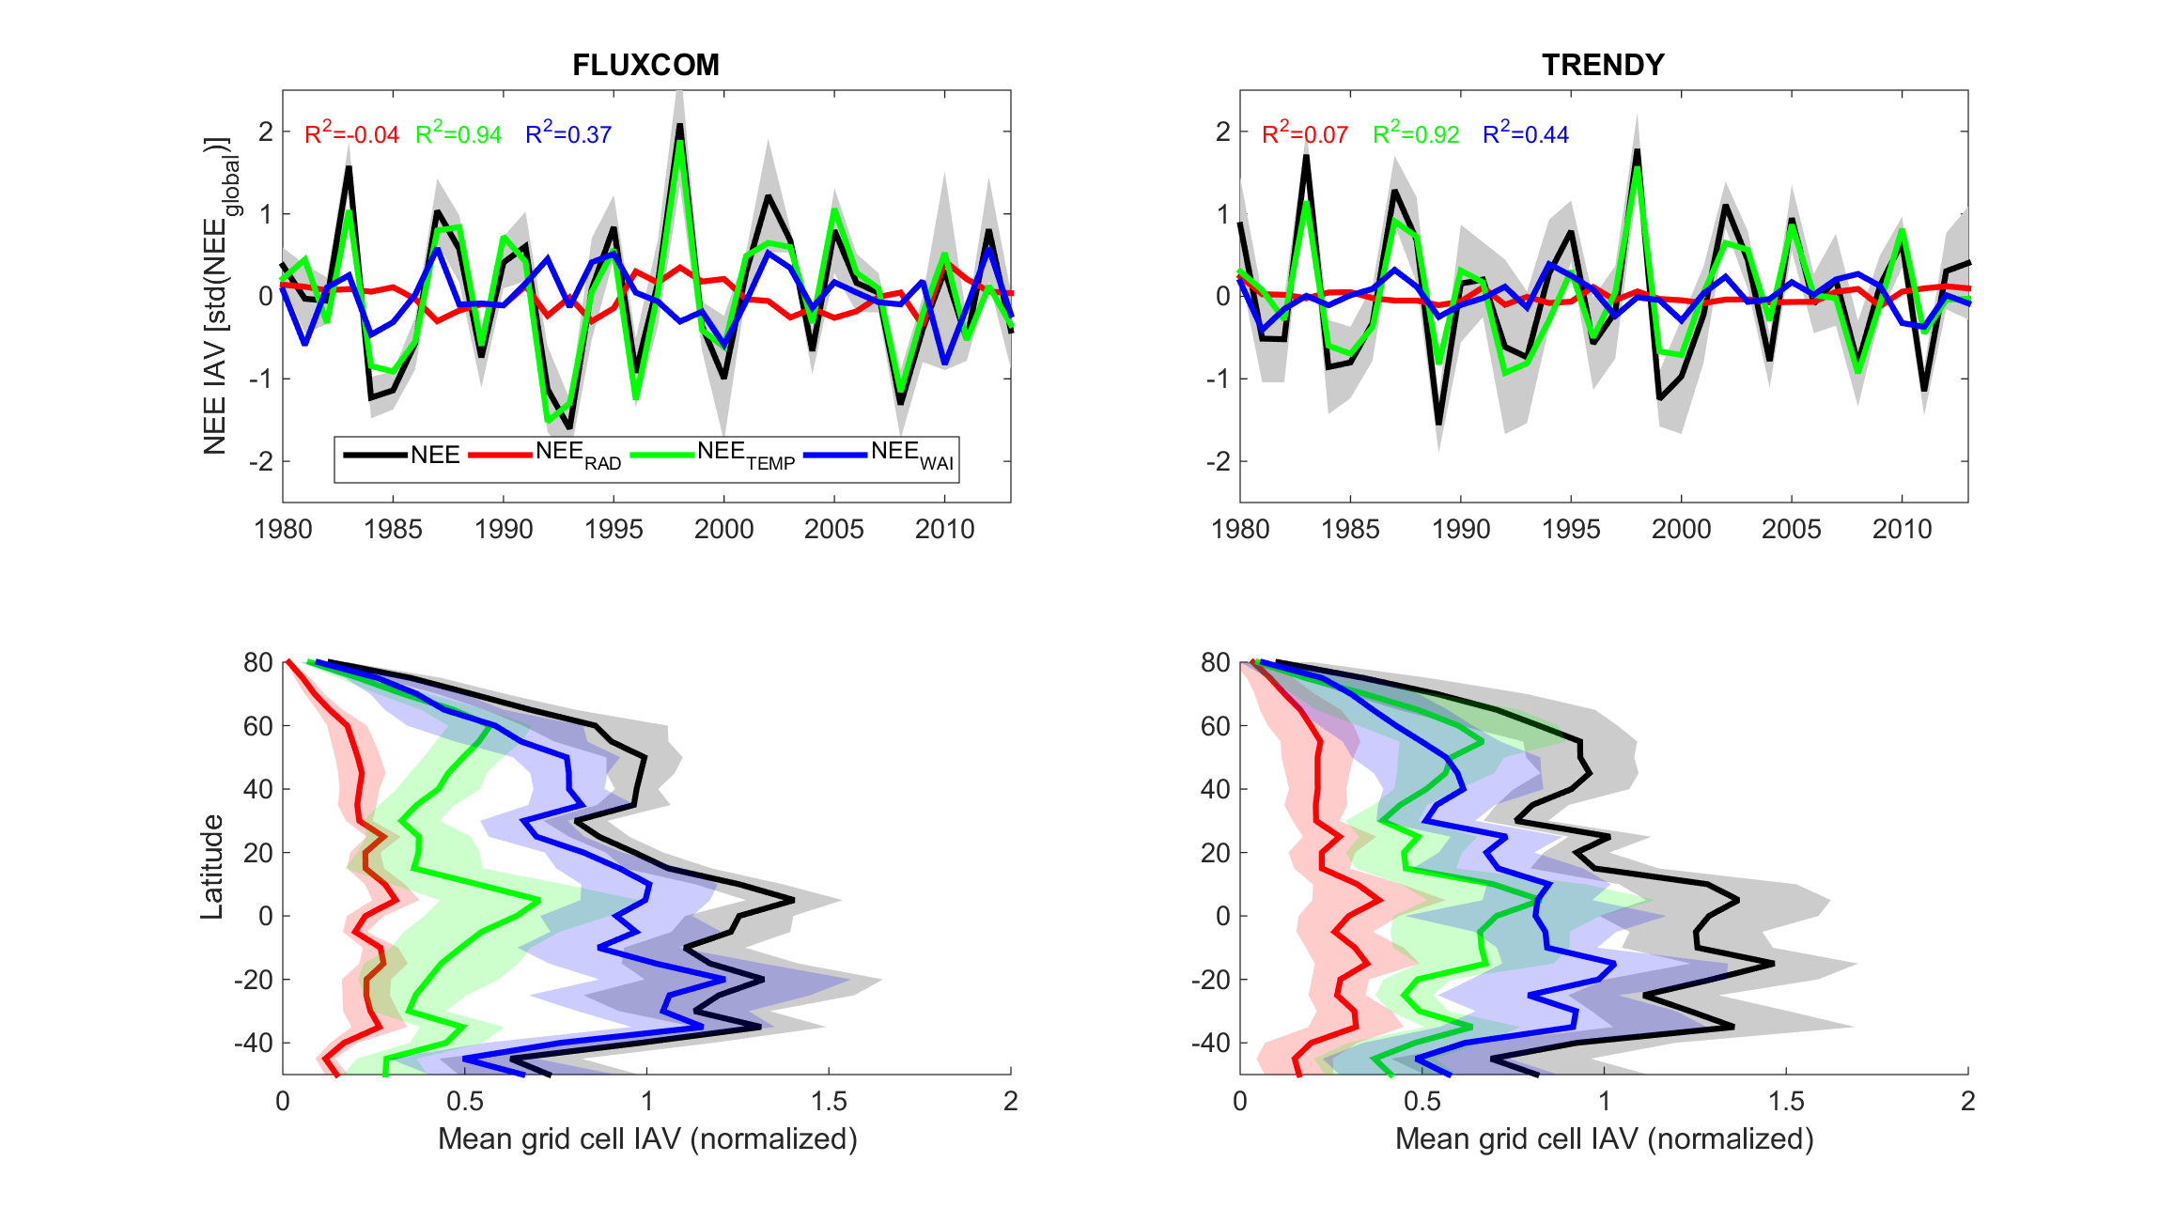
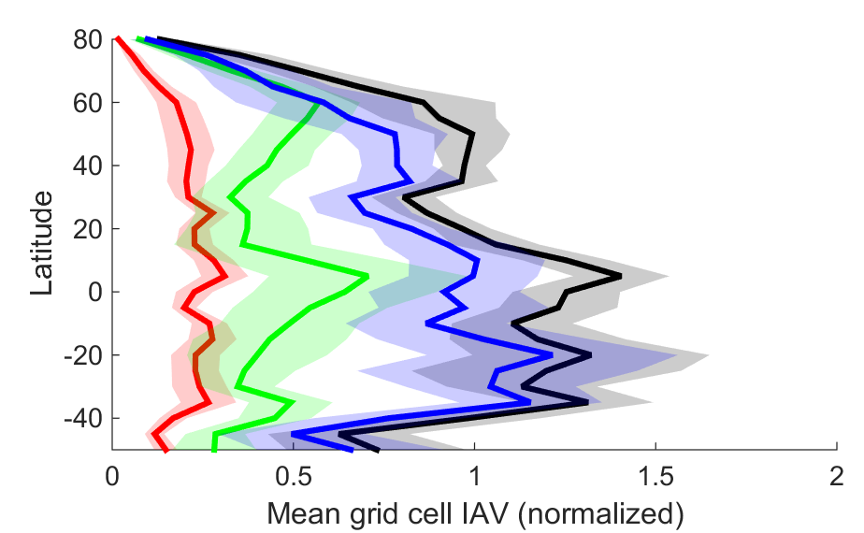
Temperature dominate global land carbon sink variations, but moisture most important at local scale
Global Scale
Source
Temperature dominates at global scale
Sink
Local Scale
Response to moisture
dominates at local scale
Inter-annual variability, net C exchange
Jung et al. Nature, 2017
Notes:
Figure 1: Temperature drives globally integrated NEE while water drives spatial patterns of NEE IAV. Patterns of interannual variability of NEE derived from FLUXCOM (left) and TRENDY (right) for the period 1980-2013. Top: Comparison of globally integrated modelled annual NEE anomalies and response to NEE anomalies by temperature, water availability, and radiation in isolation. R2 values between the climatic NEE components and total NEE are given in the respective colour. Bottom: Mean grid cell IAV magnitude (normalized, see Methods) of NEE components for latitudinal bands of 5°. Uncertainty bounds where given as shaded area refer to one standard deviation for FLUXCOM and TRENDY ensembles.

Slide 21
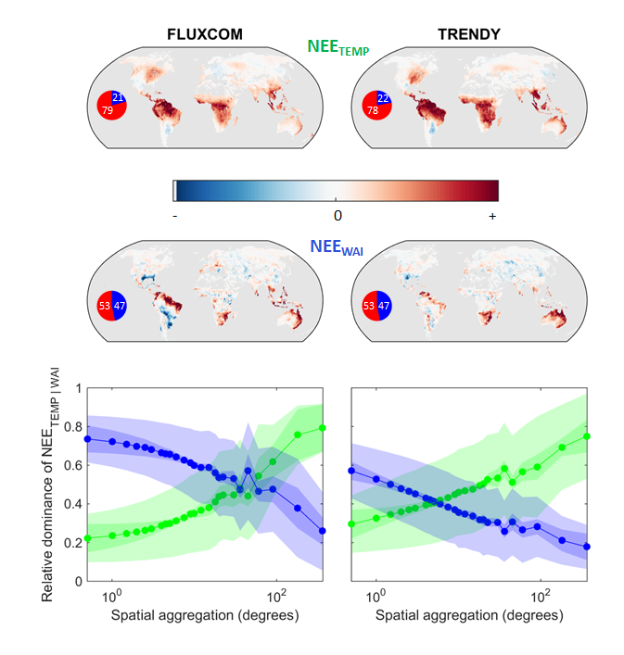
Compensating moisture effects make temperature dominate global land carbon sink variations
NEE_{TEMP}
Relative dominance of NEE _{TEMP/WAI}
NEE_{WAI}
Jung et al. Nature, 2017
Notes:
Figure 2: Spatial co-variation and scale drives NEE control. Top: Scores of the first empirical orthogonal function of spatial IAV patterns of NEE_{TEMP}, and NEE_{WAI}. Inset pie charts show the fractions of positive (red) and negative (blue) covariances across grid cells of NEE_{TEMP} and NEE_{WAI} anomalies (see Methods). Bottom: Dominant control of NEE as a function of spatial scale (see Methods). Outer uncertainty bounds given as shaded area refer to one standard deviation for FLUXCOM and TRENDY ensembles and are dominated by uncertainty of the mean relative dominance. Inner uncertainty bounds refer to one standard deviation with respect to the shape of the curves only (see Methods).

Slide 22
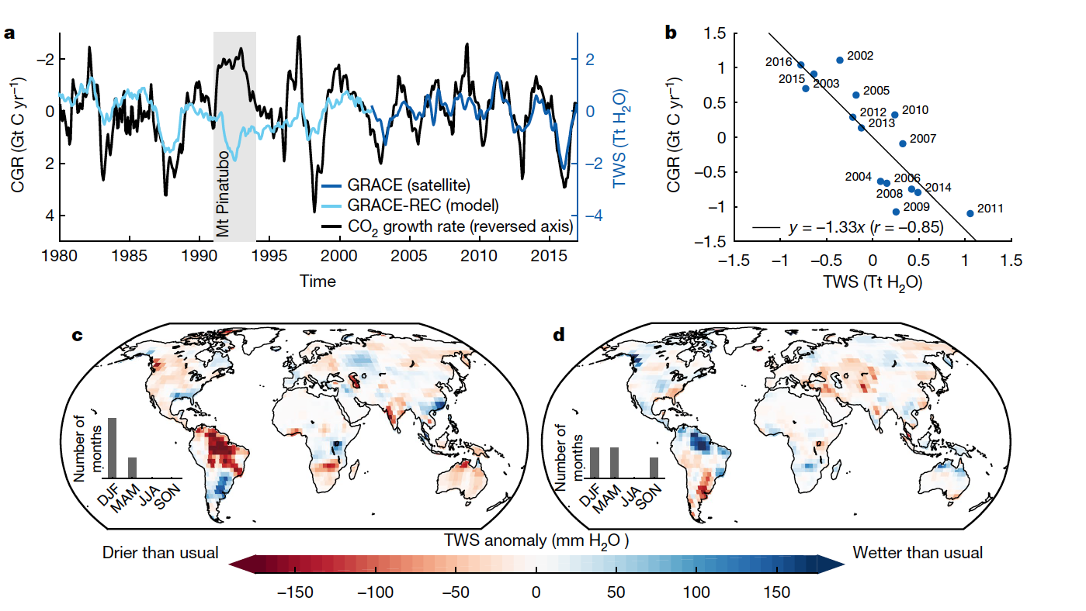
Sensitivity of atmospheric CO₂ growth rate to observed changes in terrestrial water storage
Humphrey et al. Nature 2018

Slide 23
Benchmarking soil moisture

Slide 24

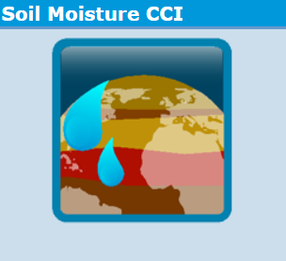
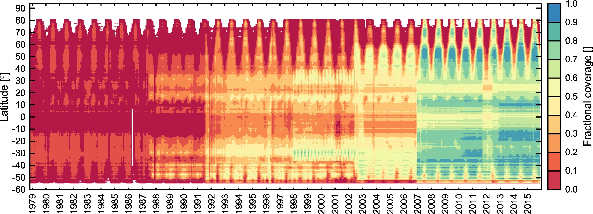
CCI Soil Moisture
Spatial: 0.25 resolution
Temporal: Daily from Nov 1978 – Dec 2016
  Took a subset: 2007-2016 (+ calculated monthly means)
Merged product of active and passive sensors.
  ~1-10 GHz frequency.
  Penetrate ~2cm of soil (Owe et al. 2008)
Top soil layer from 6 TRENDYv7
models
Computed corr coeff on raw data
  + deseasonalised data
Corrected for bias between satellite product and
  TRENDY models (CDF matching) – focus on spatial patterns
Dorigo et al 2017

Slide 25
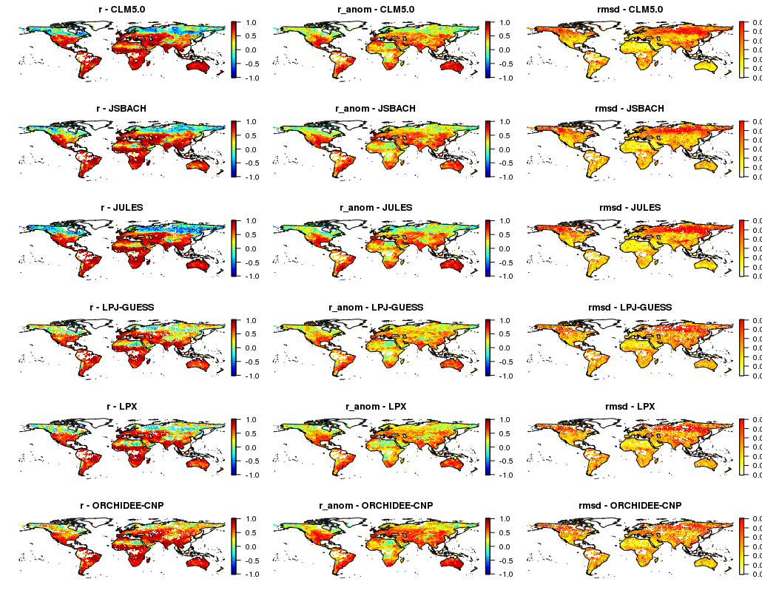
Global statistics
Good agreement in tropics / sub tropics (exception dense forests), and central Eurasia
Large negative correlation in high lats
Above patterns largely associated with seasonal cycle
  Absolute correlations reduced
Highest “unbiased” RMSD in regions with lowest correlation

Slide 26
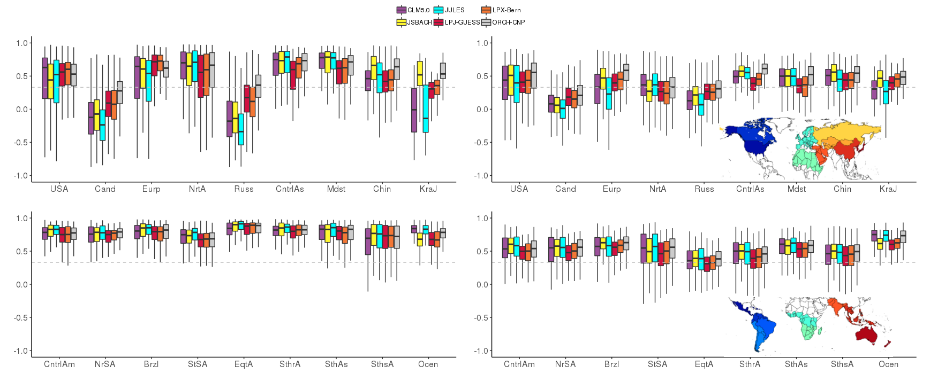
Regional breakdown
r
r (anomalies)
Low agreement in Canada, Russia. Satellite poor performance?
High correlations in regions with pronounced seasonal cycle. r reduces when focus on anomalies.
Models are generally consistent with each other. (Is this surprising since they were all scaled to the observations?)

Slide 27
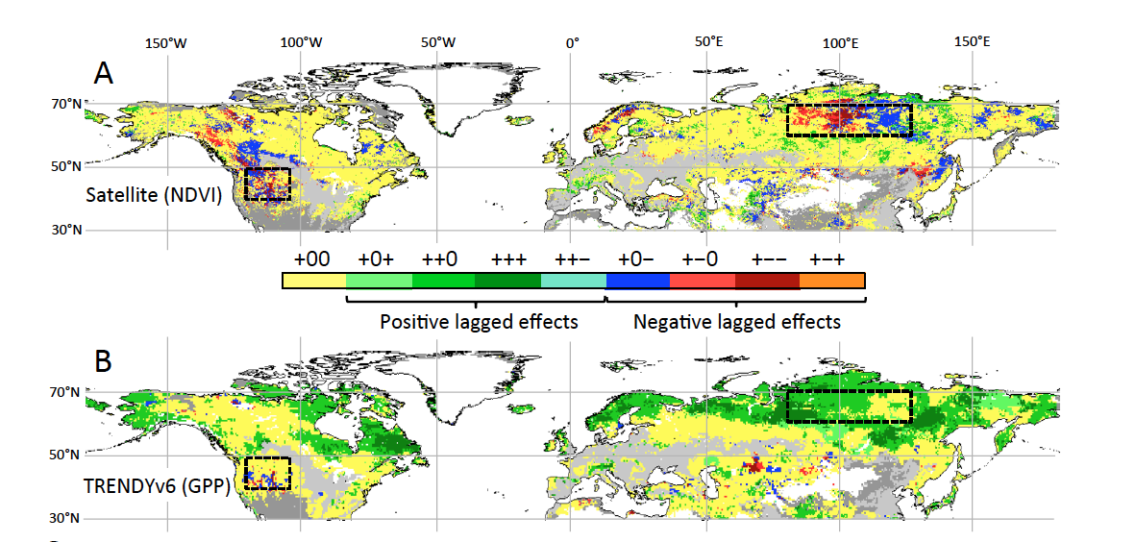
Widespread seasonal compensation effects of spring warming on northern plant productivity
Buermann et al. Nature 2018

Slide 28
Drylands

Slide 29
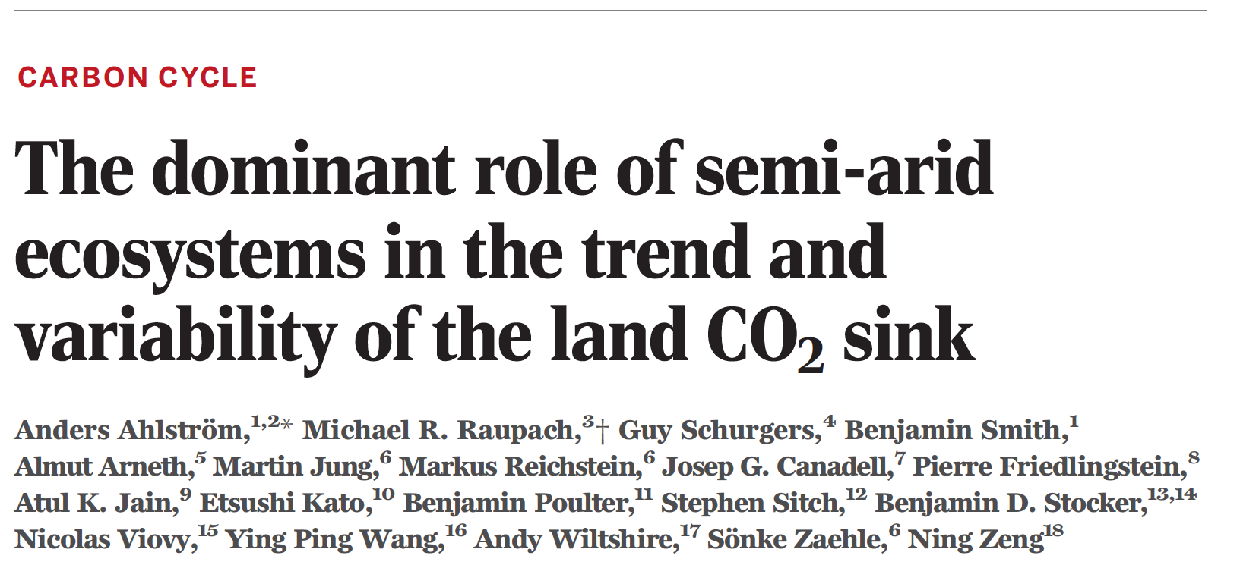
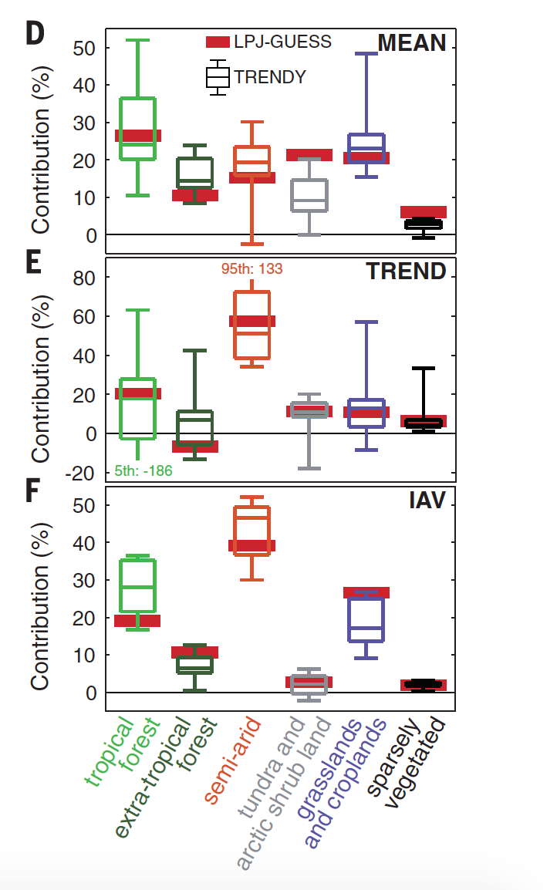
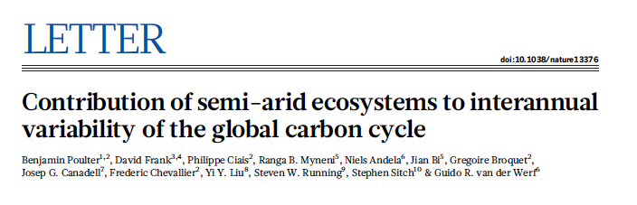
Drylands important for Trend and IAV in Land C sink
Science, May 22, 2015
Notes:
Mean sink dominated by Tropical rainforests (D), but Trend in sink 1982-2011 (E) and Interannual variability (IAV) (F) dominated by semi-arid
Background:
Drylands cover 40% of the global land area
>25% terrestrial C (small per unit area, but large-area)
High variability in climate and C uptake and release very sensitive to variability

Slide 30
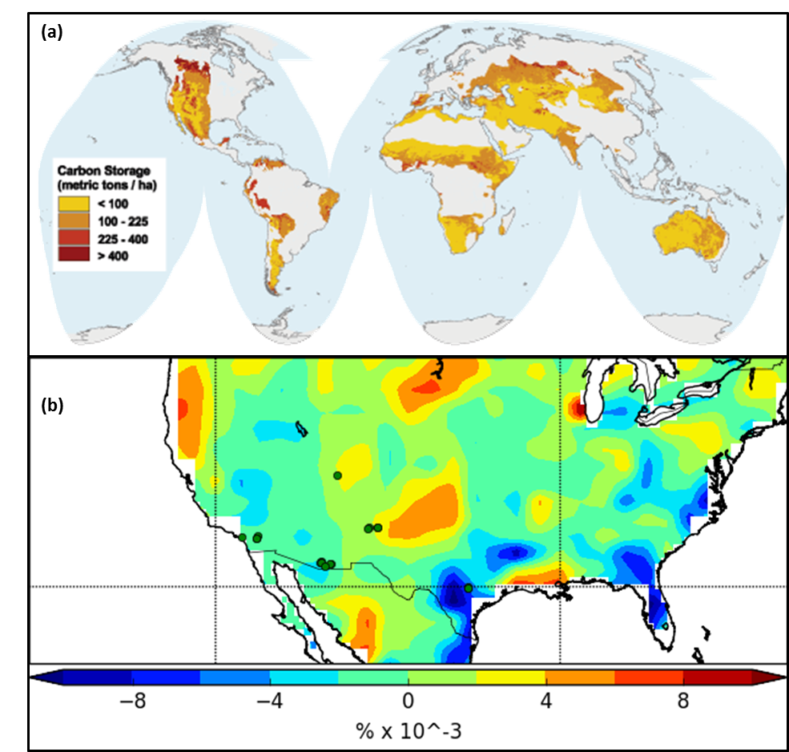
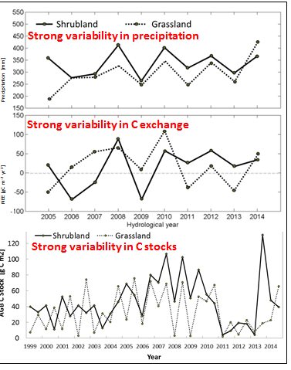
Importance of dry ecosystems in the carbon cycle
Drylands cover 40% of the global land area
>25% terrestrial C (small per unit area, but large-area)
High variability in climate and C uptake and release very sensitive to variability
Sevilleta LTER, Courtesy, Scott Collins

Slide 31
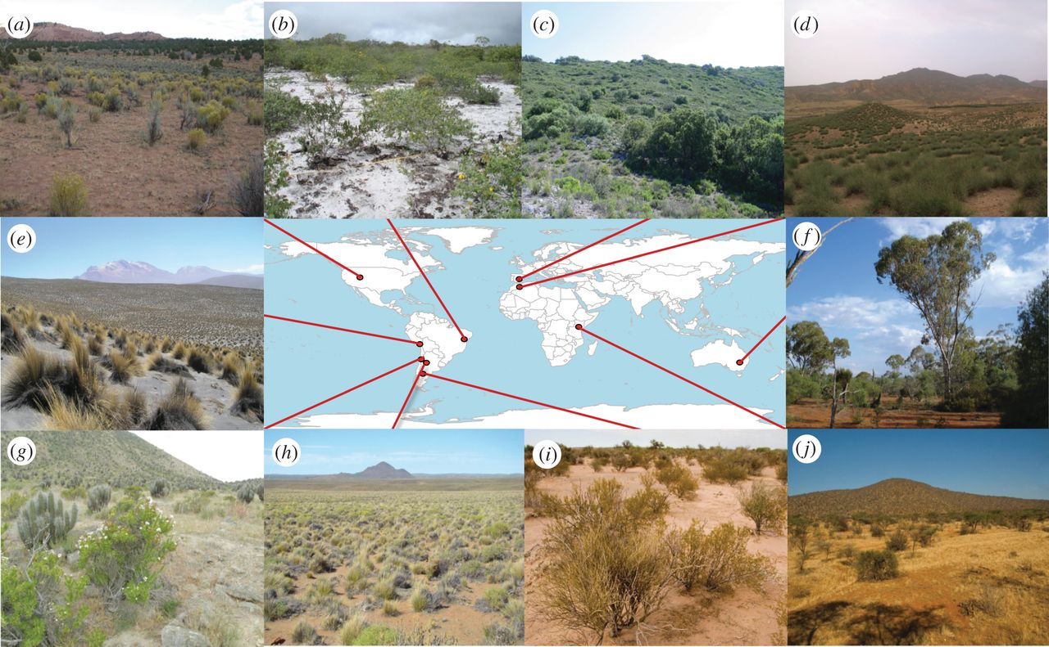
Changing semi-arid climate sensitivity
  Invasive species and grazing by domestic animals (Asner et al 2004)
  Fire suppression (Andela et al 2013)
  Increased water-use efficiency (Donohue et al 2013) and shrub expansion (e.g. +6% across Australia since 1982)
  Climate trends (Dohohue et al 2009)
Semi-arid carbon uptake is more transitory than in forests?
Increasing sensitivity of semi-arid regions not represented in CMIP5 ensemble
Poulter et al. Nature, 2014
Notes:
5.6% expansion of FPAR > 20%

Slide 32


(Dryland Regions control Interannual Variability In Global Carbon flux)
DRIVING-C
Core Team: Richard Brazier, Andrew Cunliffe, Stephen Sitch, Tim Hill, Karen Anderson and Fabio Boschetti
3.5 year project
Notes:
DRIVING-C project – Dryland regions control Interannual variability in global carbon flux.
The core team is lead by Rich…
This project is funded by NERC…

Slide 33
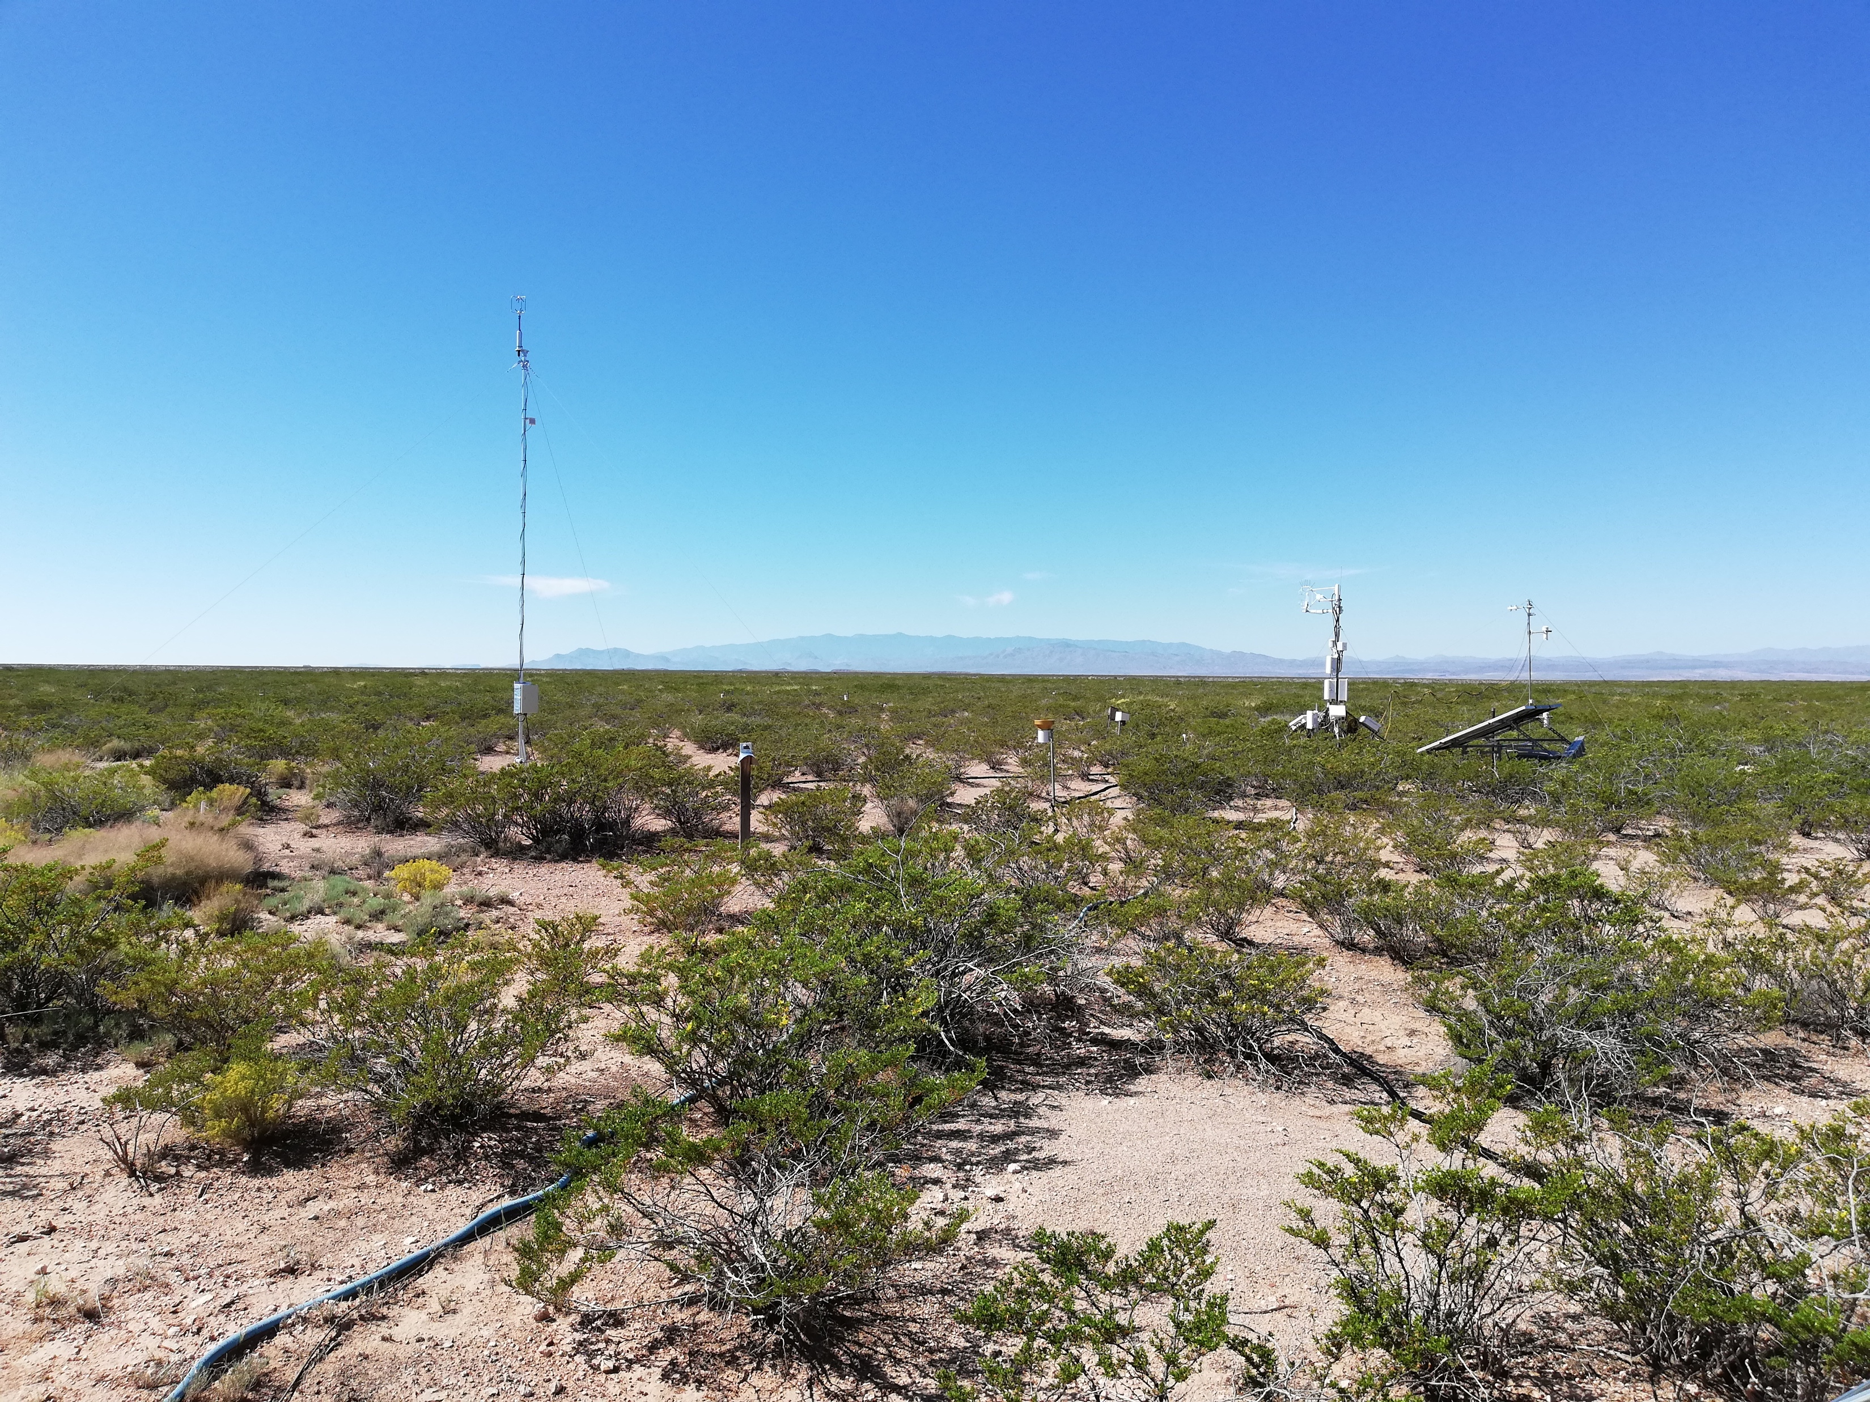
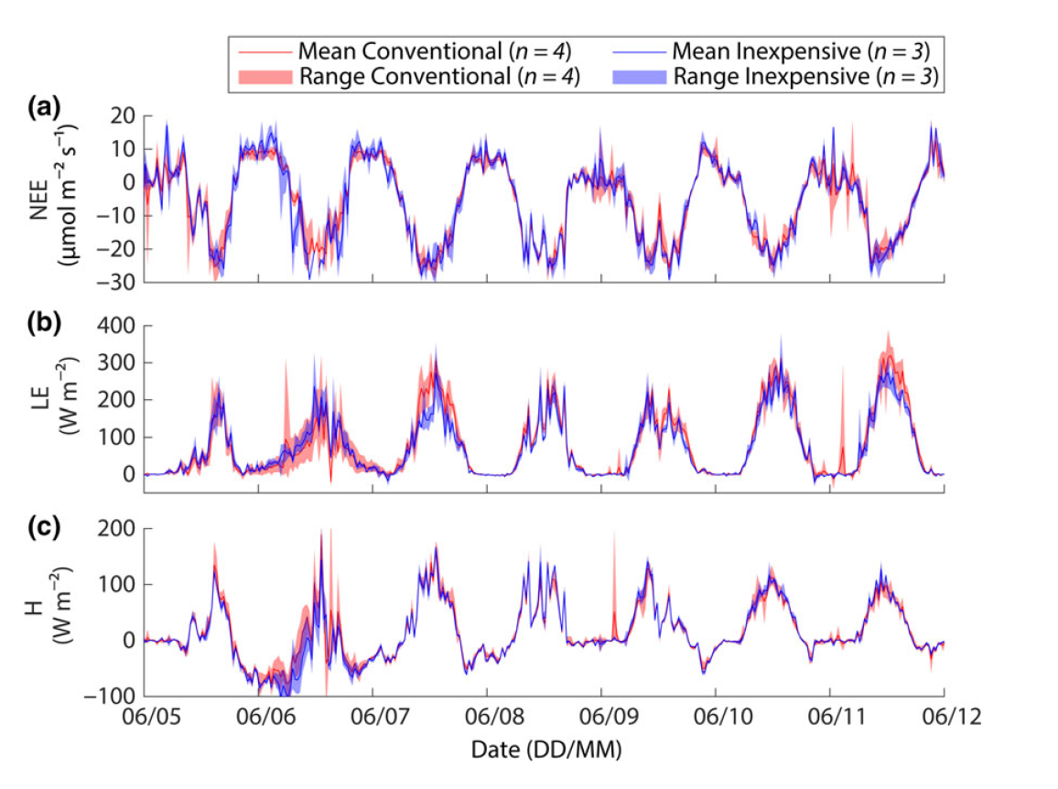
Combining Inexpensive EC system for spatial replication, Monitoring, Remote Sensing (EO, UAV) & DGVMs
Hill et al., Global Change Biology, 2016

Slide 34
Land-Use Change Emissions

Slide 35
Large Uncertainty in the Land Use Flux
forest regrowth
(1.6±0.5)
Houghton bookkeeping
7 Process Models
Satellite data (tropics only)
3 Model average
Net land-use change CO₂ emissions (GtC yr⁻¹)
Net emissions
(1.3±0.7)
year
gross deforestation
(2.9±0.5)
1750 – 2011 Cumulative emissions:
180 [100 to 260] GtC
Pan et al. (2011) 1990 – 2007
source: Ciais et al. 2013 IPCC AR5

Slide 36
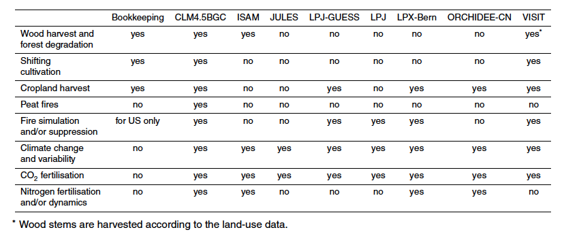
Different Representation of Land Use across models
Comparing “Apples with Oranges”

Slide 37
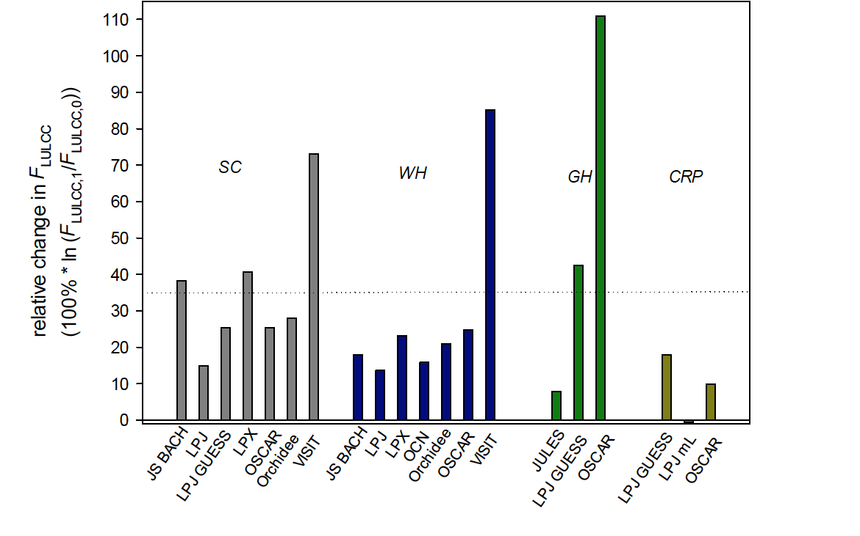
Have CO₂ emissions from land use change systematically been underestimated?
Grazing and Crop Harvest (grass PFT)
Wood Harvest
Shifting Cultivation
Crop Management
Arneth et al. Nature Geo, 2017

Slide 38
Ecosystems Mitigate Climate Change
2006-2015
16.4 GtCO₂/yr
44%
34.1 GtCO₂/yr
91%
Sources = Sinks
31%
11.6 GtCO₂/yr
9%
3.5 GtCO₂/yr
26%
9.7 GtCO₂/yr
Source: CDIAC; NOAA-ESRL; Houghton et al 2012; Giglio et al 2013; Le Quéré et al 2016; Global Carbon Budget 2016

Slide 39
Regional Carbon Cycle Assessment Project 2

Slide 40
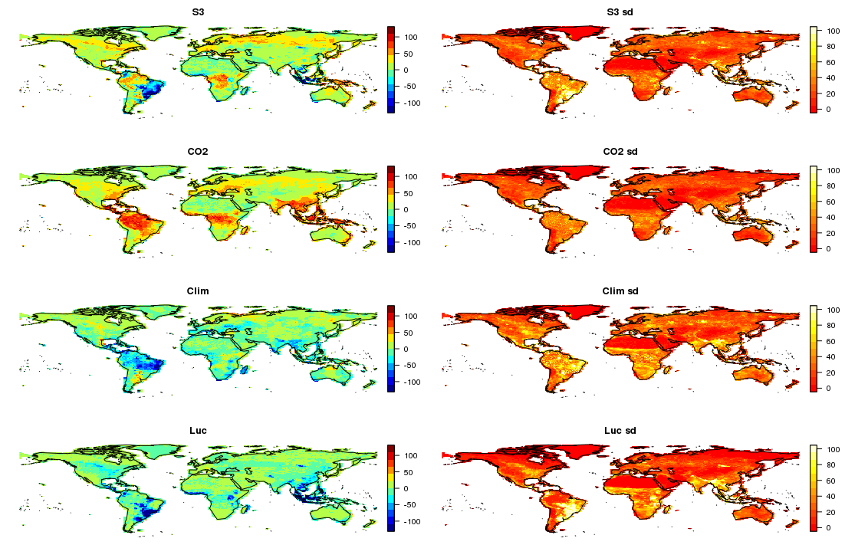
2010-2017 mean sink (gC/m2/yr)

Slide 41
2010-2017 mean sink (gC/m2/yr)

Slide 42
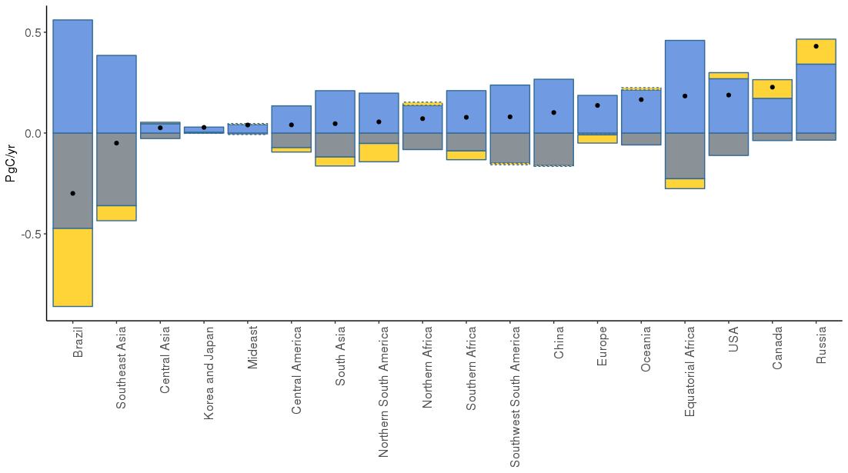
Regional breakdown (PgC/yr)

Slide 43
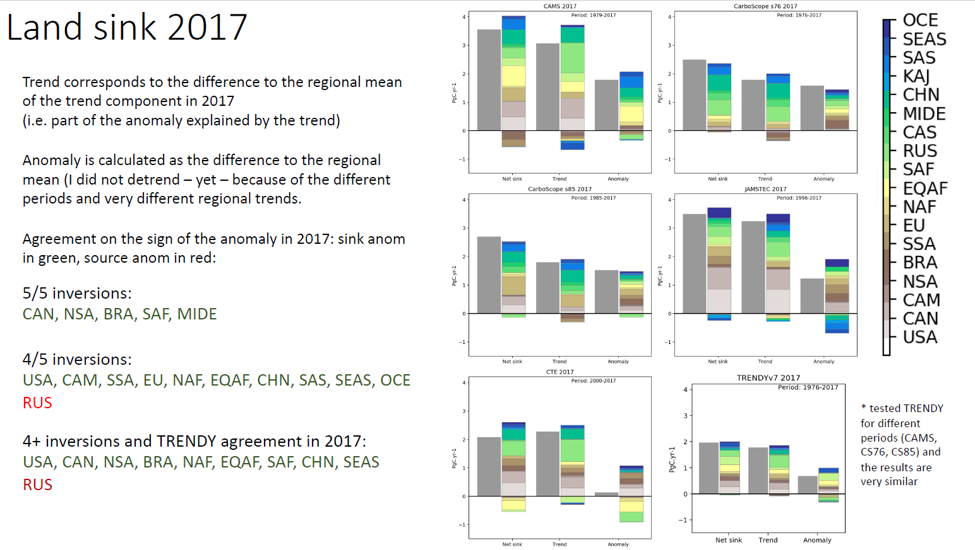
Ana Bastos

Slide 44
Summary
Drylands are important in the global carbon cycle, in particular for IAV and Trend in the land carbon sink
Moisture dominates the land IAV response at the local scale, but Temperature & Moisture at the global scale (?)
The dry season intensity is important for NPP trends.
DGVMs explain ~65% of the reduced land uptake due to 2015-16 El Niño, and attribute this to reduced GPP.
Have CO₂ emissions from land use change systematically been underestimated?
Need to improve land-use flux estimates
Need to improve representation soil moisture & plant drought response

