Slide 1
TRENDY project: Overview, Lessons, future directions
Philippe Ciais, Trendy Consortium

Slide 2
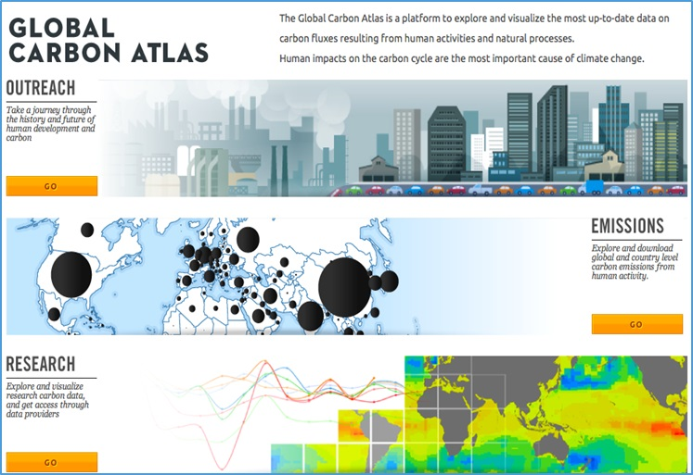
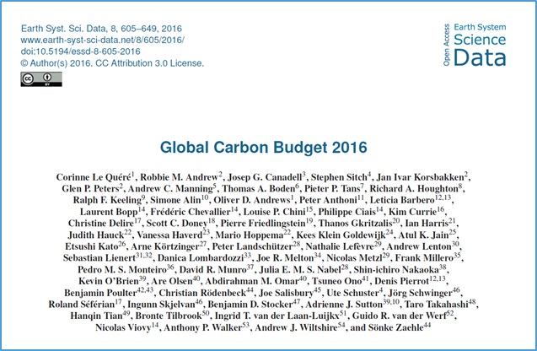
Global Carbon Budget Annual Updates
More information, data sources and data files:
www.globalcarbonproject.org
Contact: c.lequere@uea.ac.uk
More information, data sources and data files:
www.globalcarbonatlas.org
(funded in part by BNP Paribas Foundation)
Contact: philippe.ciais@lsce.ipsl.fr

Slide 3
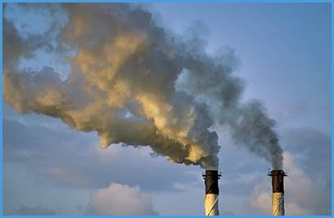
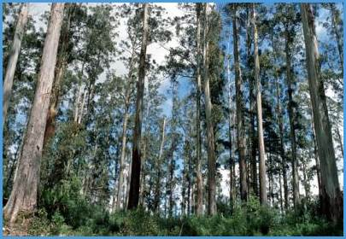
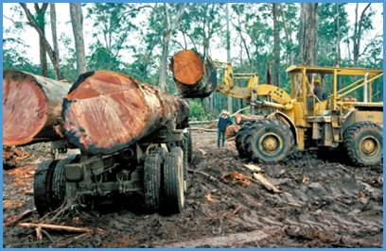
Trendy and the Global Carbon Project
2006-2015
16.4 GtCO₂/yr
44%
34.1 GtCO₂/yr
91%
Sources = Sinks
31%
11.6 GtCO₂/yr
9%
3.5 GtCO₂/yr
26%
9.7 GtCO₂/yr
Source: CDIAC; NOAA-ESRL; Houghton et al 2012; Giglio et al 2013; Le Quéré et al 2016; Global Carbon Budget 2016
Notes:
Trendy provides land fluxes for GCP;
Originally for the natural sink
AIM – to close the Global Carbon Budget, i.e. the bottom-up mechanistic DGVMs consistent with the residual sink
Also LU enabled DGVMs can provide the net LU flux (including environmental effects) for the emissions.

Slide 4
Trendy-v1 (GCP-RECCAP)
Aim
Provide anual NBPestimates to GCP & Regional Carbon Cycle Assessment Report (RECCAP)
Models (9 DGVMs)
Hyland, JULES, LPJ, LPJ-GUESS, NCAR-CLM4, ORCHIDEE, OCN, SDGVM, VEGAS
Experiments
S1 1901-2010 CO₂ only
S2 1901-2010 CO₂ + Climate
Extra Spin-off Study and Simulation (6 DGVMs)
1901-2010 Climate only (Frank et al. WUE study)
Publications
Sitch et al. Trends and drivers of regional sources and sinks of carbon dioxide over the past two decades, Biogeosciences, 2015
Piao et al. Evaluation of terrestrial carbon cycle models for their response to climate variability and to CO₂ trends. Global Change Biology. 19(7), 2117-2132
Le Quéré et al., 2013, The global carbon budget 1959–2011, Earth Syst. Sci. Data, 5, 165–185, 2013, www.earth-syst-sci-data.net/5/165/2013/doi:10.5194/essd-5-165-2013

Slide 5
First Priority Variables (monthly)
Physical Variables
Near Surface Temp, Precipitation, shortwave Rad, Soil moisture content, Runoff, Evapotranspiration, Plant Functional Type (PFT) level data
Biogeochemical
Carbon Pools and Fluxes (GPP, NPP, Rh, wildfire flux, NBP, LU flux, PFT level fluxes)
Second Priority Variables (monthly)
Physical variables
Soil temp, interception
Biogeochemical
Carbon in leaves, roots, wood, CWD etc.
Notes:
Request second priority variables – but invariably no one submits these.

Slide 6
Typical Annual Experimental Timeline
Update monthly CRU climatology 1901-2014 early June 2015
GCP provide annual global CO2 data
+2 weeks LSCE (Nicolas Viovy) generates CRU-NCEP merged 6-hourly forcing data
Modified Experimental Protocol Circulated
Update LULCC datasets from HYDE (Kees Klein Goldewijk, PBL)
+2 weeks wood harvest / LU transitions (Louise Chini, Uni Maryland)
+3 weeks, DGVMs make simulations (S2: CO₂ + Climate; S3 CO₂+Climate+LULCC); global output from DGVMs supplied to GCP; gridded datasets on Exeter ftp site (follow-on studies)
Submit updated Global Carbon Budget (Sept/Oct)
Notes:
Emphasise the tight time schedule, hence don’t want to change much from year to year in terms of modelling protocol (risk losing DGVM from participating)

Slide 7
Trendy-v7
Aim
Provide annual land –atmosphere flux and LU flux estimates to GCP, attribute regional C fluxes to processes. Contribute to RECCAP2
Models (16 DGVMs)
CABLE-POP, CLASS-CTEM, CLM5.0, DLEM, ISAM, JSBACH, JULES, LPJ-GUESS, LPJ,
LPX-Bern, OCN, ORCHIDEE-Trunk, ORCHIDEE-CNP, SDGVM, SURFEXv8, VISIT
Experiments
S0: Control. No forcing change (needed to diagnose any issues / drift)
S1: CO₂ (time-invariant “pre-industrial” land use mask)
S2: CO₂ and climate (time-invariant “pre-industrial” land use mask)
S3: CO₂, climate and land use (Using updated annual LULCC maps to 2017)
S4: Land use only (time-invariant “pre-industrial” climate and CO₂, using updated annual LULCC maps to 2017)
Notes:
Fast forward 7+ years we completed TRENDY – v7 last summer. More developed protocol – includes N-cycle model (and thus recommendations for common N forcing), includes LULCC – encouraging gross transitions (not only net transitions).

Slide 8
Nitrogen cycle
Models having a nitrogen cycle should use time varying Nitrogen inputs as follows:
S0 none (PI CO₂, PI Ndep, PI climate, PI LC)
S1 CO₂ + Ndep
S2 CO₂ + Ndep + climate
S3 CO₂ + Ndep + climate + LCC + N fertiliser
S4 LCC + N fertiliser

Slide 9
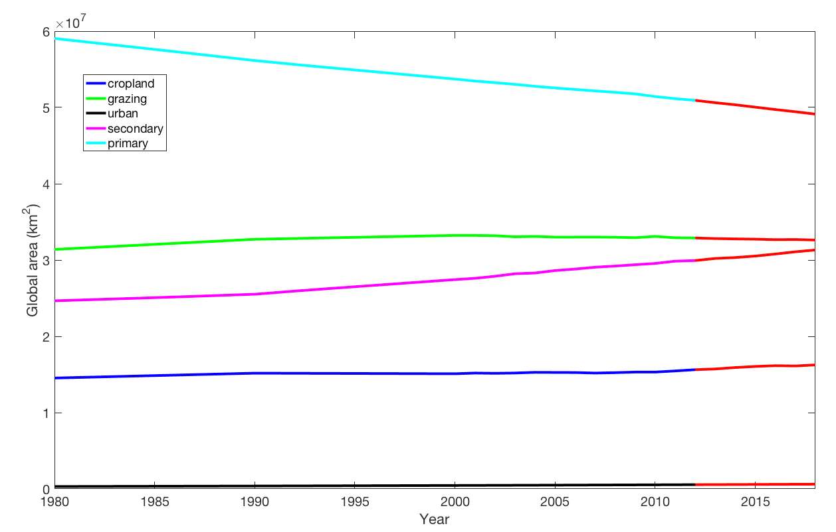
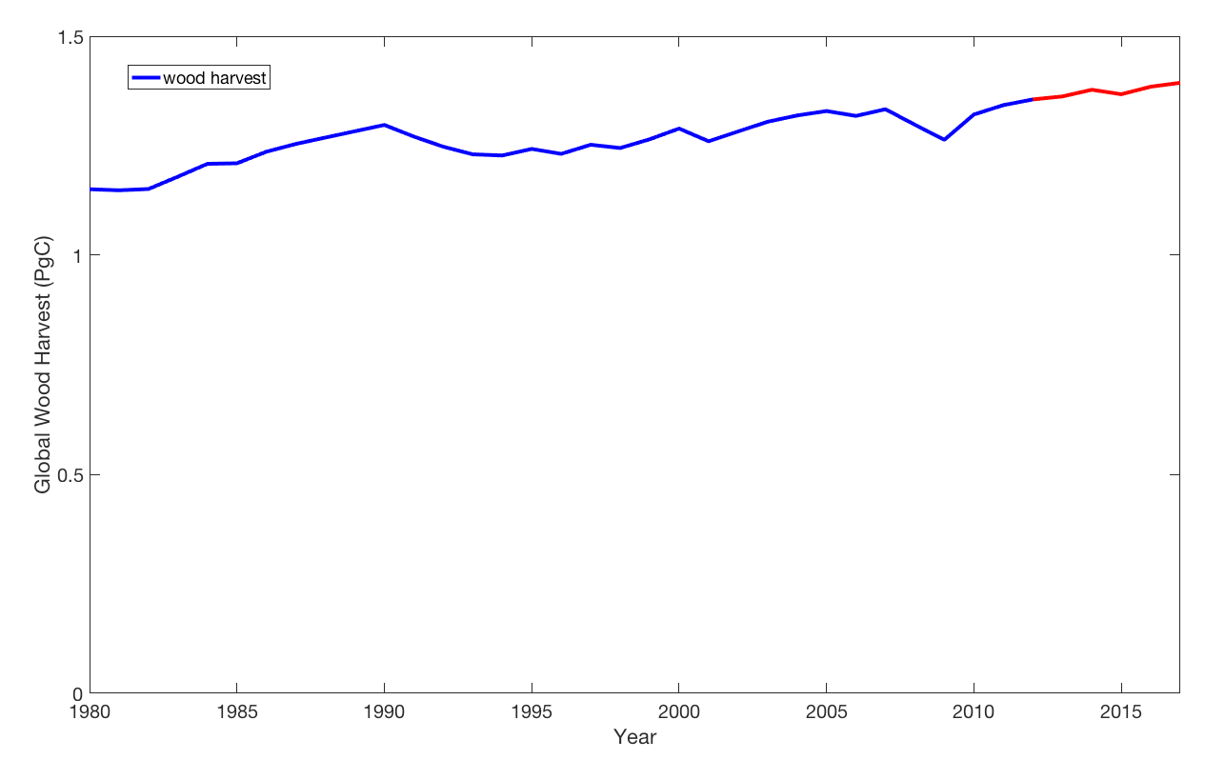
LULCC forcing
Land-use states for the years 850-2012, and land-use transitions for the years 850-2011, are the same as LUH2 v2h (released for CMIP6).
Land-use states for the years 2013-2018, and land-use transitions for the years 2012-2017, are new, based on new inputs from HYDE, and new FAO data for the national wood harvest demands.

Slide 10
Courtesy, Beni Stocker
Major DGVM Advance: Gross vs Net Land Use Change
Shifting Cultivation = Sub-grid Scale Transitions
with gross LU transitions:
Large C source with deforestation (fast)
Smaller C sink with abandonment & regrowth (slow)
Notes:
Shifting Cultivation. Better “Sub grid scale transitions”

Slide 11
Criteria for budget Inclusion
We apply three criteria for minimum model realism by including only those models with:
(1) steady state after spin-up. Diagnosed from S0 run.
(2) net annual land flux (S_{land}-E_{LUC}) is a carbon sink over the 1990s (and potentially 2000s) as constrained by global atmospheric and oceanic observations (McNeil et al., 2003; Manning and Keeling, 2006; Mikaloff Fletcher et al., 2006). Diagnosed from S3 run.
(3) global net annual land use flux (E_{LUC}) is a carbon source over the 1990s.

Slide 12
+ Benchmarking : iLamb
DGVM evaluated in the iLamb benchmarking system, summary statistics for each model included in the supplementary material of the ESSD paper.
Enable to document model improvement each year, and to identify possible issues / model deficiencies to aid model development.
Do not envisage using the benchmarking results as criteria for budget inclusion at the moment, but potentially in future years after further consultation among participating groups.

Slide 13
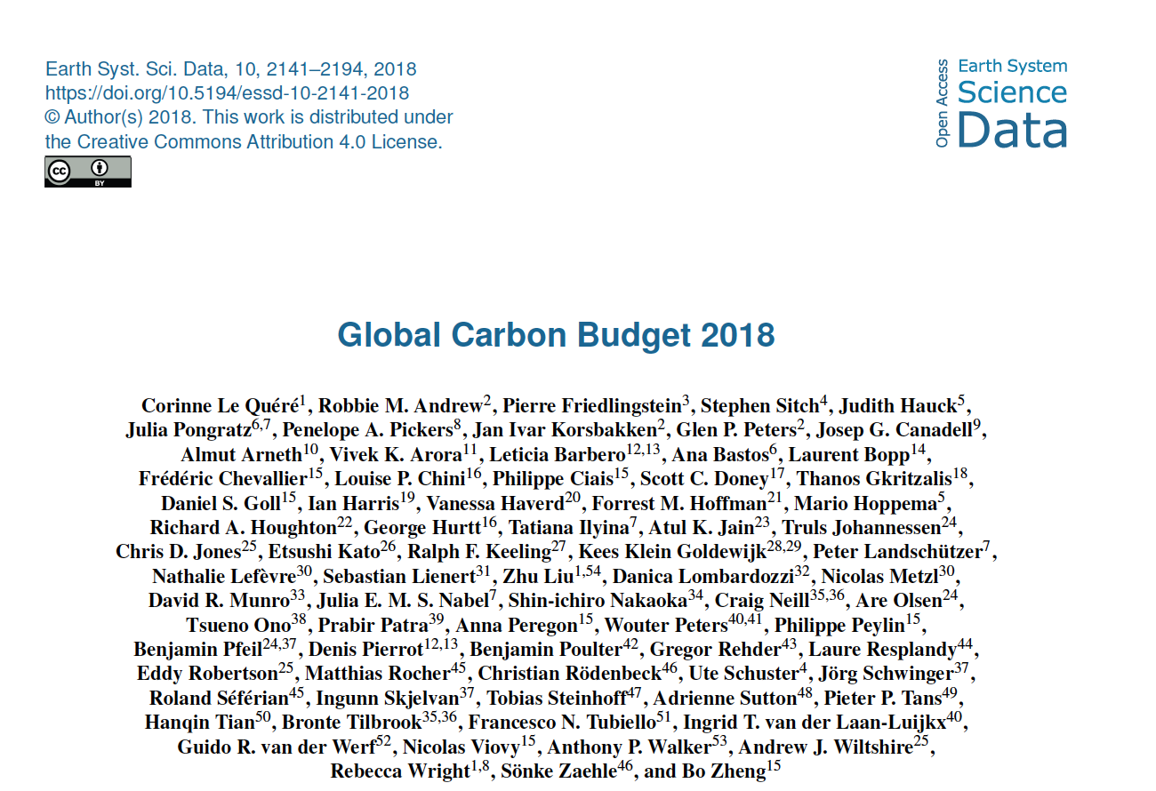
Publications
Le Quéré et al., (2018) Global carbon budget 2018, Earth Syst. Sci. Data., 10, 2141-2194
Notes:
Latest GCB2018 using TRENDY-v7 publication

Slide 14
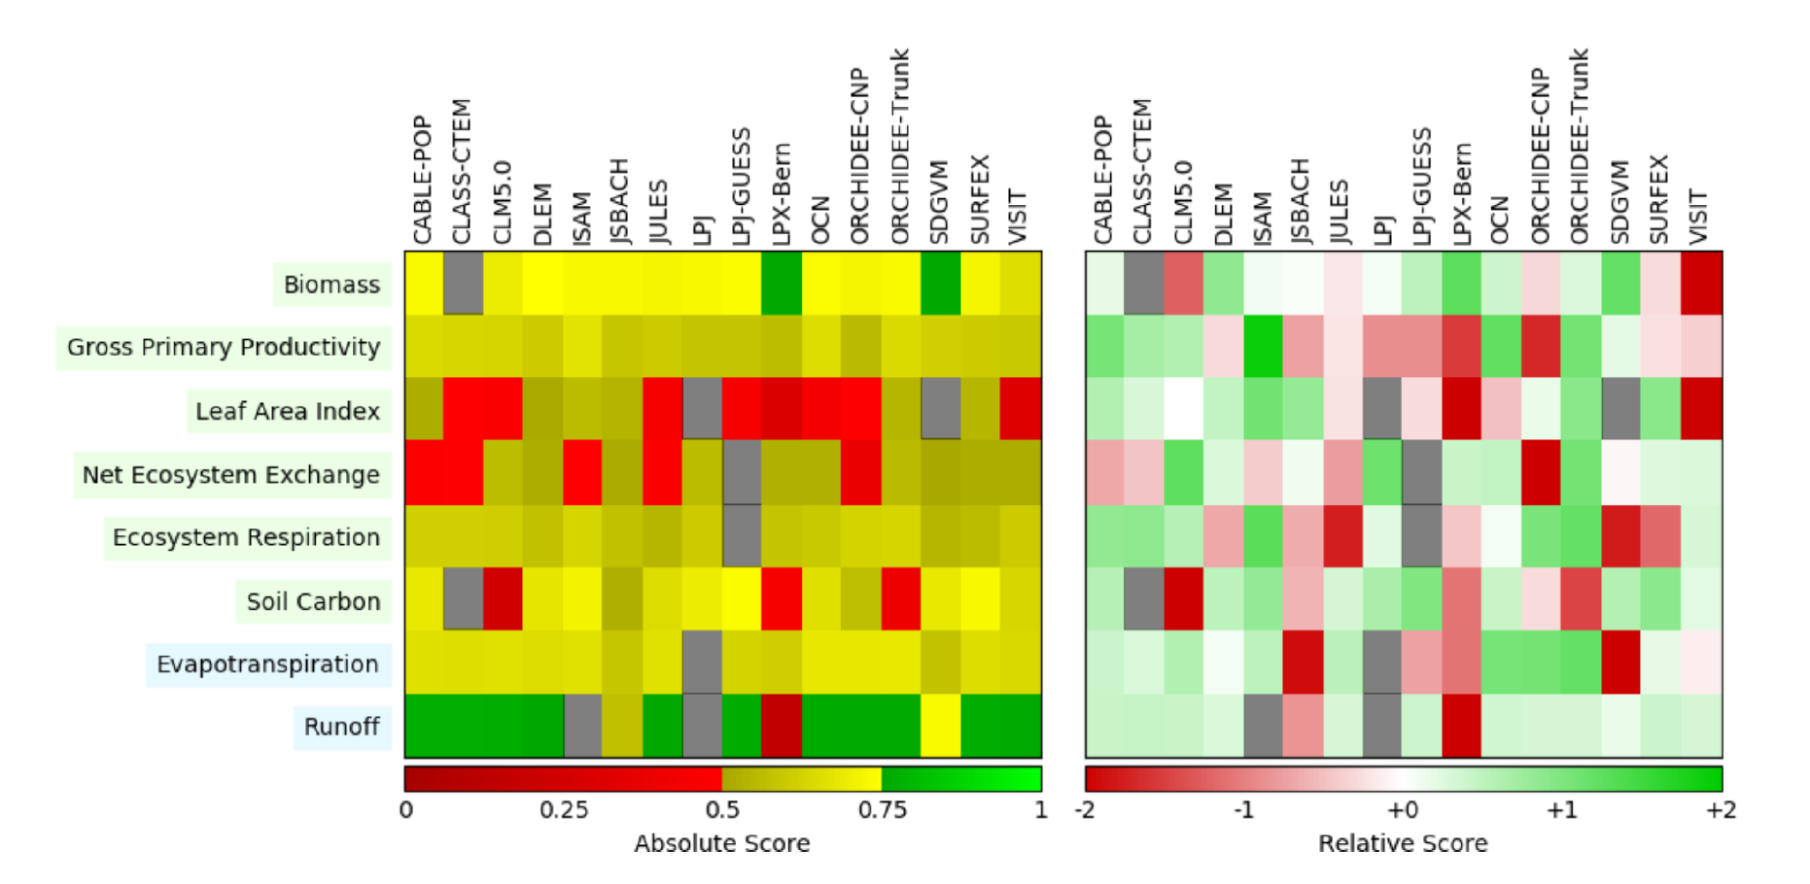
Summary Benchmark Statistics
Notes:
Aim to have more detailed papers – linked to ESA project (soil moisture, biomass, biomass burning, vegetation)
Also explore weighting global NBP for each DGVM by performance against carbon benchmarks

Slide 15
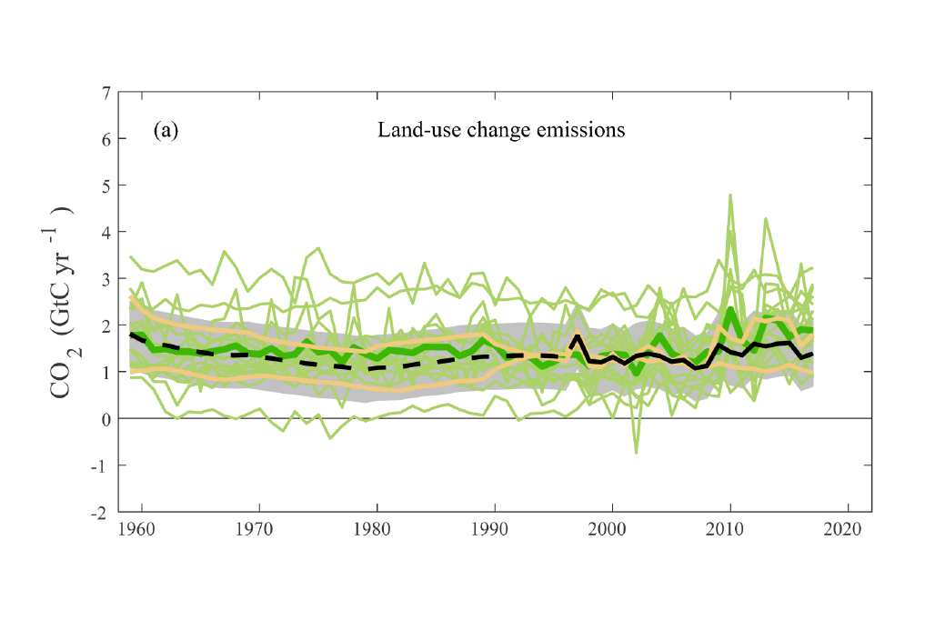
Challenges: Land-Use Change Emissions
Notes:
Still large uncertainty across approaches
Apples and oranges linked to different processes included
There is still a big challenge on the dataset side

Slide 16
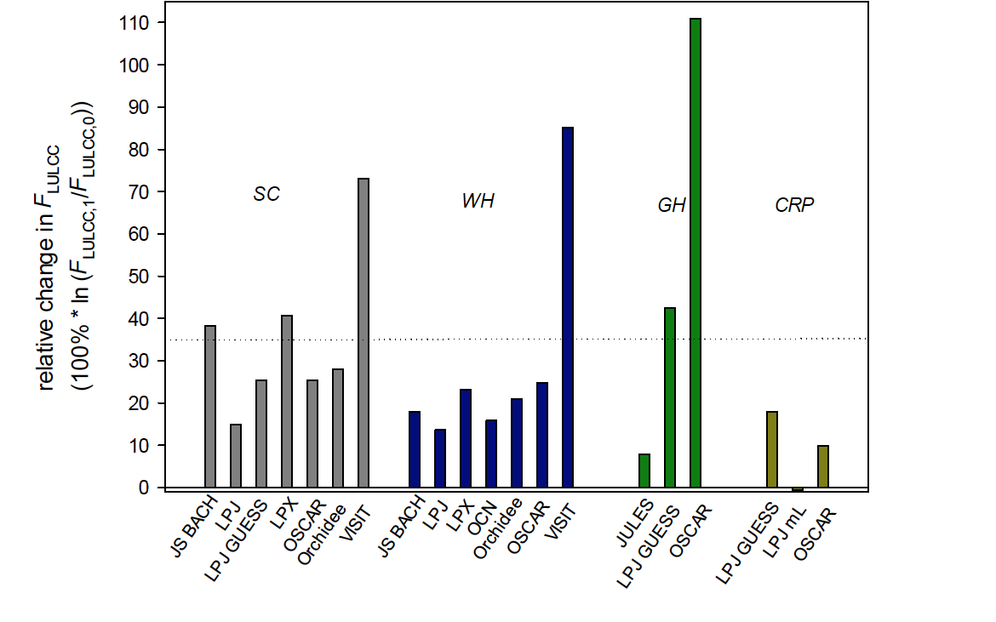
Have CO₂ emissions from land use change systematically been underestimated?
Grazing and Crop Harvest (grass PFT)
Wood Harvest
Shifting Cultivation
Crop Management
Arneth et al. Nature Geo, 2017
Notes:
More LU processes greater the simulated LU flux with obvious implication for the natural sink!

Slide 17
Challenges: Budget ImBalance (BIM)

Slide 18
BIM: Budget Imbalance / Unexplained Carbon
the 1960s UC sink, matching an anomaly of the Southern Annular Mode;
the 1970s UC source during a wet decade with multiple La Niña events;
the 1990-1992 large UC sink with onset before the volcanic eruption of Mount Pinatubo;
the 2000-2010 decreasing UC source at the time of the global temperature hiatus; and
the 2005-2015 quasi bi-annual seesaw suggesting lead-lags in carbon – climate variability.

Slide 19
TRENDY Challenges
Unfunded activity
Incentive to participate beyond GCP / RECCAP2 are numerous spin-off studies
Quality & Quality control of input forcing & individual DGVM output- temptation to use prototype model versions. Need to centralize checking of input forcing before distribution & introduction of iLamb to ensure improvement of individual model performance from year-to-year. Each year we interact with groups individually to improve their delivery
Need to be realistic in demands (e.g. minimum set of first priority variables)
”New” models. Changes in models participating. Want commitment to participate not for one year but on the medium term (otherwise difficult to demonstrate improvement with MME NBP). How to deal with proliferation of model variants? Need to demonstrate different processes are represented and only one model per group etc.
Major Science Challenges remain, e.g. LULCC representation, and thus also natural sink; BIM

Slide 20
Future Plans
Develop evaluation / benchmarking to reduce BIM (help/encourage DGVM development)
Consolidate (system works, continue for future years)
Open to spin –off studies requiring additional simulations, or output variables / resolution (e.g. currently monthly output. Could provide sub-daily output from LSMs if identified product)
Link to FIREmip in TRENDY-v8 to facilitate evaluation of updated fire models.
Explore with LUH2 & HYDE groups strategy for LULCC dataset provision, including dedicated GCP LUH2 dataset (rather than modified CMIP6)
Advance timeline to late spring / early summer (e.g. UEA provide both CRU & CRU-JRA forcing); LULCC can potentially be supplied earlier in the cycle
Link benchmarking to traceability framework approach to better understand reasons for model differences (e.g. residence times versus fluxes)
Notes:
i.e. if we ask groups to output extra variables or make additional runs there’s needs to be a clear/definite product/ paper identified as a carrot for the groups to do the extra work. We don’t just want a wish list from the community, then find the data isn’t used.

Slide 21
Summary
TRENDY project provides annual update for GCP, RECCAP 1 and now for RECCAP 2
Multiple spin-off studies (carrot for DGVM community)
Regional Carbon Cycle & role of drought (Sitch et al., BG, 2015)
20thC changes in WUE (Frank et al., NCC, 2015)
Role of semi-arid vs Forests in c-cycle at multiple timescales (Poulter et al., Nature 2014, Ahlström et al., Science, 2015)
Now completed 7th TRENDY – iteratively improved methodology, timeline & processes included / accounted for (LULCC, N cycle …)

