Slide 1
Modelling Cellular Excitability
Basic reference: Keener and Sneyd, Mathematical Physiology

Slide 2


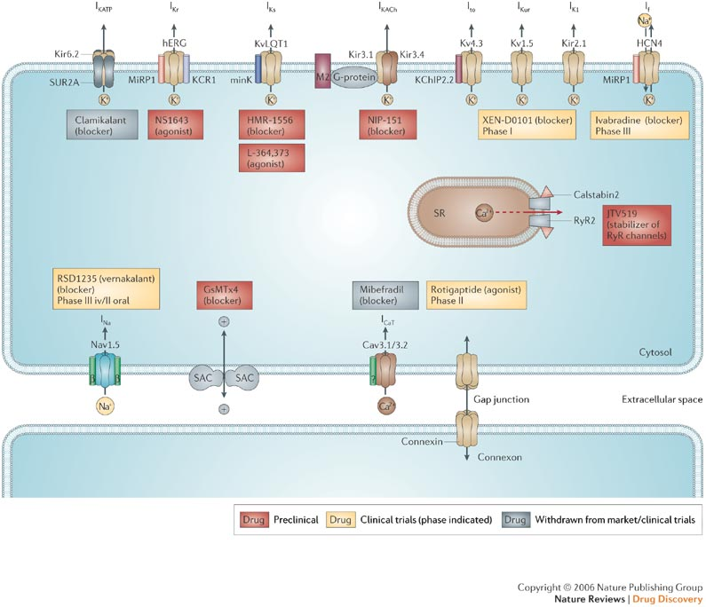
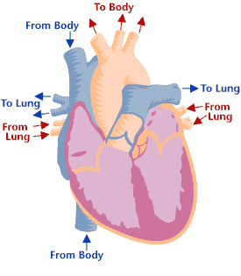
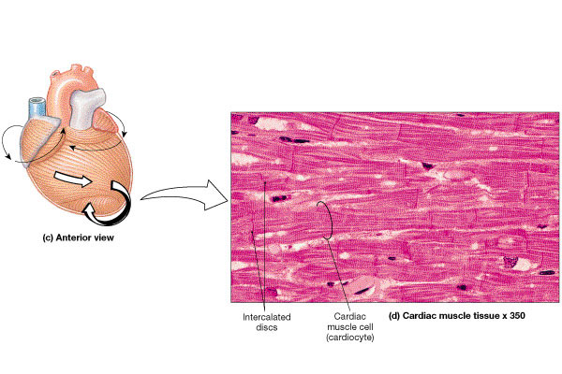

Cardiac Cell
Nattel and Carlsson Nature Reviews Drug Discovery 5, 1034–1049 (December 2006)

Slide 3
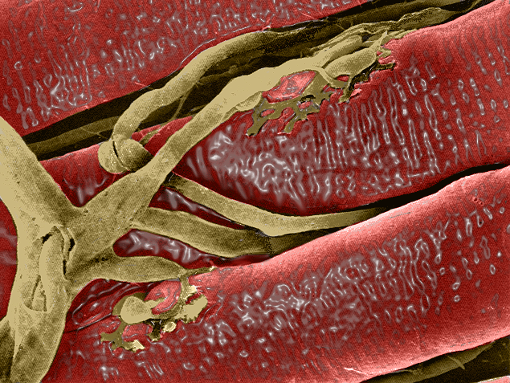
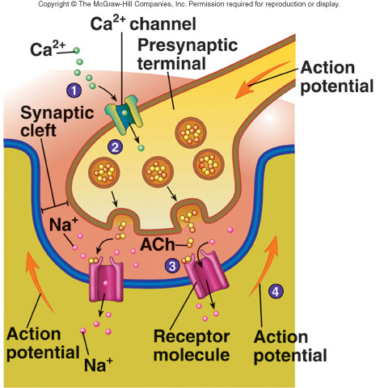
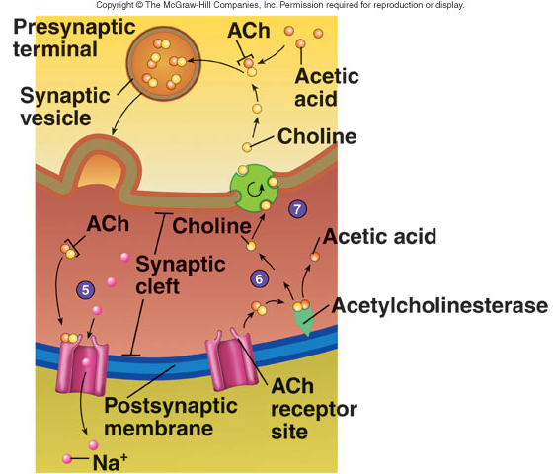
Neuromuscular Junction

Slide 4
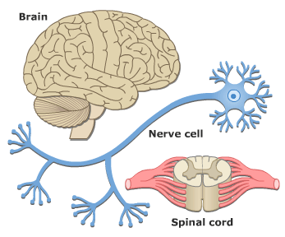
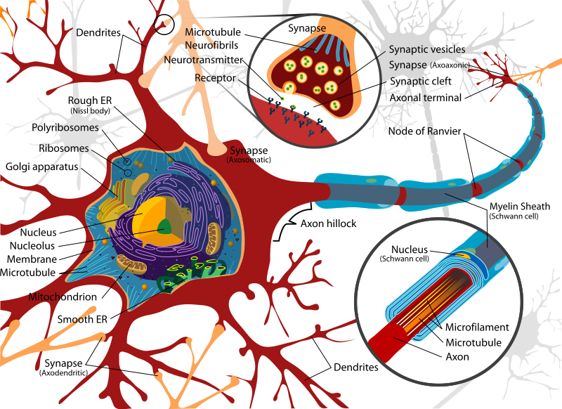
Neuron

Slide 5
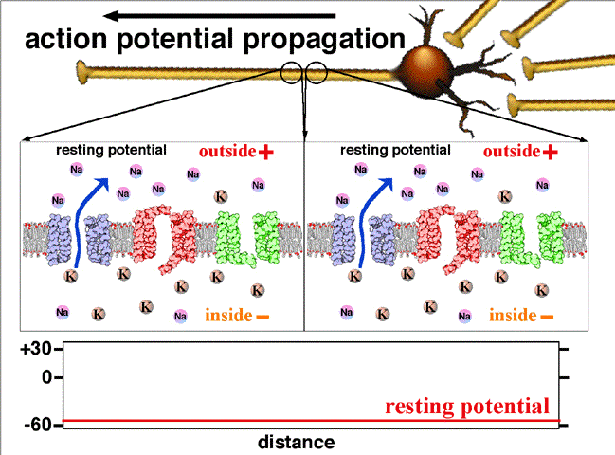

Slide 6
Cell membranes, ion channels and receptors

Slide 7
Basic problem
The cell is full of stuff. Proteins, ions, fats, etc.
Ordinarily, these would cause huge osmotic pressures, sucking water into the cell.
The cell membrane has no structural strength, and the cell would burst.

Slide 8
Basic solution
Cells carefully regulate their intracellular ionic concentrations, to ensure that no osmotic pressures arise
As a consequence, the major ions Na⁺, K⁺, Cl⁻ and Ca²⁺ have different concentrations in the extracellular and intracellular environments.
And thus a voltage difference arises across the cell membrane.
Essentially two different kinds of cells: excitable and nonexcitable.
All cells have a resting membrane potential, but only excitable cells modulate it actively.

Slide 9
Typical ionic concentrations (in mM)
 | Squid Giant Axon | Frog Sartorius Muscle | Human Red Blood Cell
Intracellular
Na⁺ | 50 | 13 | 19
K⁺ | 397 | 138 | 136
Cl⁻ | 40 | 3 | 78
Extracellular
Na⁺ | 437 | 110 | 155
K⁺ | 20 | 2.5 | 5
Cl⁻ | 556 | 90 | 112

Slide 10
The Nernst equation
[S]_{i}=[S’]_{i}
[S]_{e}=[S’]_{e}
V_{i}
V_{e}
Permeable to S, but not S’; S and S’ have opposite charge
(The Nernst potential)
Equilibrium is reached when the electric field exactly balances the diffusion of S. In the case of a single ion species the net current is zero at the Nernst potential. However this is not true when more than one type of ions can cross the membrane.
Note: equilibrium only. Tells us nothing about the current. In addition, there is very little actual ion transfer from side to side.

Slide 11
Resting potential
No ions are at equilibrium, so there are continual background currents. At steady-state, the net current is zero, not the individual currents.
The pumps must work continually to maintain these concentration differences and the cell integrity.
The resting membrane potential depends on the model used for the ionic currents.
linear current model
(long channel limit)
GHK current model
(short channel limit)

Slide 12
Electrical circuit model of cell membrane
How to model
this is the crucial question!

Slide 13
Simplifications
In some cells (electrically excitable cells), the membrane potential is a far more complicated beast.
To simplify modelling of these types of cells, it is simplest just to assume that the internal and external ionic concentrations are constant.
Justification: Firstly, it takes only small currents to get large voltage deflections, and thus only small numbers of ions cross the membrane. Secondly, the pumps work continuously to maintain steady concentrations inside the cell.
So, in these simpler models the pump rate never appears explicitly, and all ionic concentrations are treated as known and fixed.

Slide 14
Steady-state vs instantaneous I-V curves
So far we have discussed how the current through a single open channel depends in the membrane potential and the ionic concentrations on either side of the membrane.
But in a population of channels, the total current is a function of the single-channel current, and the number of open channels.
When V changes, both the single-channel current changes, as well as the proportion of open channels. But the first change happens almost instantaneously, while the second change is a lot slower.
Proportion of
open channels
I-V curve of single
open channel

Slide 15
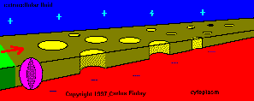
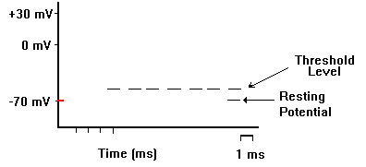
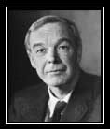
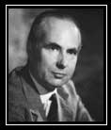
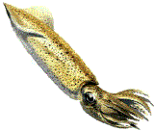
Hodgkin
Huxley
Alan Lloyd Hodgkin and Andrew Huxley described the model in 1952 to explain the ionic mechanisms underlying the initiation and propagation of action potentials in the squid giant axon. They received the 1963 Nobel Prize in Physiology or Medicine for this work.

Slide 16
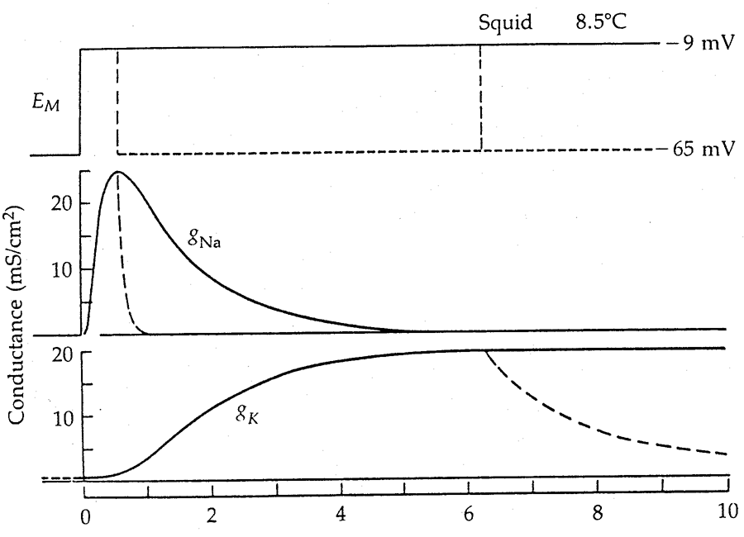
Example: Na⁺ and K⁺ channels

Slide 17
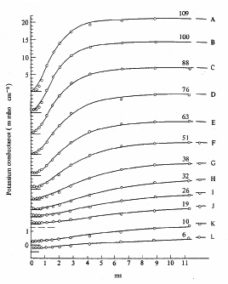
Experimental data: K⁺ conductance
If voltage is stepped up and held fixed, g_{K} increases to a new steady level.
four subunits
rate of rise
gives τ_{n}
steady-state
time
constant
Now just fit to the data.
steady state
gives n∞

Slide 18
K⁺ channel gating
If the channel consists of two identical subunits, each of which can be closed or open then:
S₀₀
S₀₁
2α
α
S₀
S₁
S₂
β
2β
S₁₀
S₁₁

Slide 19
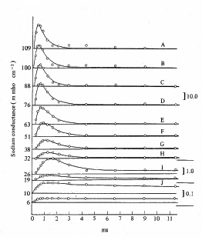
Experimental data: Na⁺ conductance
If voltage is stepped up and held fixed, g_{Na} increases and then decreases.
Four subunits.
Three switch on.
One switches off.
steady-state
time
constant
Fit to the data is a little more complicated now, but still easy in principle.

Slide 20
Na⁺ channel gating
If the channel consists of multiple subunits of two different types, m and h, each of which can be closed or open then:
S₀₀
2α
S₁₀
α
S₂₀
S _{i j}
β
2β
γ
δ
γ
δ
γ
δ
S₀₁
2α
S₁₁
α
S₂₁
activation
inactivation
β
2β
the fraction of channels in state S₂₁
activation
inactivation

Slide 21
Hodgkin-Huxley equations
applied current
generic leak
∞
∞
much smaller than
the others
activation
(increases with V)
∞
inactivation
(decreases with V)

Slide 22
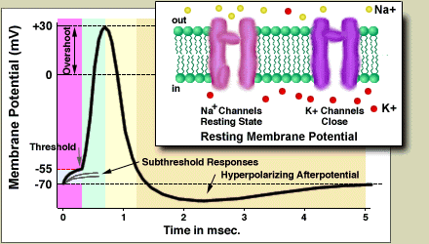
An action potential
g_{Na} increases quickly, but then inactivation kicks in and it decreases again.
g_{K} increases more slowly, and only decreases once the voltage has decreased.
The Na⁺ current is autocatalytic. An increase in V increases m, which increases the Na⁺ current, which increases V, etc.
Hence, the threshold for action potential initiation is where the inward Na⁺ current exactly balances the outward K⁺ current.

Slide 23
The fast phase plane: I
n and h are slow, and so stay approximately at their steady states while V and m change quickly

Slide 24
The fast phase plane: II
h₀ decreasing
n₀ increasing
As n and h change slowly, the dV/dt nullcline moves up, v_{e} and v_{s} merge in a saddle-node bifurcation, and disappear.
v_{r} is the only remaining steady-state, and so V returns to rest.
In this analysis, we simplified the four-dimensional phase space by taking series of two-dimensional cross-sections, those with various fixed values of n and h.

Slide 25
The fast-slow phase plane
Take a different cross-section of the 4-d system, by setting m=m∞(v), and using the useful fact that n + h = 0.8 (approximately). Why? Who knows. It just is. Thus:
depolarization (I_{app} >0)

Slide 26
Oscillations
When a current is applied across the cell membrane, the HH equations can exhibit oscillatory action potentials.

Slide 27
Where does it go from here?
More detailed models - Traub, Golomb, Purvis, … .
Simplified models - FHN, Morris Lecar, Hindmarsh-Rose…
Forced oscillations of single cells - APD alternans, Wenckebach patterns.
Other simplified models - Integrate and Fire, Poincare oscillator
Networks and spatial coupling (neuroscience, cardiology, …)

Slide 28
Some further references
Koch (1999) Simplified models of single neurons.
Rinzel & Ermentrout (1997) Analysis of neural excitability and oscillation.
Gerstner & Kempter (2002) Spiking neural models
Koch (1999) Phase Space Analysis of Neural Excitability

Slide 29
Why Simplified Models?
Analysis of the dynamical behaviors of single neurons
Reduce the computational load
To be used in network models

Slide 30
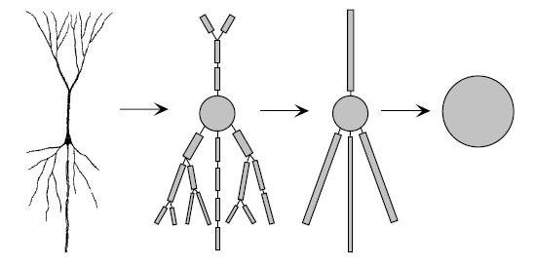
From Compartmental models to Point Neurons
Axon hillock (Soma)

Slide 31
Point Neurons
General Form :

Slide 32
Two Dimensional Neurons
Enables phase plane analysis
Most important variants
  Fitzhugh-Nagumo Model
  Morris-Lecar Model
Software: XPPAUT, MatCont, DDEBifTool

Slide 33
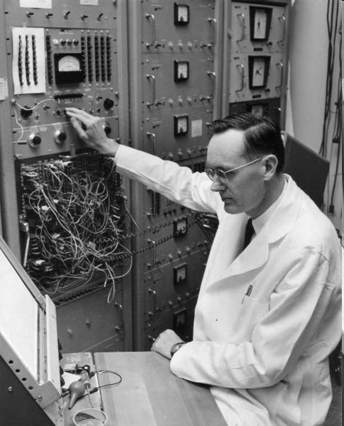
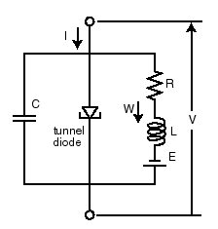
FitzHugh-Nagumo model
Figure 1: Circuit diagram of the tunnel-diode nerve model of Nagumo et al. (1962).
Fast variable
FitzHugh modified the Van der Pol equations for the nonlinear relaxation oscillator. The result had a stable resting state, from which it could be excited by a sufficiently large electrical stimulus to produce an impulse. A large enough constant current stimulus produced a train of impulses (FitzHugh 1961, 1969).
Slow (recovery) variable
http://www.scholarpedia.org/article/FitzHugh-Nagumo_model

Slide 34
How do we analyze this class of models?
Phase plane: Study the dynamics in the (V,w)-plane rather than V or w versus time
Nullclines: Determine the curves along which one ofthe time derivatives is 0
Steady states: At the intersections of the two nullclines both derivatives are 0, so the system is at rest
Direction arrows: The nullclines divide up the plane, and the direction of flow in each region can be determined

Slide 35
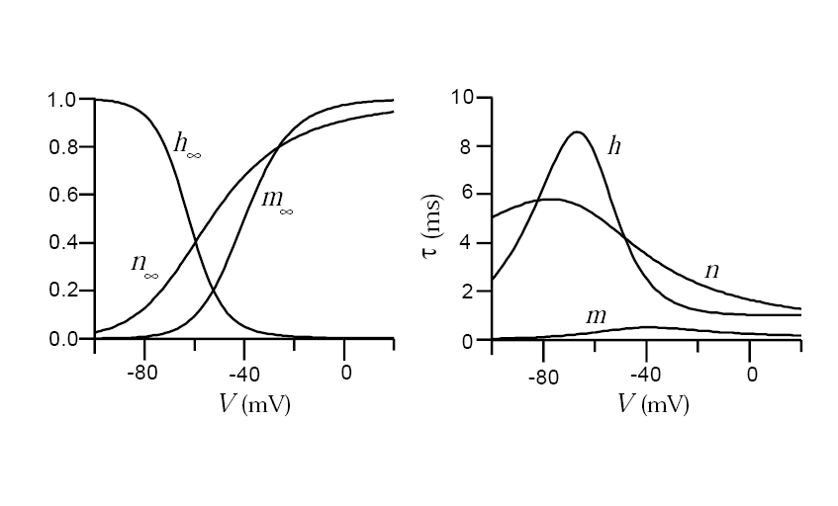
Fitzhugh-Nagumo Model (1)
A simplification of HH model
m is much faster than the others:

Slide 36
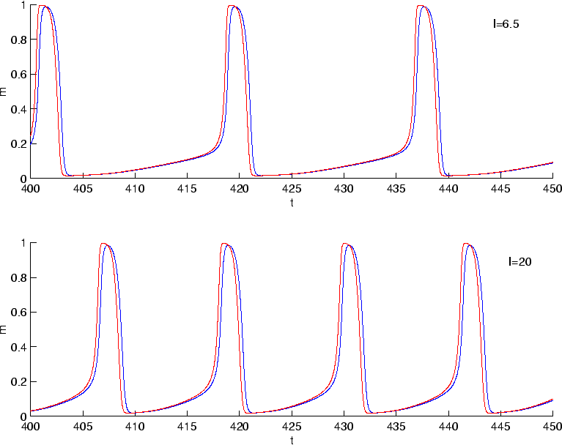
Fitzhugh-Nagumo Model (2)
Eliminating the fast dynamics
Blue: Full system
Red: Reduced System

Slide 37
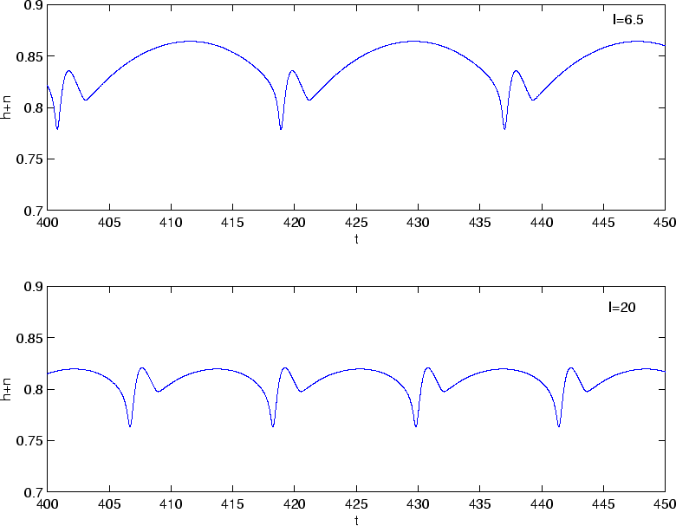
Fitzhugh-Nagumo Model (3)
Eliminating h

Slide 38
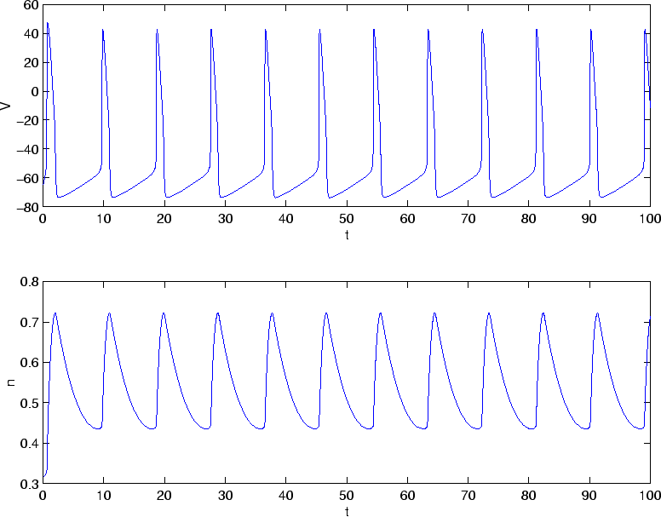
Fitzhugh-Nagumo Model (4)
Fitzhugh-Nagumo 2D model:

Slide 39
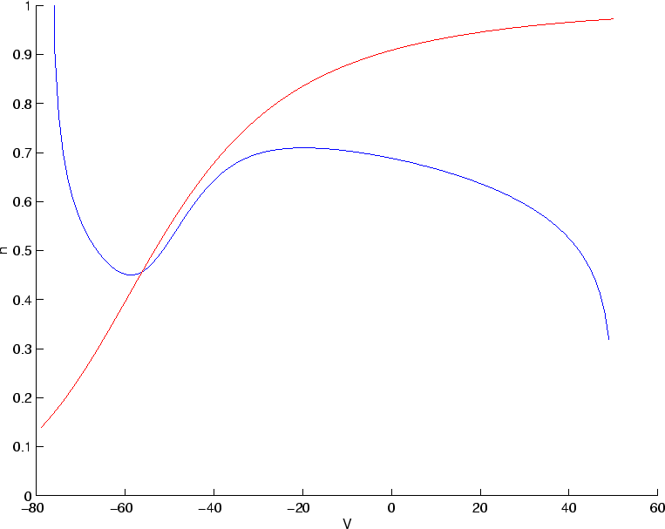
Fitzhugh-Nagumo Model (5)
Nullclines:
n nullcline
Orbit or
Spiral?
V nullcline

Slide 40
Fitzhugh-Nagumo Model (6)
Fitzhugh- Nagumo equations:
W
V
Qualitatively captures the properties of the exact model

Slide 41
Analysis of Fitzhugh-Nagumo System (1)
Jacobian:
Fixed point for I=0 : V=-1.20, W=0.625
The fixed point is:
Stable Spiral

Slide 42
Analysis of Fitzhugh-Nagumo System (2)
Response of the resting system (I=0) to a current pulse:
W
V

Slide 43
Analysis of Fitzhugh-Nagumo System (3)
Response of the resting system (I=0) to a current pulse:
W
V
Threshold is due to fast sodium gating (V nullcline)
Hyperpolarization and its termination is due to sodium/potassium channel

Slide 44
Analysis of Fitzhugh-Nagumo System (4)
Response to a steady current :
Jacobian:
Fixed point for I=1 : V=0.41, W=1.39
The fixed point is:
Unstable spiral

Slide 45
Analysis of Fitzhugh-Nagumo System (4)
Response of the resting system (I=1) to a steady current:
W
Stable
Limit Cycle
V

Slide 46
Analysis of Fitzhugh-Nagumo System (4)
Response of the resting system (I=1) to a steady current:
W
V

Slide 47
Bifurcation
By increasing the parameter
  I the stable fix point renders unstable
  A stable limit cycle appears
If by changing a parameter qualitative behavior of a system changes, this phenomenon is called bifurcation and the parameter is called bifurcation parameter

Slide 48
Onset of oscillation with non-zero frequency
In the resting (I=0) the fixed point is a stable spiral
The imaginary part of the eigenvalue is not zero and the real part is negative
In the bifurcation, the fixed point loses its stability → the real part of eigen value becomes positive and the imaginary part remains non-zero
The frequency of oscillation is proportional to the magnitude of the imaginary part of the eigenvalue
By increasing I, the oscillation onset starts with non-zero frequency
Hopf Bifurcation

Slide 49
IF response of Fitzhugh-Nagumo model
30
f
0
0 0.25 0.5 0.75 1
I

Slide 50
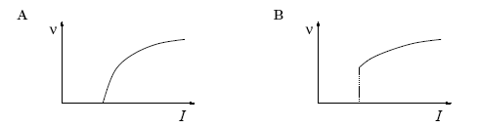
Neuron Type I / Type II
Gain functions of type I and Type II neurons
I
II
Neural Coding
Type I : Axon Hillock (Soma) of most neurons
Type II: Axons of Most neurons, whole body of non-adaptive cortical interneurons, the spinal neurons

Slide 51
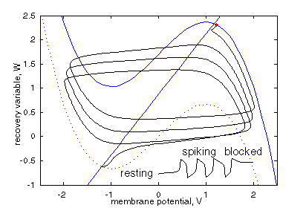
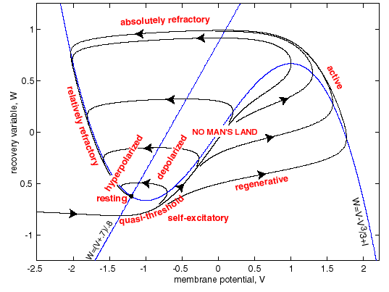
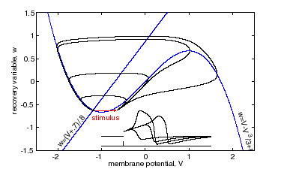
FitzHugh-Nagumo model
Figure 3: Absence of all-or-none spikes in the FitzHugh-Nagumo model.
Figure 4: Excitation block in the FitzHugh-Nagumo model.
Fast variable
Figure 2: Phase portrait and physiological state diagram of FitzHugh-Nagumo model (modified from FitzHugh 1961).
Slow (recovery) variable
http://www.scholarpedia.org/article/FitzHugh-Nagumo_model

Slide 52
Question
What happens if we feed the Fitzhugh-Nagumo neuron with a strong inhibitory pulse?
Post inhibitory rebound spike
W
V

Slide 53
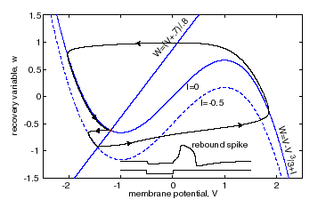
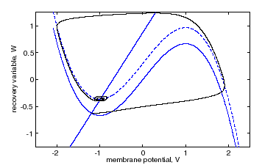
FitzHugh-Nagumo model
Figure 5: Anodal break excitation (post-inhibitory rebound spike) in the FitzHugh-Nagumo model.
Figure 6: Spike accommodation to slowly increasing stimulus in the FitzHugh-Nagumo model.
Fast variable
Slow (recovery) variable
http://www.scholarpedia.org/article/FitzHugh-Nagumo_model

Slide 54
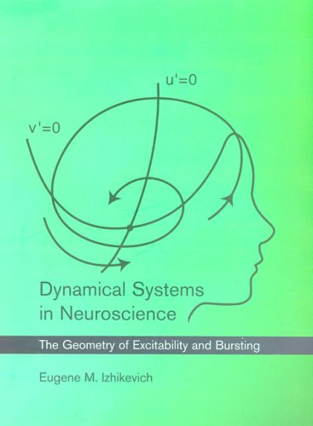
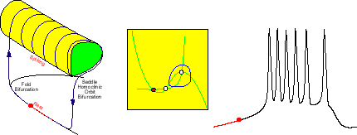
Bursting Neurons
Adding another slow process (Eugene Izhikevich 2000)
  Three dimensional phase plane

Slide 55
Dynamic Clamp/Conductance Injection
A method to assess how biophysically-defined ionic conductances shape the firing patterns of neurones
Or
A Physiologist’s dream: Adding and removing defined channel types without having to resort to pharmacology or molecular biology

Slide 56
How would the cell behave if it also had conductance X?
Patch amplifier
V_{mem}
from cell
Dynamic clamp:
Mathematical
Definition of conductance X
PC
Current command signal to recording
Develop method using cultured hippocampal neurones

Slide 57
Adding/Subtracting M-current (Kv7) with Dynamic Clamp
V
I_{K}(V)
Patch clamp amplifier
(current clamp)
I
XE-991
I_{Kv7}
V
I_{Kv7}
Digitizer
I_{Ca}(V)
I_{SK}(Ca)
read V
compute
df/dt = (f∞(V)-V)/τ_{Kv7}
Computer
I_{Kv7} = g_{Kv7} × f × (V-V_{K})
write I_{Kv7}
Original concept : Sharp et al, 1993
Implementation : Cambridge Conductance (Robinson, 2008)

Slide 58
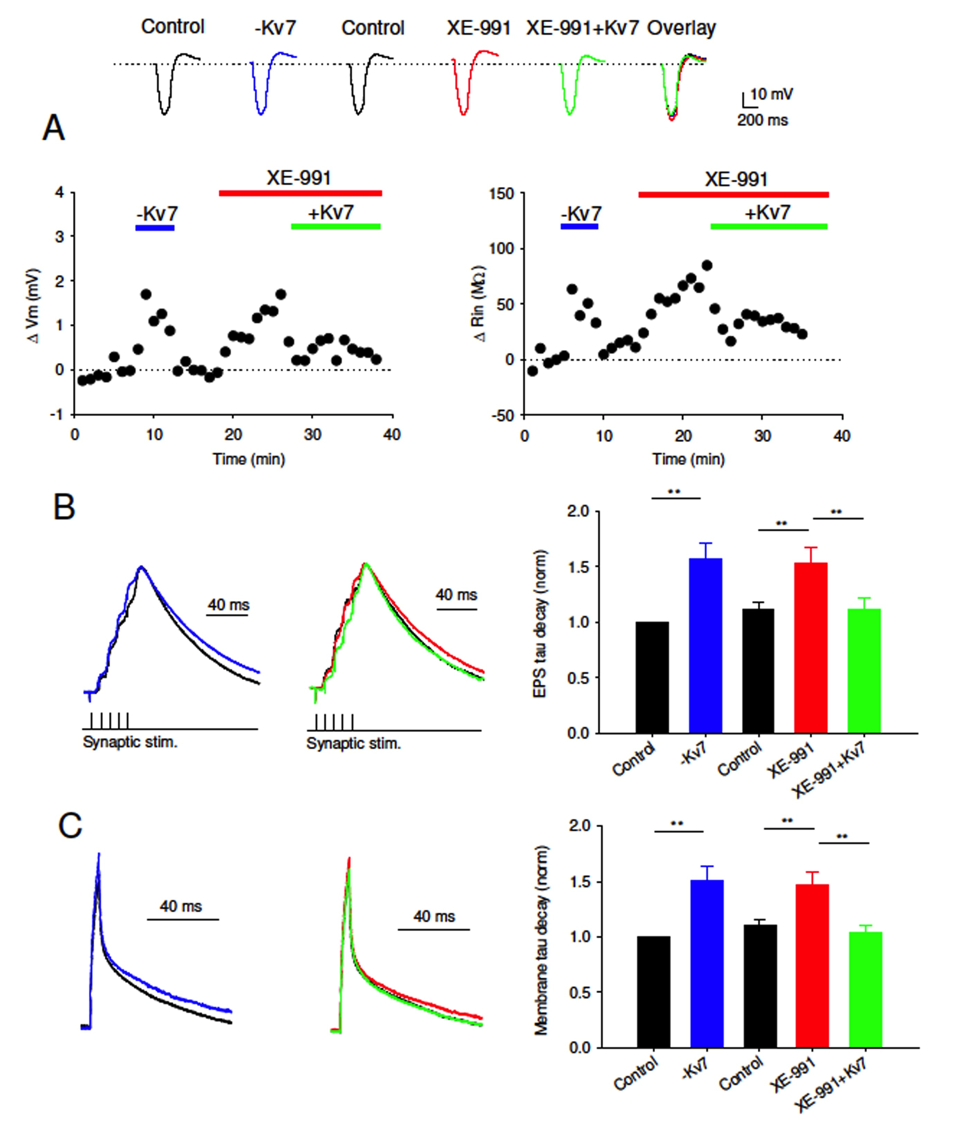
Notes:
Injection or removal of Kv7 conductance by dynamic clamp reverses or mimics the effects of XE-991.
A) Changes in membrane potential and input resistance caused by introduction of negative dynamic clamp Kv7 conductance (blue bar), XE-991 (10 mM, red bar) and positive dynamic clamp Kv7 conductance (green bar). Example voltage traces show responses to a hyperpolarising current in each condition.
B) Left: Negative dynamic clamp Kv7 conductance prolongs the duration of summated EPSPs. Switching the dynamic clamping off completely reversed its effects. Example voltage traces in control (black) or negative dynamic clamp (blue). Middle: XE-991 prolonged the duration of summated EPSPs and this effect was completely reversed by positive dynamic clamp Kv7 conductance. Example voltage traces in control (black), XE-991 (red) and XE-991+Kv7 conductance (green). Right: Average membrane decay time constant shows similar increase in both negative dynamic clamp Kv7 conductance and XE-991. The effect of XE-991 is completely reversed by positive dynamic clamp Kv7 conductance.
C) Left: Negative dynamic clamp Kv7 conductance prolonged the membrane decay time constant in response to a short subthreshold current injection. Switching the dynamic clamping off completely reversed its effects. Example voltage traces in control (black) or negative dynamic clamp Kv7 conductance (blue). Middle: XE-991 (red) prolonged the membrane decay time constant compared to control (black) and this effect was completely reversed by positive dynamic clamp Kv7 conductance (green). Right: Average membrane decay time constant shows similar increase in both negative dynamic clamp Kv7 conductance and XE-991. The effect of XE-991 is completely reversed by positive dynamic clamp Kv7 conductance.

Slide 59
Overview of the neural models:
Biological Reality
Numerical Simulation
Detailed conductance based models (HH)
Reduced conductance based models (Morris-Lecar)
Two Dimensional Neurons (Fitzhugh-Nagumo)
Integrate-and-Fire Models
Firing rate Neurons (Wilson-Cowan)
Steady-State models
Binary Neurons (Ising)
Analytical Solution
Artificial

