Slide 1
Modelling Calcium Dynamics
Basic reference: Keener and Sneyd, Mathematical Physiology

Slide 2
Calcium is a vital second messenger
So far we concentrated on Na⁺ (and K⁺), as those are the ions that are most important for the control of cell volume and the membrane potential.
But Ca²⁺ plays an equally important role in practically every cell type.
Ca²⁺ controls secretion, cell movement, muscular contraction, cell differentiation, ciliary beating and many other essential cellular processes.
Important in both excitable and non-excitable cells.

Slide 3
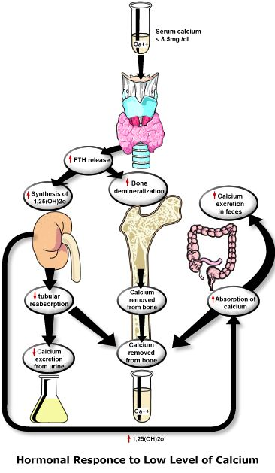
Whole-body control
Maintained high levels of calcium in the blood
they really mean
response

Slide 4

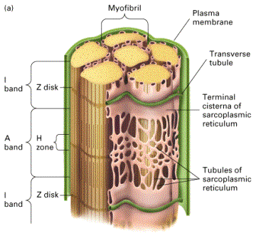
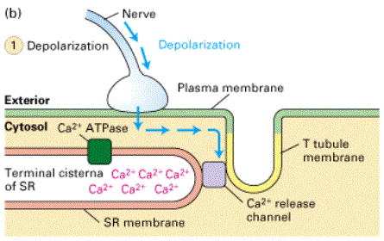
Calcium in muscle

Slide 5
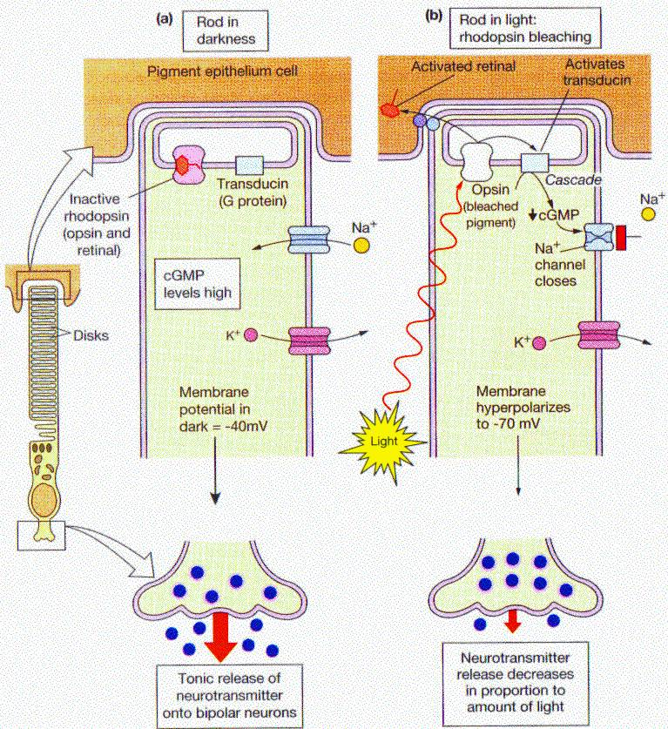
Calcium in phototransduction

Slide 6
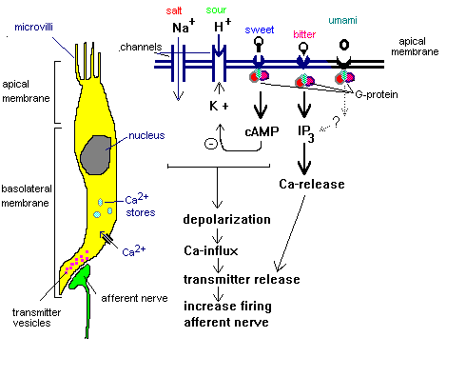
Calcium in taste receptors

Slide 7
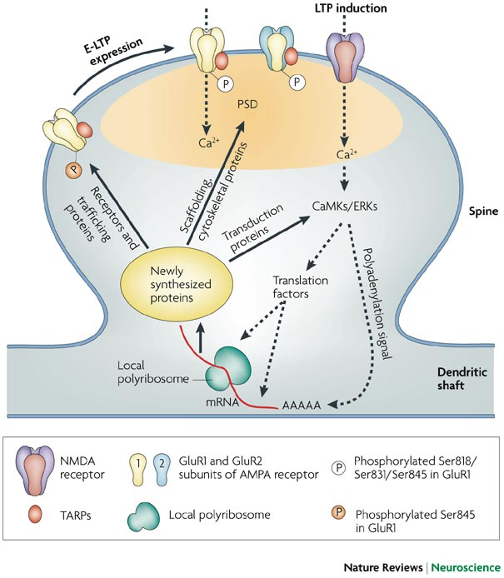
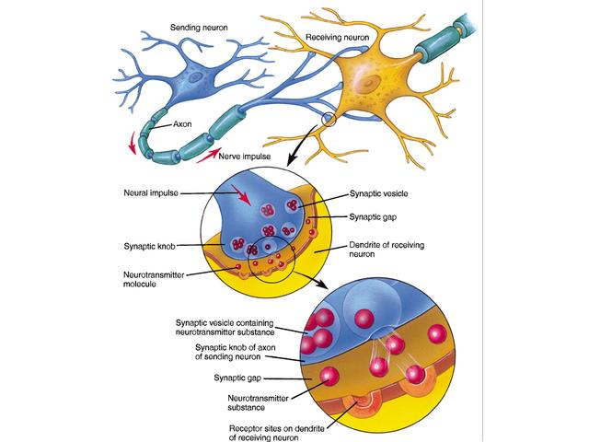

Calcium and synapses
Derkach et al. Nature Reviews Neuroscience 8, 101–113 (February 2007) | doi:10.1038/nrn2055

Slide 8
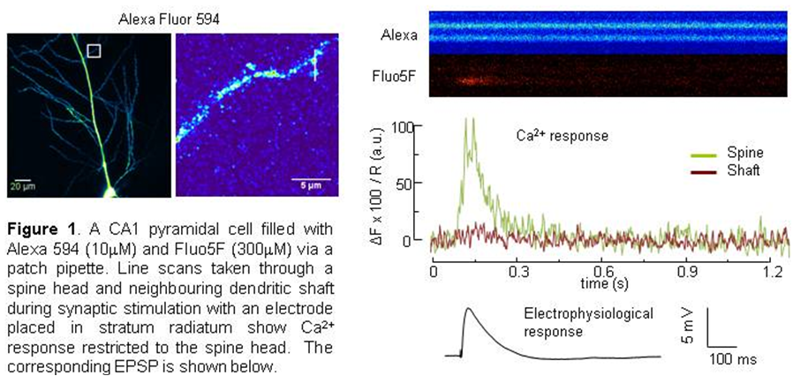
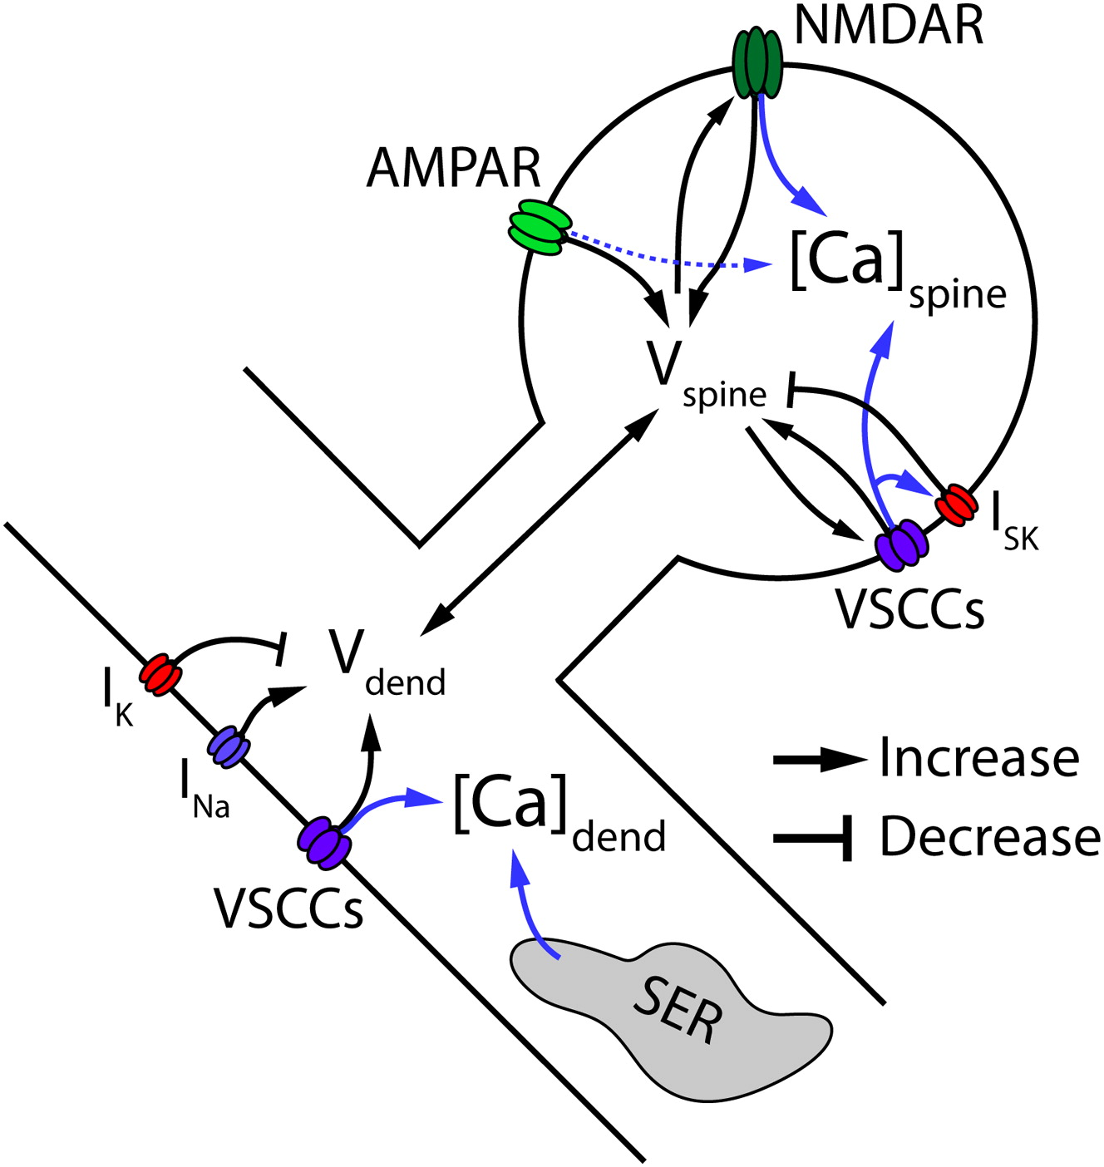
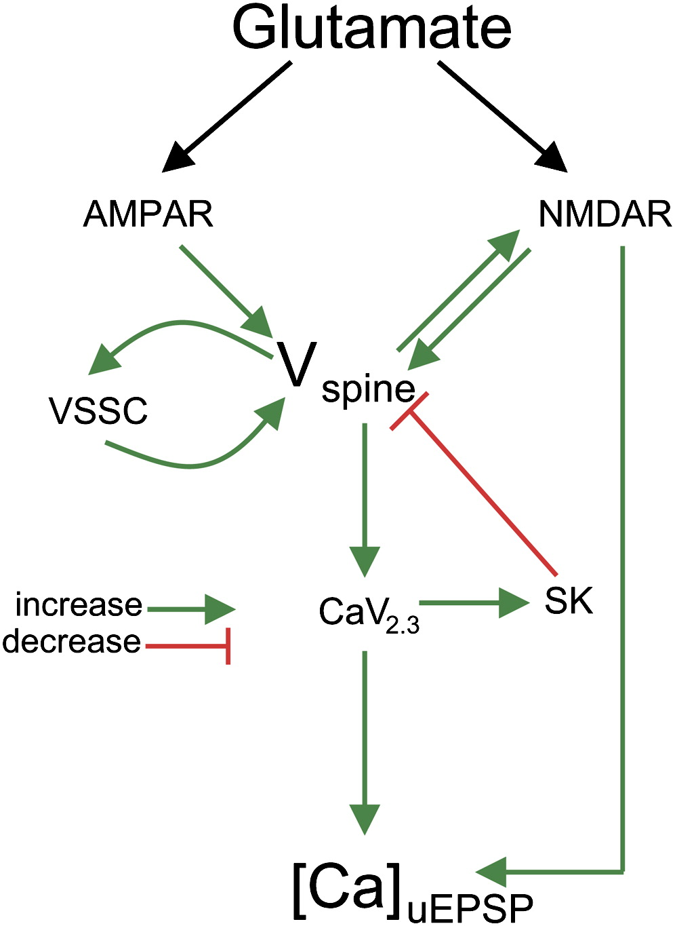
Cezar Tigaret
Jack Mellor
University of Bristol

Slide 9
Three principal mechanisms
Not dependent on membrane potential. Oscillations arise from recycling of calcium to and from internal stores (ER and mitochondria)
Inward flux of calcium through voltage-gated calcium channels. Dependent on fluctuations of the membrane potential.
Ryanodine
receptors
IP₃ receptors
Often seen in electrically excitable cells such as neurosecretory cells
Muscle cells and many neurons
Electrically non-excitable cells. Smooth muscle

Slide 10
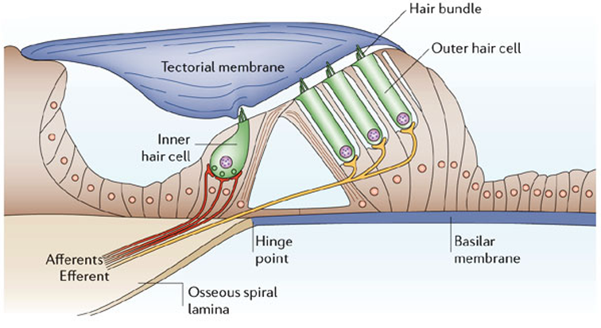
Calcium and auditory system
Inner hair cells are excitable sensory cells in the inner ear that encode acoustic information

Slide 11

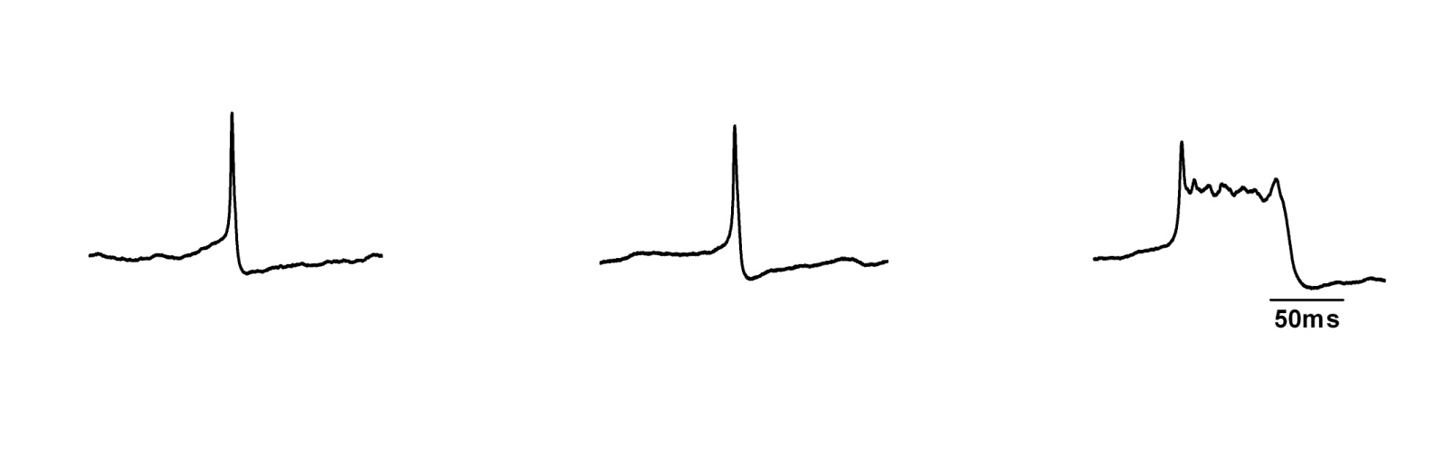
Calcium-based electrical activity
Voltage gated
Ca²⁺ channels
Ca²⁺ dependent K⁺ channel
I_{K(V)}
I_{K(v)}
[Ca²⁺]_{i}
K_{Ca}
K⁺
Voltage gated
Ca²⁺ channels
Ca²⁺
Courtesy of H. Kennedy
University of Bristol
During prolonged APs, Ca²⁺ spreads further into the cell

Slide 12
Time scale is of order of milliseconds
Time scale is of order of seconds
Typically found in endocrine cells and only some types of neurons

Slide 13
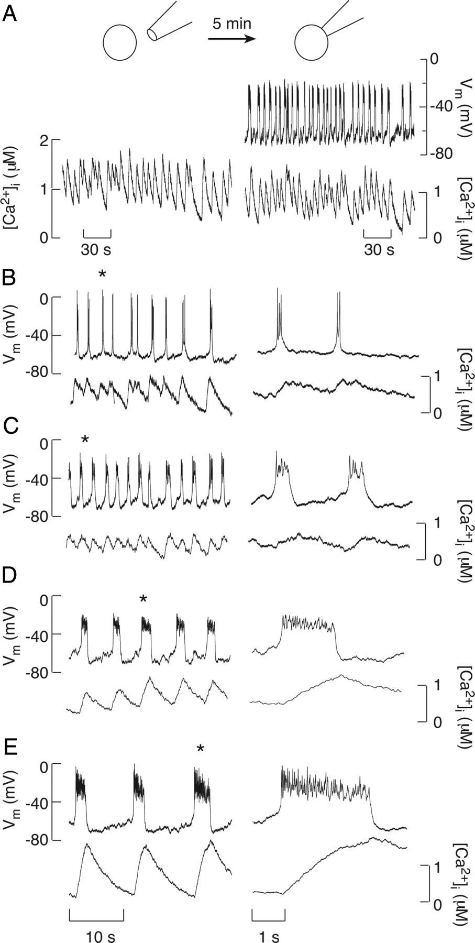
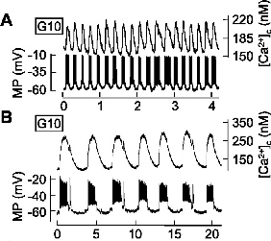
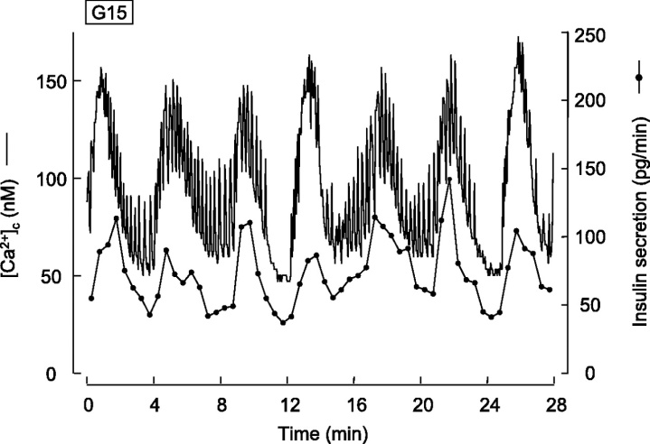
FIG. 2. Simultaneous measurements of Vm and [Ca²⁺]_{i}
oscillations in spontaneously firing somatotrophs
Fig. 2. Temporal correlation between membrane potential (MP) and [Ca²⁺]_{c} oscillations
Fig. 5. Mixed [Ca²⁺]_{c} oscillations trigger synchronous oscillations of insulin secretion

Slide 14
Time scale is of order of milliseconds
Time scale is of order of seconds

Slide 15
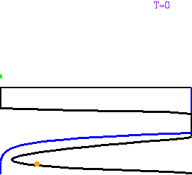
Bursting Mechanism
Fold-Homoclinic
Chay-Keizer Model
Morris-Lecar
β-cell Model
Fold-subHopf
Pituitary Cells Model
Inner Hair Cells Model

Slide 16
Adding BK current with Dynamic Clamp
V
I_{K}(V)
Patch clamp amplifier
(current clamp)
I
I_{BK}
IBTX
V
I_{BK}
Digitizer
I_{Ca}(V)
I_{SK}(Ca)
read V
compute
df/dt = (f∞(V)-V)/τ_{BK}
Computer
I_{BK} = g_{BK} × f × (V-V_{K})
write I_{BK}
Courtesy of J. Tabak
Florida State University, US
Original concept : Sharp et al, 1993
Implementation : QuB (Milescu et al, 2008)

Slide 17
Adding I_{BK} (fast) back with dynamic clamp restores bursting
Control
0
-
2
0
-
4
0
BK block
0
V (mV)
-
2
0
-
4
0
+ g_{BK} = 0.5 nS
0
-
2
0
-
4
0
1 sec
Notes:
Try increasing tau_ca: when does bursting stops
2 steps

Slide 18
Subtracting I_{BK} converts bursting into spiking
Control
0
V (mV)
-
20
-
40
- g_{BK} = 1 nS
0
V (mV)
-
20
-
40
1 sec
Courtesy of J. Tabak
Florida State University, US
Notes:
Try increasing tau_ca: when does bursting stops
2 steps

Slide 19
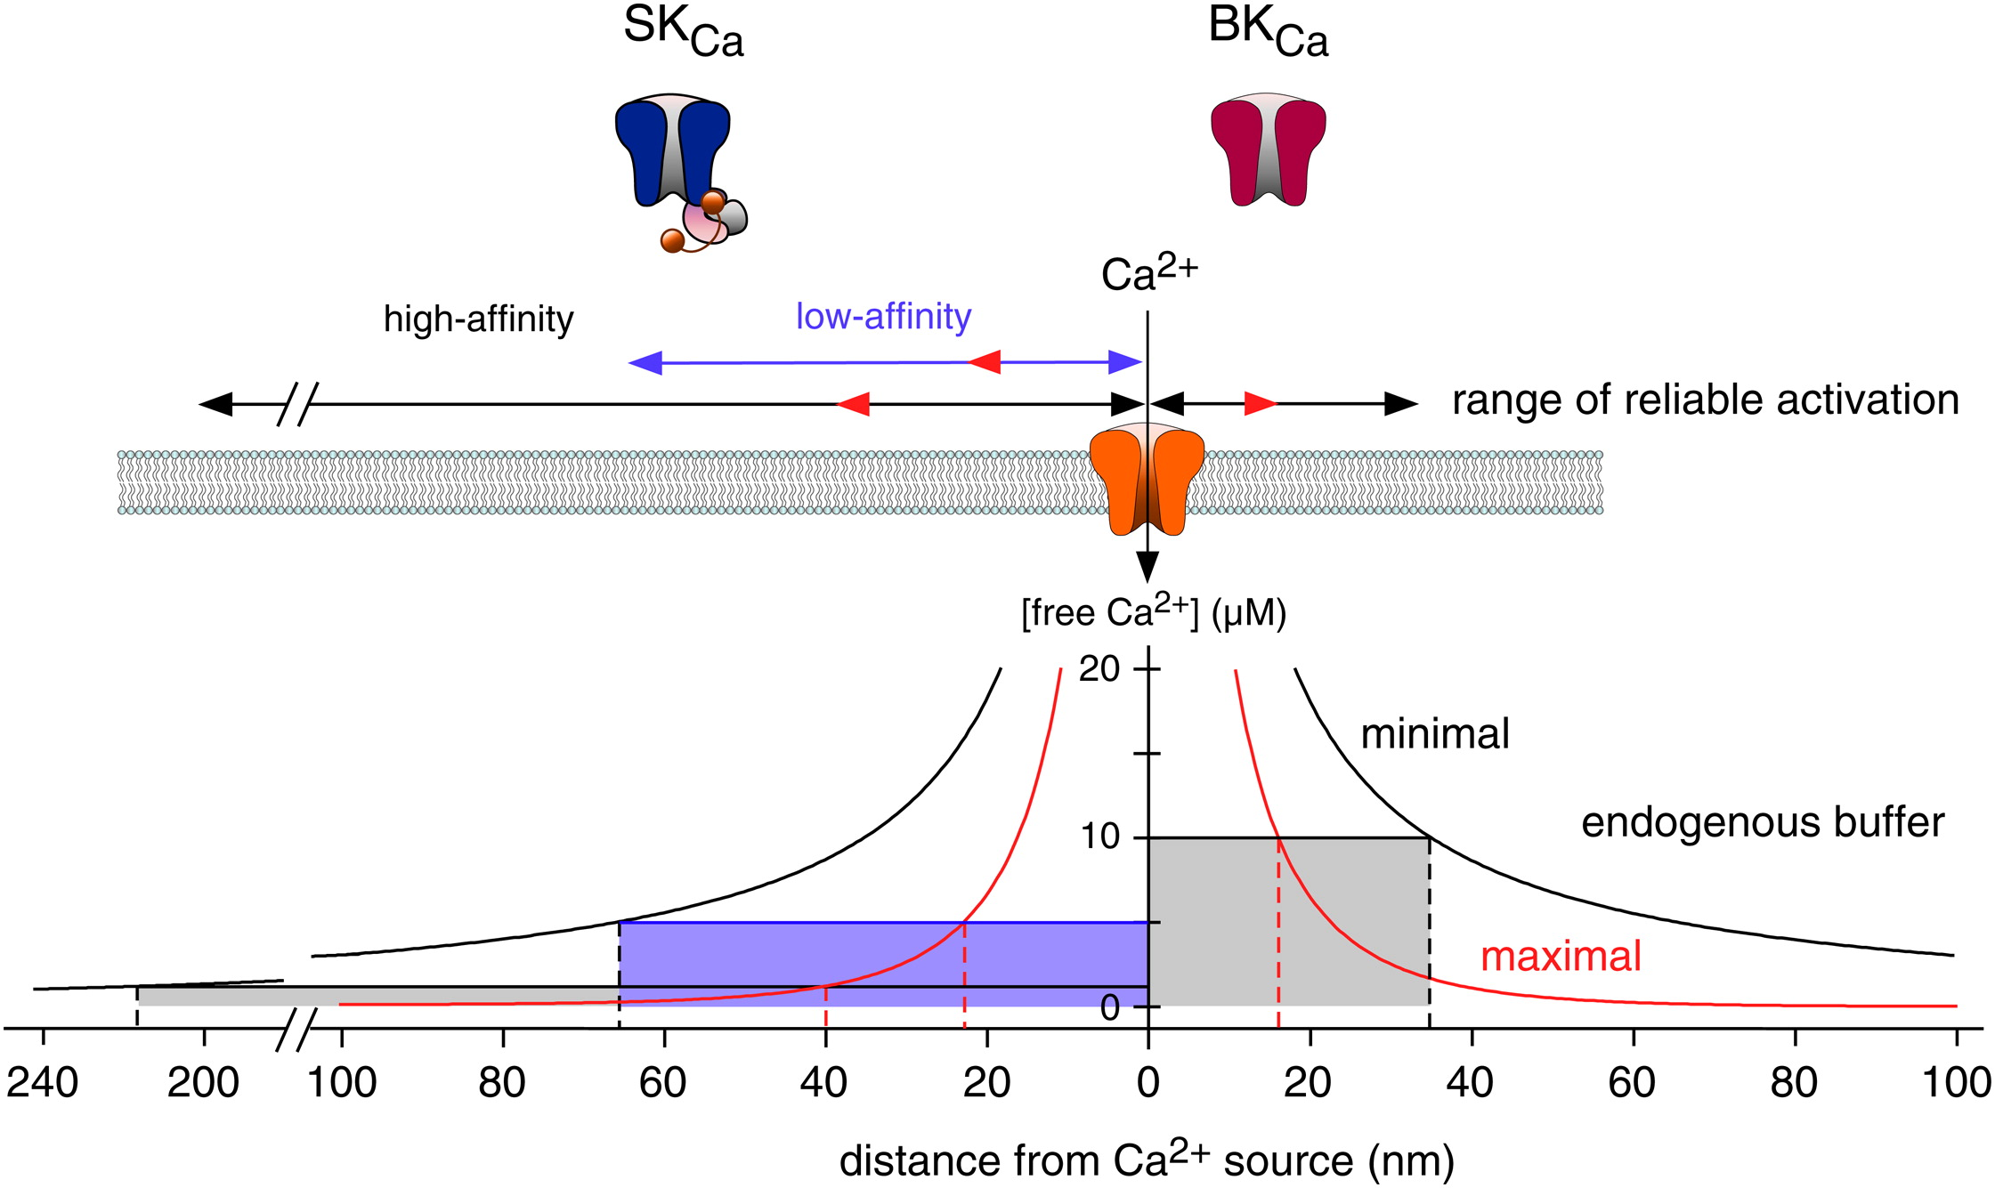
The challenge

Slide 20
Calcium buffering
Over 99% of all calcium in the cytoplasm is bound to large proteins, called calcium buffers
In other words, if 100 calcium ions enter the cell, less than 1, on average, ends up as a free ion in solution. The others all get bound to the buffers
It’s very important to understand how such buffers get included in models.

Slide 21
Slow buffering
k_{on}
Ca²⁺ + P
B
k_{off}
b_{t} is total buffer
If buffering is slow, this is just included as an extra term in the equation for c, as well as an additional equation for b. Thus

Slide 22
Fast buffering
If the buffer is assumed to be at pseudo-steady state (i.e., k_{on} and k_{off}
are large) then
Hence
But if we add the two PDEs in the previous slide, we get

Slide 23
Hence, it follows that
Oh dear. Buffers give a nasty nonlinear transport equation for
calcium.

Slide 24
Simple case
If the buffer doesn’t diffuse, and K>>c, then things simplify well.
Then the previous nasty equation just becomes
Buffering is now a simple scale factor, and all fluxes must be
interpreted as effective fluxes.
Often called fast, linear, buffering.

Slide 25
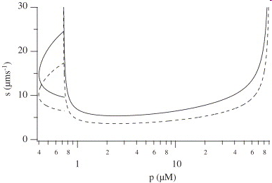
Travelling wave equation
The U-shaped curve is a curve of Hopf bifurcations, the C-shaped curve is a curve of homoclinic bifurcations.

Slide 26
Generic modelling
Total buffer
Set up a typical reaction diffusion equation for calcium:
ER fluxes
PM fluxes
mitochondrial
fluxes
buffering
This reaction-diffusion equation is coupled to a system of o.d.e.s (or p.d.e.s), describing the various receptor states, IP₃, the reaction and diffusion of the buffers, calcium inside the ER or mitochondria, or any other important species.
The specifics of the coupled o.d.e.s depend on which particular model is being used.
Sometimes the PM fluxes appear only as boundary conditions, sometimes not, depending on the exact assumptions made about the spatial properties of the cell.
In general the buffering flux is a sum of terms, describing buffering by multiple diffusing buffers.

Slide 27
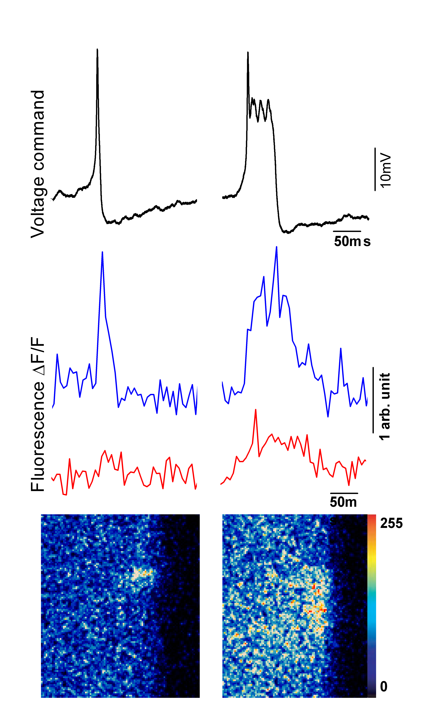
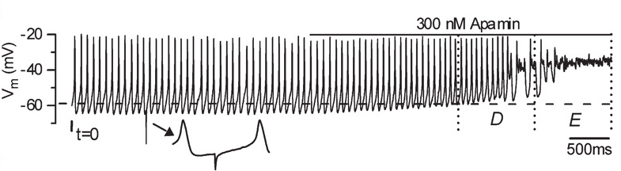
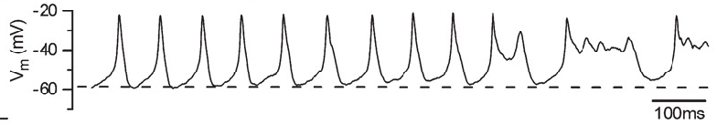
Ca²⁺ dependent K⁺ channels are responsible for APs repolarisation
(Marcotti et. al. J. Physiol. 2004)
Time (ms)
Helen Kennedy, University of Bristol

Slide 28
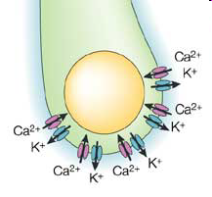
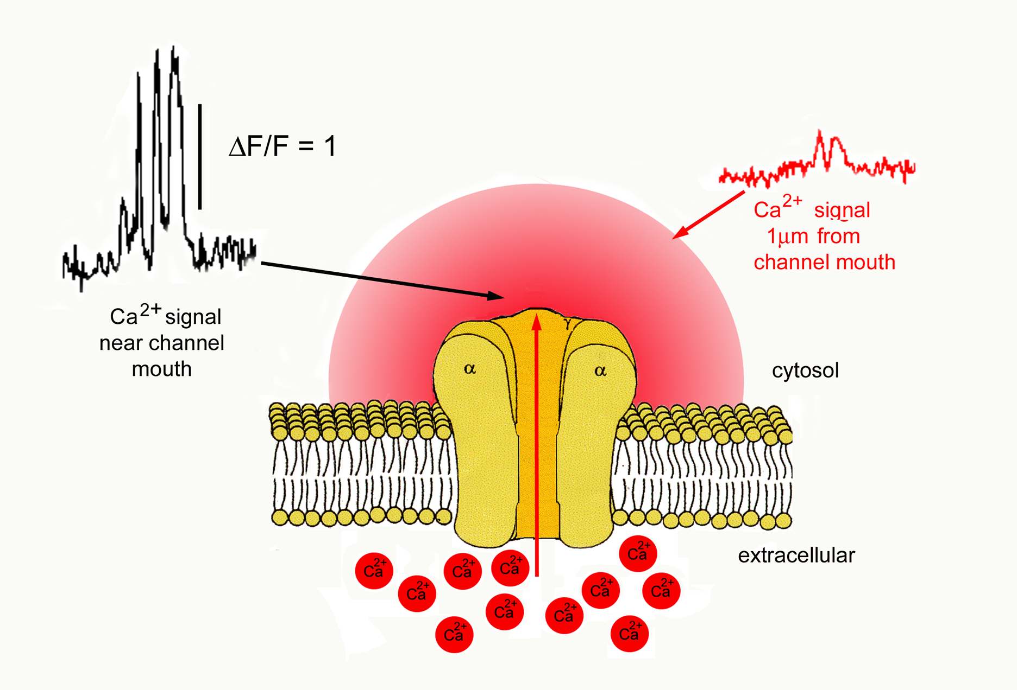
Boundary Conditions:

Slide 29
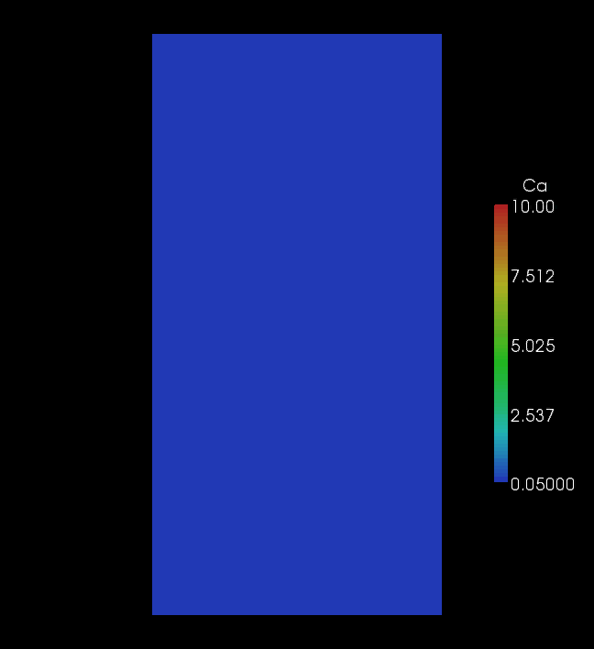

Slide 30
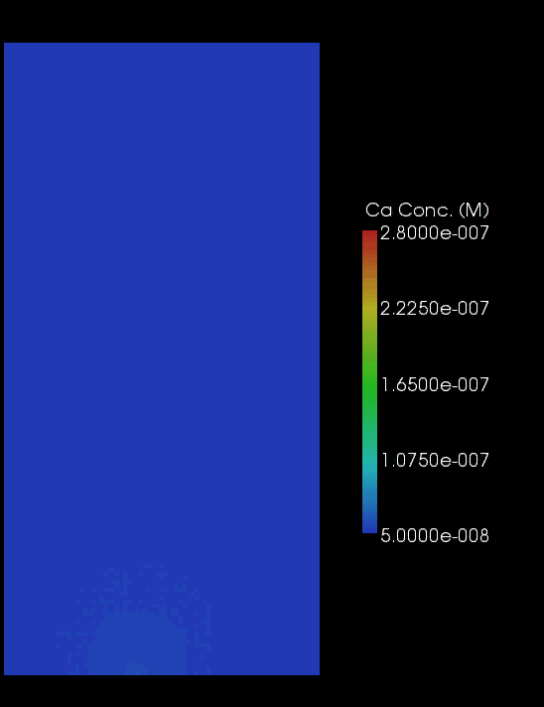
Ca²⁺ channel
K_{Ca} channel

Slide 31
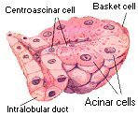

Calcium in pancreatic acinar cells
An intercellular wave of calcium in pancreatic acinar cell cluster.
From David Yule.

Slide 32
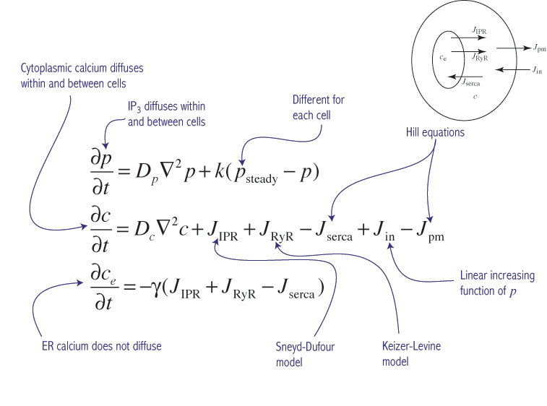
A typical example

Slide 33
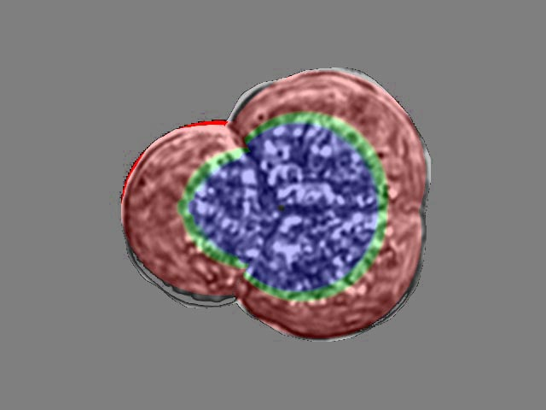
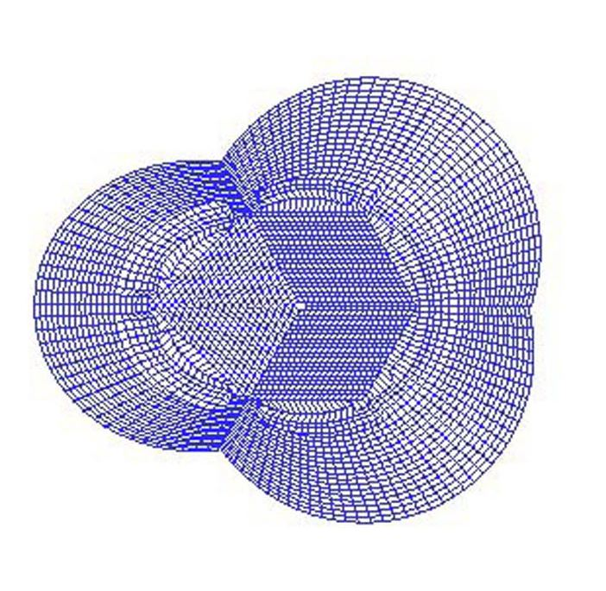
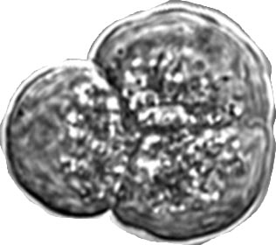
Question: coupled calcium oscillators
Three spatially distributed
coupled oscillators
Real image
FEM mesh
Apical Region
a
b
c
Mitochondrial buffer
Basal Region
Two dimensional model; no flux boundary conditions are applied on the external borders of each cell and the cells are connected by flux BC applied on the internal borders.
Question: How important is intercellular diffusion of Ca²⁺ and IP₃ for the coordination (or lack thereof) of the intercellular waves?

Slide 34

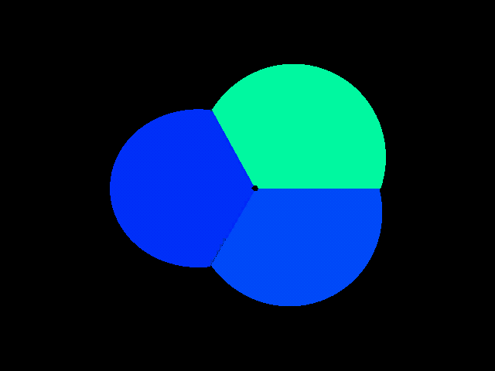
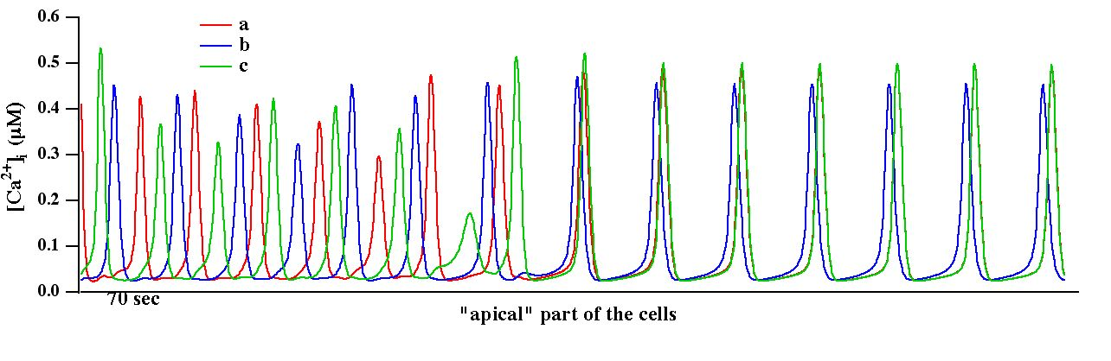
Identical cells
Cell Movie
Falls into the 2/1 pattern, where two go together with the third slightly out of phase. This seems to be a lot more stable.

Slide 35
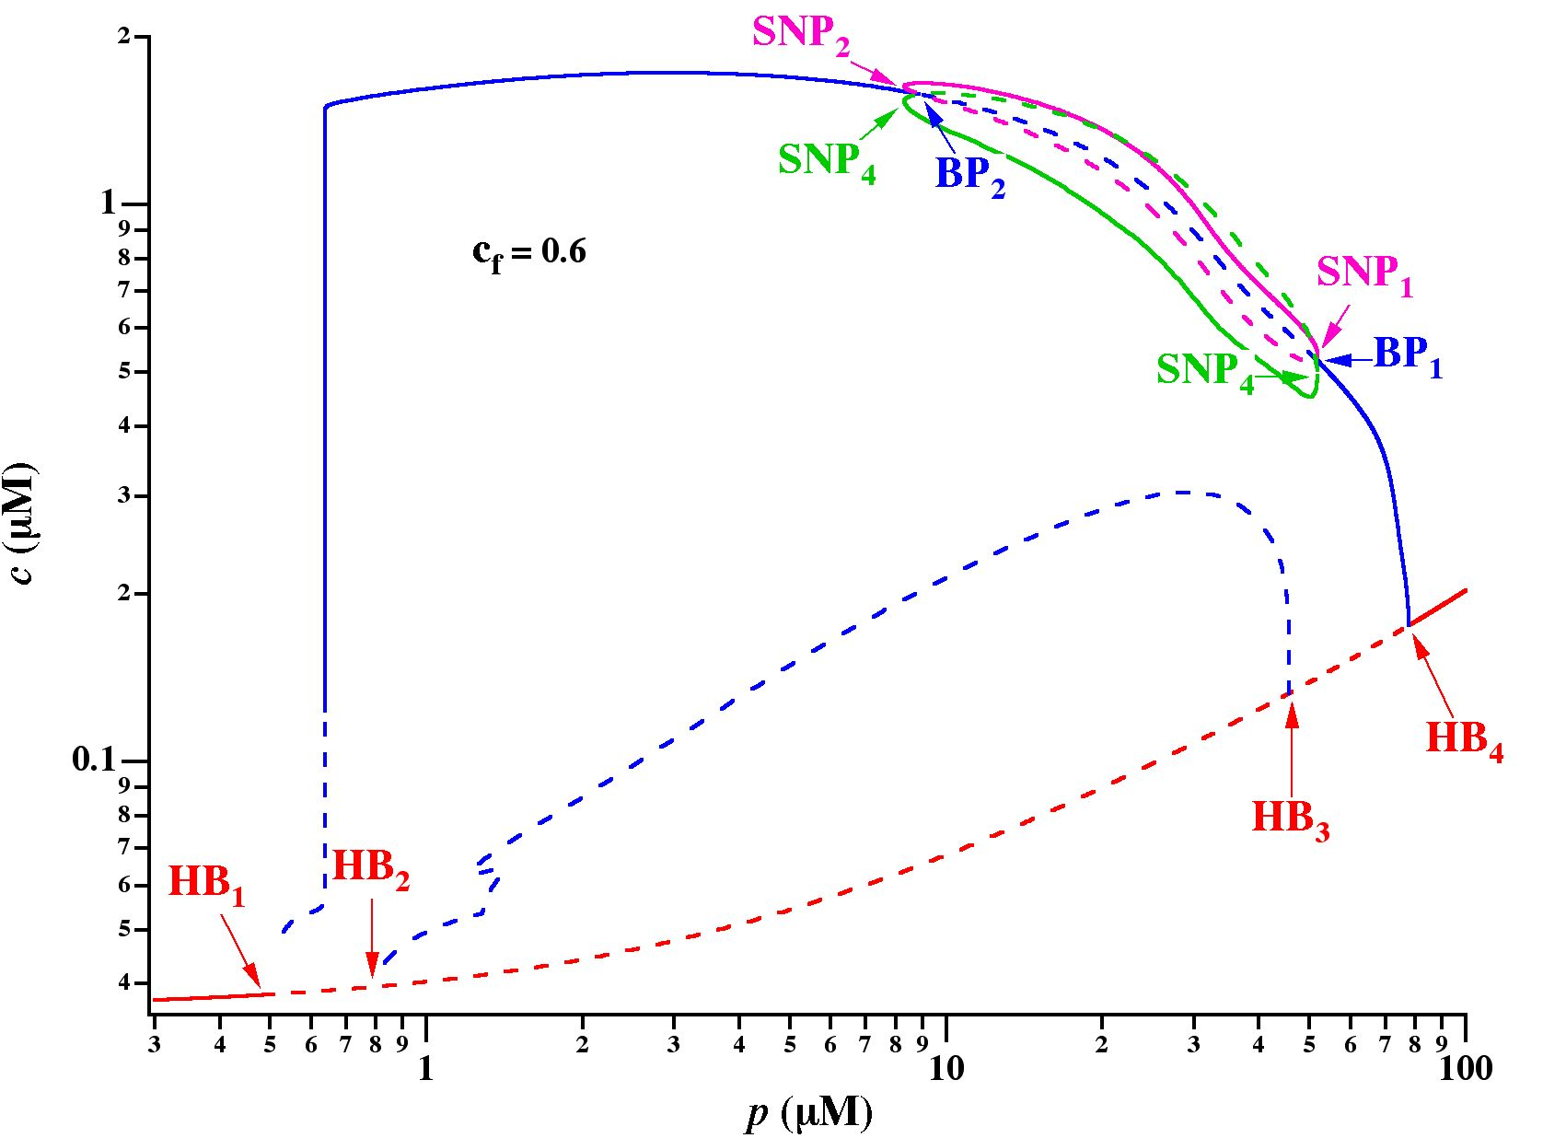
Insights from a point model
1
2
3

Slide 36
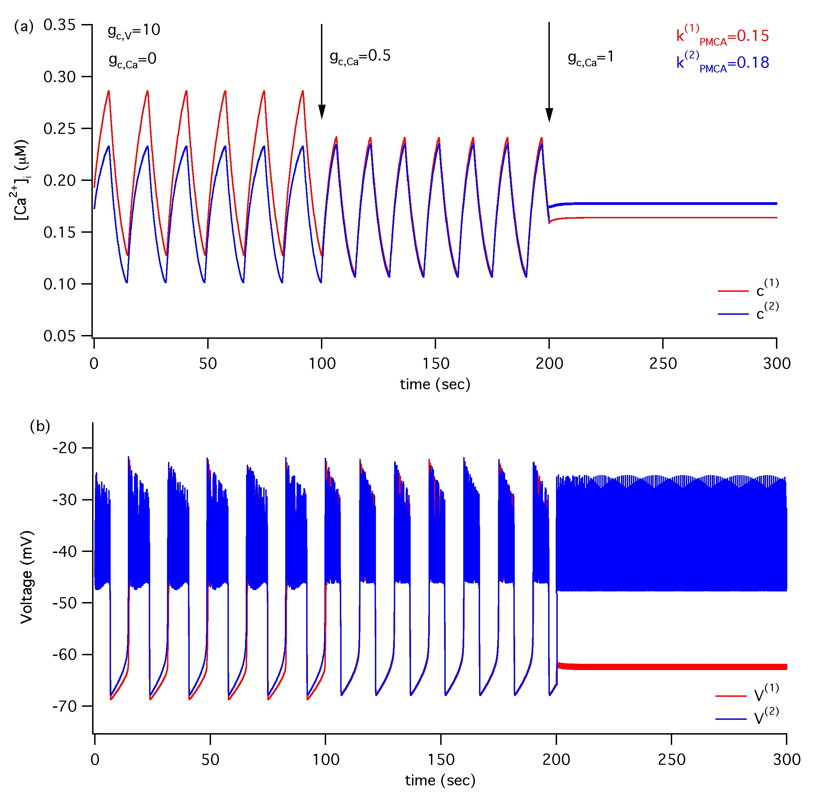
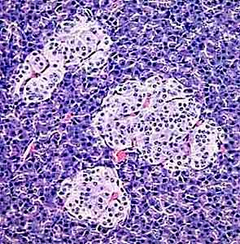
Ca²⁺ Coupling Can Kill the Oscillations
pancreatic
islets

Slide 37
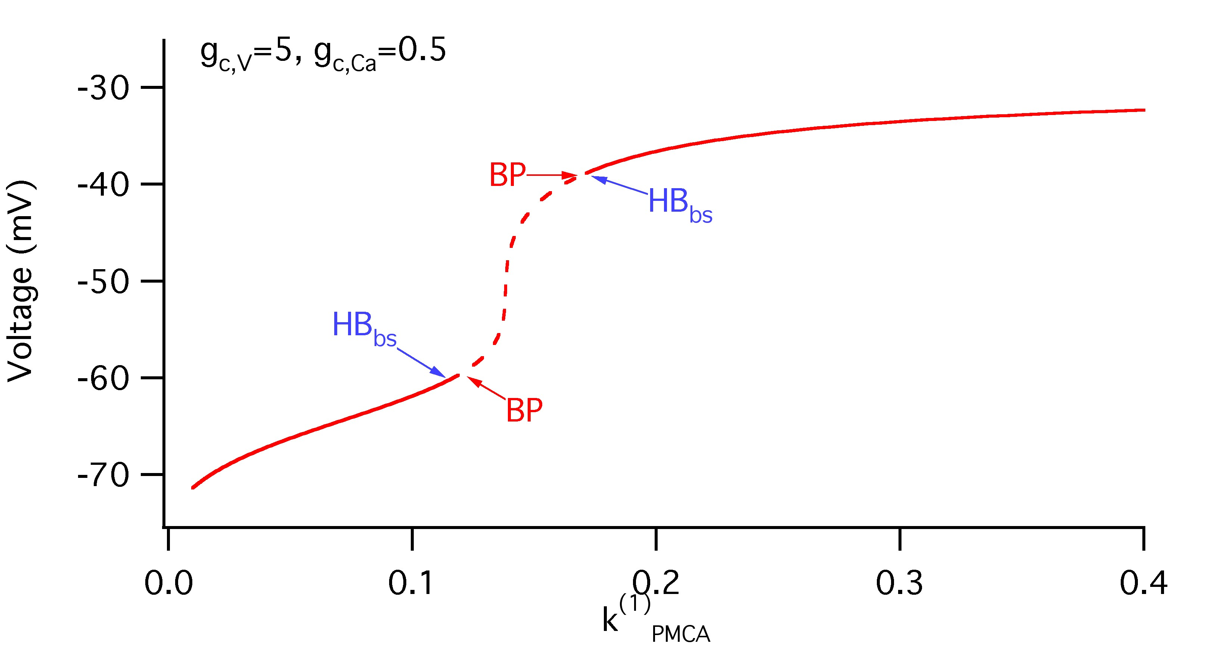
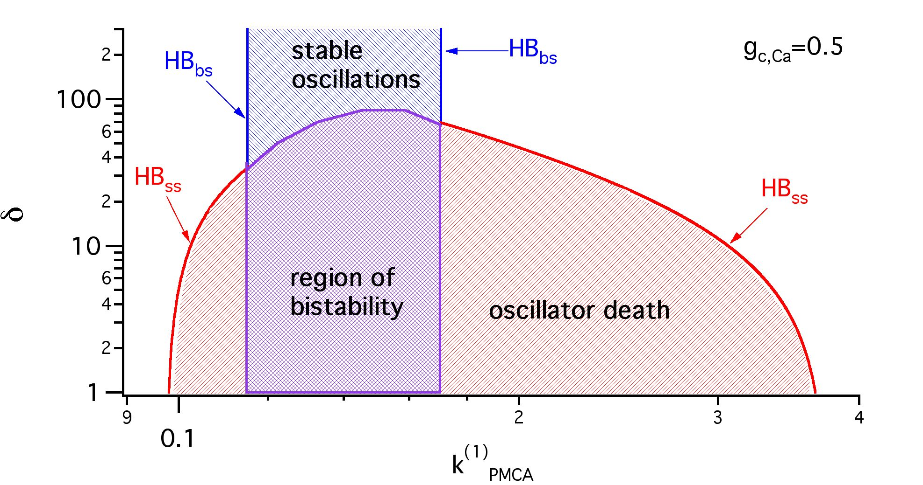
Oscillator Death in Coupled System of Identical β-cells

Slide 38
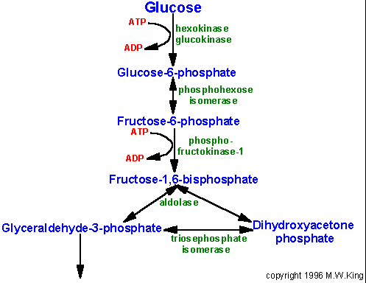
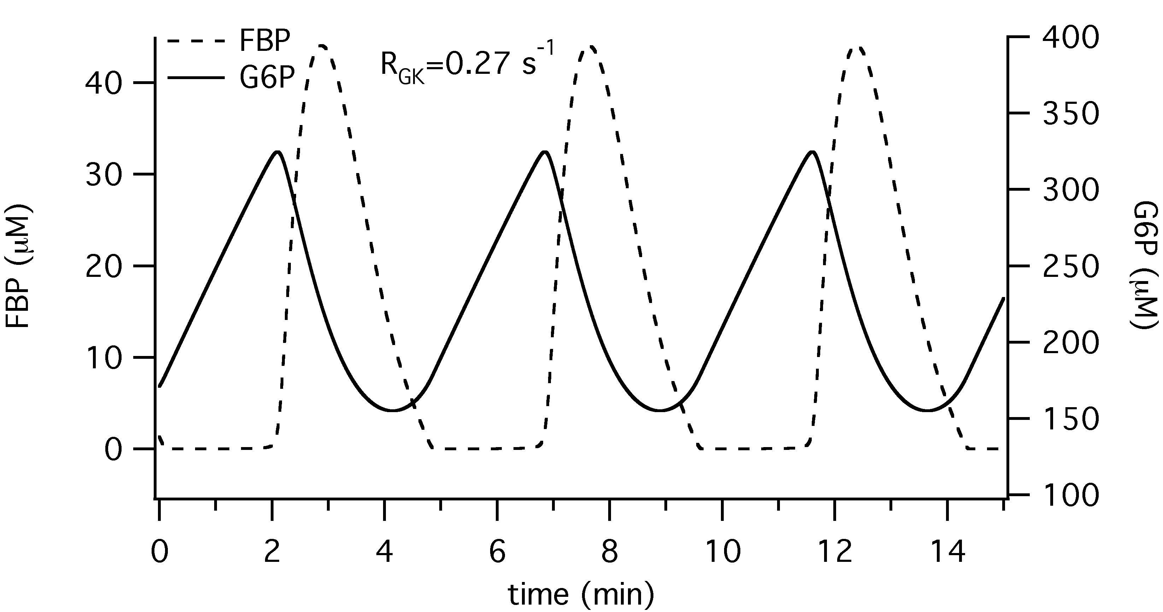
Glycolytic Oscillator
(G6P)
(FBP)
Pathway of glycolysis from glucose to pyruvate. Substrates and products are in blue, enzymes are in green. The two high energy intermediates whose oxidations are coupled to ATP synthesis are shown in red (1,3-bisphosphoglycerate and phosphoenol-pyruvate).

Slide 39
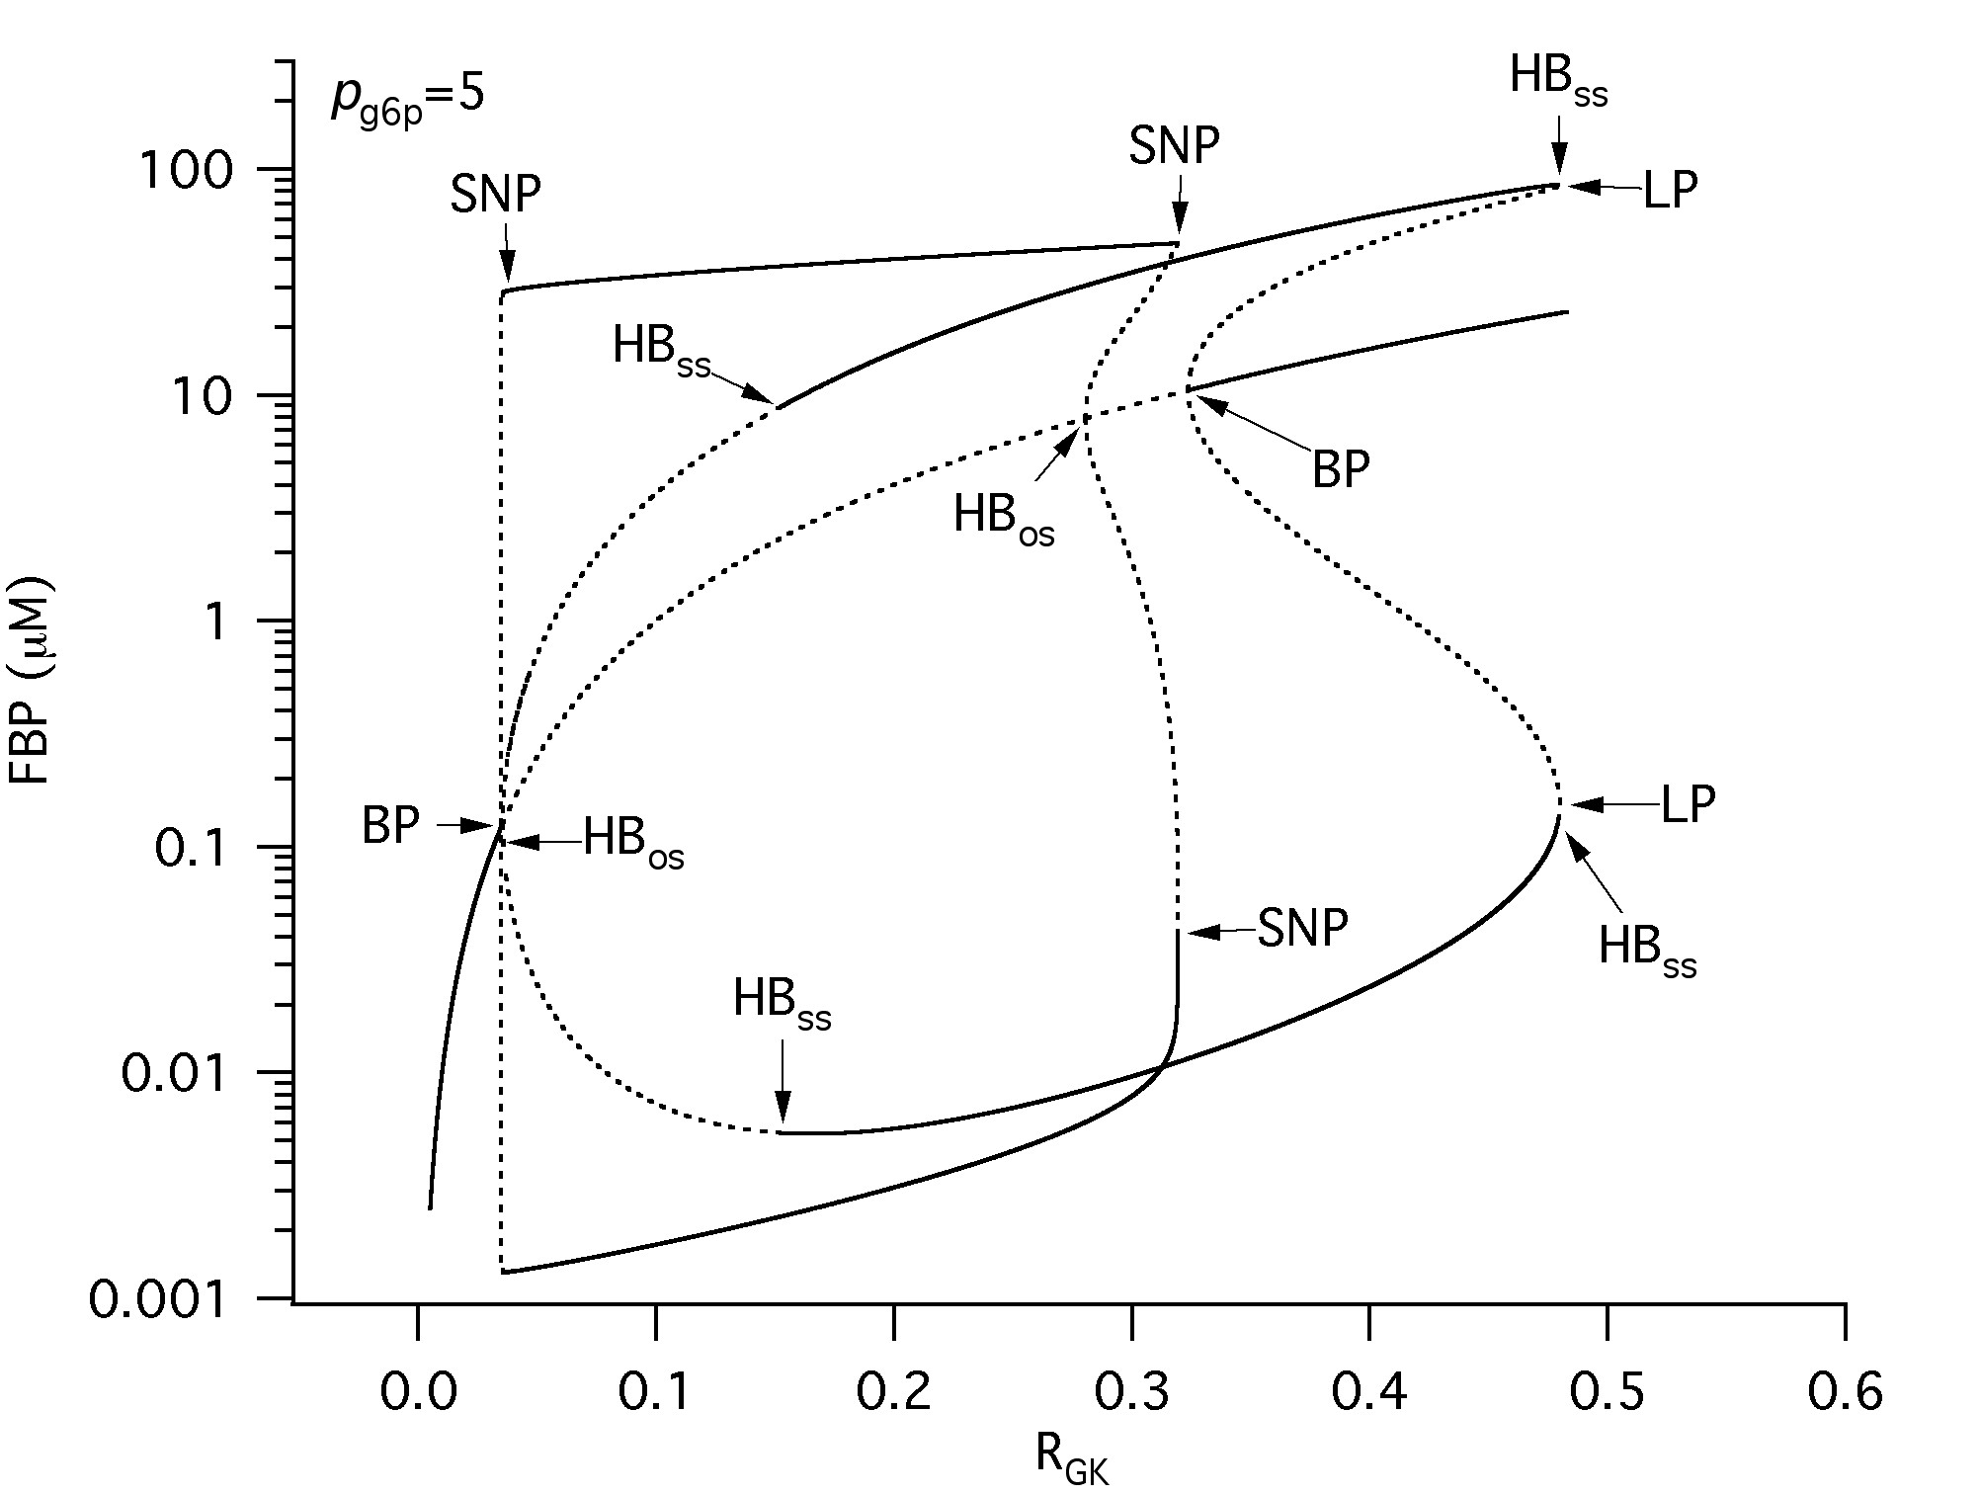
Coupled Glycolytic Oscillators

Slide 40
