Slide 1



Creating inclusive schools: research and practice

Slide 2
AGENDA
Morning - hybrid
09.30 - 09.45 Coffee and registration
09.45 – 10.00 Introduction to the Economic and Social Research Council Grant - Professor Adam Rutland
10.00 – 10.30 Assistant Professor Seçil Gönültaş - Challenging immigrant exclusion: group membership, similarity and self-efficacy, inclusion norms
10.30 - 11.00 Dr Ayşe Şule Yüksel - Postdoctoral Research Associate - Challenging immigrant exclusion: peer group norms, shared knowledge and stereotypes
11.00 - 11.15 Coffee break
11.15 - 11.55 Professor Melanie Killen - Promoting fair and just school environments: developing inclusive youth
11.55 - 12.35 Professor Peter Smith - Interventions to reduce school bullying
12.35 - 12.50 Dr Tracey Anne Warren - Postdoctoral Research Associate – professional reflections on the ESRC project
Wrapping up the morning session and answering questions from the audience - Professor Adam Rutland

Slide 3



Workshop: Creating Inclusive Schools - Research and Practice
Professor Adam Rutland

Slide 4



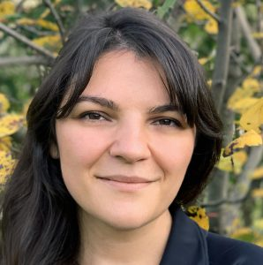


ESRC Research Grant: Bystander reactions to the intergroup exclusion of immigrants among British children and adolescents (2018-2022)
Principle Investigator – Professor Adam Rutland (2018-2022)
Postdoctoral Research Fellows & Graduate Research Assistant
Dr. Sally Palmer (July 2018 – September 2020)
Dr. Seçil Gönültaş (March 2021 – January 2022)
Dr. Ayşe Şule Yüksel (February – June 2022)
Dr. Tracey Anne Warren (February – June 2022)
Eirini Ketzitzidou Argyri (September 2019 – October 2021)

Slide 5

Social Exclusion
We do not want you to join our group because you are shy/awkward
(interpersonal)
We do not want you to join our group because you are from different country
(intergroup)
Exclusion is commonplace in many every peer group interactions
Exclusion is less overt and more ambiguous compared to other types of bullying
Intergroup exclusion typically has roots in prejudice, therefore needs a different intervention approach

Slide 6
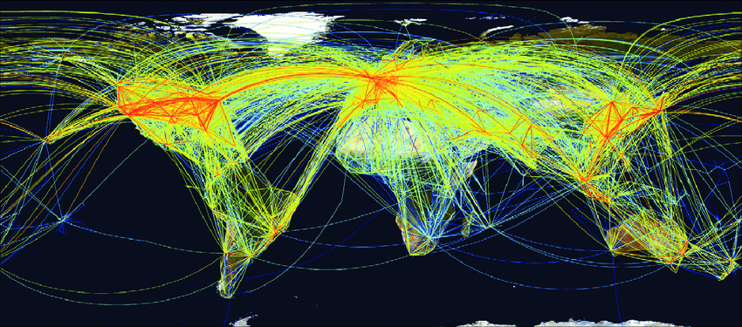
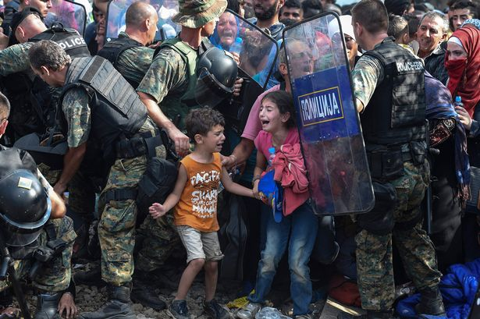
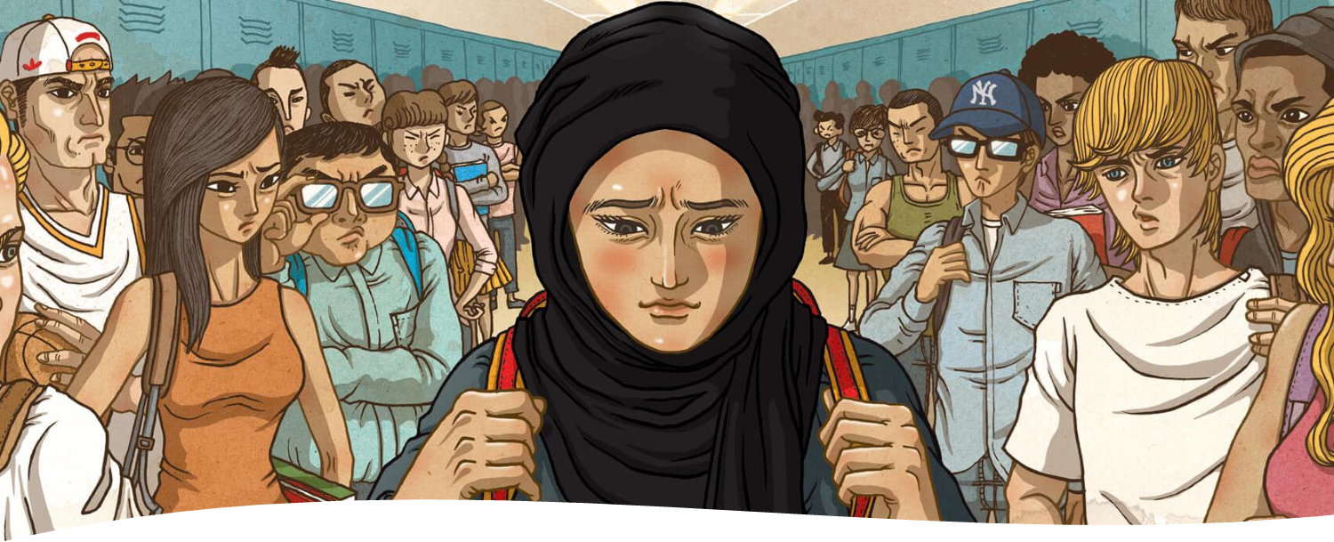
Increased global diversity, but also intergroup conflict & social exclusion of IMMIGRANTS (Brown et al, 2017; Gönültaş & Mulvey, 2019)
Notes:
I wish to look at bystander intervention in the context of immigrant social exclusion
Timely issue with…….title

Slide 7
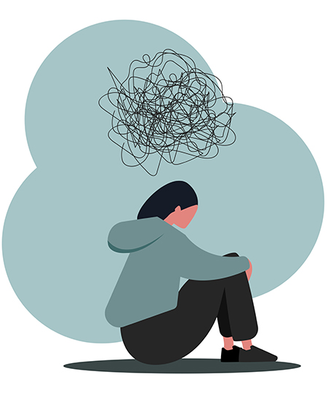



Consequences of peer group social exclusion
Life-long adverse outcomes (Killen & Rutland, 2011; Rodriguez-Hidalgo et al., 2014; Russell et al., 2012)
Depression
Low self-esteem
Loneliness & anxiety
School under-achievement
Notes:
Important and timely considering the global concerns around negative attitudes and behaviors towards immigrants

Slide 8
Goals of Grant
‘Take the child’s perspective’ – examine how they think and reason about the intergroup exclusion of immigrant
Focus on children and adolescents as active agents for change who can challenge the exclusion of immigrants
Make evidence-based recommendations about how bystander challenging can be promoted in childhood and adolescents to reduce prejudice-based exclusion of immigrants

Slide 9

‘Child as agents of change’ - So who is involved in social exclusion within peer groups?
Excluded
Excluder
Bystanders

Slide 10
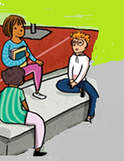
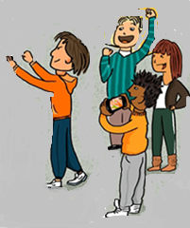

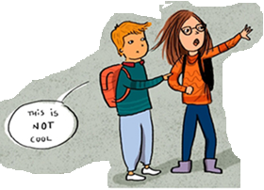
Let’s have a closer look to the bystander responses
Not involved and stay passive
Excluder
Supporters
Excluded Peer
Challenger

Slide 11

Bystanders – creating inclusive youth
spend much time in peer groups and peers often witness exclusion (‘bystanders’)
how bystanders respond is pivotal in reducing bullying, including social exclusion (Salmivalli, 2010)
Can bystander intervention reduce prejudice-based social exclusion?
First, need to understand when and why British children and adolescents as bystanders challenge or support the exclusion of immigrants within peer groups

Slide 12


Social Reasoning Developmental (SRD) model
children with age increasingly reason about everyday intergroup exclusion, whilst simultaneously considering and giving priority to various concerns…
Moral (e.g., fairness, equality, and rights)
Group (e.g., group identity, group norms, group dynamics)
Psychological (e.g., personal autonomy, intentionality or mental states)
Present children & adolescents with hypothetical scenarios of exclusion and ask them what they think and would do as bystanders? Series of experiments
Killen & Rutland, 2011, 2017; Rutland et al, 2010
Notes:
I began to change my view of prejudice development when I started to talk to and work with Melanie
As she explained we have developed the SRD model of social exclusion & prejudice
Broadened our notion of the child as being active – reasoning based on different concerns…We contend…..CLICK

Slide 13


results should be beneficial in terms of understanding how students think and feel around the issue of immigration
identify what factors can facilitate everyday peer group interactions which foster inclusive and cohesive schools, which are vital for the social-emotional well-being of all students, as well as their academic engagement
inform educational policy and practice, especially what factors encourage children and adolescents to become bystander challengers in schools

Slide 14

Challenging Immigrant Exclusion: Group Membership, Perceived Similarity, Self-Efficacy, and Peers’ Inclusion Norms
Presenter:
Seçil Gönültaş

Slide 15
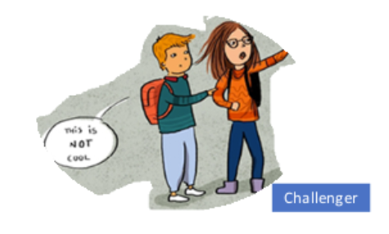

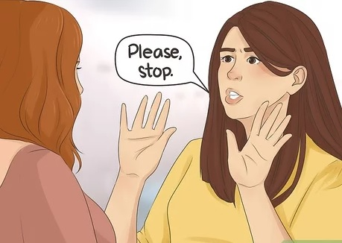

Peers who Challenge Social Exclusion
Challengers can serve as central actors to offset both the occurrence and effects of social exclusion
What do you think about the challenger?
How do you respond to social exclusion as a bystander?
What does your group think about the challenger?
Notes:
As Adam introduced Challengers can serve as central actors to offset both the occurrence and effects of social exclusion
So, it is important to motive children and adolescents to be a challenger when they witness social exclusion
To do that, first we need to learn how children and adolescents perceive their challenger peers.
And we can learn their perceptions about challenger and challenging behaviors by asking questions like ……………………

Slide 16
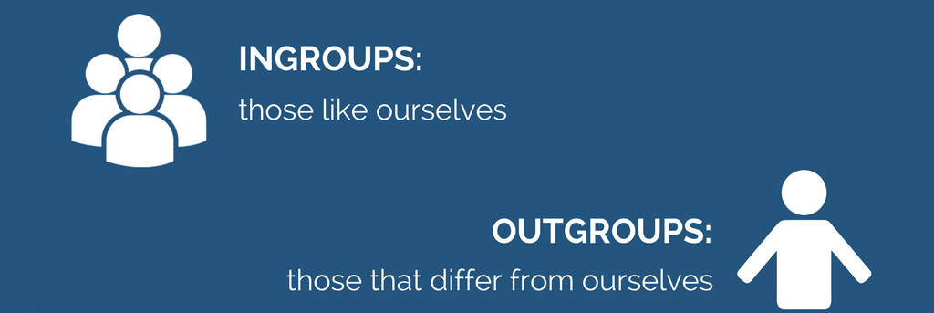



Factors in Evaluations of Challengers and Bystander Responses
Group Membership
Self-efficacy
Perceived Similarity
Inclusion-
exclusion peer norms
Notes:
While answering such questions about challenging, children and adolescents' evaluations and responses can be affected by some factors.
In our project, we wanted to examine potential factors. Imagine this as a puzzle. And throughout our project we tried to identify some of the pieces to understand complex nature of social exclusion and challenging behavior.
As a first factor, we wanted to understand whether group membership in our case nationality or immigration status of the victim effects children and adolescents' responses. It is known that children and adolescents are more likely to help when the victim is from their ingroup members.
Second, we wanted to understand how perceived similarity with the excluded peer (which means the likelihood of perceiving excluded peers as similar or dissimilar to their groups). So, it is possible that children and adolescents can be more likely to help to similar peers compared to dissimilar ones .
Third, children’s and adolescents’ feeling of confidence in themselves to defend the excluded peer, that we called self efficacy in challenging can be another factor. In other words, if children and adolescents believe that they can stop the excluder, help the excluded peer, they can be more actively intervene in social exclusion to stop it.
And lastly, children and adolescents can be affected by their peer groups and norms. For example, if their peers are inclusive for everyone like if they are inviting everyone to their play, then children and adolescents in such peer context can be also more inclusive and challenge if they witness social exclusion.

Slide 17
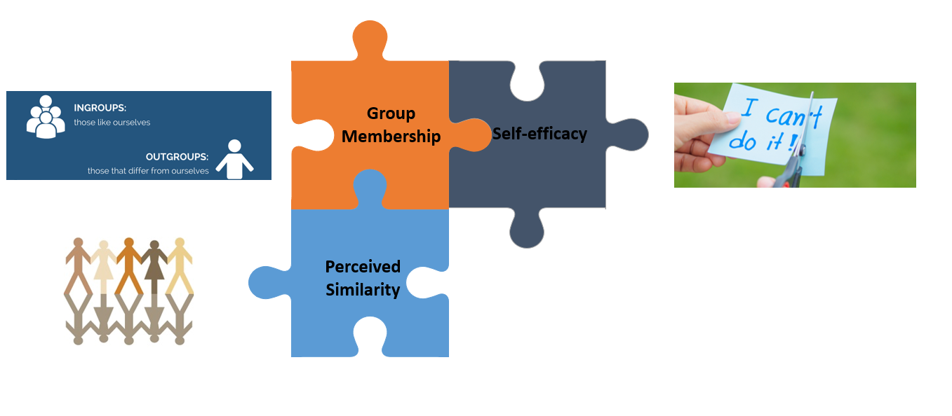
Study 1- Aim and Participants
To understand how nationality of the excluded peer, perceived similarity, and self-efficacy are related to the evaluations of challenger and bystander responses
British children (n = 110, 8-11 years) and adolescents (n = 193, 13-16 years)
Gönültaş et al., in press
Notes:
So, together in our first study, we aimed to understand…….
We collected data from British children and adolescents in their classrooms. They individually filled our surveys from their laptops.

Slide 18
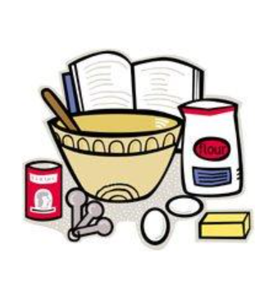

Study 1- Hypothetical Scenario for Social Exclusion
Imagine that your British friends chose to do an activity that involves cooking and baking food that is popular in Britain.
Notes:
Our survey starts with a hypothetical scenario in which children and adolescents were introduced a gender matched British friend group.
And then they introduced an activity that involves cooking and baking food that is popular in Britain.

Slide 19




Study 1- Hypothetical Scenario for Social Exclusion
Newcomer
Jamie was born in Britain. She recently moved from another city with her family to live here.
Charlie was born in Australia. She recently moved from Australia with her family to live here.
Deniz was born in Turkey. She recently moved from Turkey with her family to live here.
Notes:
And then they were introduced a newcomer who wants to join cooking club.
As we wanted to see how nationality of the excluded peer might be related to children and adolescents' evaluations and responses,
some of our participants read that the newcomer was born in Britain and moved from another city.
And some of our participants read that the newcomer was born in Australia and moved from there
and some of participants read that the newcomer moved from Turkey.

Slide 20


Study 1- Hypothetical Scenario for Social Exclusion
Excluder
Challenger
Sam, who is in your British group of friends, says to the newcomer: ‘We don't want you to join our group because you are from somewhere else - you're different.’
Alex who is in your British group of friends disagrees with Sam. Alex thinks that your group should invite the newcomer to cook with them.
Notes:
Then all participants read about an excluder peer Sam says to the newcomer that We don't want you to join our group because you are from somewhere else - you're different.’
Then they were introduced a challenger member, Alex, who disagrees with Sam and think that the group should invite the newcomer.

Slide 21
Excluded newcomer
Excluder
Challenger

Slide 22
Study 1- Evaluation of Challengers as Outcome Measures
Individual evaluation:
How OK or not OK was it for Alex to say that we should include the newcomer?
(from 1 (Really not OK) to 6 (Really OK)
Group evaluation:
How OK or not OK does your group think that Alex says that we should include the newcomer?
(from 1 (Really not OK) to 6 (Really OK)
Why?
Why?
Notes:
After all these scenarios we asked some questions to understand how children and adolescents evaluate the challenger.
Open-ended why questions.
So, for example, if children thinks that Alex’s challenging behavior is really okay, we asked them why it is really okay to see their justifications.

Slide 23
Study 1- Results for Evaluations of Challengers
non-immigrant
immigrant
VS
>
>
Adolescents
Children
Children report more positive individual evaluations compared to their group evaluation only when the excluded peer was non-immigrant
Adolescents were more likely to be positive towards the challenger and to think that their peers would be supportive of the challenger compared to children when the excluded peer was immigrant
British adolescents are more likely than children to support bystanders who challenge exclusion of immigrant peers
    being more aware of prejudice and discrimination as underlying reason
Notes:
First, we wanted to understand children and adolescents' evaluations will change based on whether the newcomer is immigrant or not.
What we found is children’s individual evaluations were more positive than their group evaluations of challenger when the newcomer was British.
This means that they can differentiate between their own and their groups perceptions when the newcomer is British.
However, they can not differentiate their evaluations from their groups evaluations if the newcomer is immigrant.
But adolescents were always more positive for the challenger compared to their groups regardless of whether the newcomer is non-immigrant or immigrant.
Further, what we found is that adolescents compared to children were more positive for the challenger when the excluded peer was immigrant
What those results tell us that British adolescents are more likely than children to support bystanders who challenge exclusion of immigrant peers.
This can be explained by adolescents being more aware of prejudice and discrimination as underlying reasons of social exclusion

Slide 24
Study 1- Results for Evaluations of Challengers
Reasoning
Individual evaluations of the challenger
When the excluded peer was immigrant:
Children were more likely to use “social and group norms” than “fairness, rights, and equality”
Adolescents use these categories similarly regardless of nationality of the excluded peer
‘it depends on what the rest of the group thinks as well’
Children differentiate justifications based on the immigration status of the excluded peer
Notes:
Children, compared to adolescents, were more likely to reason about social and group norms to justify their evaluations only when the excluded peer was an immigrant but not when the excluded peer was British.

Slide 25
Study 1- Results for Evaluations of Challengers
Reasoning
Perceived group evaluation of the challenger as Positive:
more likely to use “fairness, rights, and equality” than “group dynamics/functions”
‘because other people in the group also think that it’s just unfair to exclude someone’

Slide 26
Study 1- Perceived Similarity and Self-efficacy
Perceived Similarity
Self-efficacy
e.g., “How easy or difficult would it be to: Comfort [EXCLUDED]; Encourage [EXCLUDED] to speak to a teacher about being left out”
e.g., “How much are British people and immigrants similar or different in what they like?”
from 1 (Completely different) to 4 (Completely same)
from 1 (Very difficult for me) to 5 (Very easy for me)
Palmer et al., in press
Notes:
We also measure their perceived similarity with the immigrants through self report by asking questions like
And similarly we measured their self efficacy in defending with self report by asking questions like

Slide 27
Study 1- Bystander Responses as Outcome Measures
Direct challenging
e.g., tell [excluder] they should have included the newcomer; tell the newcomer you didn't agree with the excluder
Notes:
In the same study, we also examined children and adolescents bystander responses. How likely they would directly or indirectly challenge the excluder.

Slide 28
Study 1- Results for Bystander Responses
similar
dissimilar
VS
Children
Adolescents
More likely to challenge the social exclusion when the excluded peer was similar compared to dissimilar
no difference
children showed more challenging for British/Australian excluded peers BUT adolescents showed similar challenging responses irrespective of the excluded peer’s nationality
Notes:
We examined how they are going to respond when the excluded peer was similar or dissimilar peer.

Slide 29
Study 1- Results for Bystander Responses
When the excluded peer was dissimilar to ingroup (Turkish)
perceived similarity
Age
Challenging
self-efficacy
Notes:
When the excluded peer was Turkish
With age ---participants reported higher perceived similarity with the immigrants and higher self-efficacy to be a challenger which in turn lead more challenging intentions.
What does it mean that perceiving someone as similar to your group and feeling that you can defend someone when you observe a social conflict, all these two are helpful to increase active challenging responses.

Slide 30


Study 1- Take away messages
nationality of the excluded peer is related to evaluations and bystander responses, especially in children
the similarities between national ingroup and immigrant outgroups should be emphasized
  similarities rather than dissimilarities
the belief that children and adolescents can effectively challenge excluder peers should be encouraged
we need to start early to encourage children to think about similarities and to believe themselves in challenging
for inclusive schools
Notes:
Our results showed that nationality of the excluded peer shapes evaluations and bystander responses, especially in children
We also found that perceived similarity does matter---which suggest that the similarities between national ingroup and immigrant outgroups should be emphasized
As we also found that self efficacy does matter----the belief that children and adolescents can effectively challenge excluder peers should be encouraged
And since those two, perceived similarity and self efficacy—increase with age---

Slide 31
Factors in Evaluations of Challenger and Bystander Responses
Group Membership
Self-efficacy
Perceived Similarity
Inclusion/exclusion peer norms

Slide 32

Inclusive and Exclusive Peer Group Norms
  Supporting inclusive norms is related to promoting positive attitudes (McGuire et al., 2015; Nesdale & Lawson, 2011)
  From childhood into adolescence, the importance of peer groups increases greatly (Brechwald & Prinstein, 2011; Brown & Larson, 2009).
Group norms about inclusion and exclusion
Ingroup Norms
Outgroup Norms
Notes:
Inclusive norms are related to promote positive attituded towards outgroups
Which means for example if children and adolescents are surrounded by peers who are inclusive for immigrants they are also more likely to show inclusion tendencies
And also we know from studies that the importance of peer group norms increases greatly from childhood into adolescence.
And if we consider intergroup interactions as a two-way street, it likely that both ingroup norms and outgroups norms can matter. So again from similar example it is not only about what your peers think about immigrants but also about what immigrants think about your group.

Slide 33
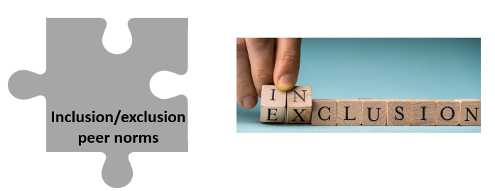
Study 2- Aim and Participants
To understand how inclusive/exclusive ingroup and outgroup norms might shape adolescents’ evaluations of the challenger and their bystander responses in the context of intergroup social exclusion
British early adolescents (n = 209, 9-13 years) and British late adolescents (n = 224, 15-18 years)
Gönültaş et al., in preparation

Slide 34
Study 2- Hypothetical Scenario and Norm Manipulation
British peers are being exclusive toward dissimilar groups
Outgroup
Immigrant peers are being inclusive toward everyone
Immigrant peers are being exclusive toward dissimilar groups
British peers are being inclusive toward everyone
Ingroup
Notes:
I will briefly summarize very similar method that we used in the previous study. They read that either their ingroup members are inclusive or exclusive
And they read either their outgroups are inclusive or exclusive

Slide 35
Study 2- Hypothetical Scenario for Social Exclusion
Newcomer
Imagine that your British friends chose to do an activity that involves cooking and baking food that is popular in Britain.
There’s a new student who has come along to your group’s cooking club and wants
to join in. Deniz was born in Turkey. She recently moved from Turkey with her family to live in Britain.
Notes:
They presented with the similar after school activity and a new comer who was born in Turkey and recently moved from Turkey and wants to join in.

Slide 36
Study 2- Hypothetical Scenario for Social Exclusion
Excluder
Challenger
Sam, who is in your British group of friends, says to the newcomer: ‘We don't want you to join our group because you are from somewhere else - you're different.’
Alex who is in your British group of friends disagrees with Sam. Alex thinks that your group should invite the newcomer to cook with them.

Slide 37
Study 2- Evaluation of Challengers as Outcome Measures
Individual evaluation:
How OK or not OK was it for Alex to say that we should include the newcomer?
Group evaluation:
How OK or not OK does your group think that Alex says that we should include the newcomer?

Slide 38

Study 2- Perceived Support and Direct Challenge as Outcomes
Perceived support:
Do you think your British group would like you if you include the newcomer?
Direct Challenge
Tell [excluder] they should have included the newcomer
Tell the group you do want the newcomer to join

Slide 39
Study 2- Results
Late adolescents
Early adolescence
X
late adolescents who read that their peer group is inclusive were more likely to think that their group would be positive for the challenger
late adolescents who read that their peer group and their outgroup are inclusive were more likely to think that their group would be supportive of them
early adolescents who read that their peer group is inclusive were more likely to think that their group would be supportive of them
Late adolescents compared to early adolescents were more sensitive to ingroup and outgroup norms
Notes:
late adolescents who read inclusive ingroup norms were more likely to think that their group would be positive for the challenger
late adolescents who read inclusive ingroup and outgroup norms were more likely to think that their group would be supportive of them

Slide 40
Study 2- Results
inclusive ingroup norms
perceived peer group support
direct challenge
Notes:
We also found that when adolescents exposed to inclusive ingroup norms were more likely to think that their group would be supportive for them which means---they feel they are going to be supported by their peers and not be alone if they become inclusive for everyone--- and that way they were more likely to directly challenge

Slide 41
Study 2- Take away messages
Inclusive/exclusive ingroup and outgroup peer norms are important especially for late adolescents
Promoting activities that all adolescents can join
Inclusivity tendencies should be encouraged
  in both non-immigrant and immigrant adolescents
Creating inclusive norms by encouraging inclusive social interaction between adolescents from different groups
Notes:
Our results suggests that inclusive/exclusive ingroup and outgroup peer norms are important especially for late adolescents---
Thus, it is important to promote activities that all adolescents can join—that way we can increase inclusivity tendencies---in both non-immigrant and immigrant adolescents to create inclusive norms in the classrooms and in the school climate.

Slide 42

Any questions?

Slide 43

Challenging Immigrant Exclusion: Peer Group Norms, Shared Knowledge and Stereotypes
Presenter: Ayşe Şule Yüksel

Slide 44




Factors in Bystander Responses
Peer Group Norms
Shared Knowledge
Challenging
Forms: Direct/Indirect
Stereotypes
Notes:
To further explore the role of peer group norms, we examined different forms of norms, injunctive and descriptive norms about challenging social exclusion, children’s perception of what the peer group should do and what the peer group usually would do.
Further we explored the role of shared knowledge and stereotypes in understanding of social exclusion and bystander responses as we know inclusion of peers into social groups can be based on shared knowledge and stereotypes about outgroup members.
In our project, we examined these factors in relation to bystander responses
Finally, we explored developmental differences in children’s and adolescents’ different forms of bystander challenging reactions and specifically indirect bystander reactions

Slide 45
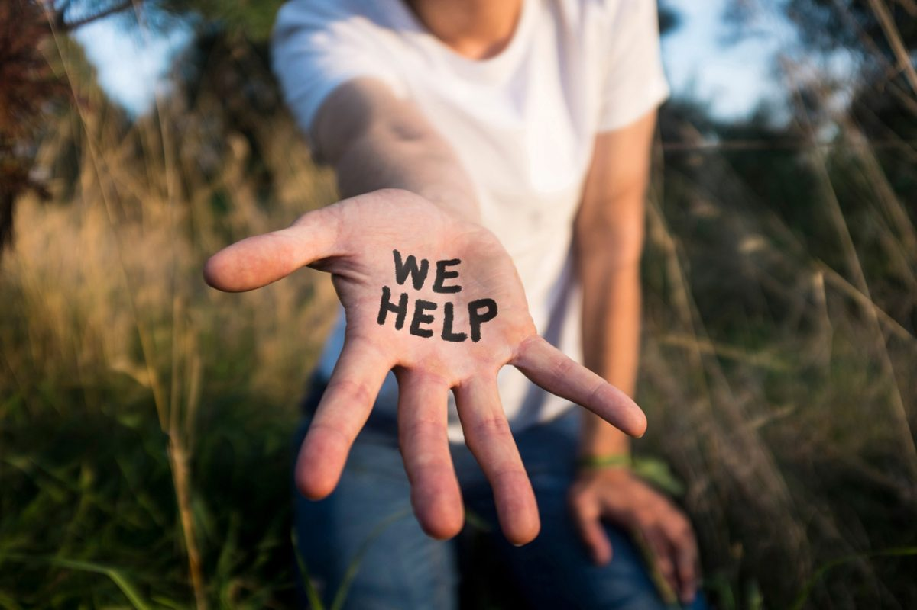
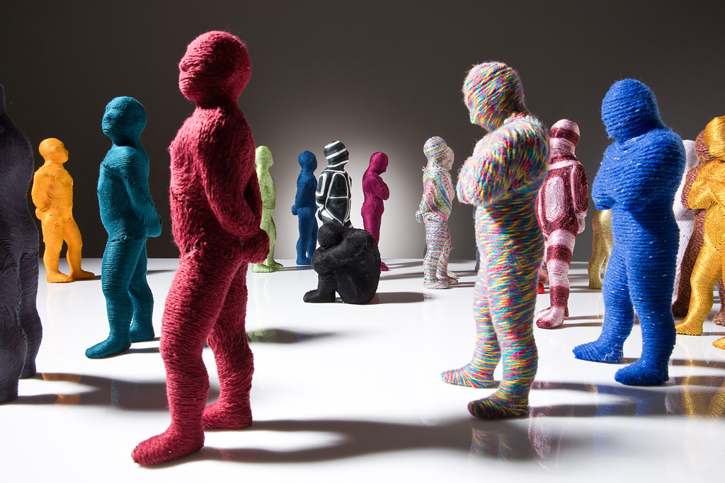
Study 3- Aim and participants
Injunctive Norms
Descriptive Norms
Peer Group Norms
what we should do
what people usually do
Notes:
Starting with the peer group norms, we know that children’s bystander reactions can developmentally influenced by peer group norms.
In this study, we focussed on two types of group norms. Injunctive and descriptive norms:​ Injunctive norms tell people what behaviour is approved or disapproved of, what people should do
Whereas descriptive norms describe what most people do in a particularsituation, what people usually do. It is people’s perception of how people actually behave in a given situation, regardless of whether the behaviour is approved or disapproved of by others. ​​An example of injunctive norm is helping other people. ​helping others is what we should do, right?​​ But is it always the case?​​
People do not always help others. ​And seeing people not helping others as a norm might affect people’s actual behavior of helping others.​

Slide 46
Study 3- Aim and participants
Injunctive Norms
Descriptive Norms
Peer Group Norms
To understand how injunctive and descriptive peer group norms about challenging social exclusion might shape children’s and adolescents’ likelihood of bystander responses
463 British children (n = 226, 8-11 years) and adolescents (n = 237, 13-15 years)
Notes:
So in this study, we explored how injunctive and descriptive peer group norms about challenging social exclusion, in other words how children’s and adolescents’ perception of their group helping or not helping the excluded peer as a bystander might shape their likelihood of bystander responses
Four hundred sixty three British children and adolescents took part in our study in South West of England
In the current study, we focussed on two age groups (8-11/ 13-15)

Slide 47


Study 3- Hypothetical Scenario for Social Exclusion
Injunctive Norm
“Your group has one rule that You should help people if they are being left out.”
Notes:
We presented participants with a hypothetical scenario and introduced them to their “British group of friends”
Then we set up the injunctive norm telling them: “your group has one rule that you should help people if they are being left out.”
Next participants were asked to imagine that their group formed a cooking club for students who like cooking.

Slide 48


Study 3- Hypothetical Scenario for Social Exclusion
Immigrant
Newcomer
Ingroup Excluder
“Sam, who is in your British group of friends, says to the new student,
"I don't want you to join our group."
Notes:
Then we told them that there’s a new student, an immigrant who wants to join in the cooking club.
Next, participants read about a peer in their group, Sam excluding the new student saying I don’t want you to join our group.

Slide 49

Study 3- Hypothetical Scenario for Social Exclusion
Most of your group of British friends
HELPED
the new student
Most of your group of British friends
DID NOTHING TO HELP
the new student
No information given

Slide 50
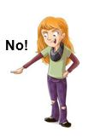


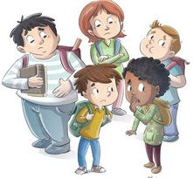
Study 3- Bystander Responses
HELP
BYSTANDER RESPONSE
Imagine you are there,
what would you do?
Reasoning
WHY?
DO NOTHING

Slide 51
Study 3- Results
Age Difference
Children were
more likely to help
and less likely to do nothing
as a bystander
than adolescents
Reasoning
Children
Moral
e.g.,
“Because it is kind to help”
“Because it's mean to leave people out”
Adolescents
Group Dynamics & Autonomy
e.g.,
“I don’t want to be left out as well”
“I would let my mates decide”
“Because I might not like him”
Notes:
And what did we find?
Starting with the age difference, we found that children were more likely to help the excluded peer as a bystander than adolescents.
We also analysed participants reasoning, their responses to why questions
We found that children were more likely to justify their bystander reaction with reference to moral reasons
Whereas adolescents were more likely to refer to group related reasons such as group dynamics or autonomy.
For example children said things like
“because it is kind to help”
or Because it is mean to leave people out.
Whereas adolescents said things like
“I don’t want to be left out as well”
or “I would let my mates decide”
or “Because I might not like him”

Slide 52
Study 3- Results
Age Difference
Peer Group Norm
Children were
more likely to help
and less likely to do nothing
as a bystander
than adolescents
When participants heard their group helped the new student
When participants heard their group did nothing to help the new student
When participants did not hear what their group did
Reasoning
Children
Moral
e.g.,
“Because it is kind to help”
“Because it's mean to leave people out”
Adolescents
Group Dynamics & Autonomy
e.g.,
“I don’t want to be left out as well”
“I would let my mates decide”
“Because I might not like him”
More likely to do nothing to help
More likely to help
Notes:
When it comes to peer group norms we found that
when participants heard their group helped the new student, they become more likely to help the new student.
However, when participants heard their group did nothing to help the new student, or when they did not hear about what their group did, they become more likely to do nothing to help.

Slide 53
Study 3- Results
Age Difference
Peer Group Norm
Children were
more likely to help
and less likely to do nothing
as a bystander
than adolescents
“Your group has one rule that You should help people if they are being left out.”
When participants heard their group helped the new student
When participants heard their group did nothing to help the new student
When participants did not hear what their group did
Reasoning
Children
Moral
e.g.,
“Because it is kind to help”
“Because it's mean to leave people out”
Adolescents
Group Dynamics & Autonomy
e.g.,
“I don’t want to be left out as well”
“I would let my mates decide”
“Because I might not like him”
More likely to do nothing to help
More likely to help
Notes:
There are two important things I’d like to highlight here.
Remember that before we presented participants with the story we told them that your group has one rule that you should help others when people were left out. Even though we set up this strong peer group norm, they were more likely to follow what their group did, doing nothing to help.

Slide 54
Study 3- Results
Age Difference
Peer Group Norm
Children were
more likely to help
and less likely to do nothing
as a bystander
than adolescents
“Your group has one rule that You should help people if they are being left out.”
When participants heard their group helped the new student
When participants heard their group did nothing to help the new student
When participants did not hear what their group did
Reasoning
Children
Moral
e.g.,
“Because it is kind to help”
“Because it's mean to leave people out”
Adolescents
Group Dynamics & Autonomy
e.g.,
“I don’t want to be left out as well”
“I would let my mates decide”
“Because I might not like him”
More likely to do nothing to help
More likely to help
Notes:
Secondly and interestingly, participants were again more likely to do nothing, when they were not told about what their group did.
This might be because youth might not be witnessing bystander helping happening a lot.
So when they didn’t get any information about what their peer group did, they still might expect no-intervention even with a strong ingroup norm says to help.

Slide 55
Study 3- Take away messages
Different interventions for different age groups
Schools should reinforce prosocial peer group norms around bystander challenging
Youth should be encouraged to resist non-challenging ingroup norms
Notes:
So what these results tell us?
Our results suggest that interventions might need to adopt different approaches for different age groups. A morally focused intervention might work for children whereas interventions designed for adolescents might require a greater focus on group dynamics and processes.
The findings might also suggest that children’s perceptions of what the peer group would do best improve bystander challenging reactions.
Setting up strong injunctive school and peer group messages at school is crucially important. However, this should be supported by peers’ active bystander interventions to reinforce prosocial norms around bystander challenging as contradictory messages seem to weaken youth’ bystander reactions.
Interventions should also encourage adolescents to think about group related factors, for example, schools can encourage young people to do what they think is right no matter what they think their group would think or do.

Slide 56

Factors in Bystander Responses
Peer Group Norms
Shared Knowledge
Challenging
Forms: Direct/Indirect
Stereotypes
Notes:
Next we’ll be talking about how shared knowledge and stereotypes can influence children’s and adolescent’s evaluations of and bystander reactions to the social exclusion of immigrant peers

Slide 57

Shared Knowledge and Stereotypes
  Shared characteristics i.e., shared interest influence children’s and adolescents’ decisions about including or excluding outgroup members (Hitti & Killen, 2015)
  Stereotypes and assumptions about the knowledge or interests of outgroup members can influence how they view outgroup members and inclusion decisions (Hitti & Killen, 2015).
Notes:
We know from the previous research that shared characteristics such as shared interest, shared values, shared beliefs can influence decisions about including or excluding outgroup members.
Moreover, stereotypes and assumptions about whether outgroup members have the same knowledge, interest or belief can also influence decisions about including outgroup members into groups and activities.

Slide 58
Study 4- Aims and Participants
Shared Knowledge
To understand how shared knowledge and stereotypes might shape children’s and adolescents’ likelihood of bystander responses and their evaluations of the challenger in the context of intergroup social exclusion
Stereotypes
457 British children (n = 225, 8-10 years) and adolescents (n = 232, 12-15 years)
Notes:
In our project, we explored how shared knowledge and stereotypes might shape children’s and adolescents’ likelihood of bystander responses and their evaluations of the challenger in the context of intergroup social exclusion.
Four hundred fifty seven British children and adolescents took part in our study in South West of England
And as before, we focussed on two age groups (8-11/ 13-15)

Slide 59

Study 4- Hypothetical Scenario
Notes:
Similar to the other studies, we presented participants with a hypothetical scenario and introduced them to their “British group of friends”
Then we asked them to imagine that their school is organizing a quiz competition on music popular in Britain and their group decided to form a team to join the competition.
We told them that everyone in their team like and know about music popular in Britain and they want to join this competition as a team to win.

Slide 60
Study 4- Hypothetical Scenario and Shared Knowledge Manipulation
SHARED KNOWLEDGE
The new student
knows about popular music in Britain
The new student does not know about popular music in Britain
Immigrant
Newcomer
Ingroup
EXCLUDer
“Sam, who is in your team of British friends, says to the new student,
"I don't want you to join our team for quiz competition"
Notes:
Then we told them that there’s a new student who wants to join their team and take part in the quiz competition.
Then we manipulated the shared knowledge of the new immigrant student-
half of the participants read that the immigrant peer knows about popular music in Britain
And the other half read that the immigrant peer does not know about popular music in Britain
Next, again, Sam, from the British group of Friends, excluded the new student saying I don’t want you to join our group.

Slide 61
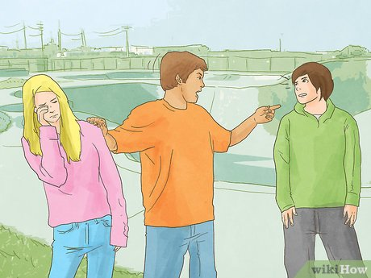
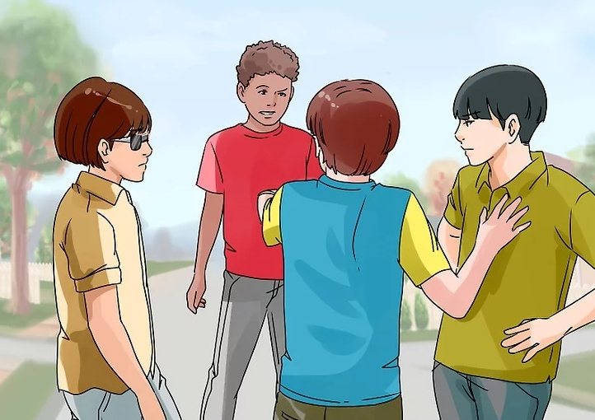
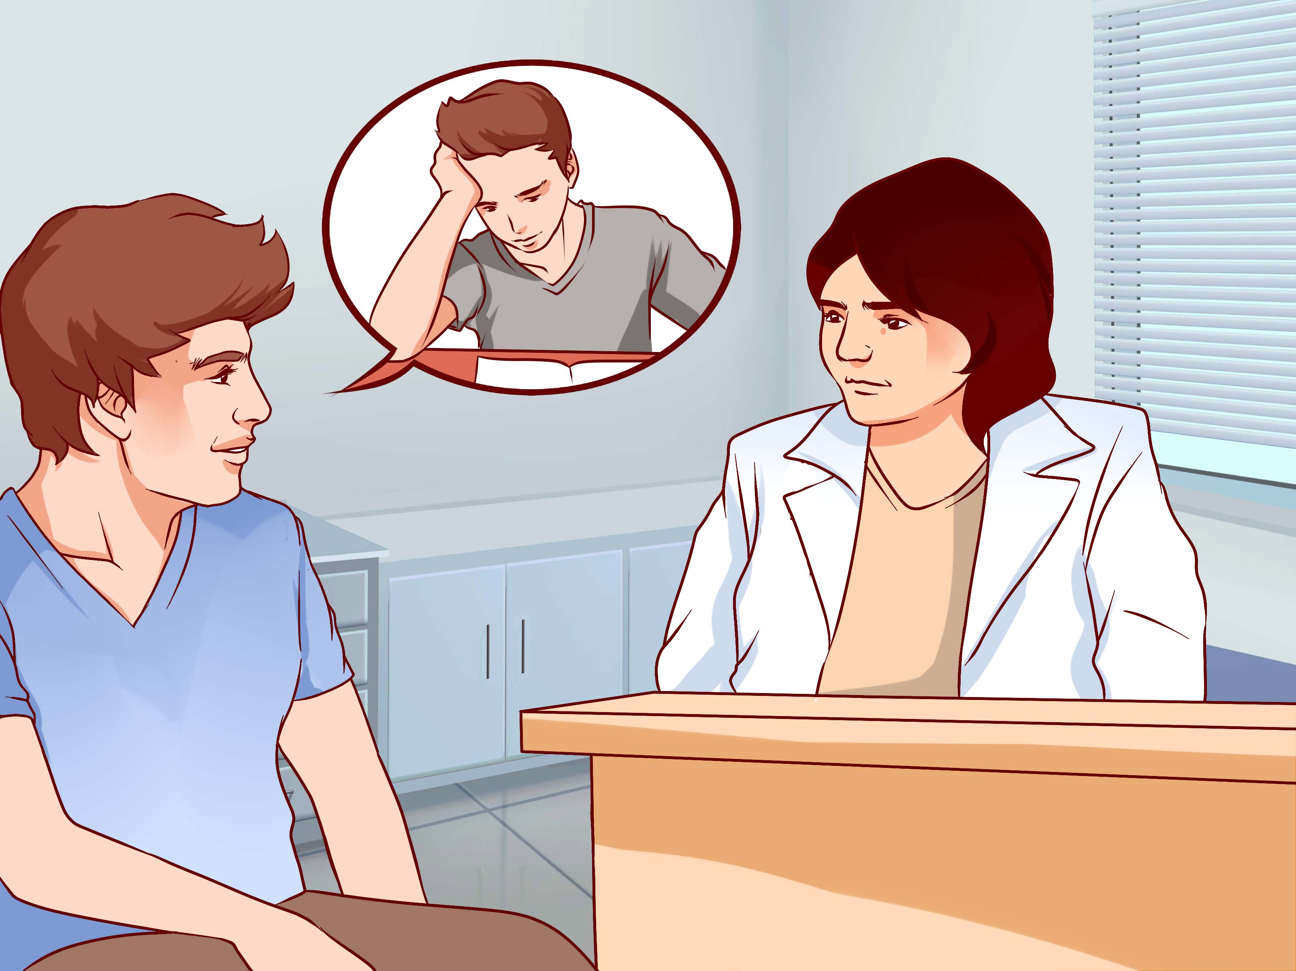
Study 4- Bystander Responses to Social Exclusion
direct bystander challenging
e.g., tell Sam to include the new student
retaliatory bystander challenging
e.g., tell the team you don’t want Sam in the group anymore
indirect bystander challenging
e.g., get help from a teacher or adult

Slide 62
Study 4- Results
Shared Knowledge
Age Difference
No Shared Knowledge
When they heard the new student did not know about music popular in Britain
Shared
Knowledge
When they heard the new student knew about music popular in Britain
Children were more likely to show
direct bystander challenging
retaliatory bystander challenging and indirect bystander challenging
than adolescents
More direct bystander challenging
More retaliatory bystander challenging
Notes:
Firstly we found that children were more likely to show direct, retaliatory and indirect bystander challenging (so all types of challenging) than adolescents.
When it comes to shared knowledge
When participants heard the new student knew about music popular in Britain, they were more likely to show more direct and retaliatory bystander reactions compared to when they heard the new student did not know about music popular in Britain.
We found no differences for indirect bystander challenging reactions.
These results suggest that the immigrant peer’s sharing knowledge with the team matters when youth make decision about challenging the exclusion of them.

Slide 63
Study 4- Bystander Challenger and Stereotypes
Individual Evaluation of the challenger
Stereotypes
How OK or not OK was it for Alex to say that to Sam?
1-definitely not OK to 6-definitely OK
Tell us what you think of immigrants. What are they like?
INGROUP
Challenger
“Imagine that Alex tells Sam that s/he thinks the team should invite the new student to join the team for the quiz competition about music popular in Britain.
Notes:
In the same study, we also introduced participanst to a peer group member, Alex, who challenged the exclusion telling Sam that the team should invite the new student to join the team.
Then we asked participants to evaluate the challenger- we asked them how OK or not OK was it for Alex to say that to Sam?
We then measured participants’ stereotypic perceptions asking them:
“Tell us what you think of immigrants. What they are like?”
In an open-ended question.

Slide 64
Study 4- Results
Stereotypes
Negative Stereotypes
e.g., “a lot of them are bad”
Negative Stereotypes
No Stereotype
Positive Stereotypes
Positive Stereotypes
e.g., “they are nice and friendly”
Participants with positive stereotypes were
more positive to Alex, (challenger)
than participants who hold no stereotypes and
who hold negative stereotypes
No Stereotype
e.g., “they are same as everyone else”
Notes:
We analysed participants responses and coded them into three categories:
negative stereotypes, positive stereotypes or no stereotypes.
Participants who hold negative stereotypes said thing like “a lot of them are bad”
Participants with positive stereotypes said things like: They are nice and friendly
Finally no stereotype category included examples such as “they are same as everyone else”
The analyses we run showed:
participants who hold positive stereotypes were more positive to Alex, the challenger than participants who hold no stereotypes and who hold negative stereotypes.
These results suggest that stereotypes matters when participants evaluate bystander challenging.

Slide 65
Study 4- Take away messages
Youth are aware of shared knowledge and pay attention to the similarities with immigrants
Interventions focusing on similarities than differences
Promoting positive stereotypes and challenging negative stereotypes
Notes:
In terms of take away messages, these findings might suggest that participants are aware of shared knowledge and pay attention to the similarities with immigrants
Considering the evidence, interventions can be developed focusing on similarities between ingroups and outgroup rather than differences
The findings also suggest that stereotypes and assumptions about outgroup members and specifically immigrants matter.
And interventions and antibullying programmes should promote positive stereotypes and encourage youth to challenge negative stereotypes about outgroup members specifically about immigrants.

Slide 66
Factors in Bystander Responses
Peer Group Norms
Shared Knowledge
Challenging
Forms: Direct/Indirect
Stereotypes
Notes:
Finally, as the last factor, the last piece of the puzzle,
we will focus on the developmental differences in different forms of bystander challenging reactions

Slide 67
Different forms of bystander challenging
DIRECT BYSTANDER REACTIONS
INDIRECT BYSTANDER REACTIONS
>
Less resources (i.e., empathy, self-efficacy)
Less risk
(i.e., perceived cost, retaliation)
(Lambe et al., 2019; Levy & Gumpel, 2018)
Notes:
We previously mentioned that direct bystander reactions involve direct intervention such as confronting the perpetrator while indirect bystander reactions involve indirect interventions such as getting help from a teacher or a friend
Unlike direct forms, indirect bystander challenging requires less resources such as empathy or self-efficacy and involves less risks such as perceived costs within peer group or potential retaliation from bully
Therefore, when social exclusion is witnessed, indirect challenging is often more likely to realistically happen compared to direct challenging.

Slide 68


Indirect bystander challenging
Getting help from a teacher or adult
Getting help from a
friend
Notes:
In this study we focused on two types of bystander challenging: getting help from a teacher or an adult and getting help from a friend
Teachers have a critically important role as they are usually the first adults to respond to conflicts among peers. However, research shows that teachers rarely take action
One of the ways to make teachers take action is students telling teachers about bullying incidents which was found to be the strongest prediction of teacher intervention
However, children do not often tell the teachers about the bullying incidents and they become less likely to inform a teacher as they become adolescents-
NEXT
Getting help from a friend, on the other hand, is also an important response because it increases the likelihood of bystander intervention- being asked to help a victim make other bystanders more likely to intervene

Slide 69
Study 5- Aims and Participants
To understand how children’s and adolescent’s indirect bystander reactions to social exclusion (getting help from a teacher and getting help from a friend) change developmentally
Indirect Bystander Challenging
340 British children (n = 155, 8-10 years) and adolescents (n = 185, 12-15 years)
Notes:
In this study, we explored how children’s and adolescents’ indirect bystander reactions to social exclusion (getting help from a teacher and getting help from a friend) change developmentally
Three hundred fourty British children and adolescents took part in our study in South East of England
And as before we focussed on two age groups (8-11/ 13-15)

Slide 70
Study 5- Hypothetical Scenario for Social Exclusion
Immigrant
Newcomer
Ingroup
EXCLUDer
“Sam, who is in your British group of friends, says to the new student,
"I don't want you to join our group."

Slide 71

Study 5- Indirect Bystander Responses
Getting help from a teacher or an adult
Getting help from a friend
How likely or not likely is it that you would get help from a teacher or an adult?
How likely or not likely is it that you would get help from friend?
Why?
Why?

Slide 72
Study 5- Results
Developmental Differences
CHILDREN
More trust in teachers:
“because teachers help you and if somebody is left out you can tell them and they fix it”
“teachers are reliable”
Getting help from a teacher or an adult
Getting help from a friend
ADOLESCENTS
Less trust in teachers, more group concerns, more autonomy
“it is best to sort it out between ourselves, teachers or adults might make the situation worse”
“I am not a snitch”
“I can sort it out myself”
Getting help from a teacher or an adult
Getting help from a friend
Notes:
Adolescents were less likely to show indirect bystander reactions compared to children
Children also were more likely to get help from a teacher than a friend but adolescents were more likely to get help from a friend than a teacher
Their reasoning justifications helped us to explain this reverse pattern that children were more likely to refer to their trust in teachers. They said thing like
“because teachers help you and if somebody is left out you can tell them and they fix it”
and “teachers are reliable”
Whereas adolescent were more likely to refer to mistrust in teachers, group related concerns and autonomy.
They said things like
“it is best to sort it out between ourselves, teachers or adults might make the situation worse”
“I am not a snitch”
“I can sort it out myself”

Slide 73
Study 5- Take away messages
The consequences of letting an authority figure know about the negative situation
Making teachers more approachable
Increasing teachers’ awareness of adolescents’ understanding of group concerns
Notes:
Some take away messages here: In this study- We found that with age adolescents were less likely to get help from a teacher. This may be related to that adolescents become more aware of the consequences of letting an authority figure know about the negative situation- as they think teacher involvement in bullying situations can make things worse.
In terms of practical implications, making teachers more approachable and more understanding of why adolescents might not feel able to intervene can be crucially important.
Also increasing teachers’ awareness around adolescents’ understanding of group related concerns, social exclusion and their reactions to it could help teachers to support adolescents’ well-being and self- efficacy.
When designing interventions, these developmental differences should be taken into consideration in order to develop more effective anti-bullying programmes.

Slide 74
Any questions?

Slide 75

Break for coffee
We will return at 11.15

Slide 76
Creating inclusive schools: research and practice
Tracey A Warren – Professional and personal reflections on the ESRC project
Notes:
Thank colleagues in the project and members of the advisory board for their presentations, findings and inspiration.
This is a different perspective from my colleagues, Adam says it is unique: as a researcher and an educator. It is all intents a personal and yet professional reflection on a developmental psychology project.
I have been fortunate to be a member of multi-disciplinary team in several previous roles and have an education background. I have had the opportunity to reflect on the relevancy of the knowledge gained through the studies that have been a part of this project.

Slide 77
So WHAT?
Themes:
Child and adolescent level data –thoughts, evaluations about exclusion and challenging social exclusion​
Immigration, increasing global diversity and conflicts – social exclusion ​
Stereotypes and shared understanding​
Creating inclusive environments – strategic policy​
Notes:
Adam asked So What at the beginning
What I have done is picked out some themes from the morning presentations.
The so what is important to me as someone who has been an educator and leader. Looking at the spectrum of those involved in bullying and consider school, parents and the child. Powerful moment when you recognise that the agent for change in bullying is the child, as Adam has also mentioned. Engagement of children / adolescents understand their thoughts, ideas and actions on social exclusion
It is clear that social exclusion has a significant impact on mental health and well being and that in turn impacts on learning outcomes. As an educator, policy maker and those that work with immigrants/newcomers to a school environment this is helpful to understand the link between the two. As highlighted during the morning there is increasing global diversity and conflicts so this project has been important to understand the challenges faced by Immigrants and their children – higher risk of social exclusion due to background - impact on life outcomes (Gonultas and the work of Killen and Rutland) Reinforces the need to understand this link not just as immigrants but as newcomers to a school.
Challenge negative stereotypyes and develop shared understanding - emphasise similaritiies rather than differences / stereotypes matter! (Yuksel)
Strategic - engagement of leadership, teachers and administration / conversely down to individual schools – positive as this takes into consideration local context (Smith)

Slide 78
Creating inclusive environments – viewpoint of children​
'Bystander' as a strategy ​
The power of the Challenger​
Children / adolescents – understanding of context​
Notes:
Findings suggest:
Excluded, excluder and a bystander/challenger are a triangle. Children observe within their groups social exclusion. They can be the way to support the excluded.
Focus on similarities rather than differences – shared knowledge and understanding. (Secil – if the excluded peer was similar to the group) Discussion about cultural events celebrating cultural/religious events/occasions. emphasise how different we are – a balance?
Supporting the challenger/ the bystander is key to reducing bullying and social exclusion as shown in Yuksel study when children heard their group helped the new student – they were more likely to help. Killen – the options children have are powerful. Children spend time in peer groups and peers often witness exclusion. Supporting them to make choices, choices that may seem challenging eg supporting someone being excluded / recognising it is not easy to stand up for someone. From the research findings a strategy to deal with social exclusion is building on the belief that they can challenge the excluder.
Understanding of the developmental differences between childhood and adolescents to put in effective strategies – childhood focus on moral reasoning equality – adolescent context is crucial. Adolescents are more likely to help as they recognise the reason for the exclusion is likely to be racism / discrimination compared to children.

Slide 79
So WHAT?
The role of parents? teachers? school leaders? national and local government?​
Children are central​
Academic findings as evidence to support strategies for inclusion​
Notes:
Engagement with teachers – understand development – understand strategies that support each phase of child development and support through training so they can facilitate discussion about stereotypes, prejudice and empathy. (Killen) An area for prof dev for teachers to feel empowered and enabled to manage discussion and challenging questions/views (there are some books that provide scenarios with points for parents and teachers)
Adolescents – impacted by peer group (Secil) ****** (Ayse – expectations of the peer group – what we should do and what usually do – children would be more help to help / different interventions @ different ages)
Child focus and Peter viewpoint of school, policy and parents – whole of society has a part to play in supporting anti-bullying approaches
Ukrainian refugees current – our current studies
So what? The goals of the grant – perspectiive of a child. The morning has been the project team and advisory board opportunity to present findings from studies that provide an evidence base for those who work in schools, with children on anti-bullying approaches to consider appropriate strategies for inclusion, particularly those who are newcomers to our schools.
These findings will inform educational policy and practice, as well as national/local, charity/NGO in the education, anti-bullying and equity. What I want to take away is the importance of the child in this project, their perspective and their power to be the agent of change.

Slide 80

Break for lunch
We will return at 14.00

Slide 81
AGENDA
Afternoon – workshops
14.00 - 15.00 Facilitated workshops
15.00 - 15.30 Plenary and close of the day

Slide 82
Workshop discussion questions:
What are the key findings that interest you from the research you heard about this morning and why?​
What practical strategies do you currently employ/aware of that aim to create inclusive schools for a newcomer? ​
Think of a future practical strategy / policy / intervention that could promote inclusive schools for newcomers in your organisation?​

Slide 83
Questions from the audience
How do we convince schools to abandon zero tolerance policies and encourage schools to develop more relational / empowering / non re traumatising practice in place of behaviourist approaches as advocated by Tom Bennet?
How can we teach neurotypical primary school pupils about neurodiverse so that they can act as role models to raise awareness in their neighborhoods?
Discussion on introduction and implementation of inclusion in mainstream schools in third world/developing Asian context.
What are the 3 most important things we need to do nationally to support more schools in becoming more inclusive? Do you see a role for the Index for Inclusion in supporting participatory education?
I hope the speakers can provide some insights into inclusivity in international schools where multiculturalism and multi -backgrounds of students and staff are the norm.
Notes:
Index for Inclusion – creating inclusive cultures – Indicators for building a community and establishing inclusive values (3 dimensions, cultures, policies, practices). Participatory education = inclusive.

