Slide 1



Medicalisation, mobilisation and Social Identity Theory
Ginny Russell & Jennie Hayes

Slide 2
Prevalence and medicalisation
How conditions and behaviours outside the medical domain and previously a part of normal social life, come to be considered medical conditions, or problems and thus become subject to medical diagnosis, prevention, or treatment (Conrad, 1992).
‘Autism Counts’ Nature Nov 2011, 479, p.24

Slide 3




Making up people
1. Count! 2. Quantify! 3. Create Norms! 4. Correlate! 5. Medicalise! 6. Biologise! 7. Geneticise! 8. Normalise! 9. Bureaucratise! 10. Reclaim our identity!
Feedback: An interplay of social movements, health institutions and scientific experts that creates and shapes how we view autistic people & ultimately what we understand autism to be.

Slide 4
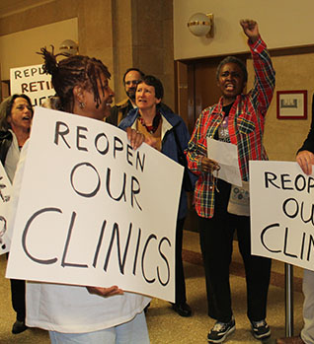
Social Identity Theory (SIT)
We self-categorise with others who we consider are ‘like us’
SIT suggests this is because our group memberships help us to define our sense of who we are and gives us a sense of belonging (Tajfel, 1979)
Its in our interest to display loyalty to our ‘ingroups’; conversely, it can lead to discrimination against ‘outgroups’
Social identities make group behaviour possible (Turner, Hogg et al, 1987)

Slide 5
Sense of meaningfulness, purpose and direction
Social support – emotional, intellectual and material
Positive social identity as a social and psychological resource
Social and psychological resource
Sense of belonging
Social influence
Cruwys, Haslam, Dingle, Haslam & Jetten, 2014; Haslam, Jetten, Postmes & Halsam, 2009; Haslam, Reicher & Levine, 2012; Turner, 1991; Cruwys et al, 2012; Jones & Jetter 2011

Slide 6
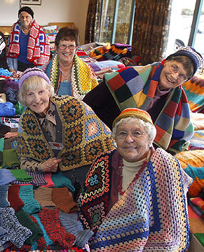
Group boundaries and identities
Social identities are prioritized depending on saliency in any given situation (e.g. Haslam et al, 2011)
Self categories can therefore be defined narrowly or broadly
How the ‘outgroup’ is defined can determine permeability of boundaries
The identity of a social movement helps to shape how we continue to ‘make up people’

Slide 7
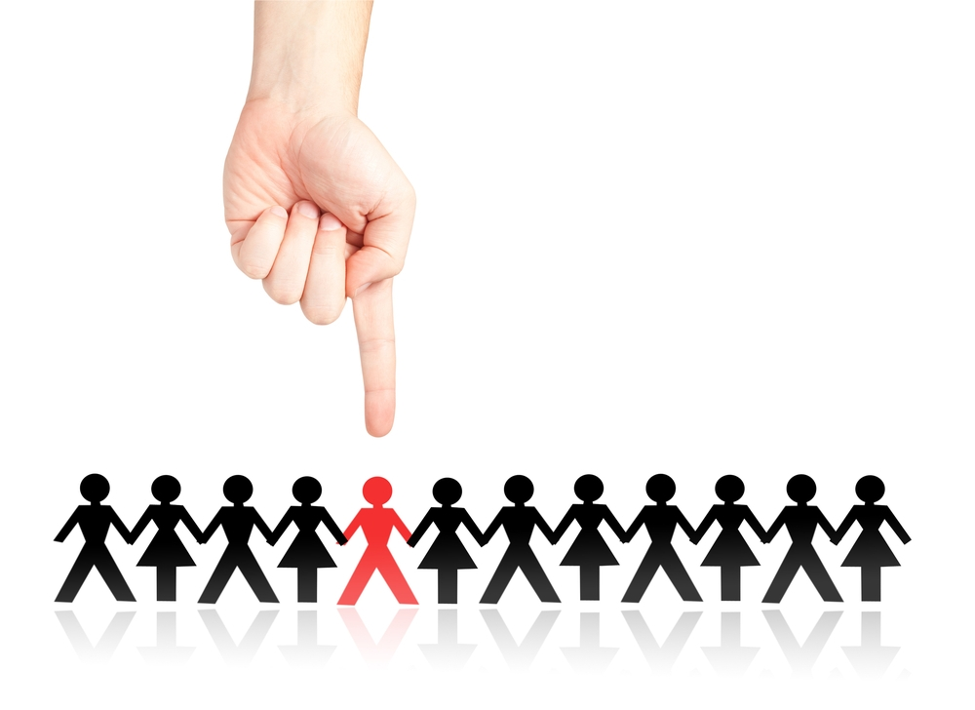
Stigma and social identity
Belonging to a negatively stereotyped group can threaten self-esteem
Response can either be individualist or collectivist (Branscombe et al, 2012)
Shared resources to mobilize and promote social change (Haslam, Reicher & Levine, 2012)
But identification requires definition of an ‘entity’ – can lead to reification

Slide 8
Resistance/Project Identity (Castells, 1997)
Legitimising Identity
Generates a civil society which reproduces the identity that rationalizes sources of structural domination
Made up of institutions and organisations in society which defines norms
Resistance Identity
Constructed in response to exclusion, devaluation and stigmatization
Individuals build ‘trenches of resistance’ in opposition to the norm
Leads to communities of resistance, mobilisation and, potentially, social change
Reverses the value judgement whilst reinforcing the boundary
Project Identity
New identity is built which redefines position in society
Seeks transformation of overall social structure
May be main potential source of social change

Slide 9

The means to Mobilise
Castells (2009)
There is a ‘transformational’ phase in social and political relationships, as ‘networks’ become fundamentally significant as a vehicle for ordering and shaping human lives.
‘Autism Counts’ Nature Nov 2011, 479, p.24

Slide 10
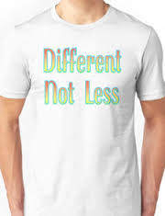
Autistic activism
History
Don’t mourn for us (1993)
InLv (1996)
Autistic Genocide Clock
Autreat (1996) ANI
Institute for the Study of the Neurologically Typical (2002)
Aspies for freedom
Declaration (2004)
In my Language (2007)
ND manifesto (now)

Slide 11

Problematizing neurodiversity
Reductionist: brains= difference (Ortega) Absolution for behaviour
Acceptance of violent traits?
Divisive (Runswick-Cole). Identity politics: over-identification of one identity to the exclusion of others
Representativeness: those who are able to speak are dominating discourse: NDM predominantly white, middle class
Commodification: What starts as a creative revolt becomes co-opted as the latest way to make money

Slide 12

The future?

