Slide 1




Interdisciplinarity in Medical Research
Ginny Russell and Steven Kapp

Slide 2
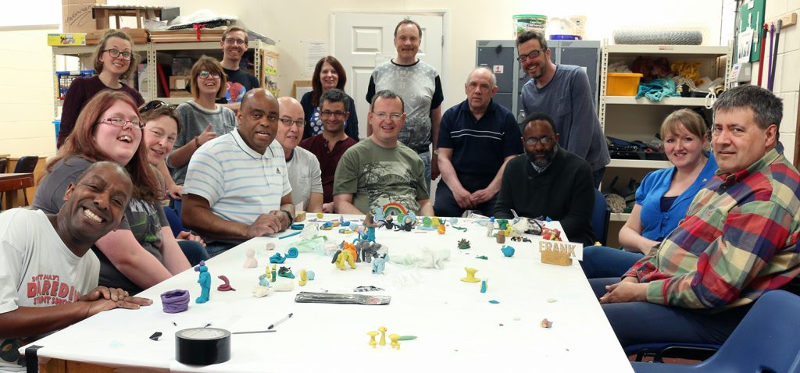
Aims for today…
…to discuss and consider some aspects of interdisciplinary research from both sociological and health perspectives …to provide a sense of some results and findings as part of this larger Welcome Trust-funded research project.
From both a sociological and child health perspective
Notes:
3 SHORT FILMS
Animation- Abstract
Not live action figures, not talking heads
Divorced soundtrack generation from visuals/imagery seen on screen. Emphasises what you hear. Notes on blindness.
Diagnosis –what is the function of the label (e.g. transfer of attribution, diagnosis as passport, diagnosis as stigmatising. Different functions and consequences in different circumstances)
Neurodiversity
What people think it is
Treatment
As per above-strengths (baby out with bathwater)
How this opposes medical narrative

Slide 3

Medical vs Sociological perspectives
Medical research:
Positivist
Discovery of truth
Often quantitative methods
Objectivity valued- medicine is a science
Context secondary to biological
Encroachment of patient (lay) perspective
Sociological research
Constructionist
Meanings ascribed to events
Often qualitative methods
How knowledge is produced- medicine is a humanity
Contextual, social factors
Power relations, medicalisation
Example: Mother’s rating of her child’s hyperactivity.

Slide 4
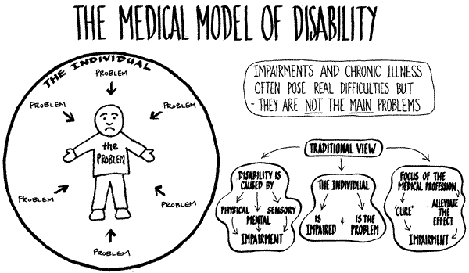
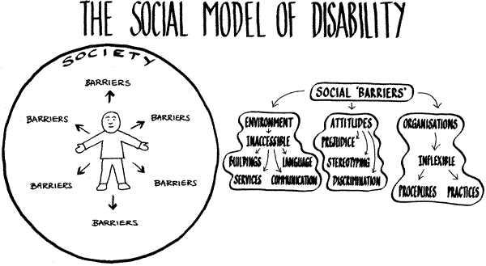
Discipline vs field: disability studies
Medical model
Social model
Biopsychosocial model
(Democracy Disability and Society Group, 2003)

Slide 5
Research world views and methods
(Creswell, 2009)
(Post)positivism
Scientific method, quantitative research
Social constructivism
Ethnography, narrative research, etc.
Participatory worldview
Action research
Pragmatism
Mixed methods

Slide 6
We want our results to have an impact on both disciplines….
To investigate whether autism research is based primarily on participants with less severe intellectual impairment. ‘Selection bias’. Why is this important?
Research Questions
Do research articles that claim to generate knowledge about autism across the spectrum have samples predominantly drawn from the less severely intellectually impaired group?
If such a bias exists, does it applies to all fields of autism research?
Method? What counts as bias?

Slide 7
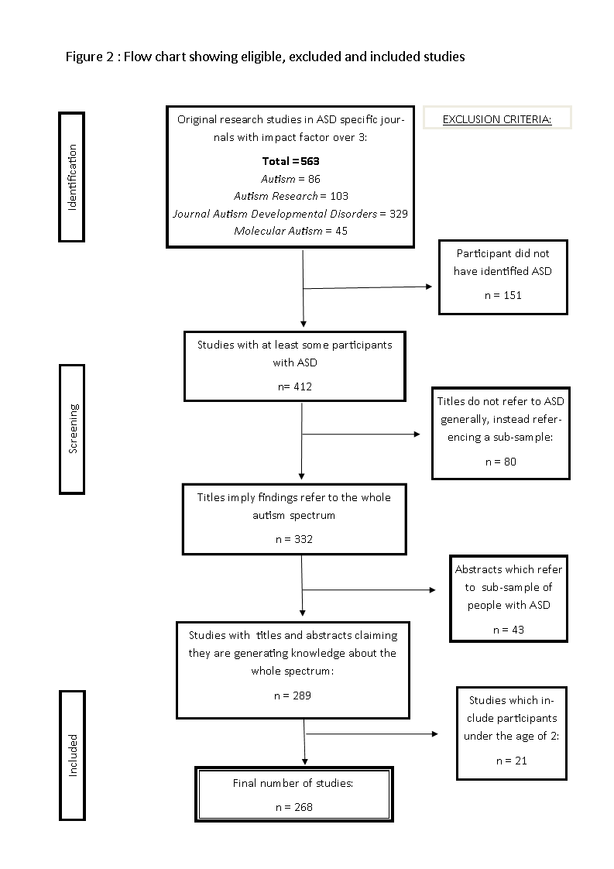
In total, there were 7188565 participants across all studies, of which 91682 participants had autism.

Slide 8
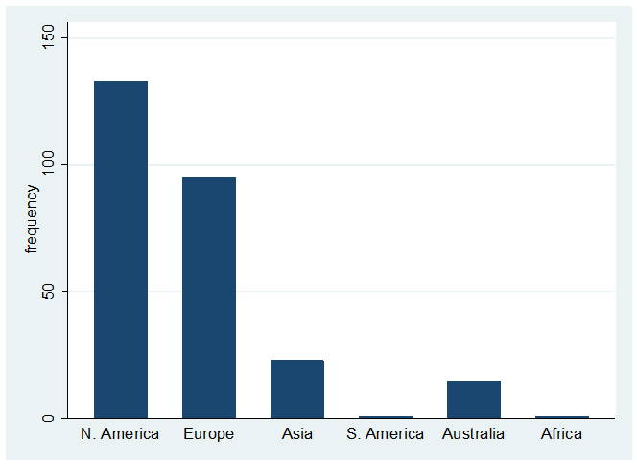
Frequency of studies by continent

Slide 9
Frequency of studies by field

Slide 10
Age range of participants

Slide 11
93% of ASD participants did not have ID.
This varied from 67% (Epidemiology)
to 96% (Psychology)
Prevalence estimates have changed from a third without ID, to a third with ID.

Slide 12
What predicted the proportion with and without ID?
Gender?
Age?
Field?
Journal?
Country or continent of origin?
How cultural and contextual factors shape our knowledge base.

Slide 13
Expanding cultural possibilities
Example with Navajo
Traditionally no concept of disability
Wellness philosophy enables patience, flexibility
Allow children to explore identity
Matrilineal society – multiple caregivers, can stay with mother
Praised, empowered for what can do
Supported where have more significant needs

