Slide 1



Including disabled people about inclusive employment
Steven Kapp

Slide 2





























How to establish discrimination?
Discrimination
Disability advocacy [employment]
Disability priority
Subminimum wage
Sheltered workshop [positions of self-advocate orgs]
Affirmative action [education, employment]
Customized employment/job carving, enclave
Importance of employers [health internship, USBLN]
Self-advocates [YAC]
[community conversation]
IDEAL school social justice
“Everyone can work. Everyone should work.” –
repeated affirmation by local stakeholders during Washington site visit by U.S. National Council on Disability
2

Slide 3














Alliance for full participation?

Slide 4
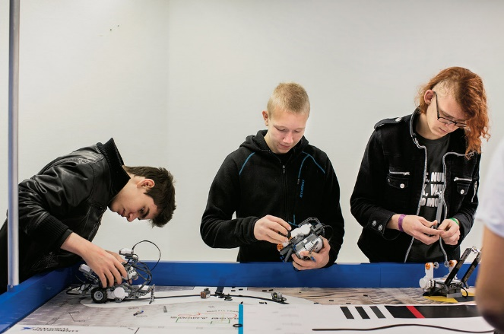

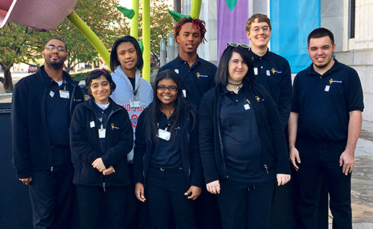

When is education, employment inclusive?
An 'ideal' school?

Slide 5




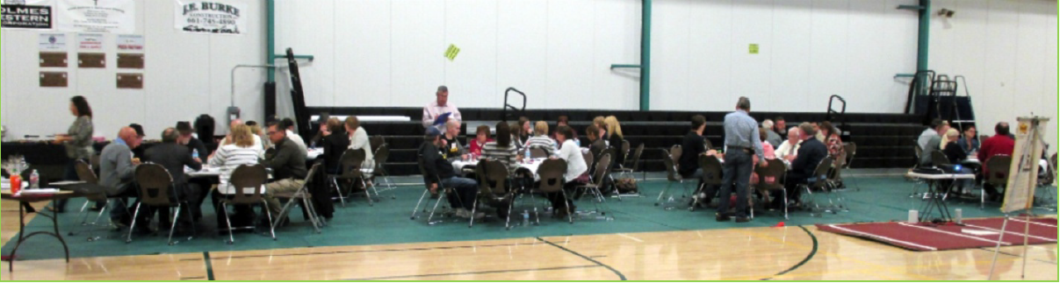
My experiences

