Slide 1



Neurodiversity: Implications of Brain-Based Research and Politics for Social Science and Early Intervention
Steven Kapp
Notes:
This presentation reflects on the academic and practical implications of neurodiversity: the brain-based differences among people that affect thoughts, feelings, and sensations. Autism rights activists in the neurodiversity movement argue for acceptance and support, adopting neurological rhetoric around autism as an identity rather than disease. Indeed, studies have suggested that neurological differences associated with autism can function as strengths and weaknesses, which may depend on the individual and social contexts. Many autistic people insist they were “born this way”, and likewise neuroscience has identified extremely early patterns in the brain that precede clear behavioural signs. Delivered by a developmental psychologist working in sociology with personal experience as an autistic activist, this talk will discuss the relevance of neuroscience for the agenda of autism research and politics, including early intervention.

Slide 2
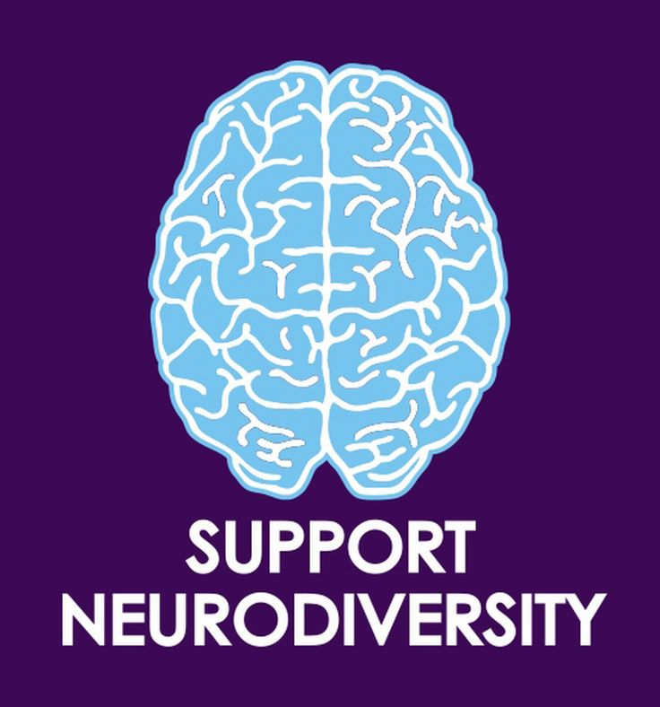
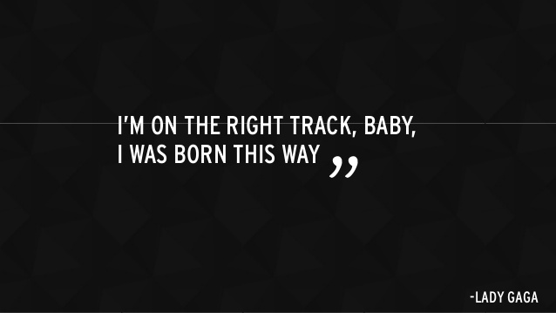
Neurodiversity: Basic Terms & Definitions (Walker, 2014)
Neurodiversity (ND): neurological variation among people
Neurodivergence: conditions of neurological difference
ND paradigm: acceptance of neurodivergence as equal
ND movement: activism of neurodivergent people
Notes:
ND: biological fact Cerebral subject biological citizenship

Slide 3
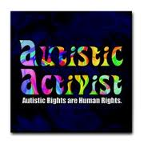

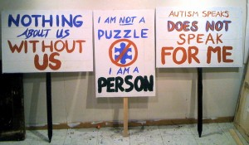
Neurodiversity movement
Complex, pervasive difference; part of personality
Often identity-first, non-medicalized language
Autism: natural, on spectrum of human diversity
Focus on an rights, access, opportunities
For acceptance; against prevention and normalization

Slide 4
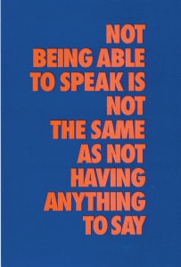
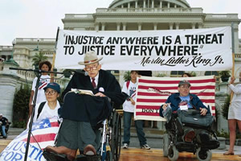

Disability rights movement
Social contribution to/construction of disability
Civil rights model – not medical model
Self-advocacy: “Nothing About Us Without Us”
Focus on self-determination and quality of life: building independence, inclusion, productivity through rights and support
For respect, against personal tragedy narrative

Slide 5
Problems with medical model
Pathologisation
Yet some aspects of autism may be strengths or neutral
Uneven skills are typical of autism
High within-person changes common in autism
Reductionism
No behaviour is specific to autism
Nothing specific is universal among autistic people
Broader mechanisms may underlie behaviour
Can social problems lie in just one person?
Is autism coherent, or multiple things?
Notes:
Variability, complexity broader mechanisms underlie social and sensorimotor affects interpersonal

Slide 6
Thinking domain-generally
Autism stems from broader factors
Within people
Sensation, language, emotion regulation, executive functioning, reasoning
Between people
Double empathy problem/similarity hypothesis
Development as dynamic system
Multicausal
Nonlinear
Notes:
Inside-out: perception-action
Exeteroception
Proprioception
Interoception
Movement (behaviour)

Slide 7
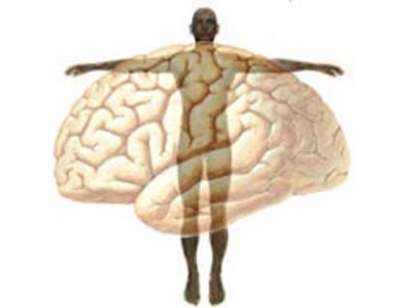
Mind-body interaction
Social cognition is not just social
Nonverbal cues: require sensorimotor, attention use
Effortful: language, executive functioning, reasoning
Sensory processing is not just nonsocial
Hypersensitivity/overload may cause social withdrawal
Hyposensitivity reduces social responsiveness
Autism: atypical attention, memory, emotions, language not just social; stem from body
7
Notes:
reading social cues – involves facial expressions, body language – embodied

Slide 8
Theory of mind example
What does it mean for autistic people to have deficits in “social” abilities like theory of mind, or the ability to attribute mental states to oneself and others?
Theory of mind involves “memory, joint attention, complex perceptual recognition (such as face and gaze processing), language, executive functions (such as tracking of intentions and goals and moral reasoning), emotion processing – recognition, empathy, and imitation” (Korkmaz, 2011).
Notes:
Understanding what people think, feel

Slide 9
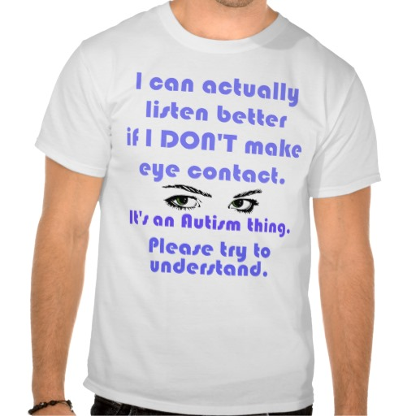
Reasons for atypical eye contact
Enhanced perception
Difficulty watching and listening at the same time
Intense threat detection
Reduced oculomotor (eye movement) control
Sticky attention
Prosopagnosia (faceblindness)
Culture!
Note: eye contact is not necessarily atypical
Notes:
Visual perception is more accurate, focused on surrounding details; non-autistic more biased by prior experience, expectations, get the gist | Eye contact may be painful/anxiety-provoking or may make it more difficult to concentrate lack of eye contact does not necessarily mean disinterest

Slide 10


Complex differences
Strengths present challenges (visual, then auditory ex’s)
Strengths: patterns, details; challenges: lights, eye contact
Strengths: e.g. perfect pitch; challenges: filtering, painful
Particular difficulty integrating information
Speech, learning movement and body language
Challenges with gist and context, learning from experience
Empathizing with sensory and movement differences: moving toward sensitive understanding of autism
Steven K. Kapp
10
Notes:
What functions as strength or not varies by context: help harness, leverage strengths to work on challenges

Slide 11

Person-environment interaction
Anything social happens between people!
Much evidence of lack of reciprocity from non-autistics
Extreme reactions, measures taken by desperate people
Bullying, other abuse, rejection
Lack of understanding or interest
Great demands on autistic people
Exceptional effort to do what others do intuitively
Underappreciated coping mechanisms (stimming, routines)
Stress
Affects anxiety, depression, loneliness, aggression, self-injurious behavior, digestion, sleep
Notes:
Filicide: parents kill their kids media often sympathetic to parents, but nothing justifies murdering the child some behaviors diagnosed as core to autism are actually coping mechanisms

Slide 12
Problems with social “disorders”
The new social communication (pragmatic) disorder was created for “political and health reasons…DSM-5 was not a scientific process…the empirical evidence is NOT in support of social pragmatic disorder”.
"...as somebody who's been trying to measure social behavior for a long time, I don't think there's even one thing that is social behavior. I think social behavior is actually many different things. We do much less well quantifying social behavior than we do lots of other things, even repetitive behavior."
Catherine Lord
Notes:
Nothing may just be social | Catherine Lord is a leading expert on autism diagnosis, created the diagnostic instruments regarded as gold standard, key member of DSM-5 committee that revised autism diagnosis last year

Slide 13
Social interaction
social cognition
empathy reciprocity
relationship
person
person

Slide 14
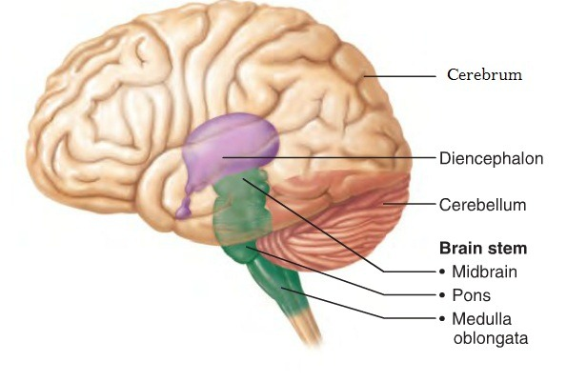
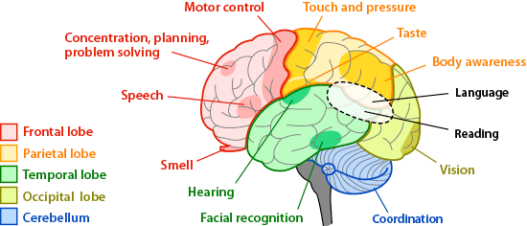
Sensorimotor importance
Generally
No socially specific module or brain region/network
“Neurological signs” are often sensorimotor

Slide 15
Cerebellum
Region at back of brain
Integrates and relays signals to body via spinal cord
Coordinates movement but also important for cognition
Houses most of brain’s neurons
Critical in typical infant development
Size, activity, connectivity functional links for autism

Slide 16
Sensorimotor importance: autism
Asperger, Kanner, Bettelheim
Autistic people’s own accounts
Developmental research: origins and stability
Within-person variability stems from sensory cortices
Interlink between sensorimotor and social “symptoms”

Slide 17
Bottom-up processing in autism
Typically
Perceptual narrowing
Top-down processing
Autism
Enhanced perceptual capacity
Embodied processing in autism
Reduced neural habituation
Developmental trajectory

Slide 18
Early development in autism
Some patterns
Visual, auditory strengths
Reduced benefit from baby talk
Enhanced learning for unexpected words
High early eye contact, responsiveness that declines
Other behavioural plateaus or regressions
Early hyperconnectivity followed by less synchronicity
Enlarged cerebrum followed by relative reduction
Notes:
Enhanced visual search, pupil size, prolonged pupillary light reflex
Higher autonomic visual response to sound visual preference
Reduced prejudice
Using another’s line of sight for perpsecitve taking
Greater understanding and production of unexpected words for language level

Slide 19
Neuroscience considerations
Measure the entire brain, not only the forebrain
Connect neuroscience data to clinical, functional data
Brain scanners sensitive to movement
Eye movement
Head movement
Cannot directly study brain (tissue)
Seek replication across teams, cultures
Potential for subtyping autism?
Notes:
Research on neurological compensation – deaf people activating visual cortex for sound?

Slide 20
Neurodiversity of autism
Support for complex differences
Beware of confirmation bias
Neurological compensation
Consider differences between volume, communication, activity
Opposite profile as psychopaths?
Notes:
[[e.g. ‘oversized brain volume]]
[[– deaf people activating visual cortex for sound?]]
[[adults with differences related to history not current presentation]]
Check social deficit paper – dehumanization, pathologization, reductionism, essentialism

Slide 21
Sensory-sensitive support
Lipreading to interact
Slowing down the presentation of facial expressions
Colour filters for communication
Responsive rather than directive caregiving
Song, music
Others’ imitation of autistic people
Augmentative & alternative communication (e.g. iPad)
Notes:
Song/music

Slide 22


What works for whom and why?
Little knowledge about what “works” for whom and why
Common knowledge that no intervention works for all
Little evidence treatment improves long-term “outcomes”
Yet, nearly conventional wisdom: (early) intervention helps
Little ability to predict “outcomes” at individual level
Little known for whom, how autism diagnoses tend to help
Humans of New York
“…We noticed these [challenging symptoms] early, identified that he was on the autism spectrum, and got him in therapy. We've been working hard on it with intensive therapy from a very young age, and we're so much better. We still have some issues, but I think we're outgrowing the symptoms. I tell everyone who will listen: 'Early intervention, early intervention, early intervention.'"

Slide 23
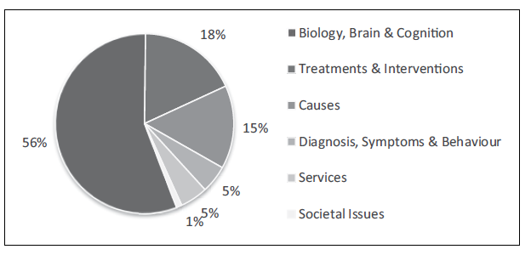
Unbalanced research funding
UK research grant funding, 2007-2011 (Pellicano, Dismore, & Charman, 2014)

Slide 24
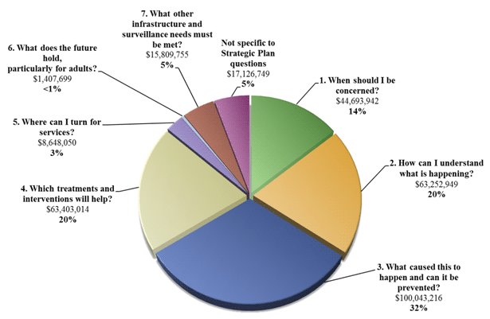
Unbalanced research (cont.)
U.S. Interagency Autism Coordination Committee, 2009

Slide 25
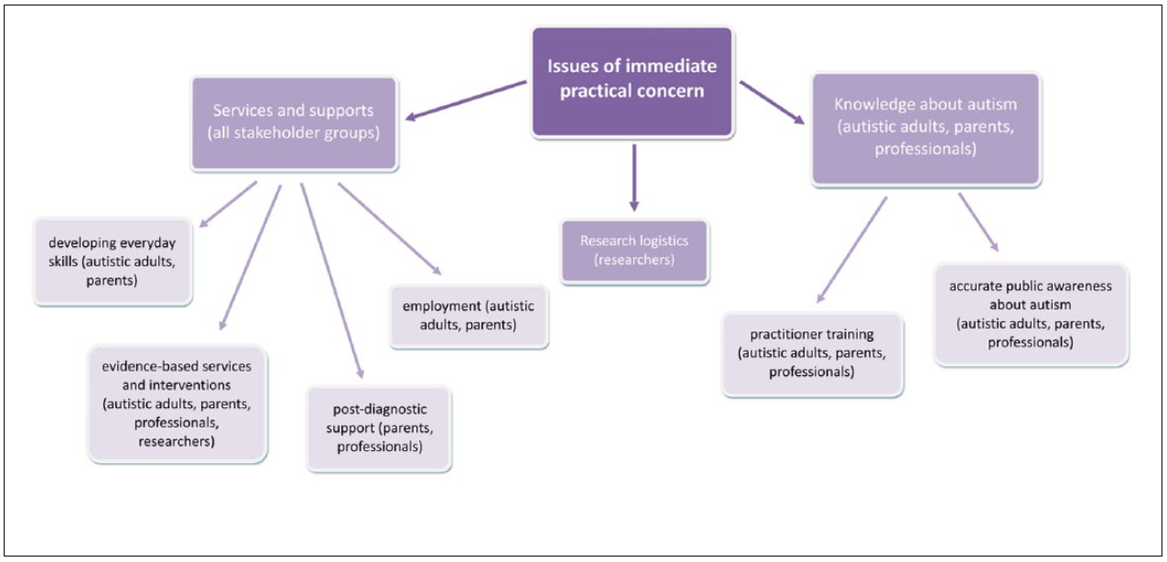
Common ground on priorities
Priorities for autism research in UK (Pellicano et al., 2014)

Slide 26

Q & A
Questions?
Comments?
Suggestions?
For further contact: s.k.kapp@exeter.ac.uk

