Slide 1

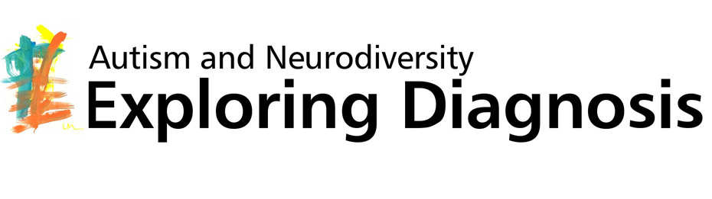

Autism diagnosis across the globe: DSM-5 as a focal point
Steven Kapp

Slide 2
Overview
Background of autism and DSM
The context: Critiques of DSM-5
The players: DSM-5 Workgroup and ASAN
Impact

Slide 3
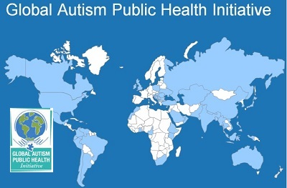
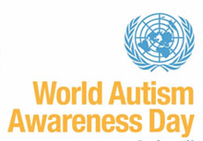

World autism awareness – for what?
  Autism criteria, diagnoses, resources have grown rapidly
  “Epidemic”, validity, utility unclear
  Euro-American origins, influence: cultural imperialism?
"Before the white man came, we were blind [to disabilities]. You brought us the gift of sight. I think we were happier when we
couldn't see.” Elderly Navajo Singer/medicine man (Connors and Donnellan, 1993, p. 279)
Notes:
Some cultures provide more informal support (in extended family, church etc.), more collectivistic; often more disconnected from Western medical system and it may not be serving them well – e.g. African American mothers with more formal education more likely to say autistic child is having negative impact than counterparts with lower formal education; African American autistic young adults are less likely to identify as having a disability despite feeling less self-efficiacious

Slide 4
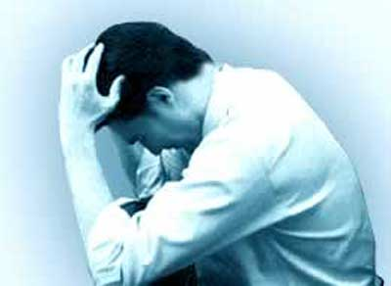
DSMs as reaction to crises in legitimacy of psychiatry
  Eugenics, Nazis -> turn toward environmental etiology
    DSM I (1952), II (1968): Broad, continuous, biopsychosocial model
    Autism as symptom of childhood schizophrenia
  Overmedicalisation concerns -> specific disease framework
    DSM III (1980), IV (1994): Symptom-based, categorical model
    Autism as various independent disorders
  Problems of “comorbidity”, heterogeneity
  DSM-5 (2013): More flexible, dimensional
  Autism spectrum disorder (with various specifiers)
4
Notes:
Reflects cultural context: eugenics (psychoanalysis)
cognitive biomedical revolution
crisis of legitimacy
Mayes, R., & Horwitz, A. V. (2005). DSM‐III and the revolution in the classification of mental illness. Journal of the History of the Behavioral Sciences, 41(3), 249-267.
Wilson, M. (1993). DSM-III and the transformation of American psychiatry: a history. American Journal of Psychiatry, 150, 399-399.

Slide 5
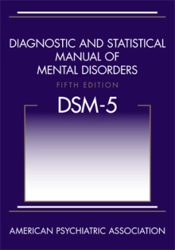
Politics, criticisms of the DSM-5
Drug companies, (often) psychiatrists want broad diagnoses
Insurance companies, scientists want narrow diagnoses
  Often sometimes clinicians, community too
Yet autism community (lay and professional) largely want broad diagnosis

Slide 6
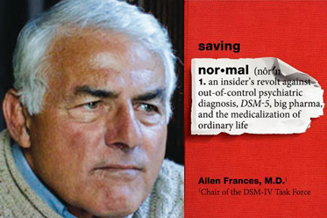

Critiques by powerful scientists
DSM-IV Chair Allen Francis:
overmedicalisation
The National Institutes of Mental Health: lack of validity
  NIMH to stop funding research based on DSM
  Developing more biological RDoC framework
While DSM has been described as a “Bible” for the field, it is, at best, a dictionary, creating a set of labels and defining each.
The weakness is its lack of validity. Unlike our definitions of ischemic heart disease, lymphoma, or AIDS, the DSM diagnoses are based on a consensus about clusters of clinical symptoms,

Slide 7















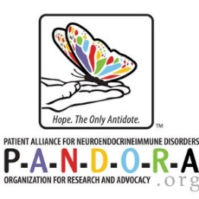












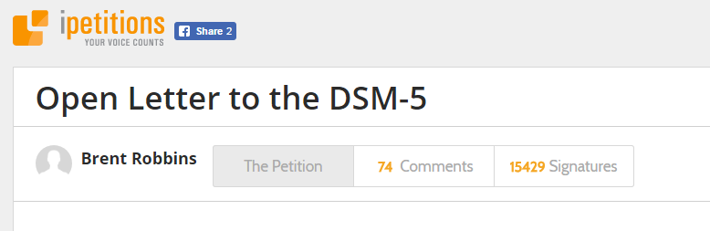


Psychologists: overmedicalisation
Notes:
Open letter to the DSM-5 by grief researcher (medicalising grief exemplar of critiques of overmedicalisation) – over 15k signatures, almost 75 comments – with following signatories

Slide 8
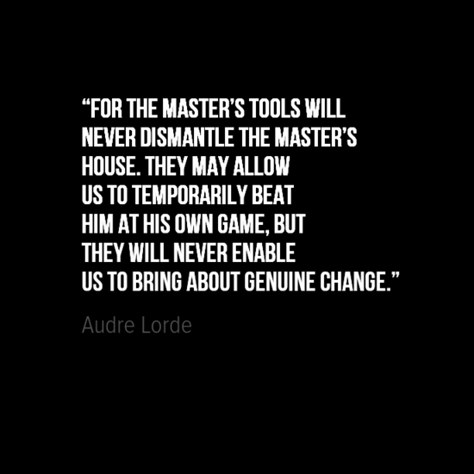
(Western) autistic community
Mostly concerned DSM-5 would reduce access to diagnosis
  Some specifically for loss of Asperger’s label
More radical activists against DSM entirely
Proposed autism diagnosis changes anger ‘Aspies’
By ASSOCIATED PRESS |
February 11, 2010 at 2:05 am

Slide 9

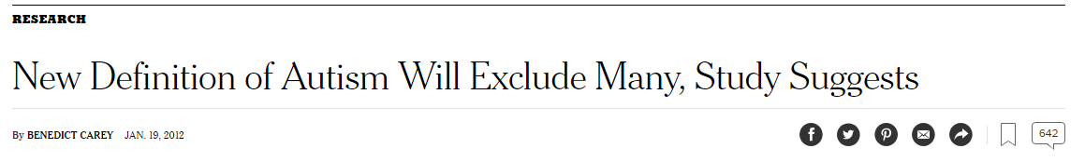
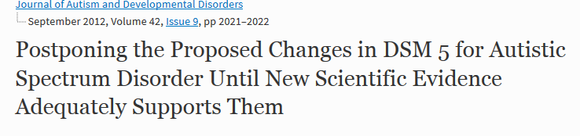
Autism researchers against dx drop
Chair of autism workgroup in DSM-IV, Fred Volkmar, published research claiming DSM-5 will “miss” many
Letter to editor signed by 30 scientists in 7 countries in prominent journal edited by Volkmar

Slide 10

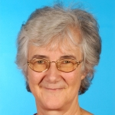

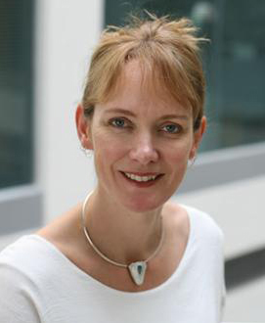



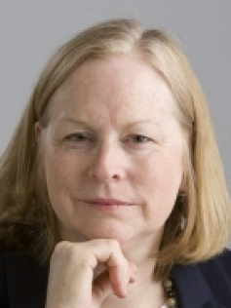



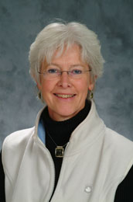

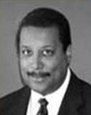

DSM-5 Workgroup
Gillian Baird,
U.K. developmental paediatrician
Susan Swedo (Chair)
U.S. paediatrician
Edwin Cook Jr.,
U.S. child psychiatrist
Francesca Happé, U.K. developmental psychologist
James Harris, U.S. child psychiatrist
Walter Kaufmann, U.S. neurologist
Bryan King, U.S. child psychiatrist
Catherine Lord, U.S. clinical psychologist
Joseph Piven, U.S.
child psychiatrist
Sally Rogers, U.S. developmental and clinical psychologist
Sarah Spence, U.S. child psychologist
Rosemary Tannock, CAN child psychologist
Amy Wetherby, U.S.
speech-language pathologist
Harry Wright, U.S. child psychologist
Fred Volkmar, U.S. psychiatrist
Notes:
[[Volkmar resigned in ’09, was lead author of autism section in DSM-IV

Slide 11
Goals of DSM-5 Workgroup
Increase specificity (decrease false positives)
Usefulness across ages, genders, severity, development
Distinguish behaviours from biology, other conditions
Autism: 2,027 possible symptom combinations (DSM-IV)
-> 11 (DSM-5)
"If the DSM-IV criteria are taken too literally, anybody in the world could qualify for Asperger's or PDD-NOS. The specificity is terrible. We need to make sure the criteria are not pulling in kids who do not have these disorders.“ – Catherine Lord
Notes:
WG said DSM-IV criteria worked best for 5-8-year-old white boys

Slide 12


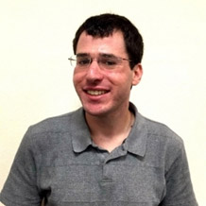

Autistic Self Advocacy Network
ASAN co-founder and (now past) director
Ari Ne’eman
Zoe Gross, ASAN intern (now director of operations)
Steven Kapp, (then) PhD student and ASAN science director
Scott Robertson, ASAN co-founder and then board chair
Notes:
Tell story of how ASAN got involved

Slide 13
Goals of ASAN
Protect access to diagnosis (for services, community)
  Retain if not expand scope of diagnostic criteria
    Especially for social communication symptoms
  Support integration of existing diagnoses into ASD
  Link social communication disorder to ASD
  Especially for adults, women and girls, BME
Prevent then-proposed severity scale
  Or detach it from use for services or treatment
Notes:
Reduce false negatives

Slide 14
A symbiotic relationship
ASAN communicated with workgroup members in person, by phone, e-mail (full group and individually)
Workgroup shared drafts privately for comment
ASAN wrote public and private briefs, memos
  Professional activism: policy, research evidence basse
Workgroup acknowledged ASAN publicly
  Singled out for praise at conferences
  Public briefs cited by members as important, accurate
  Ne’eman included as “consultant” in DSM-5
Notes:
working relationship/ collaborative process

Slide 15
Changes influenced by ASAN
Changes noted in italics
“Need for support” scale, not for services, treatment
Emphasis on inflexibility, not stereotypies, interests
Examples for adults; note of unlimited examples
Observations, history, self-report recommended to assess
Coping strategies, context, uneven skills noted acknowledged
Criteria by history, with subclinical domain functioning
Language on females, culture, adult prevalence, OCD
Notes:
Co-occurring diagnosis broader but fewer possible criteria SCD PDD-NOS
current severity may fall below Level 1

Slide 16
Outstanding questions
Do actions such as ASAN’s further essentialise autism, legitimise the DSM?
Effective to co-opt language of science (reform, work within system) or need revolution?
Why does autism community underrepresent people of colour?
How can one represent without misappropriating?
Does autism exist? How could we know?
Whose interests does the diagnosis serve? Why have it?
Why use the U.S., lobby-based DSM?
Notes:
Don’t need to go into detail, can leave this up as I conclude /// Is export of DSM a form of health imperialism?

Slide 17
Systemic questions
Why use U.S., lobby-based DSM? Why not WHO-based ICD, ICF?
Is a more holistic alternative assessment system realistic?
“I think we can all raise questions about should the diagnoses that determine access to services be determined by committees created by the Psychiatric Association or the Psychological Association or essentially a body of professionals who are advocates for their own profession, which is psychiatrists. I think that’s a really important question and it’s not going to be answered until somebody else does it.” – Catherine Lord (2012)

Slide 18
References
Baxter, A. J., Brugha, T. S., Erskine, H. E., Scheurer, R. W., Vos, T., & Scott, J. G. (2015). The epidemiology and global burden of autism spectrum disorders. Psychological medicine, 45(03), 601-613.
Baynton, D. C. (2001). Disability and the Justification of Inequality in American History. The New Disability History: American Perspectives (pp. 33-57). New York: New York University Press
Burkett, K., Morris, E., Manning-Courtney, P., Anthony, J., & Shambley-Ebron, D. (2015). African American families on autism diagnosis and treatment: The influence of culture. Journal of Autism and Developmental Disorders, 45(10), 3244-3254.
Connors
Haldane, H., & Crawford, D. (2010). What Lula lacks: Grappling with the discourse of autism at home and in the field. Anthropology Today, 26(3), 24-26.
Kapp, S. K. (2011). Navajo and autism: The beauty of harmony. Disability & Society, 26(5), 583-595.
Kim, H. U. (2012). Autism across cultures: rethinking autism. Disability & Society, 27(4), 535-545.
Mayes, R., & Horwitz, A. V. (2005). DSM‐III and the revolution in the classification of mental illness. Journal of the History of the Behavioral Sciences, 41(3), 249-267.

Slide 19
References (continued)
Snyder, S. L. and Mitchell, D. T. (2006). The Eugenic Atlantic: Disability and the Making of an International Science. Cultural Locations of Disability (pp. 100-129). Chicago: The University of Chicago Press.
Sotgiu, I., Galati, D., Manzano, M., Gandione, M., Gómez, K., Romero, Y., & Rigardetto, R. (2011). Parental attitudes, attachment styles, social networks, and psychological processes in autism spectrum disorders: A cross-cultural perspective. The Journal of genetic psychology, 172(4), 353-375.
Wilson, M. (1993). DSM-III and the transformation of American psychiatry: a history. American Journal of Psychiatry, 150, 399-399.

Slide 20

Q & A
Questions?
Comments?
Suggestions?
For further contact: s.k.kapp@exeter.ac.uk

