Slide 1
Right Planet: Examining the Intersections between Neuro- and Cultural Diversity
Steven K. Kapp, Rachel S. Brezis, Nidhi Singhal, Merry Barua, Jacqueline Mathaga, Alexia Rattazzi, Sabine Saade Chebli, Deepali Taneja & Kristen Gillespie-Lynch

Slide 2
Introduction
Anthropology of autism
Rise of self-advocacy in autism research
Global voices of self-advocacy

Slide 3
Outline of the presentation
Presentation from Dr. Steven K. Kapp, autistic self-advocate and post-doc at Exeter university
Docu-advocacy project: voices from autistic self-advocates and parents from 4 LAMI countries

Slide 4



1. Steven Kapp

Slide 5
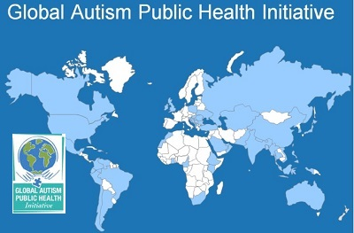
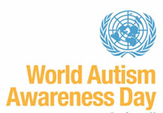

World autism awareness – What for?
Autism criteria, diagnoses, resources have grown rapidly
“Epidemic”, validity, utility of autism unclear
Euro-American origins, influence: cultural imperialism?
"Before the white man came, we were blind [to disabilities]. You brought us the gift of sight. I think we were happier when we couldn't see.”
Elderly Navajo Singer/medicine man (Connors and Donnellan, 1993, p. 279)
Notes:
Some cultures provide more informal support (in extended family, church etc.), more collectivistic; often more disconnected from Western medical system and it may not be serving them well – e.g. African American mothers with more formal education more likely to say autistic child is having negative impact than counterparts with lower formal education; African American autistic young adults are less likely to identify as having a disability despite feeling less self-efficiacious

Slide 6
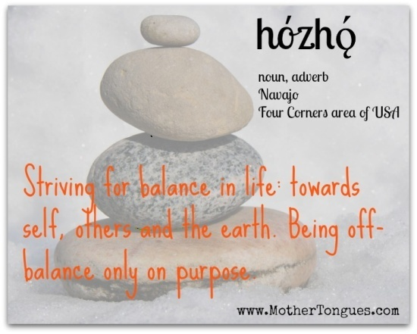
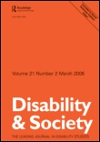


Navajo and autism
Navajo and autism: the beauty of harmony
Steven K. Kapp
pages 583-595
Matrilineal society
People with disabilities can stay with mother without stigma
Caregiving by multiple “mothers”; natural support and relief
Value of harmony (hózhó wellness philosophy)
Historically agrarian society: communal, practical to value all
Also value individuality; people have unique social roles
Accept people with disabilities following ceremonial “cure”
Autistic people viewed as children on the brink of adulthood
Responsible, celebrated for what can do, accommodated and supported for what cannot

Slide 7
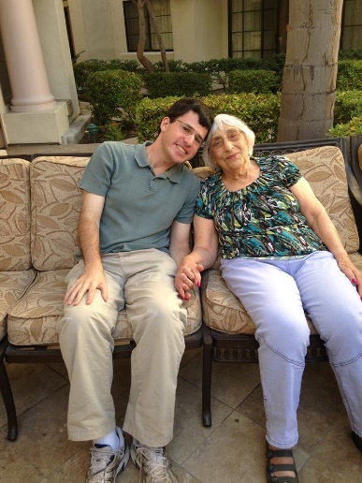
Born into the “American dream”
Raised by a teacher, the daughter of a pediatrician
Grandmother a surrogate “mother” for baby class
Normalization of Western medicine in household
Work model in father, owner of accounting business
Educational and financial (class) privilege
White American privilege; third-generation Angeleno
- white American privilege - accommodations from dx - privilege in access to services from position in field - first time working full time, independently, abroad/outside L.A. - still adjusting to basic aspects of life like getting transportation, getting food
Notes:
Picture is with Grandma who was surrogate mommy for mommy and me class from 10 mo to 2 years old

Slide 8
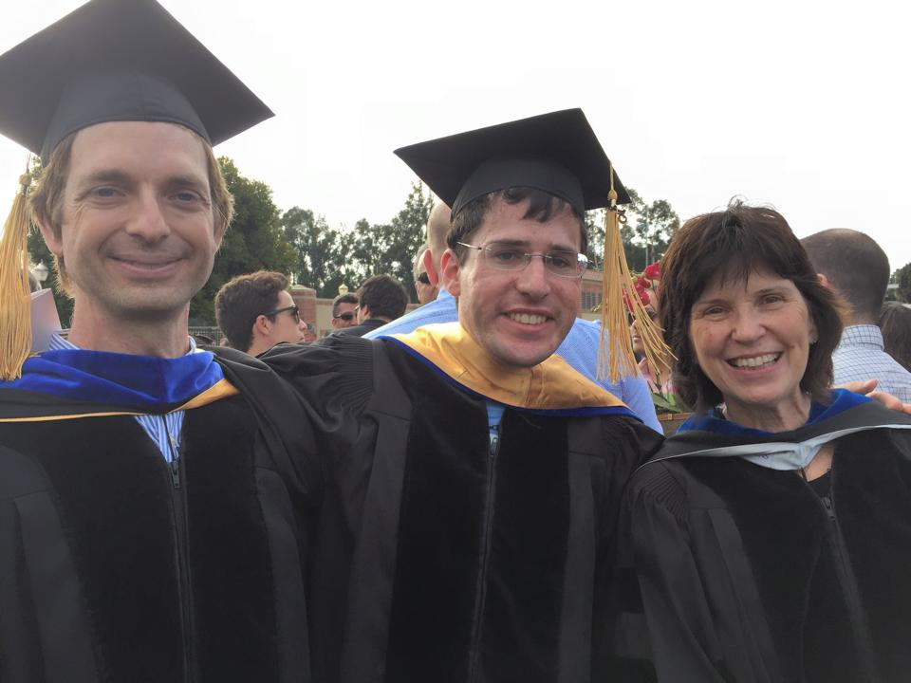
Privilege of My Autism Diagnosis
Diagnosed from, studied at heart of autism’s medical model
Diagnosis expanded access to accommodations, services
Further privilege in access to services from position in field
Autistic advocacy helps me network, helped me get job in UK

Slide 9







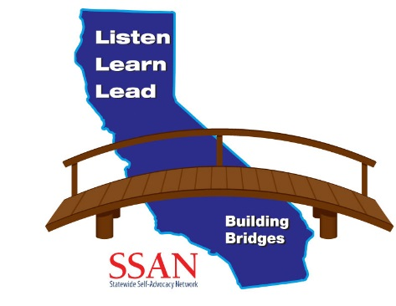


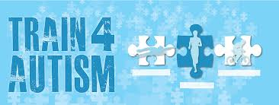
My Activities
Developmental disability policy (employment)
Disability policy (volunteer)
Autism scholarship
Autism activism

Slide 10


From the US to the UK
First time working full time, independently, outside L.A.
Adjustments: transport, food, healthcare, language, climate
Struggle with organisation, self-care, health, relationships
Yet maintain unusually high access to services

Slide 11

2. Docu-advocacy project
Voices of autism from around the world

Slide 12
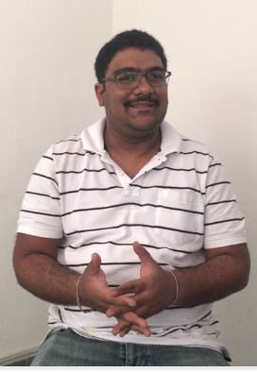
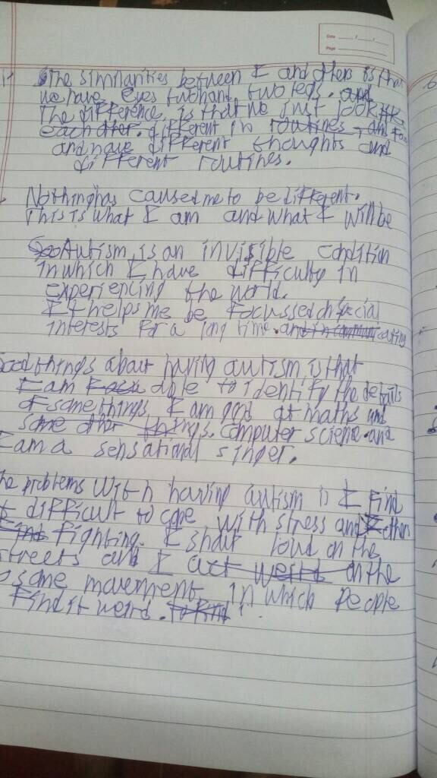
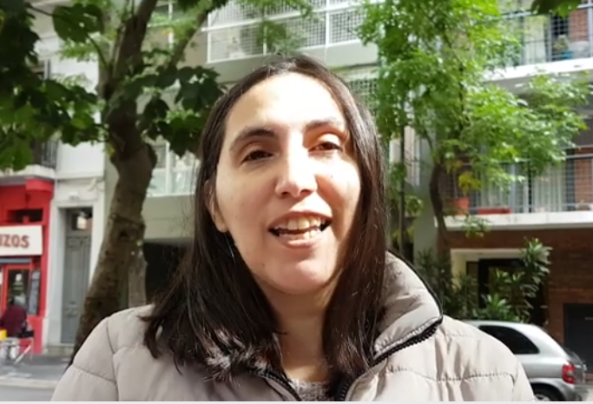
Methods
4 LAMI countries: Argentina, India, Lebanon, Kenya
Aimed to interview one autistic self-advocate and one parent from each country (no self-advocate from Lebanon)
Participants could respond by video, audio, or in writing

Slide 13
Interview questions
What makes you/your child similar and different from other people you know?
What do you think caused you/your child to be different?
What is autism?
What are good things about having autism?
What are problems with having autism?
How does autism affect your/your child’s life? How does it affect the lives of people you are close to?
How do the people in your community talk about autism? How do people respond to you and your family?
When were you/your child diagnosed? How did receiving an autism diagnosis affect how you see yourself/your child, if at all?

Slide 14
Interview questions cont.
How do you feel about autism now?
How do you expect to feel about autism in the future?
What treatments/services/supports have helped you cope with autism, and why? Was it difficult to get the supports you have? Why or why not? What supports do you wish you had that you don’t have now? What autism supports does your community need and why?
When and how do you tell people about autism? Does telling people about autism change how others treat you/your child? If so, how?
What do you think autism research should focus on?
What autism advocacy have you participated in? What do you think autism advocacy should focus on?
What is neurodiversity? (Define it if they do not know). How do you feel about it?
Do you have a message for other autistic people around the world?

Slide 15
Voices from Argentina
Mario: Autistic self-advocate
Paula: Mother of autistic 13-year-old, Antico

Slide 16
Voices from India
Akash: Autistic self-advocate
Drishaan: Autistic self-advocate
On sharing:
On identity:
I tell people about autism when: (1) They are familiar with me. (2) When I want them to understand me and better help me.
Telling people about autism changes the way people treat me. Sometimes they help me further and sometimes they reject me.
Nothing has caused me to be different, this is what I am and what I will be… I am proud about feeling myself autistic.
On advocacy:
On neurodiversity:
In the society that I live I have distributed blue bulbs and pamphlets about autism to the families living here to make people aware about autism.
It refers to the differences in brain thoughts. People should be okay about other people who have thoughts different from them. Those thoughts should be respected.
16

Slide 17
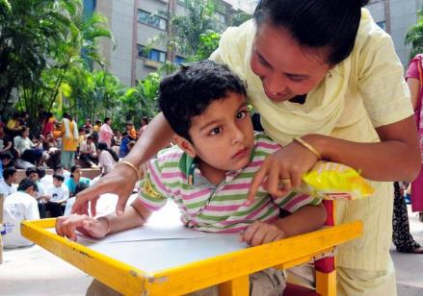
Voices from India
Shweta: Mother of autistic child
On the need for mainstreamed education:
On the need for family support:
I read that most of the autistic people they learn a lot in the mainstream schools; I have heard that a lot of them are trying to get in, but it’s very difficult bc there are no supports for them there.
[I need more support from my] family– sometimes, when it’s hard, I don’t know what to do. He [my husband] understands, but if things happen with my mother in law sometimes she understands, sometimes she doesn’t, so it is very hard.
Message:
Be happy, people will accept you. Just be what you are.
17

Slide 18
Voices from Lebanon: Nidal’s Story
“Renoir is my favorite artist, so I relate different aspects of my life to his art. There’s also the black, obviously, symbolizing mourning. I do feel I’m in mourning, only it lasts much longer than a few weeks. There’s also the way one of the girls is trying to communicate with the other while the other girl is not there. This makes me think of my son, when he’s staring into nothingness and I’m trying to get his attention. There’s also the chaos in the background. Our lives have been very chaotic in the last year. Suddenly I forget things, I make mistakes when working, I am late to appointments, to name a few examples of the chaos that has suddenly entered our lives.” Nidal: Autism researcher, professor & mother of autistic 3 year old. Relocating to the US so her son can receive the services he needs.

Slide 19
Nidal’s Story
“I realized that I wasn’t being overly anxious or suffering from an occupation hazard or medical students’ disease…I realized that my worst nightmare was coming true…As far as it affects my son, autism takes away basic opportunities and rights that mostly everyone else in the world gets to take for granted. There’s nothing that isn’t affected by it…I never used to be negative about autism… but it’s one thing to see it from a distance and a whole other phenomenon when you see it through the single most important person in the world…With respect to my son, there’s nothing good about having autism…I find that I’m resentful that the overwhelming majority of parents have this enjoyment and these dreams – I had dreams for my son too… I don’t think the diagnosis affects how I see my son. It affects how I see the world and the specific context in which my son lives”

Slide 20
Nidal’s Story
“I trained two former students to work with him – I used to suffer so much during training sessions…I had my students in there and I needed to keep that professional face. I couldn’t show them that I was dying because I was seeing my son doing things I had seen other kids do. Other kids with whom I worked and whom I loved, but seeing those behaviors emerge from my son was so painful, so surreal, like some supernatural force making a joke on me…I think a lot about the way I used to work with autistic kids when I was in New York. I used to be kind to them, I was effective, I did good work. I loved them, was attached to them. Why did this happen that I now see them in my son? I do feel that autism is a big punisher. I know that philosophically speaking, one could say “hey, you loved those kids, so now you see them through your son, and that’s beautiful”. I don’t feel that way… It’s a paradox maybe, but my two truths are that I loved those kids and I don’t want my son to have autism, and those two truths aren’t incompatible…”

Slide 21
Nidal’s Story
“I now wish the biomedical researchers would just figure out a way to stop it, stop its effects, cure it. I know “cure” is offensive to autistic self-advocates, but I have issues with them being spokespersons to everyone affected by autism. I have issues with the DSM-5 making it all under one label. I don’t believe the high-functioning autistic has a right or the knowledge to speak for families like us who have to teach their child to point, just to point. I don’t see autism as being part of a person’s identity; I see it as something that blocks a person’s ability to function. This doesn’t make sense when referencing high functioning autistic people who are completely independent and able to communicate and live their life to the fullest, but it makes a lot of sense when in reference to those who are far from meeting their full potential and far from living life the way most humans have the luxury to.”

Slide 22
Nidal’s Story
Lebanon is “so far from what it’s like in the U.S. and Canada and I was hoping to try and change that at a small scale, by starting an (ABA) training program in my department...working with a school or two to develop their inclusivity and special-education resources, and helping to open an intervention center…I would’ve loved to undertake these goals – and even started – so things would be a little better for the autism community in Beirut, but I can’t continue with those now. I have to spend my time and energy on my son, not on developing things that would not be ready in time for him, especially not in Lebanon, one of the most corrupt countries on earth…I want none of these corrupt pseudo-professionals – the credentialed ones and those who are just BA holders who attended an ABA workshop and are now calling themselves ABA therapists – to have anything to do with my son. The clock is ticking because he’s 3 years and 2 months old, and early intervention ends at the age of 5 and we have under 2 years to make a meaningful difference in his life…so we won’t waste more time here.”

Slide 23
Voices from Lebanon: Nadine’s Story
"All people - all typical kids are the flowers - the beautiful flowers - life's decoration. At the same time you have other people, such as those on the spectrum, and they are symbolized by the light, toward the right side of the photograph. To me, as a parent, this is light for me more so than it is for them - they light up my life. In general, the photograph is beautiful. It opens up a way for you to see the real light that you can see within yourself or within the autistic child - and that happens with the right intervention, ABA, which offers the right path to lead you to a good place. Even the flowers, that are basics in life, they might have thorns. The light, however, doesn't have limitations or borders; it leads you to the sky." Nadine: Mother of 7-year-old autistic daughter, Serena.

Slide 24
Nadine’s Story
“I cannot give a rigid definition of autism because I only experienced a small side of it through my daughter. It’s a condition that is flexible; a person can get out of it. There’s a paradox here; you cannot deny the autism and at the same time you shouldn’t succumb to it. …It is a difference – it has its advantages and disadvantages, but it’s not a big deal. You should be the one to adapt to this condition, this experience. You decide whether you want to see it positively or negatively. If you take it positively, the results will be so much better. Autism is more difficult than being a typical kid, but even typical kids have various issues and difficulties, some of which appear at an early age and others late on. With autism, you get the difficulties early on.”

Slide 25
Nadine’s Story
“I feel that Serena benefited from her experiences with the ABA approach…I don’t find many differences between her and her peers…I find there’s a great difference between what I would’ve thought – on my own – to be right or wrong and what ABA taught me. ABA taught me to be consistent and well-organized. If there was no autism, then I wouldn’t have learned these aspects of right and wrong and I wouldn’t have learned to be constructive and positive, so if Serena were a typical child I think my parenting wouldn’t have been as good. Another positive thing is that I am now more open and tolerant to diversity; I appreciate the kinds of difficulties any person with a disability or with some kind of difference might have. Autism helped me determine what is meaningful…The problem in Lebanon is the way people view my child or her differences. Serena is sensitive and people can be harsh here.”

Slide 26
Nadine’s Story
“Our community needs all sorts of supports. No one is prepared. We just happened to have a new program at AUBMC that includes ABA services and to have you [Nidal] for the research sessions that are teaching Serena. It’s so upsetting that the services are so scarcely available and those available are so expensive. It makes me cry to see other parents who can’t afford services for their children and they just watch them deteriorate…Research should focus on the child’s potential. I don’t know much about the technicalities of research, but I find that there’s a lot of potential that is hidden inside the child. It takes a lot of effort and hard and creative ways to get this potential to materialize in the child’s behavior.”

Slide 27
Voices from Kenya
Ryan: 22-year-old autistic self-advocate
Nomi: Mother of 8-year-old autistic son
Jaki: Mother of 11-year-old autistic son & president of Kenya Autism Alliance

Slide 28
Recurring themes
Autism as a different way of being and perceiving
Variability and change across individuals and contexts
Positive aspects of autism:
Sincerity, transparency & focused skills
Teaches those who are close
Barriers to care:
Lack of trained specialists, high cost, & distance
Loneliness for parents and autistic people
Varied responses from community:
From pity/rejection to understanding and encouragement

Slide 29
Paradoxes and tensions
To share or not to share?
Mothers in Kenya, Argentina – share profusely; Lebanon- hesitant (autistic college students declined to participate); Self-advocates – mixed/context dependent
To cure or not to cure?
Does autism open doors, or close them?
Education/work opportunities; need to immigrate; new identity and support group
Highlight the differences, or focus on similarities?
Diversity as part of humanity

Slide 30
Discussion
Ideas travel fast and wide – but services don’t
Similar views of autism as a way of perceiving the world
Similar knowledge of existing therapies although preferred therapies differed (e.g., relationship-based Argentina vs ABA Lebanon & ABA/biomedical Kenya)
But great disparities in access to care (professional development, geographic, financial)
Stigma and lack of knowledge remain a barrier
Research should focus on intervention and societal education and should be informed by people who are directly affected by autism

Slide 31
Conclusions and Future Directions
Culture affects challenges, opportunities – autism itself too?
These stories offer insights but are not generalizable
We are similar, yet different – should respect diversity
Need more collaboration amongst LAMI countries
E.g., Argentina – Doing more with less
India – How to empower mothers
Family networks and support or advocacy groups
To counter loneliness, to increase acceptance, to educate
More self-advocacy around the world!

Slide 32
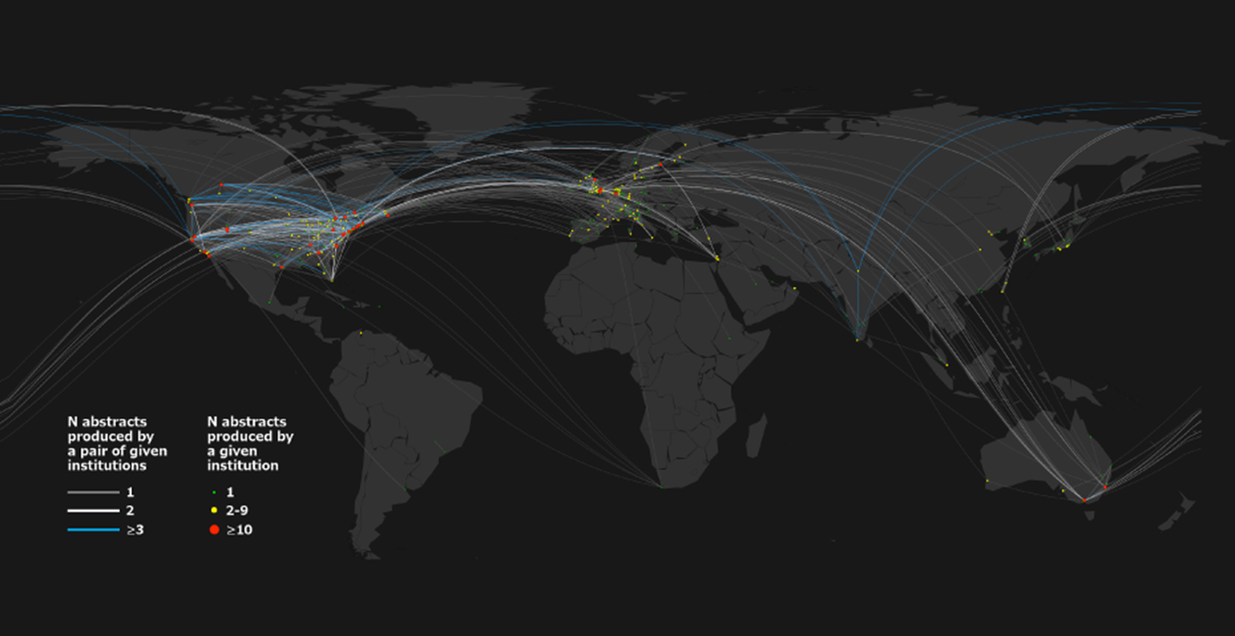
Map of IMFAR autism collaborations 2008-2013
Goldstein et al., 2014

Slide 33


