Slide 1
Reconceptualizing Migration and Journey Stories

Slide 2
Learning Objectives for the Day
The aim of today is…
  To gain an understanding of how journey stories shape the society in which they are told.
  To think about journeys as both an individual experience and one that is shaped by and depends on interactions and networks.
  To gain historical knowledge about migration.
  To gain an understanding of how journeys and migration have changed over thousands of years, and to see if they differ to the modern day.

Slide 3

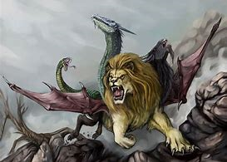
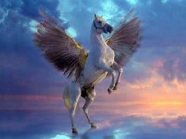
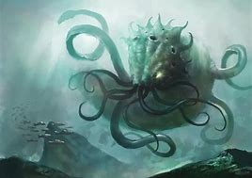
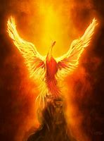
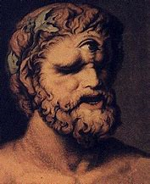
What we are going to do
We will be splitting each workshop into 6 groups within the workshops.
Each group will have the opportunity to take part in 3 separate activities, which will work on a rotation basis.
Each group will be named after a mythical creature these are: Cyclopes, Pegasus, Phoenix, Chimera and Kraken, Minotaur.
Chimera
Pegasus
Kraken
Phoenix
Cyclopes
Minotaur

Slide 4

Giocherenda
Giocherenda - An artistic collective of young refugees who invent, build and animate games devised for sharing through storytelling
Giocherenda is a term from the African language Fula which means "solidarity", "interdependence", "strength deriving from union", "joy coming from doing something together".
Their countries of origin are: Guinea, Gambia, Mali, Burkina Faso, Morocco and Kosovo. Among them there are refugees, stateless Romani and second generations.

Slide 5

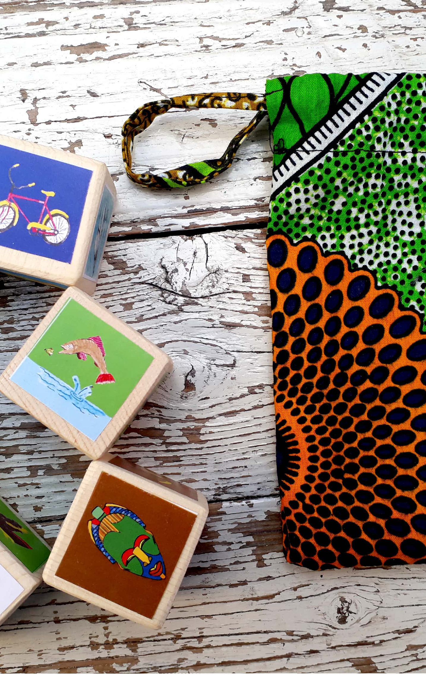

The Giocherenda Game
Each group will spend 10 minutes playing the Giocherenda game.
The game involves six dice with different images on each side.
The purpose of the dice is to help create a verbal journey story.
Each person will roll the dice and add a line to the story, this will move around the group one by one and will be recorded on a Dictaphone. It is important that you speak into the Dictaphone.

Slide 6
Postcard maps of your journey to school
The purpose of this activity is to help you think about your journey to school in a different way.
We would like you to draw a map of your journey to school this morning, using your senses; taste, smell, touch. Your emotions; how different areas make you feel.
For example, if you are driven to school, the sound and smell of the car and other areas you may pass. If you walk it could be the smell of a bakery you may pass or even a house you used to live in and how that makes you feel.

Slide 7
Class Map
Each class will be given a large sheet of paper with a basic map drawn on it.
We would then like you to place mythological creatures and other ancient monuments onto this map.
The purpose is for you to imagine where these creatures and monuments were positioned in the Mediterranean.
These maps are then for you to keep and put up in your tutor rooms.

Slide 8
With the people next to you discuss what comes to mind if we say the word migration?

Slide 9
Migration
Modern meanings:
1st: Movement of people to a new area or country in order to find work or better living conditions.
2nd: Movement from one part of something to another.
Ancient meaning:
This is currently a highly problematic topic as it was primarily based on material culture. However, historical sources show occasional moments of large-group migration; the mass movement of armies and the Barbarian invasion of the Roman Empire, 300AD. and small group migration; regular trading routes along the coast, up rivers and Greek colonies. as well as other types of migratory phenomena; exile and slavery.

Slide 10
With the people next to you discuss what comes to mind if we talk about journeys?

Slide 11
Journey
Modern meaning:
1st: An act of travelling from one place to another.
2nd: A long and often difficult process of personal change and development.
Ancient meaning: problematic, no fixed translatable word in the ancient Greek or Latin languages.
Greek:
Nostos which translates to homecoming stories found in Homeric epics.
Periploi which translates to voyages around. Via sea following the coastline.
Latin:
Iter which translates as march, path, road or travel.
Via which means way, road, highway or path.

Slide 12
With the people next to you discuss examples of where you would find journey stories both factual and fiction?

Slide 13
Examples of where you can find journey stories
Books
Films
Myths
Fairy Tales
Bible
Comic Books
News
Poetry
Documentaries

Slide 14
With the person next to you discuss why journey stories might have been told?

Slide 15
Reasons why journey stories are and were told and repeated and then recorded
Share experiences.
Educational.
Learning about different cultures.
Teach moral values.
Entertainment
Embed cultural values
To explain the origin of a group of people or a significant place.

Slide 16
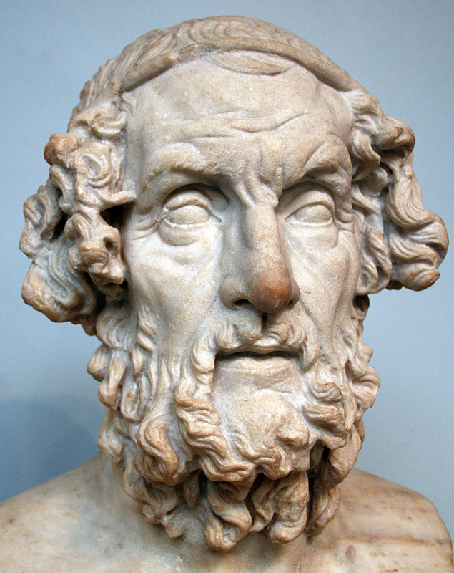
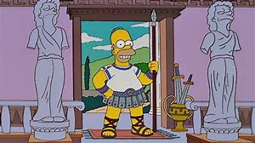
The Ancient Works
Some of the most famous ancient journey stories come from Homer and Virgil.
Written by this Homer
Not this Homer.
This Photo by Unknown Author is licensed under CC BY-SA

Slide 17
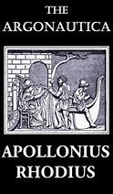
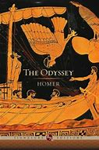
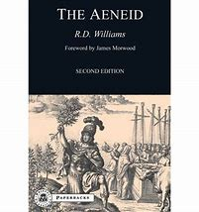
Ancient Journeys
Here are examples of some of the most famous ancient journey stories,
which were all written in the form of epic poetry.
Homer:
  The Odyssey: Odysseus’ homecoming nostos after the Trojan war where he faces many challenges.
  Apollonius of Rhodes:
  Argonautica: Jason and the Argonauts adventure to find the golden fleece.
  Virgil’s:
    The Aeneid: Aeneas a Trojans journey to Italy where he becomes the founder of Rome, also known as a foundation myth.

Slide 18
Homer: The Odyssey
Odysseus homeward journey (nostos) from the Trojan War because he angered Poseidon. Penelope, Odysseus wife is overwhelmed by suitors.
Telemachus, Odysseus son, travels around Southern Greece to enquire into his father’s whereabouts. Encounters: Nestor, Menelaus and Helen.
Odysseus held captive by Calypso for 7 years. The Gods send message to her to allow him to leave.
After 18 days at sea he encounters the Phaeacians, where he is offered hospitality and stories of the Trojan War are told.
Odysseus finally told his own journey story including encounters with the Cicones, the Cyclopes, Polyphemus, the son of Poseidon, Aeolus, ruler of the winds, Laestrygonians, the land of the giants, witch-goddess Circe, spirit of Tiresias and lost souls from the Trojan war.
The Phaeacians provide a ship for Odysseus and he travels back home and rids his home of Penelope's suitors.

Slide 20
Apollonius of Rhodes: Argonautica
The story of Jason and the Argonauts voyage to retrieve the Golden Fleece from Colchis (Georgia).
The voyage takes them around the Mediterranean, the Black Sea and up river systems on a Ship called the Argo.
Throughout the voyage, Jason and the Argonauts encountered many different societies, some which were hostile and other which were friendly.
  Queen Hypsipyle and the women of Lemnos who had killed all of their men folk.
  The six-handed savages and the much more civilized Doliones people.
  King Amycus of the Bebrycians, who challenges any Argonaut champion to a boxing match.
  Phineas who was cursed by Zeus with extreme old age, blindness and constant visits from the Harpies.
  King Aetes and Medea, trails of strength to gain the golden fleece.

Slide 22
Virgil’s: The Aeneid
The story of Aeneas, a Trojan who travelled to Italy, where he became the ancestor of the Romans.
This story can be divided into two parts: the journey to Italy and then the war when they arrived in Italy.
The story starts with a storm which devastates Aeneas fleet, they take shelter on the coast of Africa, near Carthage, where Aeneas finds favour with the Queen Dido.
Aeneas recalls the Trojan war, how the other survivors made new homes all over the Mediterranean, getting caught in the whirlpool of Charybdis and came ashore on the lands of Cyclopes.
Aeneas leaves Carthage and holds funeral games on Sicily, where he is told to visit the Sibyl in Cumae who guides Aeneas to the underworld.
Aeneas leads the Trojans to settle in Latium, where they fight a battle against the local people, the Rutuli.

Slide 24
Differences between ancient and modern journey stories
Ancient
  Circular, so journeys always ended the same place they started.
  Borderless, had no borders to cross.
  Most journeys were based on trade.
  The further away from home the traveller the more mythological the creatures became.
Modern
From one destination
to another.
Cross borders.
Migration is viewed
differently depending
on the reason for it.
Mythical creatures are
not used to signify distance.
Similarities
Certain groups are
viewed negatively
compared to others.
Differences
Ancient, cultural
differences.
Modern, economic
reasons.

Slide 25
How the ancients viewed their world
The Ancients could not fly and only had knowledge of the areas in which they travelled or had heard journey stories: around the Mediterranean and the Black Sea.
They saw the world from eye level.
So, the highest view of their surroundings would have been from on top of a hill.
The Ancients maps were therefore very different:
    Only focusing on the Mediterranean or on river systems.
    The water was at the centre of these maps with important settlements on the land.
‘like frogs around a pond’ (Plato Phaedo 109b)

Slide 26
Nile Mosaic created in the 2nd-1st century BC

Slide 27
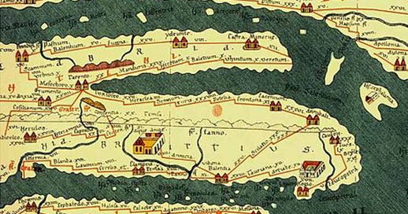
Peutinger Map or Itinerary, created 4th century AD.

Slide 28
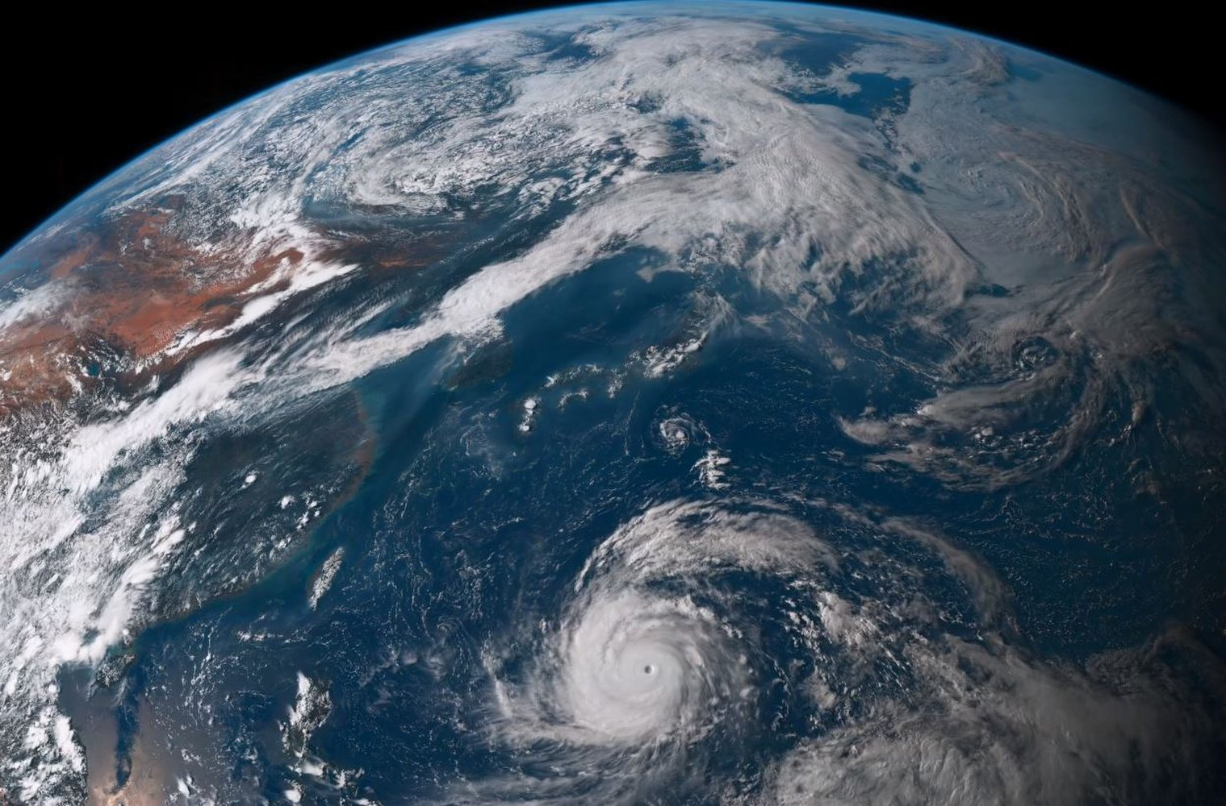
How we view the world
We have an awareness that the world is round.
We tend to view the world from a bird’s eye view (google maps).
We also have access to images and footage
of every inch on the world, so we have
preconceived ideas about different cultures and
places.
Therefore, many people do not view journeys
as an experience, instead more of an daily
necessary.

Slide 29
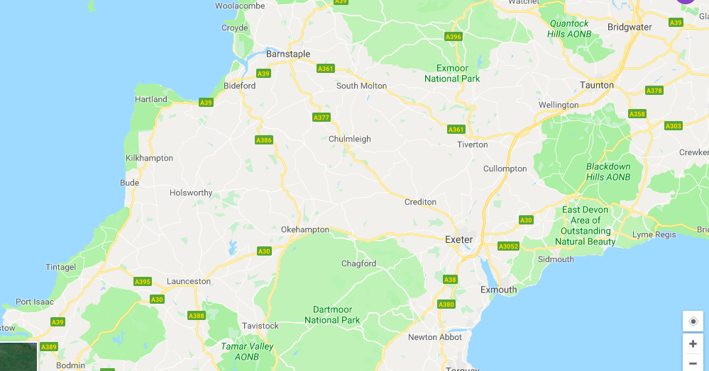

Slide 30
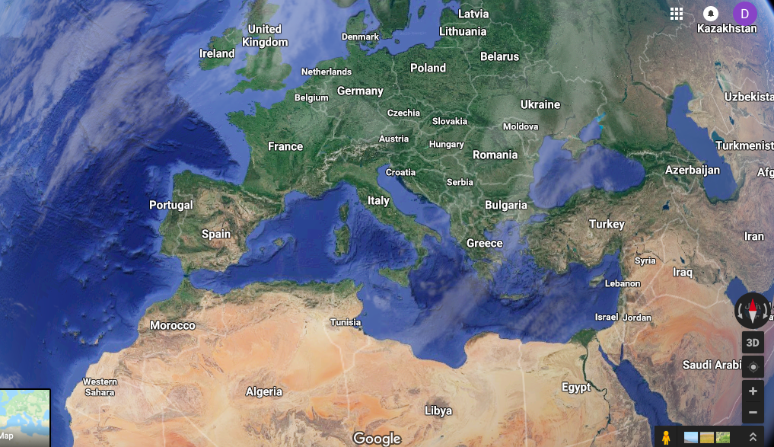

Slide 31
Ancient Context in Modern Times
Numerous ideas from ancient times have been used within modern work that are more relatable to the audience of today.

Slide 32
If you have any questions throughout the day, don’t be afraid to ask.

