Slide 1
Lead Mentor Development, consultation and Training

Slide 2
Sharing Good Practice

Slide 3
Changes to the Exeter Model
Lead Mentor (Was PST, now more involved with assessment/FRAPs)
Reflective Mentor (Was mentor but no longer an assessment role)
Initial Teacher Education Coordinator – ITEC​ / Lead School
University Visiting Tutor/University Personal Tutor​
Notes:
Reflective Mentor (old mentor) no longer signs off FRAPs
ITEC has a STRONGER ROLE IN QA OF FRAPs

Slide 4
The Lead Mentor
This role involves an expert practitioner working with the trainee to help them learn and adopt new teaching practices, and to provide feedback and review performance.
The mentees gain from mentors’ wisdom, knowledge, and experience. Mentors counsel, actively listen, and encourage development, with benefits to mentees that include enhanced self‐confidence.
Notes:
Lead mentors are specialists in the craft of the classroom (and in the Secondary programme, experts in their main teaching subject). They assist trainees by working as partners in the classroom, demonstrating teaching, jointly planning and carrying out focused observations of their teaching and providing feedback and advice. Each trainee is allocated a Lead Mentor who is responsible for coordinating the trainee's learning.
This informs our model for instructional coaching and the basis of the mentoring model for our Lead Mentor but with elements of the less classical model that include reverse mentoring.
This will inevitably fall more towards the directive end of the mentoring spectrum but with the caveats mentioned in previous training.

Slide 5
Responsibilities of the Lead Mentor
As Before…
CHANGED
WDM
Observations
Demonstrations and Agendas – still evaluate the same
No changes to planning templates – on the website
Classroom contact time 12 – 15 hours
Lead Mentor will have an ongoing role discussing the FRAP – will tick a supportive statement at the point the trainee has evidenced the phase
Framework for Dialogue is now called The Exeter Model Framework
Trainee will complete a Weekly Reflection before each WDM, in the Developing Independence Phase this changes to the Focused Reflection.
Pupil Learning Story is now an option for Focused Reflection
GONE
PST Checklist
Work Scrutiny

Slide 6
FRAP 2
This will mainly be completed back at university by personal tutors but there are 2 sections that need to be completed by Lead Mentors before trainees return.

Slide 7
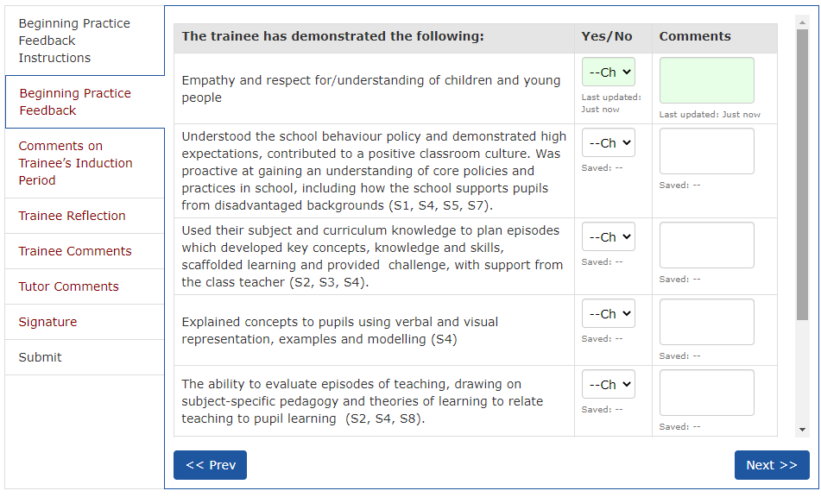
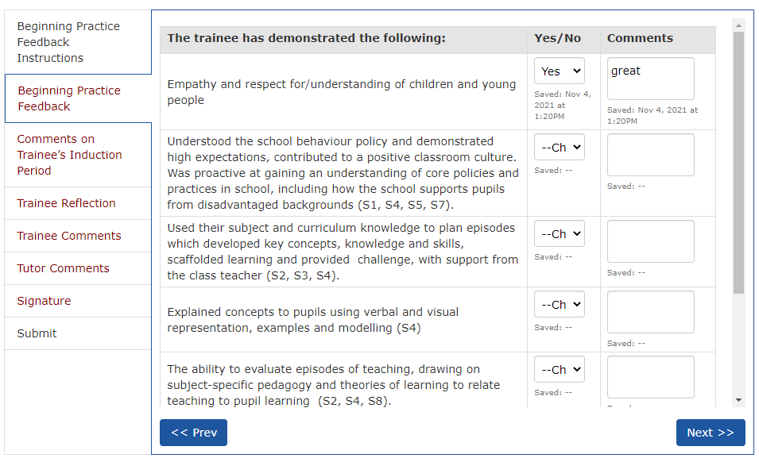

Slide 8
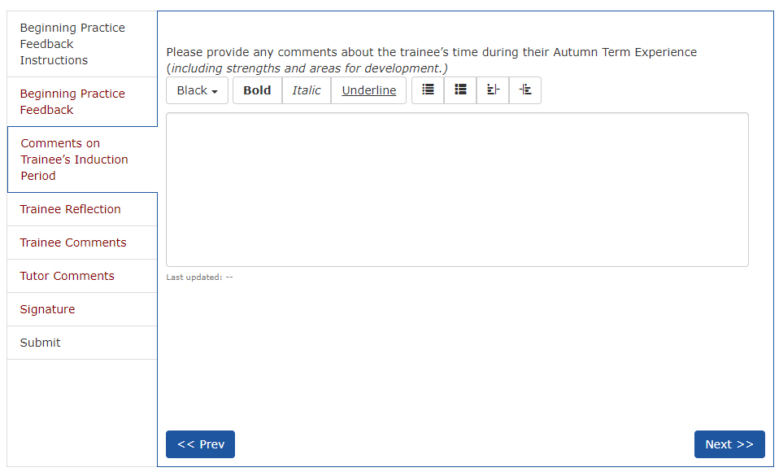

Slide 9
Curriculum
The Core Content Framework for ITT is NOT the curriculum. It is a statutory entitlement which our curricula include.
Each trainee follows a carefully designed and sequenced curriculum in their subject, identifying what they are learning across both University-led teaching and school placements
The Curriculum Maps outline this sequenced curriculum and show when and how the CCF minimum content is included.

Slide 10
Curriculum
Where are the connections between what is learned in the taught course and what is learned on placement?
How can Lead Mentors draw upon trainees’ prior learning during school-based training?
What can Lead Mentors ask UVTs to do to help draw on trainees’ prior learning during school-based training?

Slide 11
Research
Ofsted Curriculum Research Review: languages
https://www.gov.uk/government/publications/curriculum-research-review-series-languages
British Council Language Trends Survey 2021
https://www.britishcouncil.org/research-policy-insight/research-reports/language-trends-2021

