Slide 1
Lead Mentor Training, Development and consultation
May 2022

Slide 2
Sharing Good Practice
Notes:
Good mentoring practice identified by UVTs during visits to be highlighted and discussed

Slide 3
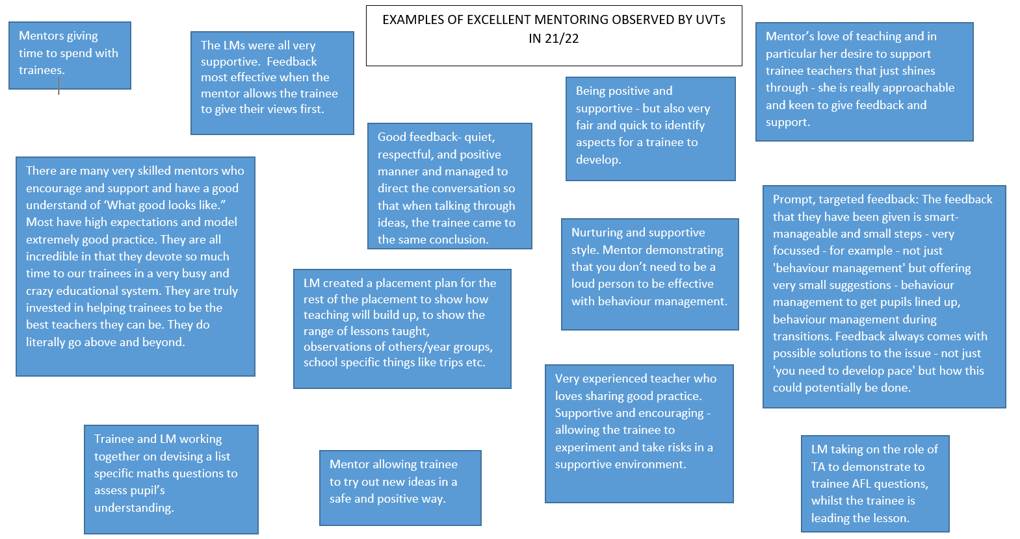
Notes:
These examples were sent by UVTs, could prompt a discussion about practical tips to being a good mentor- break out rooms, or use chat function

Slide 4
Mentor Training

Slide 5
Expectations of the Phases
Anticipating Practice
Beginning Practice
Consolidating Practice
Developing Independence
Enrichment and Extension
Notes:
As you move into the Developing Independence Phase, you will start to think about your classroom practice in a more holistic and challenging way, including focussing on your pupils and their learning.

Slide 6
Consolidating Practice
Trainees should:
Take increasing responsibility for planning, teaching and assessment for learning in whole lessons, as and when you judge that they are ready
Continue to observe experienced teachers demonstrate teaching strategies and approaches on which they can model their own practice
Develop an increasing awareness of the individual needs of pupils and their learning achievements
Begin to learn about methods of assessment both of and for learning
Take increasing responsibility for their own professional development.

Slide 7
Developing Independence
Trainees should:
Plan, teach and assess pupils’ learning in whole lessons and sequences of lessons
Continue to observe experienced teachers demonstrate teaching strategies and approaches on which they can model their own practice
Develop higher levels of teaching skills in areas where they have already shown proficiency such as question-and-answer techniques, approaches to formative assessment, managing groupwork or using ICT to enhance learning
Develop a pro-active and independent approach to their own professional development
Notes:
In the developing Independence phase they should be taking a more holistic approach to their reflection and learning and showing that they can consistently carry out aspects of the phase descriptors. We’ll talk about this again later on.

Slide 8
Extension and Enrichment
Extension and Enrichment phase is instead of, not in addition to, their existing workload. It may be that their teaching commitments are reduced slightly in order to create time for this. Trainees may decide to pursue extension and enrichment phase activities whilst continuing to teach all or the majority of their existing classes.
Their training should continue to follow the Exeter Model while in Enrichment and Extension, including Weekly Development meetings and Focused Reflections. Their focusses should be chosen to fit with the targets on their Extension and Enrichment Action Plan.
If they have opted to follow the leadership strand, the Leadership Framework Task should be completed during extension and enrichment .
Trainees undertaking extension and enrichment activities in another school should continue to complete Focused Reflections in this alternative setting.
Notes:
All trainees are expected to be in their placement school on the dates of External Examination, 22nd & 23rd June.

Slide 9
Take Care…
You probably took on the role of mentor in order to help to shape the next generation of teachers. You may need to be careful that you are not seeking to shape them into your own image and likeness.
Do you want your mentee to be able to teach in exactly the same way that you do? Or do you want your mentee to become the best teacher that he/she can be, making the best use of their own skills, interests, expertise, personality etc?

Slide 10
Effective Mentoring
An effective mentor enables the mentee to tell their own story in order to:
Review the past (e.g. how did last week’s lesson with Year 9 students go?)
Reflect on the present (e.g. how did this week’s lesson with Year 9 students go?)
Envisage the future (e.g. if I continue to do things as I have been, is next week’s lesson with Year 9 students likely to go the way I want it to go?)
(Gravells & Wallace, 2012)

Slide 11
The Mentor’s Role
You need to facilitate this process of review, reflection and envisaging using careful questioning and probing
Help the mentee to become aware of and explore alternative perspectives and possibilities within their own practice. They should not just be imitating yours.

Slide 12
Enabling Trainees to Take Risks
The process of review, reflection and envisaging cannot be a passive act of ‘navel gazing’, it must lead to action.
Without action change is impossible and this means that mentors needs to allow their trainees to take risks and not always do what they (and you) feel is ‘safe’.

Slide 13
Completing the FSR
Notes:
The Final Summative Report is due on 15th June for Secondary trainees and 17th June for Primary trainees. All trainees who have met FRAP4 and met all the Teachers’ Standards must submit FSR on the 15th or 17th June. Extension requests for the FSR deadline is not permitted.
Trainee adds the FSR form to their timeline in the IDP
Lead Mentor / ITEC review evidence in the trainee IDP and teaching file.
In the FSR template, Lead Mentor selects ‘yes’ from the drop down box if the trainee has met all the Teachers’ Standards.
Trainee and Lead Mentor go to signature tab to sign and date the FSR.
If Lead Mentor / ITEC agree the trainee has not met all the standards they select ‘no’ in the drop down box and select the standards not yet met contacting exeterpartner@exeter.ac.uk to inform them.
Lead Mentor writes additional information about the standards not met in the free box go to point 4.
Exeter Partner will arrange a fail moderation visit for the trainee.

Slide 14
Completing the FSR
Notes:
The Final Summative Report is due on 15th June for Secondary trainees and 17th June for Primary trainees. All trainees who have met FRAP4 and met all the Teachers’ Standards must submit FSR on the 15th or 17th June. Extension requests for the FSR deadline is not permitted.
Trainee adds the FSR form to their timeline in the IDP
Lead Mentor / ITEC review evidence in the trainee IDP and teaching file.
In the FSR template, Lead Mentor selects ‘yes’ from the drop down box if the trainee has met all the Teachers’ Standards.
Trainee and Lead Mentor go to signature tab to sign and date the FSR.
If Lead Menor / ITEC agree the trainee has not met all the standards they select ‘no’ in the drop down box and select the standards not yet met contacting exeterpartner@exeter.ac.uk to inform them.
Lead Mentor writes additional information about the standards not met in the free box go to point 4.
Exeter Partner will arrange a fail moderation visit for the trainee.

Slide 15
Curriculum Focus

Slide 16
Secondary PGCE programme
Specialist Subject Knowledge & Pedagogy
Education and Professional Studies
Professional Learning

Slide 17
Curriculum
The Core Content Framework for ITT is NOT the curriculum. It is a statutory entitlement which our curricula include.
Each trainee follows a carefully designed and sequenced curriculum in their subject, identifying what they are learning across both University-led teaching and school placements
The Curriculum Maps outline this sequenced curriculum and show when and how the CCF minimum content is included

Slide 18
Focused Reflections
Notes:
Choose a focus from the suggested options. It’s not a tick list.
The focus allows trainees to move away from looking at the minutiae of their lessons and look more holistically at their training, bringing together their learning from all three strands of the course. As we said before as they move into the Developing Independence Phase, they will start to think about classroom practice in a more holistic and challenging way, including focussing on pupils and their learning.
The change in focus means that the training tools are used in a slightly different way.
Decide on what training tools you want to use.

Slide 19
Focused Reflections
Notes:
Interim discussion at second weeks meeting.
This continues into E&E phase.

Slide 20
Working with Teaching Assistants

Slide 21
The Effects of TA Support
Little evidence of improvement on positive approaches to learning (apart from in Year 9)
Evidence of a negative effect on academic progress
(Webster et al, 2011)
Notes:
Controversial and possibly counter intuitive findings of the Deployment and Impact of Support Staff study…
The study controlled for pupil characteristics so unlikely to have been because of pupil factors meaning Tas work with pupils likely to make less progress.
Some evidence that lower qualifications of Tas relative to teachers does not have an effect.
So what is the problem?

Slide 22
The Wider Pedagogical Role
(Webster et al, 2011)
Notes:
The findings on deployment allow us to make some stark conclusions about the role of TAs. To summarise the key findings: it is clear that TAs have a direct pedagogical role, supporting and interacting with pupils, usually in one-to-one and group contexts, and predominantly with pupils with SEN. The interactions pupils have with TAs are much more sustained and interactive than those they have with teachers, where pupils tend to be passive
This kind of support might seem pedagogically valuable, but it was also found that there were serious and unintended consequences. A main consequence of the widespread model of TA deployment is that TA-supported pupils become separated from the teacher, missing out on everyday teacher-to-pupil interactions. (deployment)
The DISS findings on practice make it clear that pupils’ one-to-one interactions with TAs are not only longer, more sustained and more interactive compared with their interactions with teachers, but these interactions are much lower in quality. TAs are more concerned with getting tasks completed than with learning and understanding; and inadequate preparation leads to TAs’ interactions being re-active. In addition, Radford, Blatchford, and Webster (in preparation) found that a key difference between teacher-to-pupil talk and TA-to-pupil talk is that teachers generally ‘open up’ pupil talk, whereas the TAs ‘close down ’the talk, both linguistically and cognitively. TAs, therefore, do not know how to make the best use of the extended, more frequent interactions they have with pupils, compared with teachers: TAs’ interactions fail to foster active pupil participation which has longer term implications for creating passive learners (Practice)
Preparedness relates to training and professional development but also day to day aspects of planning and preparation and feedback.

Slide 23
A TA’s Experience
“You come into a classroom, you listen to the 20 minutes of teaching, and from that, you should know. And then you’re to feed it to the children. It’s scary.”
(Webster, Bosanquet & Blatchford, 2020)
Notes:
Perhaps the most common refrain we hear is that the lack of opportunities for teachers and TAs to meet—to plan, prepare, discuss feedback, and talk about pupils’ learning and progress—is the biggest barrier to fully unlocking the potential of classroom support. Although key information may be provided in other ways (e.g., via lesson plans shared ahead of time), TAs report that this rarely happens.

Slide 24
Ensure TAs are Fully Prepared for Their Role in the Classroom
(Education Endowment Foundation, 2015)
Notes:
A range of strategies that schools have used to enable teacher–TA interactions out of class, as well as some key ‘need to knows’ for TAs in advance of lessons.

Slide 25
Use TAs to Develop Independent Learning
(Education Endowment Foundation, 2015)

Slide 26
Use TAs to Develop Independent Learning
(Education Endowment Foundation, 2015)
Notes:
Understand that the TA’s role is to supplement rather than replace support from teachers.

Slide 27
Feedback
As trainees moved into Developing Independence were there any surprising weaknesses?

Slide 28
References
Blatchford, P., Webster, R. and Sharples, J., (2015). Making Best Use of Teaching Assistants Guidance Report. Education Endowment Foundation.
Gravells, J. and Wallace, S. (2012). Dial M for Mentor. Critical Publishing Ltd.
Webster, R., Blatchford, P., Bassett, P., Brown, P., Martin, C. and Russell, A., (2011). The wider pedagogical role of teaching assistants. School Leadership and Management, 31(1), 3-20.
Webster, R., Bosanquet, P. and Blatchford, P., (2020). Preparing Teaching Assistants for Including All Learners. In Oxford Research Encyclopedia of Education.

