Slide 1
Lead Mentor Training, Development and consultation

Slide 2
Sharing Good Practice

Slide 3
Mentor Training
http://socialsciences.exeter.ac.uk/education/partnership/mentor_zone/welcome/
MFL Blog: https://sites.exeter.ac.uk/pgcemfl/
Digital technologies seminar: https://www.eventbrite.co.uk/e/digital-literacy-of-secondforeign-language-teachers-project-seminar-tickets-265734678577

Slide 4
Key Principles of Effective Feedback
Focus on the practice not the person
Select and prioritise (focus on 2-3 things only)
Be specific
Be evidence based

Slide 5
Offering feedback
Remember that your feedback is just that…it is ‘your’ feedback. There may be other ways of looking at the issues that you haven’t thought of.
Your understanding of ‘good practice’ may not be the same as another person’s understanding.
It is important therefore to ground your feedback in evidence. Why, for instance, might it be important for your mentee to use more group work in his/her teaching? What evidence is there to suggest that this might enhance students’ learning?

Slide 6
Experiencing Feedback
For feedback to be effective, it is important to think about how the other person will receive it. What do you already know about how that person sees their own practice? How will your feedback reinforce or challenge that view? What aspect of your feedback are they more likely to focus on?
This will help you to know how to offer feedback in a positive and non-confrontational way.

Slide 7
Critical Issues
Brandt (2008) identifies 8 ‘critical issues’ related to how trainee teachers experience and perceive feedback
Trainees preferred to be given authentic feedback at all times, rather than feedback which was felt to be overly lenient or critical, for whatever reason.
Trainees tended to equate real feedback with criticism, which they accept more readily from tutors than peers

Slide 8
Critical Issues
Some trainees found, particularly during the second half of their training course, that feedback was overly negative and harsh in its delivery and/or content.
Trainees experienced inconsistency in expectations among tutors in interpreting course objectives and judging related performance.
Trainees experienced unexplained incongruence in feedback between peers, tutors, and their own views.

Slide 9
Critical Issues
Some trainees found that the value of listening to each other’s feedback, while useful in the early stages, diminished as the course progresses
The value of feedback for trainees was influenced by the quality of the trainee-tutor relationship, which was not always a good one
Trainees described a need to justify their choice of certain techniques and activities, often precluded during feedback by lack of time
Brandt, C. 2008 ‘Integrating feedback and reflection in teacher preparation’, English Language Teachers Journal, 62:1, 37-46

Slide 10
Common errors
1. Leniency (giving overly favourable feedback in all areas)
2. Severity (giving overly harsh feedback in all areas)
3. Central tendency (giving mid-range ratings in all areas)
4. Halo (allowing performance in one area to influence review of performance in another)
5. Similarity (giving overly favourable feedback to a person with similar characteristics to yourself)
6. First impression (allowing first impressions to influence review of performance)
7. Recency effect (allowing recent event to influence retrospective review of performance)
8. Stereotyping (be aware of your unconscious stereotyping)

Slide 11
Target Setting
Focus on the practice not the person
Select and prioritise (focus on 2-3 things only)
Be specific
Be evidence based
1. Leniency
2. Severity
3. Central tendency
4. Halo
5. Similarity
6. First impression
7. Recency effect
8. Stereotyping
Notes:
How might these common errors in feedback affect your target setting and how might you use the key principles of effective feedback to mitigate against this?

Slide 12
Completing FRAP 3

Slide 13
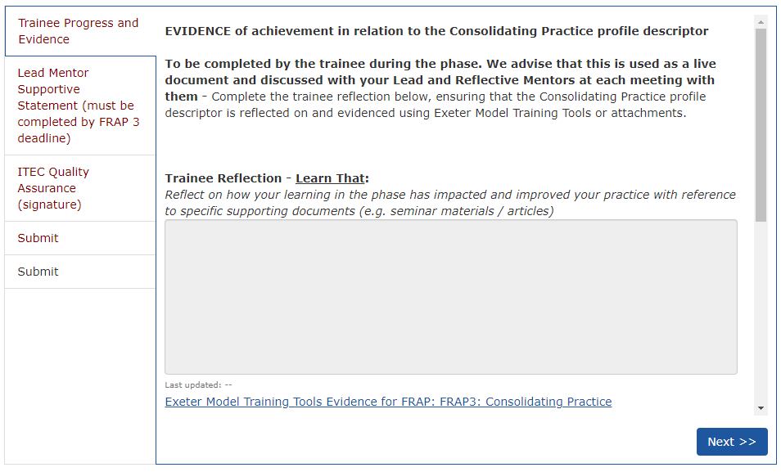
FRAP 3
Notes:
As with FRAP 2 the trainee uses the evidence in their IDP to write a reflection on how they believe that they have met the phase descriptors.

Slide 14
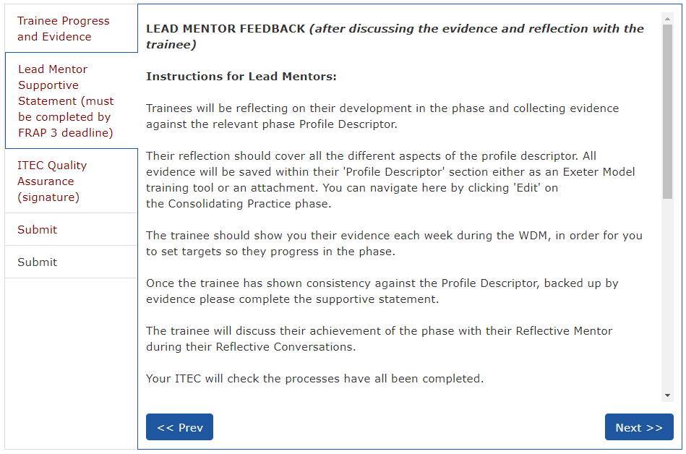
FRAP 3
Notes:
You will then be able to look at this and assess whether you also believe that they have.

Slide 15
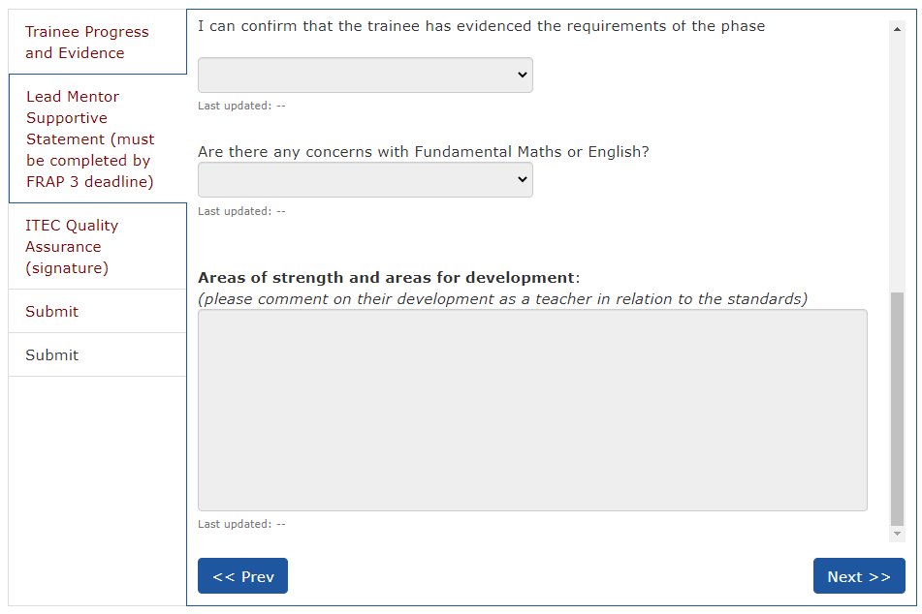
FRAP 3
Notes:
Here you can state whether or not they have met the descriptors and whether there are any concerns over their fundamental English and maths.
You also complete a statement on their areas of strength and areas for development.
The ITEC confirms that all meetings have taken place in their QA section. You then sign it off in the submit section. After this the trainee can submit the form and move onto the developing independence phase.

Slide 16
Curriculum Focus
Notes:
A quick reminder of our curriculum…

Slide 17
Secondary PGCE programme
Specialist Subject Knowledge & Pedagogy
Education and Professional Studies
Professional Learning

Slide 18
Curriculum
The Core Content Framework for ITT is NOT the curriculum. It is a statutory entitlement which our curricula include.
Each trainee follows a carefully designed and sequenced curriculum in their subject, identifying what they are learning across both University-led teaching and school placements
The Curriculum Maps outline this sequenced curriculum and show when and how the CCF minimum content is included

Slide 19
Planning Lessons in MFL
Autumn Term:
Microteaching (4 x 10-min)
Peer teaching (7 x 60-min)
How to plan:
4 seminars, moving from episode planning to full lessons
listening, reading, speaking, writing, grammar, introducing vocabulary
adaptive teaching, support and challenge
Pedagogical approaches (see notes and p. 40 onwards in study guide)
Notes:
While in school in November, trainees are directed to consider planning as follows (see study guide):
Planning and the structure of the lesson (CCF: 4)
Modern Foreign Language specific focus
Look at the activities that occur in a language lesson.
Observe how the teacher starts the lesson.
Do they use the Target Language (TL) from the beginning or are objectives set in English? Either way, consider the reasons for the teacher’s choice.
Note the order of linguistic activities e.g. listening → speaking → reading → explanation of grammar → practice etc.
Does the teacher build in pauses to assess or revise what has been learned? Do they link this back to the stated objective?
Is there a summing up (sometimes called a plenary) at the end of the lesson? What is the purpose of this?
Is it conducted by the teacher or the pupil? Does it simply consist of a “what have we learnt?” session, or is it predictive, i.e. looking forward to what will be learned in the light of the lesson that is just finished? Are the pupils consulted on what will happen next or are they told?
Use a blank scaffolded lesson plan pro forma to note down the ‘plan’ of observed lessons – can you identify a common structure? Are there differences between teachers within the department? What are they?
Teaching grammar
In order to teach grammar communicatively the following sequence (9 steps) is sometimes used:
Prior use in context
Receptive input
Overt presentation
Practice activities
Active recognition
Checking understanding
Pupils taking notes
More practice
Creative phase (production)
Observe carefully how grammar is taught.
• Does the teacher use English or the TL to explain grammatical rules and concepts?
• Are pupils encouraged to work out grammatical regularities, i.e. rules for themselves?
• Do pupils consult grammatical explanations in textbooks?
• What sort of metalanguage (i.e. language about language) is used? Is a verb called a ‘verb’ or is it referred to by another term?
• Do pupils copy notes about rules for their own reference or are they given photocopied notes?
There are several models of structural presentation of a lesson plan. The first step concerns overall planning when you look at communicative learning outcomes, language learning objectives, references to assessment, materials and resources needed; the second step is to write a summary of the sequence of lesson activities.

Slide 20
Ofsted Research Review MFL (June 2021)
https://www.gov.uk/government/publications/curriculum-research-review-series-languages/curriculum-research-review-series-languages
And the GCSE from 2024: https://ncelp.org/government-announcement-mfl-gcses/
Notes:
Key recommendations:
Based on the above (i.e. phonics), high-quality languages education may have the following features
Curriculum plans show clear logic behind progression in phonics, including around when to teach differences between English sound–spelling correspondences and those of the target language.
Planned practice and review of phonemes and how these link to graphemes is in place.
Curriculum plans show how small differences in sound can unlock meaning for pupils.
Based on the above (I.e. vocab), high-quality languages education may have the following features
Curriculum plans recognise that vocabulary is an important component of language knowledge.
Curriculum plans recognise the importance of building a strong verb lexicon, especially in the early stages of language learning.
Curriculum planning of vocabulary, grammar and phonic knowledge and progression should go hand in hand, as they are all related and connected.
Curriculum leaders consider both the breadth and depth of vocabulary knowledge they will teach. They:
make sure that they prioritise high-frequency words
consider carefully which topic-based vocabulary (other than high-frequency words) they teach
ensure that learners can use these words across different contexts
consider how ‘deeply’ items of vocabulary need to be learned and at what point
consider how and when to introduce more advanced semantic aspects of vocabulary knowledge (such as synonyms, antonyms, shades of meaning and how they change with context).
Teachers aim to increase learners’ automatic and fluent recall through:
a schedule of planned revisiting to ensure that words are retained in long-term memory
introducing and using vocabulary in comprehension and production, in both the oral and written modalities and across different topics.
Curriculum leaders also think strategically about:
which words are the most important for the scheme of work so that teachers can focus on these to develop learners’ level of mastery
gradation (what pupils learn and when across the years of study)
making links between words within word families and recognising similarities and differences between English and the language being learned
how to link vocabulary to external accreditations or assessments.
Based on the above (i.e. grammar), high-quality languages education may have the following features
When planning the curriculum for grammatical progress, leaders consider the nature and rate of grammatical progression, the complexity of grammatical concepts and structures, and which aspects of a grammatical structure are introduced and when (such as which parts of a verb paradigm).
Leaders make sure that all pupils can understand grammatical concepts and structures rather than being required to work it out for themselves, through:
an explicit but succinct description of the grammatical feature to be taught
practising the grammar point (through listening and reading)
practice in productive use of the features being taught (through speaking and writing).
Teachers consider productive use of grammar in free writing and speech in a range of contexts. Using a language spontaneously is central to pupils’ language ability and based on their ability to manipulate language.
The curriculum includes ample opportunity to revisit the same grammar in different contexts, for different tasks, with a range of vocabulary

Slide 21
Engaging Parents and carers With Learning

Slide 22
Parental Involvement
There is a large body of evidence that parental involvement (PI) has a significant effect on pupil outcomes and that parents would like to become more involved in their children’s education. However, establishing effective working relationships can be difficult in practice.
(Bilton, Jackson & Hymer, 2018)
Strong school-family relationships and high levels of parental satisfaction has a positive effect.
(Hampden-Thompson & Galindo, 2017)
Notes:
Throughout this talk I will use the term parents to include those adults who are caring for children, i.e. they have direct responsibility for their safety and wellbeing.
Much of this evidence comes from the USA rather than the UK though.
parental satisfaction evidence from UK.

Slide 23
Barriers to Parental Involvement
Individual parent and family factors
Parents beliefs about PI
Perceptions of invitations for PI
Current Life Contexts
Class, ethnicity and gender
Child Factors
Age
SEND
Ability
Behavioural problems
Parent-Teacher Factors
Differing goals and agendas
Differing attitudes
Differing language used
Societal Factors
Historical and demographic
Political
Economic
(Hornby & Lafaele, 2011; Hornby & Blackwell, 2018)
Notes:
P&F factors
Parents’ beliefs about PI
First, the way that parents view their role in their children’s education is crucial. Parents who believe
that their role is only to get children to school, which then takes over responsibility for
their education, will not be willing to be actively involved in either school-based or
home-based PI.
The belief that parents have in their own ability to help their children succeed at
school is the second belief which is crucial to PI.
Parents who believe children’s intelligence is fixed and that school achievement is
mainly due to children being lucky enough to have high ability will not see the point
in getting too involved in their children’s education.
Parents’ perceptions of invitations for involvement
Another potential barrier to PI is parents’ perceptions of the level of explicit and
implicit invitations for involvement. When parents think that PI is not valued by teachers
or schools they are less likely to get involved
Secondary schools are often seen by parents as large bureaucratic organisations which
are not welcoming to parents, which is considered to be one of the reasons why there
is a tendency for higher levels of PI in primary than secondary schools
Parents’ current life contexts
Parents’ level of education will influence their views on whether they have sufficient skills and knowledge to engage in different aspects of PI
solo parents and those with young families or large families may find it more difficult to get involved
in PI because of their caretaking responsibilities. Parents’ work situations can also be
a factor. When parents are unemployed money could be an issue as they may not be
able to afford a car or to pay babysitters in order to get to school meetings. For parents
with jobs, whether both parents work and the kind of jobs they have may be issues.
parents’ overall psychological resources may be a barrier to PI. For example,
parents with poor physical or mental health or without an effective social support
network, including extended family members, may find it difficult to engage effectively
in PI
Class, ethnicity and gender
Differences in class, ethnicity and gender may play a role in determining the degree to which parents
are involved with schools
Reay (1998) suggests that it is these parents who possess cultural capital which
matches that generally valued by schools. In contrast, working-class parents, though
possessing their own undervalued cultural capital, are aware of the difference between
the cultural capital they possess and that of teachers. Reay (1998) concludes that, for
working-class families, home-school relationships are about separateness, whereas for
middle-class families they are about interconnectedness, and this difference shapes
their respective attitudes to PI.
Obviously a complex issue, too big for this short talk but there is a question as to whether school is perceived as a place where groups belong.
Child factors
AGE
PI decreases as children grow older. Parents of secondary aged children are less likely to attend parents’ evenings.
SEND
The involvement of parents in creating support plans facilitates PI
ABILITY
Whilst being successful at school can encourage parents to become involved. However, problems can occur when parents believe their child is academically gifted and teachers do not agree. Insufficient challenge can frustrate children, leading to other issues. Also, children who succeed in non-academic areas can impact on their more academic studies.
Behavioural problems
A child’s reputation for challenging behaviour can make parents less inclined to come into schools.
PT factors
Goals and agendas
Differing expectations
Attitudes
There persists among teachers a deficit model of parents where parents who are problems, vulnerable or less able need to be kept out of schools.
Tension between the idea that schools educate children whilst parents should support and the idea that parents are the main educators while schools support with specialist expertise.
Language
Parents and professionals – dichotomy in description
Use of the word ‘partnership’ is problematic. The relationship is often about power and rights.
Societal factors
Historical reasons for lack of engagement – formality and inflexibility inhibit involvement.
Political and economic reasons, lack of support beyond rhetorical statements

Slide 24
Do Parents Know They Matter?
Parents are the most important influence on learning. Long after a child’s early years give way to formal education, parents continue to play a key role in student success and achievement. The lives parents lead today means that it is more challenging to secure their engagement in learning, but it still remains the factor that can make a significant difference to a child’s educational attainment and subsequent life chances.
Effective parental engagement will not happen without concerted effort, time and commitment of both parents and schools. It will not happen unless parents know the difference that they make, and unless schools actively reinforce that ‘all parents matter’.
(Harris & Goodall, 2008)
Notes:
Parental engagement is very important for raising achievement, particularly for pupils from low SES backgrounds.
As we’ve mentioned, engagement increases with social status, income and parents level of education. Certain parents are more likely to face barriers which can be wrongly interpreted as resistance or intransigence. As we’ve mentioned the overwhelming majority of parents want to help their children with their schooling.

Slide 25
Do Parents Know They Matter?
Parental engagement in children’s learning in the home makes the greatest difference to student achievement. Most schools are involving parents in school-based activities in a variety of ways but the evidence shows but this has little, if any, impact on subsequent learning and achievement of young people.
(Harris & Goodall, 2008)
Notes:
We need to think about HOW we engage with parents.

Slide 26

The Banking Model
Notes:
Education has tended to move away from what Freire called the banking model where knowledge can be deposited into a student towards acts of learning.
The relationships between schools and parents tends to down play the autonomy of parents in relation to their children’s learning. Parents are obviously free to act but their action is often undervalued. Schooling is actually a small part of learning overall.

Slide 27
The Banking Model
I wish to deny the dichotomy so often placed between “learning in school” and “learning anywhere else” – it is all learning, and with the removal of that dichotomy, the case for parental engagement in learning becomes much more obvious. A great deal of what parents are already doing should be acknowledged, (as it is not, at the moment, particularly when it does not fit within the expected norms of middle class, white parenting. It is true that this partnership model will require more from both school staff and parents, particularly at the outset, but not […] in the sense that one group takes over the functions of the other.
(Goodall, 2018)
Notes:
Arguably, school staff often revert to a banking model when dealing with parents.
Perhaps a more dialogic relationship is more beneficial, recognising the importance and agency of both parties.

Slide 28
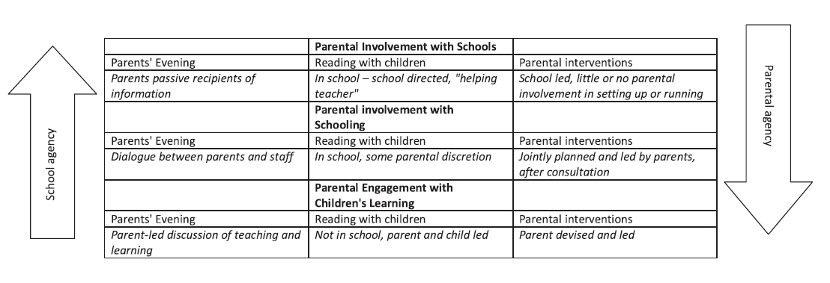
Parental Engagement
(Goodall & Montgomery, 2014)
Notes:
A good way to think about this is as a continuum from parental involvement with school to parental engagement with learning.
Ideally, there should not be a tension between school’s agency for teaching and parent’s agency for engagement in their children’s learning. Each is valuable in its own right and should work together.

Slide 29
What Can You Do?
Regularly keep in touch with parents, not just when there is a problem.
Ask for parents’ advice, what do they think will improve a problematic situation? Make sure you appreciate their responses.
Share targets with parents.
Remember that parents are only human and may have off days.
https://www.edutopia.org/article/new-teachers-how-talk-parents-terri-eichholz
Notes:
Obviously, a lot of what we have talked about here is affected by institutional factors but there is still a lot of positive work that individuals can do.
Phone calls home are invaluable, both in promoting parental engagement in the learning at home and in promoting positive learning focussed behaviour. Make sure that you regularly phone parents to discuss positive events, not just negative ones. There are other opportunities as well as phone calls. Ask to speak to them at the end of the day if they pick up their children. Send postcards, ask them to visit to look at good work. Building a positive relationship will really help if and when you need to discuss something not so good.
Try and work together to create a positive, united message for the child.
You may discuss academic or behavioural targets with parents. School will have a system in place to share them already but having you discuss them will encourage parents to support you in working towards them.
Reply to their comments in planners etc.
Don’t be afraid. It’s your job. Remember we’re trying to promote parental engagement. It won’t always work perfectly but it’s much better to try.
Read this blog post, it is American but it’s got a lot of good advice.

Slide 30
References
Bilton, R., Jackson, A., & Hymer, B. (2018). Cooperation, conflict and control: parent–teacher relationships in an English secondary school. Educational Review, 70(4), 510-526.
Hampden-Thompson, G., & Galindo, C. (2017). School–family relationships, school satisfaction and the academic achievement of young people. Educational Review, 69(2), 248-265.
Harris, A., & Goodall, J. (2008). Do parents know they matter? Engaging all parents in learning. Educational research, 50(3), 277-289.
Hornby, G., & Blackwell, I. (2018). Barriers to parental involvement in education: an update. Educational Review, 70(1), 109-119.
Hornby, G., & Lafaele, R. (2011). Barriers to parental involvement in education: An explanatory model. Educational review, 63(1), 37-52.
Goodall, J. (2018). Learning-centred parental engagement: Freire reimagined. Educational Review, 70(5), 603-621.
Goodall, J., & Montgomery, C. (2014). Parental involvement to parental engagement: A continuum. Educational review, 66(4), 399-410.

Slide 31
Feedback
What areas have you found trainees to be under prepared for?

