Slide 1
MFL Lead Mentor Training, Development and Consultation, Spring term 2023
https://sites.exeter.ac.uk/pgcemfl/

Slide 2
Sharing Good Practice
Notes:
An opportunity for more experienced mentors to share their ideas with less experienced colleagues

Slide 3
Mentor Training: 1. Developing trainee reflection 2. Target setting 3. CP FRAP
Notes:
Bryan’s slides to go here

Slide 4
Mentor Training: Developing trainee reflection

Slide 5
Facilitating professional conversations
Perhaps the most productive strategies for developing trainee reflection employed by mentors will involve engaging in professional conversations. Talking with each other is a natural way to share experiences and to uncover issues and challenges so that we can make sense of what is going on and learn from each other. It makes sense that professional conversations are the cornerstone of mentoring and why we place the WDM centrally in our model.
A significant aspect of facilitating effective professional conversations involves choosing the most appropriate form of conversation to have and finding the right balance between empathy, challenge and support.
Too much empathy, challenge or support will encourage high levels of dependency and uncertainty, likely to lead to feelings of inadequacy.
Too little empathy, challenge and support can lead to trainees feeling isolated, misguided and unsure about how they are going.
In your WDM try to create time for simple, open conversations, that provide opportunities for trainees to reveal what’s on their mind. You will gain insights into the needs of the trainee and together you can determine what kind of support is needed. Listening with the intention of truly understanding what the trainee needs is an important skill for mentors to develop.
Be mindful that ‘on the run’ conversations run the risk of masking any issues or challenges that may grow into something more difficult to manage later on.
Beginning with simple, open conversations should lead to opportunities later for deeper conversations where thornier issues or challenges might be discussed and appropriate plans for action developed. Skilful questioning and the ability to genuinely listen are vitally important skills for mentors to master. Using these skills, along with developing an empathetic disposition and being authentically interested in the trainee’s growth and development, are factors that contribute to more effective mentoring relationships.
Trainees often require help in developing their reflective practice, so guiding them in their reflections and developing analytical conversations is a critical aspect of the mentoring this term. You will find that you need to use skilled questioning techniques to clarify and probe the evidence, to draw out different perspectives that may offer new insights, which will influence what the trainee does next. It is important to use a variety of strategies to document classroom events. Analysing different forms of evidence in their IDPs will spotlight and amplify unexpected perspectives that will enrich the trainee's thinking.
Notes:
Talk Lead Mentors through FRAP process

Slide 6
Let’s consider what questions we might ask as part of a reflective conversation to help develop trainee insight. Create a set of questions that might be helpful to ask trainees over the next few weeks.
It might be useful to consider the a WHAT? SO WHAT? NOW WHAT? approach.
Notes:
Collect and discuss some good ones before moving on to the following examples

Slide 7
Below is a list of generally applicable questions for your consideration and adaptation. This is a menu of questions from which you can select those that appeal to you, rather than a structured process model. Feel free to try them out, adapt them, and adjust the language.
What’s excited you in school since our last meeting?
What have you been able to make progress on in the last week?
What’s working well for you?
Are there any unknowns you have right now that are blocking you?
How are you better placed in the classroom after the experiences of the last week?
What’s the most important thing you need to get done at this point?
What do you think are your priorities going forwards?
What’s on the horizon that you know you need to think about now?
What do you find enjoyable about teaching?
What are you doing that’s stopping you from being at your best in the classroom?
What might you try instead? What else? And what else?
What’s been successful in helping to achieve your targets?
What are you pleased with that you could add to your FRAP?
The important thing about developing questions as part of your repertoire, is to reflect on the approach you take, and the type of responses that your questions elicit from your mentee.
Notice the effect you have on your partner’s thinking, and combine this with their feedback, to really understand what makes for an effective question.

Slide 8
Initiating a reflective conversation around a lesson:
What do you feel were the successes of the lesson?
You have written here that you wanted to use their knowledge of the topic ‐ can you tell me how you planned to do that?
You are critical of your <lesson start>, what bothered you and why do think that it happened?
Was this episode/lesson/activity successful? Why/why not?
If you were to do it again, what would you do differently to help students learn more?
Did this activity help students learn more than others you’ve tried? Why/not?
Are the relationships that you have with the students helping or hindering their ability to learn?
Was your demeanour and attitude towards the class effective for student learning?
Why did you choose that particular lesson design to cover the objective? Which students did/did not benefit from your choices?
What evidence do you have that students were learning?

Slide 9
Mentor Training: Target Setting

Slide 10
Central to trainees’ progress and success is their achievement of developmental targets. It is important that targets specifically address improving the quality of the trainees’ teaching and pupils’ learning over time.
Targets should:
include a clear statement of what the trainee needs to focus on to improve and make progress;
use language which aligns with the phase descriptor at which the trainee is working;
be subject specific where appropriate;
state what actions the trainee needs to take to improve and make progress;
state what support/resources are required to help them achieve the target;
include clear success criteria explicitly stating what achieving the target will mean in terms of pupils’ learning, well-being, behaviour etc. and the quality of the trainees’ teaching - what will be demonstrated and how, when the target is achieved;
set out a realistic and workable time-frame in which the target can be achieved
state how and when the target will be reviewed (usually next WDM).

Slide 11
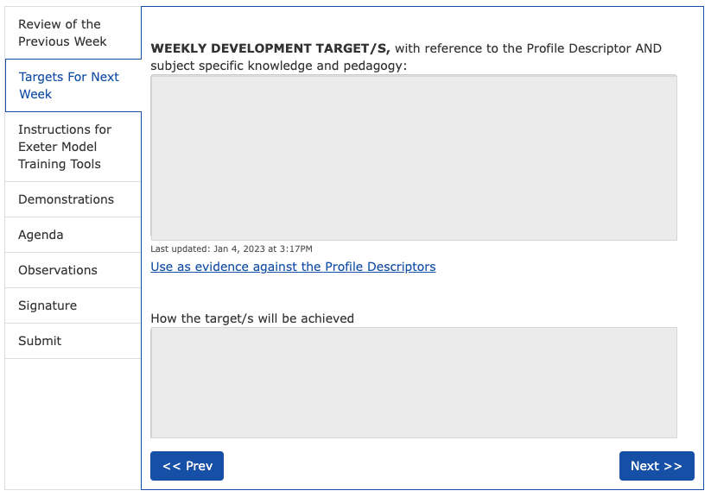
Develop differing types of questioning methods, including cold-call, pass-the-ball, think/pair/share.
Become familiar with GCSE question types for use with your Y10 classes
Observe questioning from expert teachers in demonstrations. Through the use of student names for cold-calling (paper copies of seating plans). Planning questions in advance to develop student recall from previous learning. Read school guidelines: ‘effective questioning’. Use a range in class and reflect.
Read examiner reports from previous years trying to spot/ identify patterns/themes to get insight into what is required. Knowledge used effectively in demonstrating/modelling to students in the lesson next week.

Slide 12
Mentor Training: The CP FRAP

Slide 13
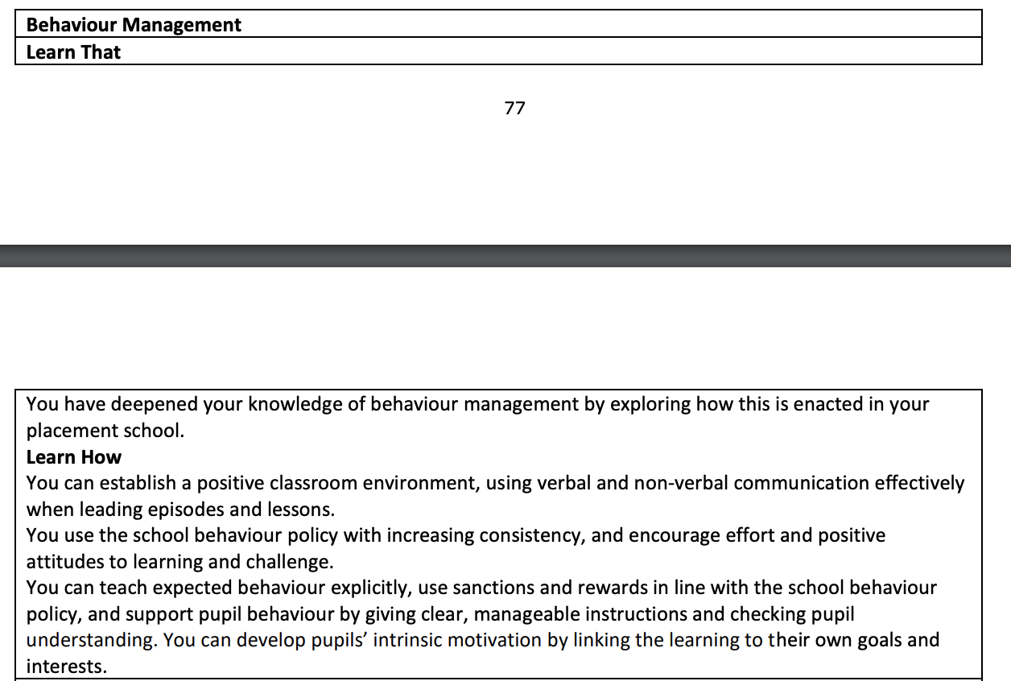
Consolidating Practice Phase Profile Descriptor

Slide 14
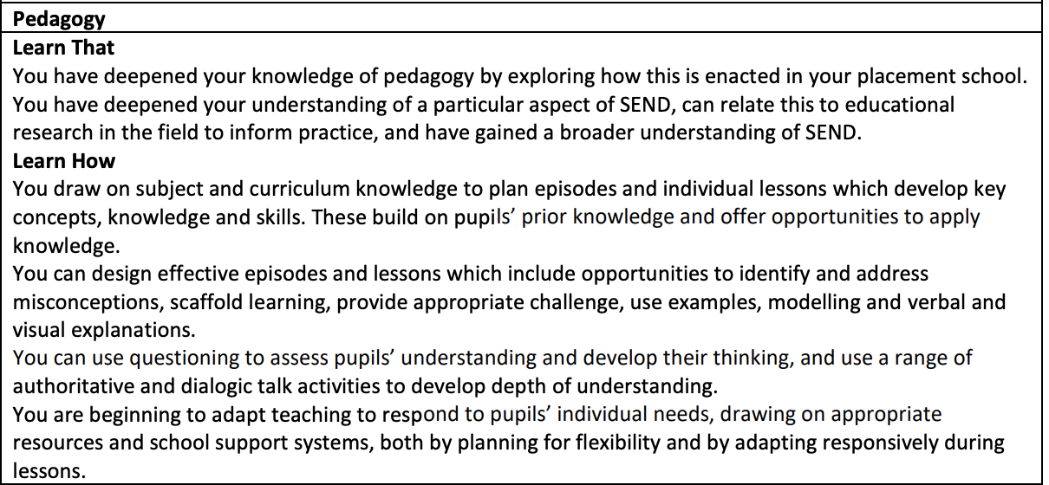
Consolidating Practice Phase Profile Descriptor

Slide 15
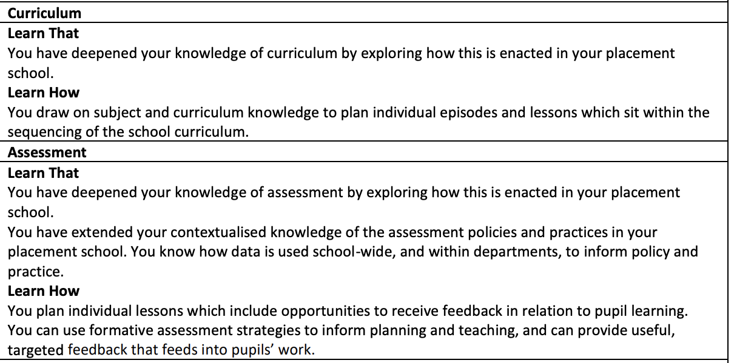
Consolidating Practice Phase Profile Descriptor

Slide 16
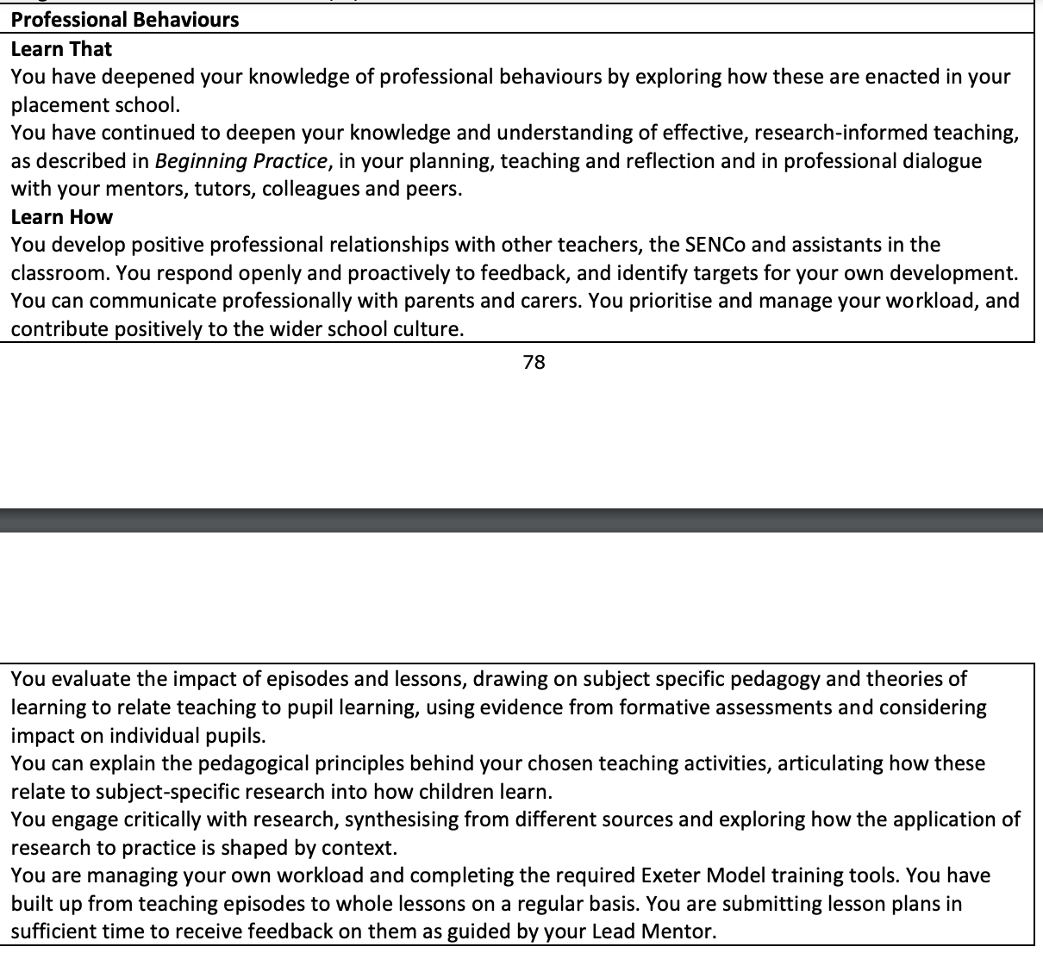
Consolidating Practice Phase Profile Descriptor

Slide 17
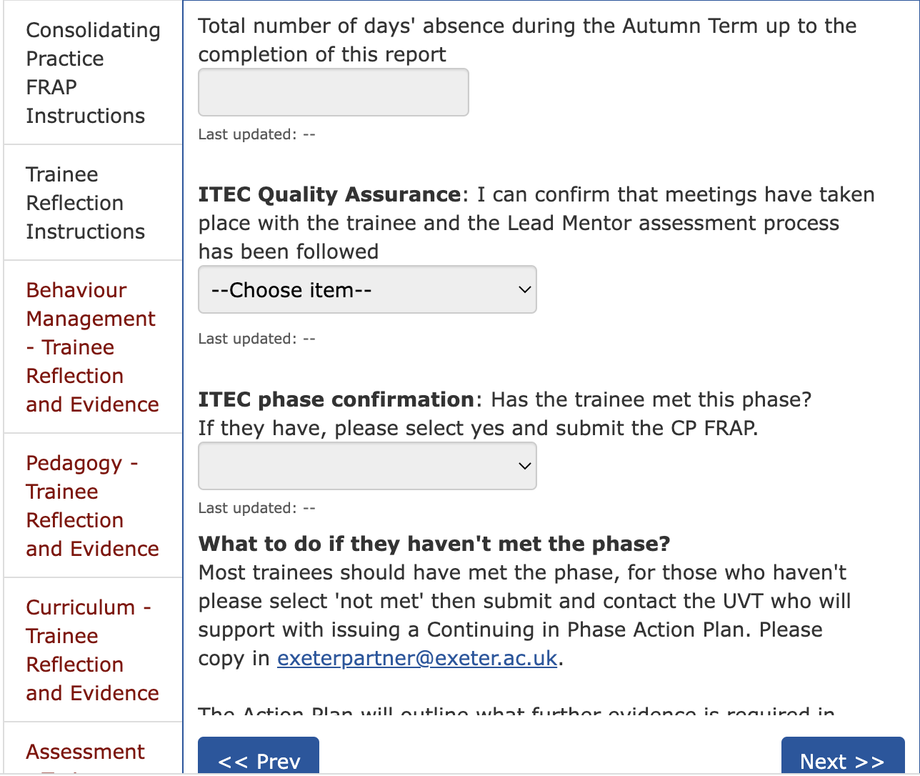
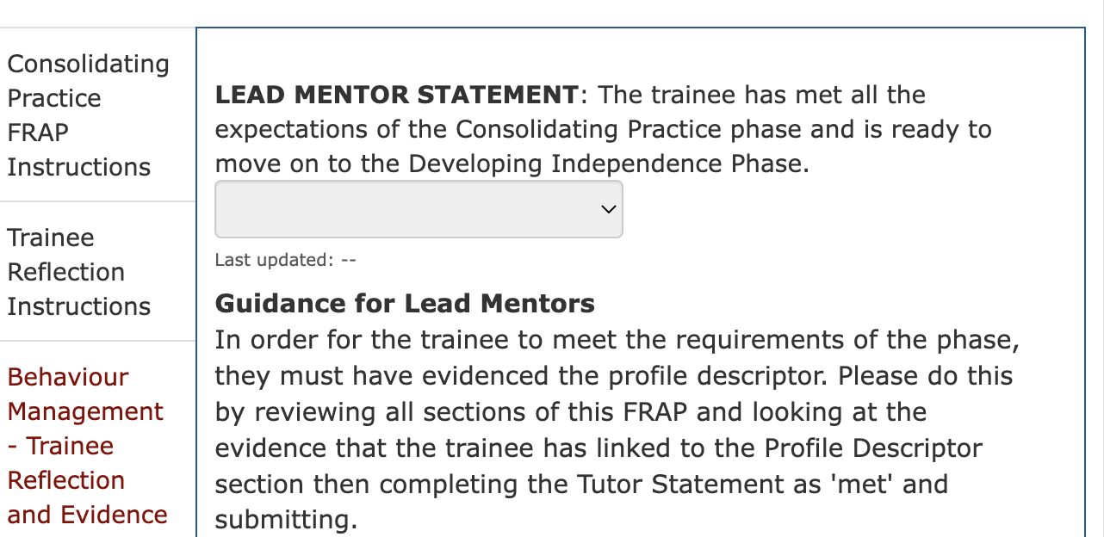
Consolidating Practice FRAP
Notes:
Talk Lead Mentors through FRAP process

Slide 18
Curriculum Focus
Notes:
Reminder of what our curriculum is in every session…

Slide 19
Specialist Subject Knowledge & Pedagogy
Secondary PGCE programme
Professional Learning
Education and Professional Studies

Slide 20
Curriculum
The Core Content Framework for ITT is NOT the curriculum. It is a statutory entitlement which our curricula include.
Each trainee follows a carefully designed and sequenced curriculum in their subject, identifying what they are learning across both University-led teaching and school placements.
Every subject has a Study Guide, Curriculum Sequence and CCF Map which outlines this sequenced curriculum and show when and how the CCF minimum content is included. It also contains the timetable for the autumn term so you can know exactly what they have covered and when they covered it.
Notes:
Reminder!

Slide 21
Study Guide, Curriculum Sequence & CCF Map
Administrative Information
Programme Aims
Guidance for Learning and Communicating Online
The Exeter Electronic Learning Environment (ELE)
Electronic Individual Development Portfolio
Online Communication
Tutorials
Peer Teaching
Enrichment Opportunities Throughout the Year
Assessment
The Curriculum
Theoretical Framing
Curriculum Sequence
Curriculum Mapped against the CCF
Notes:
Reminder!!
Here is an over view of what is in it.
Show them the mentor zone and your blog and where everything is.

Slide 22
Seminar Days Reflection on school-based work Clarification of training tools and sharing good practice Framework task feedback Employability support
Notes:
Perhaps tell them what you are looking at during spring term seminar days

Slide 23
Research: Pearson, A (2022) Teacher resilience: Long-serving teachers' perspectives on factors which have sustained them in their careers
Notes:
Suggest looking at recommendations from Allison’s project (attached to email)

Slide 24
Curriculum development Suggestions from Lead Mentors about curriculum content in 2023/24

