Slide 1
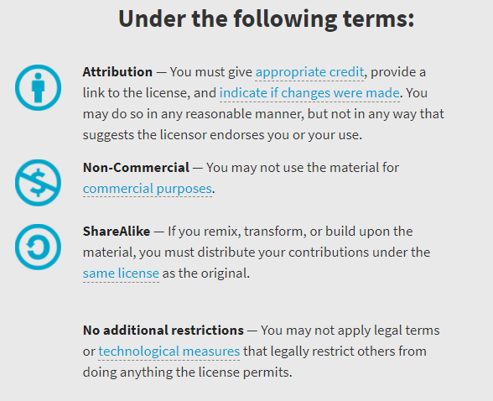
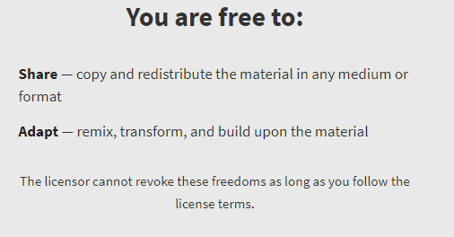
AQA Biology – GCSE Required Practicals Integrated Instructions – David Paterson – 26Apr2019 – v1 © David Paterson, 2019 Shared under a Creative Commons “Attribution-NonCommercial-ShareAlike” license. https://creativecommons.org/licenses/by-nc-sa/2.0/uk/
© D Paterson 2019
v1 - 26/6/19

Slide 2
Risk assessments
These documents are shared for information and training purposes.
If you are going to carry out practicals following these instructions, you must carry out appropriate risk assessments first. I suggest the use of CLEAPSS resources for this.

Slide 3
❶ One drop of water 
❽ Set higher power objective lens 
❿ Make a labelled drawing – annotate with total magnification factor 
❷ Epidermal tissue from onion 
❼ Focus (coarse adjustment) 
❾ Focus (use fine adjustment
❑
❸ 2 drops iodine solution
❑
❻ Move lowest power lens (short barrel) to just above slide (use coarse adjustment) 
❹ Cover slide (edge first)
❑
GCSE Biology: Microscopy
Designed in line with practicals in AQA GCSE Biology / Combined Science Handbooks
http://www.aqa.org.uk/resources/science/gcse/teach/practicals
❺ Onion slide on stage 
© D Paterson 2019
v1 - 26/6/19

Slide 4
❼ Tape lid with two small piece of tape 
❽ Incubate plate at 25°C for 48 hours 
❻ Repeat ❸❹❺ for remaining antiseptics 
❾ Measure and record perpendicular diameters of each clearance zone 
❶ Clean & disinfect hands and workspace 
❺ Place filter paper on central spot   
E. Coli.
DJP 18/6/19
❷ Mark three segments, central spots and your details 
A
B
C
❹ Lift lid a minimum distance facing away from you   
❸ Dip filter paper circle in antiseptic   
GCSE Biology: Microbiology
Designed in line with practicals in AQA GCSE Biology / Combined Science Handbooks
http://www.aqa.org.uk/resources/science/gcse/teach/practicals
© D Paterson 2019
v1 - 26/6/19

Slide 5
GCSE Biology: Osmosis
Designed in line with practicals in AQA GCSE Biology / Combined Science Handbooks
http://www.aqa.org.uk/resources/science/gcse/teach/practicals
❶ Extract five potato cores with cork borer 
❹ Add sugar solution (measuring cylinder)
A – 10 cm³ 
B – 7.5 cm³ 
C – 5 cm³ 
D – 2.5 cm³ 
E – 0 cm³ 
❺ Add water (measuring cylinder)
A – 0 cm³ 
B – 2.5 cm³ 
C – 5 cm³ 
D – 7.5 cm³ 
E – 10 cm³ 
❷ Trim cores to remove skin and make the same length 
❻ Add potato core to each tube 
❼ Leave for
required time 
00.00
❸ Accurately measure mass and length of each core 
❽ Remove and blot dry cores 
A
B
C
D
E
❾ Accurately measure mass and length of each core 
© D Paterson 2019
v1 - 26/6/19
-.-- g

Slide 6
❶ Set up 11 labelled tubes in a 35°C water bath
❑ B1  B2  B3  B4  B5: 2cm³ buffer
❑ S1  S2  S3  S4  S5: 4cm³ starch
❑ A: 10cm³ amylase
❷ Place thermometer in A – start ❺ onwards when temperature reaches 35°C 
B3
B4
B5
S3
S4
S5
A
B1
B2
S1
S2
❸ Set up spotting tile – 1 drop iodine solution per well 
❹ Add 1 drop starch to 1st well 
❺ Pour B1 into S1 and stir 
⓬ Repeat ❸ to ⓫ with
❑ B2 & S2  B3 & S3
❑ B4 & S4  B5 & S5
❻ Add 2cm³ amylase (A) to S1 and stir 
B1
A
❼ Start the stopwatch and keep stirring 
S1
00.00
⓫ Record time of first
well to not change colour
❾ Rinse glass rod in water and keep stirring 
❽ At 10s add one drop to 2nd well with glass rod 
GCSE Biology: Enzymes
Designed in line with practicals in AQA GCSE Biology / Combined Science Handbooks
http://www.aqa.org.uk/resources/science/gcse/teach/practicals
❿ Repeat ❽&❾ every 10s until 110s (12th well) 
© D Paterson 2019
v1 - 26/6/19

Slide 7
Sugar
Starch
❸ Add 3-4 drops Benedict’s 
❹ Heat for 5 minutes at 80°C (minimum) 
❷ Add food sample 
❶ Add food sample
❑
❷ Add a few drops iodine solution 
❶ Set up Bunsen burner water bath
❑
❸ Observe and record colour changes 
xxxxxxxxxxxxxxxxxxxxx
❺ Observe changes to mixture 
GCSE Biology: Food tests (sugars/starch)
Designed in line with practicals in AQA GCSE Biology / Combined Science Handbooks
http://www.aqa.org.uk/resources/science/gcse/teach/practicals
© D Paterson 2019
v1 - 26/6/19

Slide 8
Lipid
Protein
❶ Add food sample
❑
❶ Add food sample
❑
❷ Add a few drops distilled water 
❷ Add 1cm³
Biuret A solution 
❸ Add a few drops ethanol 
❸ Add 1 cm³
Biuret B solution 
❹ Shake solution gently 
❹ Shake mixture gently 
❺ Observe and record changes 
❺ Observe and record changes
GCSE Biology: Food tests (lipids/protein)
Designed in line with practicals in AQA GCSE Biology / Combined Science Handbooks
http://www.aqa.org.uk/resources/science/gcse/teach/practicals
© D Paterson 2019
v1 - 26/6/19

Slide 9
GCSE Biology: Photosynthesis
Designed in line with practicals in AQA GCSE Biology / Combined Science Handbooks
http://www.aqa.org.uk/resources/science/gcse/teach/practicals
❶ 4 spacing plasticine balls 
❷ Tap water to ¾ full 
❸ 10 cm piece of pondweed - cut edge up 
❹ Glass funnel 
❿ Repeat ❻to❾ for remaining distances 
❺ Water filled inverted measuring cylinder 
❾ Stop timer and record volume of gas collected 
❻ Position lamp at
❑ 100cm  80 cm  60 cm
❑ 40cm  20 cm
❽ Count and record total number of bubbles 
❼ Start timer for 3 minutes 
00.00
© D Paterson 2019
v1 - 26/6/19

Slide 10
❸ Person 2 – Drop ruler 
❹ Person 1 – catch ruler 
❷ Person 2
❑ Vertical ruler
❑ 0 cm mark between Person 1’s thumb/first finger
❑ “Prepare to catch”
❺ Record number on ruler above thumb 
❻ Rest and repeat ❶ to ❺ several times 
❶ Person 1
❑ Dominant hand
❑ Sitting
❑ Good upright posture
❑ Eyes across the room
❑ Forearm across table
❑ Hand overhanging table
❼ Swap Person 1 and 2 over 
❽ Repeat ❶ to ❼ 
❾ Change the factor 
❿ Repeat ❶ to ❽ 
GCSE Biology: Reaction time
Designed in line with practicals in AQA GCSE Biology / Combined Science Handbooks
http://www.aqa.org.uk/resources/science/gcse/teach/practicals
© D Paterson 2019
v1 - 26/6/19

Slide 11
❶ Label 3 petri dishes with name + location
Full sunlight 
Partial light 
Darkness 
❻ Place petri dishes in
positions   
❼ Leave for 1 day   
❷ Cotton wool soaked in
water   
❸ 10 mustard seeds
❑  
❽ Measure height
of seedlings   
❹ Warm location to allow
germination   
❺ Equalise number of
seedlings   
❾ Repeat ❼ and ❽ for
5 days   
GCSE Biology: Plant responses
Designed in line with practicals in AQA GCSE Biology / Combined Science Handbooks
http://www.aqa.org.uk/resources/science/gcse/teach/practicals
!!! Water daily or cover !!!
!!! with a beaker !!!
© D Paterson 2019
v1 - 26/6/19

Slide 12
$$eps=\frac{total area}{sampled area}×total counted organisms$$
❶ Select random coordinates 
X coordinate
Y coordinate
❻ Calculate estimated
population size (eps) 
❷ Using tape measure, find location in survey area 
❺ Repeat for ❶ to ❹ for
10 locations     
❑    
❸ Lay down quadrat 
❹ Count species 
GCSE Biology: Population size
Designed in line with practicals in AQA GCSE Biology / Combined Science Handbooks
http://www.aqa.org.uk/resources/science/gcse/teach/practicals
© D Paterson 2019
v1 - 26/6/19

Slide 13
❶ Lay out 30 m tape measure from base of tree to open ground 
❷ Quadrat at
❑ 0 m  5 m  10 m  15 m  20 m  25 m
❑ 30 m
❸ Measure and record light reading 
00 lux
❹ Count and record number of plants in quadrat 
❶ Repeat ❷ to ❹ for all distances 
GCSE Biology: Transect
Designed in line with practicals in AQA GCSE Biology / Combined Science Handbooks
http://www.aqa.org.uk/resources/science/gcse/teach/practicals
© D Paterson 2019
v1 - 26/6/19

Slide 14
❹ 7 cm³ sodium carbonate solution   
❺ Stand in water bath until at temperature   
❸ 5 cm³ milk   
❻ 1cm³ lipase AND start timer
❑  
00.00
❷ 5 drops Cresol red solution
❑  
❼ Stir until colour change (purple to yellow)   
❶ 5 cm³ lipase solution 
❽ Stop timer   
00.00
lipase
milk
❾ Repeat ❷ to ❽ at different temperatures   
GCSE Biology: Decay
Designed in line with practicals in AQA GCSE Biology / Combined Science Handbooks
http://www.aqa.org.uk/resources/science/gcse/teach/practicals
© D Paterson 2019
v1 - 26/6/19

Slide 15
❶❷❸❹❺❻❼❽❾❿ Text text text 
xxxxxxxxxxxxxxxxxxxxx
c
82.3 g
00.00

