Slide 1
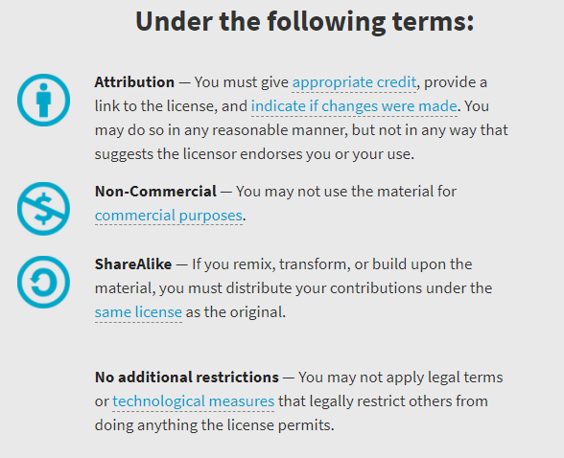
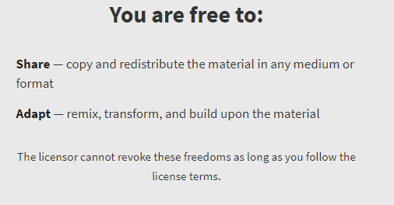
AQA GCSE Chemistry Required Practicals – Integrated Instructions – v0.1 – 09/07/18 © David Paterson, 2018 Shared under a Creative Commons “Attribution-NonCommercial-ShareAlike” license. https://creativecommons.org/licenses/by-nc-sa/2.0/uk/

Slide 2
Risk assessments
These documents are shared for information and training purposes.
If you are going to carry out practicals following these instructions, you must carry out appropriate risk assessments first. I suggest the use of CLEAPSS resources for this.

Slide 3
⬥ 1.8-2.0g copper oxide. Add half and swirl, wait 1 minute, add the other half. 
 Filter copper sulfate solution (max 3 min) 
❖ 15cm³ sulfuric acid – wait 2 minutes 
◆ Half fill with just boiled water 
xxxxxxxxxxxxxxxxxxxxx
 Pour filtered heated copper sulfate into the evaporating dish; observe for 5 minutes 
GCSE Chemistry: Making salts
Designed in line with practicals in AQA GCSE Chemistry / Combined Science Handbooks
http://www.aqa.org.uk/resources/science/gcse/teach/practicals using http://science.cleapss.org.uk/Resource/PP027-Making-copper-sulfate-crystals.pdf
 Remove funnel, then gently heat solution (half-blue) for 3 minutes – DO NOT BOIL DRY 

Slide 4
◆ 25.0 cm³ NaOH (pipette)
❑  
 Fill to 0.0 cm³ with H₂SO₄
❑  
 Measure and record volume
❑  
❖ 5-10 drops of indicator
❑  
 Add H₂SO₄ and …. 😐
❑  
⬥ Tap is closed
❑  
 ☺… swirl until colour change
❑  
GCSE Chemistry: Neutralisation
Designed in line with practicals in AQA GCSE Chemistry / Combined Science Handbooks
http://www.aqa.org.uk/resources/science/gcse/teach/practicals

Slide 5
◆ 50.0 cm³ electrolyte solution
❑   
 Power pack 4V 5 minutes
❑   
⬥ Electrodes
❑   
00.00
 Damp blue litmus paper gas test
❑   
❖ Petri dish lid
❑   
 Observe negative electrode and record
❑   
 Observe positive electrode and record
❑   
GCSE Chemistry: Neutralisation
Designed in line with practicals in AQA GCSE Chemistry / Combined Science Handbooks
http://www.aqa.org.uk/resources/science/gcse/teach/practicals

Slide 6
❖ Stir until temperature stops changing – record temperature
⬥ 5cm³ alkali
 Repeat until a total of 40cm³ alkali is added
 Repeat Step 
◆ 30 cm³ acid (measuring cylinder)
GCSE Chemistry: Temperature
Designed in line with practicals in AQA GCSE Chemistry / Combined Science Handbooks
http://www.aqa.org.uk/resources/science/gcse/teach/practicals

Slide 7
 Swirl flask
Place on cross
Start timer
⬥ Add 10cm³   
10cm³   
10cm³   
10cm³   
10cm³   
acid (measuring cylinder)
 Stop timer when cross has disappeared – record time
00.00
❖ Add 40cm³   
30cm³   
20cm³   
10cm³   
no cm³   
water (measuring cylinder)
◆ Add 10cm³   
20cm³   
30cm³   
40cm³   
50cm³   
sodium thiosulfate (measuring cylinder)
GCSE Chemistry: Rates of reaction 1
Designed in line with practicals in AQA GCSE Chemistry / Combined Science Handbooks
http://www.aqa.org.uk/resources/science/gcse/teach/practicals

Slide 8
◆ Set up gas collection apparatus 
 QUICKLY place bung into conical flask AND start the timer 
 Measure and record volume every 10 s, for 100 s.
00.00
❖ 50cm³ 2.0M acid 
00.00
⬥ 3cm magnesium ribbon 
GCSE Chemistry: Rates of reaction 2
Designed in line with practicals in AQA GCSE Chemistry / Combined Science Handbooks
http://www.aqa.org.uk/resources/science/gcse/teach/practicals

Slide 9
⬥ Label the spots 
 Place chromatogram in beaker 
 Remove chromatogram and draw the solvent front in pencil 
A B C D U
❖ Spot each food colouring in turn:
A  B  C 
D  U 
 Roll paper round glass rod and tape 
◆ Draw base line in pencil 
 Add water into beaker 
GCSE Chemistry: Chromatography
Designed in line with practicals in AQA GCSE Chemistry / Combined Science Handbooks
http://www.aqa.org.uk/resources/science/gcse/teach/practicals

Slide 10
◆ Dip loop in metal chloride solution

❖ Flame loop and observe colour

⬥ Clean the loop

GCSE Chemistry: Identifying ions 1
Designed in line with practicals in AQA GCSE Chemistry / Combined Science Handbooks
http://www.aqa.org.uk/resources/science/gcse/teach/practicals

Slide 11
◆ Separately 1cm³ each sodium salt solution   
❖ CARBONATE TEST: Add 1cm³ HCl

⬥ CARBONATE TEST: If bubbles, limewater test 
 SULFATE TEST:
3 drops nitric acid
1 cm³ barium chloride

 HALIDE TEST:
3 drops nitric acid
1 cm³ silver nitrate

GCSE Chemistry: Identifying ions 2
Designed in line with practicals in AQA GCSE Chemistry / Combined Science Handbooks
http://www.aqa.org.uk/resources/science/gcse/teach/practicals

Slide 12
 Attach delivery tube 
⬥ Clamp flask 
 Ice water 
❖ Anti-bumping granules 
xxxxxxxxxxxxxxxxxxxxx
◆ 40cm³ ‘sea water’ 
 Heat until 5 cm³ distilled water collected 
GCSE Chemistry: Water purification 1
Designed in line with practicals in AQA GCSE Chemistry / Combined Science Handbooks
http://www.aqa.org.uk/resources/science/gcse/teach/practicals

Slide 13
 Weigh empty evaporating dish and record 
◆ 1 cm³ water sample    
3.45 g
❖ 3-4 drops universal indicator
❑   
 4 cm³ water sample    
 Repeat for each water sample
⬥ Observe and record colour
❑   
 Use water bath to evaporate water sample    
xxxxxxxxxxxxxxxxxxxxx
 Remove evaporating dish (TONGS), dry base and weigh and record
❑   
GCSE Chemistry: Water purification 2
Designed in line with practicals in AQA GCSE Chemistry / Combined Science Handbooks
http://www.aqa.org.uk/resources/science/gcse/teach/practicals
3.78 g

Slide 14
⬥ 1.8-2.0g copper oxide. Add half and swirl, wait 1 minute, add the other half.
❑
xxxxxxxxxxxxxxxxxxxxx
00.00
82.3 g

