Slide 1
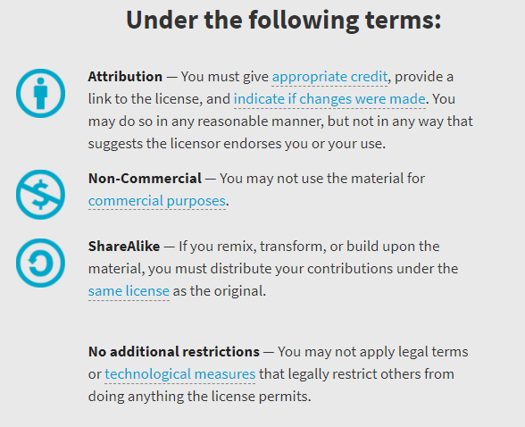
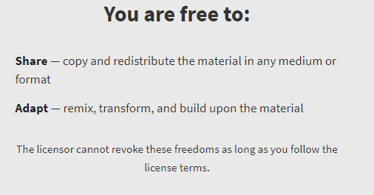
AQA GCSE Physics Required Practicals – Integrated Instructions – 10Apr2019 Draft © David Paterson, 2019 Shared under a Creative Commons “Attribution-NonCommercial-ShareAlike” license. https://creativecommons.org/licenses/by-nc-sa/2.0/uk/
© D Paterson 2019
Draft 10/4/19

Slide 2
Risk assessments
These documents are shared for information and training purposes.
If you are going to carry out practicals following these instructions, you must carry out appropriate risk assessments first. I suggest the use of CLEAPSS resources for this.

Slide 3
GCSE Physics: Density
Designed in line with practicals in AQA GCSE Physics / Combined Science Handbooks
http://www.aqa.org.uk/resources/science/gcse/teach/practicals
Density of regular solids
❖ Measure height (H) 
◆ Measure depth (D) 
 Measure mass (M) 
82.3 g
= _ _m_ _
D x H x W
 Calculate density (ρ) 
⬥ Measure width (W) 
© D Paterson 2019
Draft 10/4/19

Slide 4
GCSE Physics: Density
Designed in line with practicals in AQA GCSE Physics / Combined Science Handbooks
http://www.aqa.org.uk/resources/science/gcse/teach/practicals
Density of irregular solids
❖ Submerge object in water 
= _m_
V
 Calculate density (ρ) 
◆ Measure mass (m) 
⬥ Measure volume of water displaced (V) 
82.3 g
© D Paterson 2019
Draft 10/4/19

Slide 5
GCSE Physics: Density
Designed in line with practicals in AQA GCSE Physics / Combined Science Handbooks
http://www.aqa.org.uk/resources/science/gcse/teach/practicals
Density of liquids
◆ Measure mass of empty measuring cylinder (m_{empty}) 
❖ Measure out a volume of the liquid (V) 
 Measure mass of full measuring cylinder (m_{full}) 
 Calculate density (ρ)
❑
= m_{full} ̶ m_{empty}
V
82.3 g
94.3 g
© D Paterson 2019
Draft 10/4/19

Slide 6
❶ Weigh the metal block
❑  
❻ Power on at 12V – record ammeter and voltmeter readings
❑  
❺ Water then thermometer
❑  
❹ Voltmeter in parallel   
12V
❼ Measure temperature at 0, 1, 2, 3 …. 10 minutes
❑  
A
V
--- g
❸ Power, ammeter, heater in series   
00.00
GCSE Physics: Specific heat capacity
Designed in line with practicals in AQA GCSE Physics / Combined Science Handbooks
http://www.aqa.org.uk/resources/science/gcse/teach/practicals
❽ Data analysis
❑  
❷ Wrap block in insulation   
© D Paterson 2019
Draft 10/4/19

Slide 7
❸ Cardboard lid with hole
❑   
❹ Thermometer
❑   
❷ Insulating material
❑   
❺ Measure temperature at 0, 3, 6….15 minutes
❑   
❶ 80cm³ hot water
❑   
00.00
❻ Data analysis
❑  
GCSE Physics: Thermal Insulation
Designed in line with practicals in AQA GCSE Physics / Combined Science Handbooks
http://www.aqa.org.uk/resources/science/gcse/teach/practicals
© D Paterson 2019
Draft 10/4/19

Slide 8
❶ Set up battery, ammeter and wire in series 
❺ Measure current and potential difference 
❷ Set up voltmeter in parallel 
1.5V
A
V
❸ Attach crocodile clip to 0cm end of wire 
❹ Attach crocodile clip to 10, 20, 30 …. 100cm point on wire 
GCSE Physics: Resistance 1
Designed in line with practicals in AQA GCSE Physics / Combined Science Handbooks
http://www.aqa.org.uk/resources/science/gcse/teach/practicals
© D Paterson 2019
Draft 10/4/19

Slide 9
❻ Measure current and potential difference 
❸ Measure current and potential difference 
❺ Close switch 
❷ Close switch 
6V
6V
A
A
R₁
R₁
R₂
❶ Set up circuit (R₁ = R₂) 
V
R₂
V
GCSE Physics: Resistance 2
Designed in line with practicals in AQA GCSE Physics / Combined Science Handbooks
http://www.aqa.org.uk/resources/science/gcse/teach/practicals
❹ Set up circuit (R₁ = R₂) 
© D Paterson 2019
Draft 10/4/19

Slide 10
❶ Set up circuit component = 
component = 
❺ Reverse the battery wires. Repeat ❷&❸&❹
6V
A
❷ Adjust rheostat to give different voltage reading
Component
❹ Repeat ❷&❸ five times
V
❸ Measure voltage and current
GCSE Physics: I-V characteristics 1
Designed in line with practicals in AQA GCSE Physics / Combined Science Handbooks
http://www.aqa.org.uk/resources/science/gcse/teach/practicals
© D Paterson 2019
Draft 10/4/19

Slide 11
❺ Reverse the battery wires. Repeat ❷&❸&❹
❶ Set up circuit – including protective resistor (P) and milliammeter (mA)
mA
6V
P
❹ Repeat ❷&❸ five times
V
❷ Adjust rheostat to give different voltage reading
❸ Measure voltage and current
GCSE Physics: I-V characteristics 2
Designed in line with practicals in AQA GCSE Physics / Combined Science Handbooks
http://www.aqa.org.uk/resources/science/gcse/teach/practicals
© D Paterson 2019
Draft 10/4/19

Slide 12
❸ Clamp ruler so 0 cm is at the top of the spring 
❹ Measure length of spring
❷ Clamp spring 
❺ Add mass
❻ Repeat steps ❹ & ❺
0 masses  1 mass 
2 masses  3 masses 
4 masses  5 masses 
❶ Clamp stand to bench 
GCSE Physics: Force and extension
Designed in line with practicals in AQA GCSE Physics / Combined Science Handbooks
http://www.aqa.org.uk/resources/science/gcse/teach/practicals
© D Paterson 2019
Draft 10/4/19

Slide 13
❶ Set up trolley at 0cm mark and HOLD
❷ Tie 1.0N weight to car with string, over pulley
❸ Simultaneously release trolley AND start timer
❹ Press ‘Lap’ button at each distance marker
❺ Repeat with different weights
1.0 N  0.8 N 
0.6 N  0.4 N 
0.2 N 
00.00
GCSE Physics: Acceleration
Designed in line with practicals in AQA GCSE Physics / Combined Science Handbooks
http://www.aqa.org.uk/resources/science/gcse/teach/practicals
© D Paterson 2019
Draft 10/4/19

Slide 14
❶ Set up trolley at 0cm mark and HOLD
❷ Tie 0.6 N weight to car with string, over pulley
❸ Add a 200g mass to the car
❹ Simultaneously release trolley AND start timer
❺ Press ‘Lap’ button at each distance marker
❻ Repeat with different masses
200 g  300 g 
400 g  500 g 
600 g 
00.00
GCSE Physics: Acceleration 1
Designed in line with practicals in AQA GCSE Physics / Combined Science Handbooks
http://www.aqa.org.uk/resources/science/gcse/teach/practicals
© D Paterson 2019
Draft 10/4/19

Slide 15
GCSE Physics: Waves 1
Designed in line with practicals in AQA GCSE Physics / Combined Science Handbooks
http://www.aqa.org.uk/resources/science/gcse/teach/practicals
❶ Set up ripple tank to produce low frequency waves 
❷ Adjust height of lamp so waves are visible on card 
❻ Calculate:
wavelength 
frequency 
wave speed 
❸ Ruler at right angle to waves 
❺ Count the number of waves passing mid-point of card in 10 s 
❹ Measure length of five waves on card 
© D Paterson 2019
Draft 10/4/19

Slide 16
❶ Attach string to vibration generator, over pulley to slotted mass
❷ Adjust frequency until a standing wave is visible
❸ Measure the distance between 2 nodes
❹ Repeat steps ❷&❸ for different numbers of nodes
2 nodes  3 nodes 
4 nodes  5 nodes 
6 nodes 
GCSE Physics: Waves 2
Designed in line with practicals in AQA GCSE Physics / Combined Science Handbooks
http://www.aqa.org.uk/resources/science/gcse/teach/practicals
© D Paterson 2019
Draft 10/4/19

Slide 17
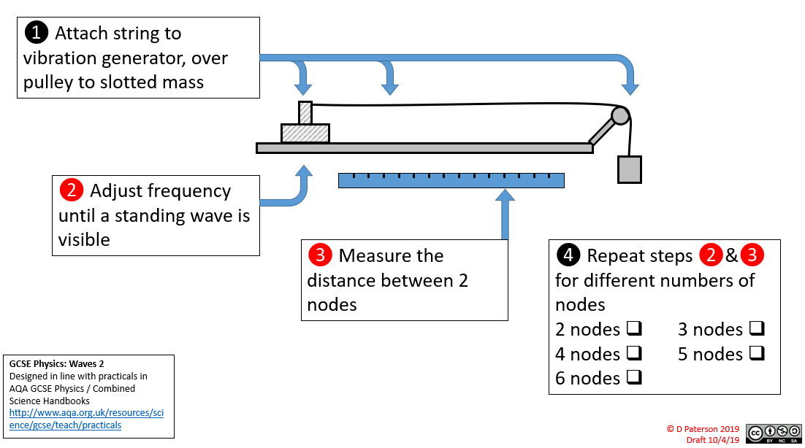

Slide 18
❷ Draw a normal
(N)  
❸ Turn on ray box
❑ 
❹ Direct ray of light at intersection of N and edge of block  
❺ Draw Xs to indicate paths of light rays (reflection and refraction)  
❶ Draw round block  
❾ Repeat with a different block
❻ Turn off ray box and remove block
❑ 
❽ Measure angles of reflection and refraction  
❼ Join up Xs to show light rays
❑ 
GCSE Physics: Light
Designed in line with practicals in AQA GCSE Physics / Combined Science Handbooks
http://www.aqa.org.uk/resources/science/gcse/teach/practicals
© D Paterson 2019
Draft 10/4/19

Slide 19
❷ Fill with just boiled water 
❸ Place lid on cube
❑
❹ Measure IR emission from each side
matt black 
shiny black 
shiny silver 
matt white 
❶ Place Leslie cube on heat resistant mat 
GCSE Physics: Radiation and absorption
Designed in line with practicals in AQA GCSE Physics / Combined Science Handbooks
http://www.aqa.org.uk/resources/science/gcse/teach/practicals
© D Paterson 2019
Draft 10/4/19

Slide 20
❶❷❸❹❺❻❼❽❾❿ Text text text 
+
–
xxxxxxxxxxxxxxxxxxxxx
00.00
82.3 g
© D Paterson 2019
Draft 10/4/19

