Slide 1
Primary PGCE and SDD Lead Mentor Training, Development and Consultation
Starting at 3:30pm

Slide 2
Sharing Good Practice
Notes:
An opportunity for more experienced mentors to share their ideas with less experienced colleagues

Slide 3
Mentor Training: The BP Phase Instructions and Profile Descriptor

Slide 4
Beginning Practice Phase Profile Descriptor
Behaviour Management
Learn That
You understand that good teaching has a positive impact on pupil outcomes through setting high expectations of all pupils. You know that teachers act as role models for pupils, influencing their attitudes and behaviour, and that the role of the teacher is particularly important for pupils from disadvantaged backgrounds. You understand the importance of creating positive relationships with pupils and a culture of mutual respect.
You know how safe classroom environments are created and maintained through development of cultures of trust and mutual respect, consistent use of rules, routines and consequences and, where relevant, through safe practices in practical settings. You understand how theories of motivation relate to behaviour management, and that prior experiences impact pupils’ attitudes to learning.
Learn How
You contribute to the creation of a positive classroom culture with high expectations, through verbal and non-verbal communication.
You begin to use the school behaviour policy, setting clear expectations for behaviour.

Slide 5
Beginning Practice Phase Profile Descriptor
Pedagogy
Learn That
You know how subject-specific research informs pedagogy in your curriculum area, including how children learn and how learning can be sequenced.
You know that lessons should be structured and that learning should be scaffolded, drawing on pupils’ prior knowledge and incorporating opportunities to assess pupils’ misconceptions, and how modelling and worked examples are used to scaffold clear explanations.
You are aware of research relating to questioning, classroom talk, group activities and grouping structures, homework, and the role of regular practice and can explain how this influences planning for learning within your subject.
You understand that teaching should adapt responsively to different pupils’ needs, including those with SEND and EAL.
You know how your placement school supports pupils from disadvantaged backgrounds.
Learn How
You draw on subject and curriculum knowledge to plan episodes which develop key concepts, knowledge and skills, scaffold learning and provide challenge, with support from the class teacher.
You can explain concepts to pupils using verbal and visual representation, examples and modelling.

Slide 6
Beginning Practice Phase Profile Descriptor
Curriculum
Learn That
You have a secure knowledge and understanding of the subject you are teaching.
You are beginning to understand general principles of curriculum design and are aware that curriculum sequencing is important. You understand how pupils’ literacy is developed, including the use of systematic synthetic phonics in early reading, and know how literacy and numeracy can be supported within your subject teaching.
Learn How
You have observed how the curriculum is delivered in your placement school.

Slide 7
Beginning Practice Phase Profile Descriptor
Assessment
Learn That
You know how subject-specific research informs assessment in your curriculum area.
You understand the importance of effective assessment, including the principles of using verbal and written feedback, and how assessment supports the development of pupils’ metacognition and self-regulation.

Slide 8
Beginning Practice Phase Profile Descriptor
Professional Behaviours
Learn That
You know that teachers are accountable for achieving the highest possible standards in work and conduct and maintain high standards in their own attendance and punctuality.
You understand that a teacher acts with honesty and integrity.
You understand that a teacher has proper and professional regard for the ethos, policies and practices of the school in which they teach, and maintains high standards in their own attendance and punctuality.
Drawing on knowledge of educational research, you understand the rationale for expert mentoring, feedback and reflective practice in learning to teach and the importance of professional relationships with colleagues and parents.
You understand how to effectively work with Teaching Assistants.
You understand your responsibilities in relation to child protection in school.
You have developed your knowledge and understanding of how British Values are taught in secondary schools.

Slide 9
Beginning Practice Phase Profile Descriptor
Professional Behaviours
Learn How
You are starting to build positive relationships with colleagues, work with mentors to identify targets for development, and respond proactively to feedback and advice. You are developing strategies to prioritise tasks and keep on top of organisation. You engage critically with educational research, drawing on a range of sources and starting to relate these to practice.
You evaluate episodes, drawing on subject-specific pedagogy and theories of learning to relate teaching to pupil learning.
You can explain the pedagogical principles which behind some teaching activities, articulating how these relate to subject-specific research into how children learn.

Slide 10
Mentor Training: The BP FRAP

Slide 11
BP FRAP SDD
Due in
11/11/2022

Slide 12
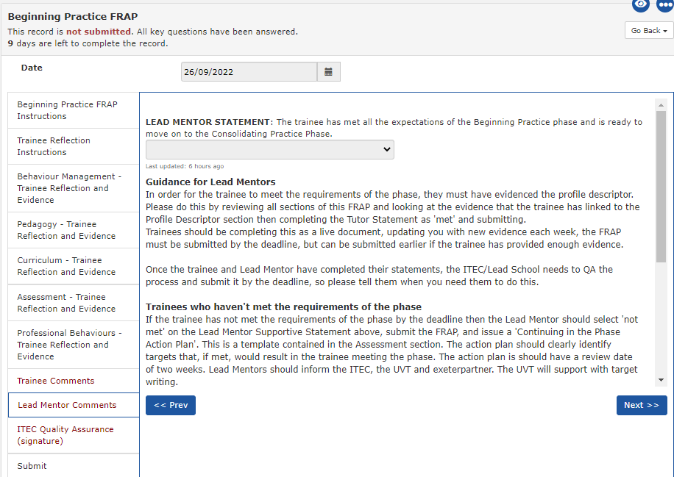
Beginning Practice Feedback SDD

Slide 13
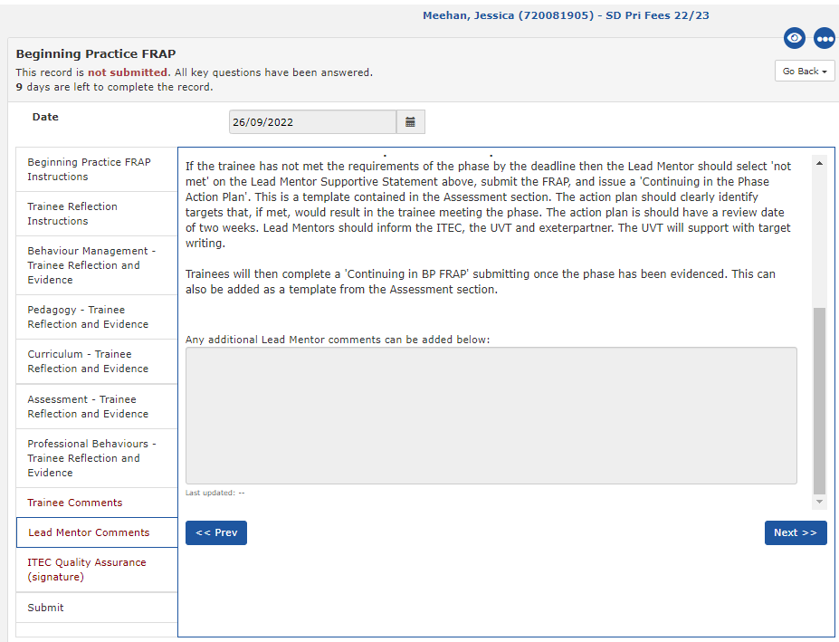
Beginning Practice Feedback SDD
Add comments here

Slide 14
Beginning Practice Phase Instructions Primary PGCE route
This phase covers the autumn term taught course and two weeks of school experience. During school experience, classroom contact time is 12 hours per week in this phase and is likely to be mainly observation. Trainees will start to use the Exeter Model Training Tools to teach short episodes, supported by team planning with the class teacher. A lesson plan should be written for each episode and submitted to the Lead Mentor or relevant class teacher at least 48 hours in advance.
Use of the IDP in the BP phase
University tutors will support trainees to understand the Exeter Model tools during the autumn term.
The Exeter Model training tools for the two weeks of school experience are programmed for trainees and can be seen on the timeline.
During the BP phase trainees are required to complete:
Exeter Model training tools during school based work:
1 Weekly Development Meeting record per week with Lead Mentor
2 demonstrations and agendas per week (using demo/agenda template)
2 observations per week on lesson episodes
Lead Mentors complete Beginning Practice Feedback by the end the two weeks of school experience which is within the BP FRAP template

Slide 15
Beginning Practice Phase Instructions
Beginning Practice FRAP PGCE
Trainees complete the Beginning Practice FRAP within their IDP during the phase.
Their Personal Tutor will confirm whether the trainee has met the phase.
The Lead Mentor feedback form contributes to this assessment.
Due in 9/12/2022

Slide 16
Beginning Practice Feedback PGCE
Notes:
PGCE primary complete this section at the end of their 2 weeks in November. Each section has yes/no choice as to whether they have demonstrated that particular skill and space for any comments that you might have.

Slide 17
Beginning Practice Feedback PGCE
Notes:
Here are the rest of the areas…

Slide 18
Beginning Practice Feedback PGCE
Notes:
Then there is a section for you to complete with any other comments.

Slide 19
Beginning Practice Feedback PGCE
Notes:
As you can see, there are several sections for the trainee to complete in relation to the BP phase descriptor. Then there is a final section for their tutor to sign off.
If they don’t meet the phase descriptor then they are given a ‘Continuing in the Phase’ action plan.
If you the LM have said no to any of the statements earlier then the tutor can make a judgement as to whether they have managed to achieve that during the taught course.

Slide 20
Curriculum Focus
Notes:
Reminder of what our curriculum is in every session…

Slide 22
Seminar Days with specialist subject knowledge
School-based timetable of training sessions
School Direct Distance
Primary
Curriculum and Professional Studies online modules
Masters levels
Subject & Curriculum study
Education & Professional Study

Slide 23
Curriculum
How do you find out what the trainees cover?
Where can you find the information?
Notes:
Pop in the chat

Slide 24
Curriculum
For example, where do you think trainees
‘learn that establishing and reinforcing routines, including through positive reinforcement, can help create an effective learning environment’?
CCF 7.1 Behaviour Management
Notes:
Pop in the chat

Slide 25
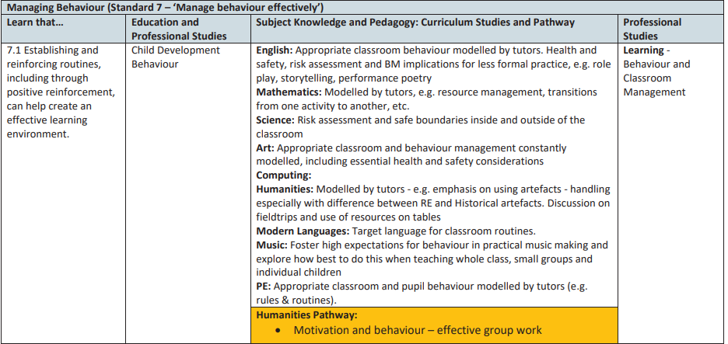
Curriculum Primary PGCE pathways
Notes:
Pop in the chat

Slide 26
Curriculum SDD school CCF mapping example
Managing Behaviour (Standard 7 – ‘Manage behaviour effectively’)
Learn that… | PRIMARY SCS & EPS | School-Led Training Sessions
7.1 Establishing and reinforcing routines, including through positive reinforcement, can help create an effective learning environment. | Autumn: Motivation and Behaviour | Autumn Emotional Literacy/SEMH Behaviour as Communication Pupils with Complex Difficulties – whose behaviour challenges (2RCL only)
Notes:
Pop in the chat

Slide 27
Curriculum
The Core Content Framework for ITT is NOT the curriculum. It is a statutory entitlement which our curricula include.
Each trainee follows a carefully designed and sequenced curriculum in their subject, identifying what they are learning across both University-led teaching and school placements.
Every subject has a ‘Study Guide, Curriculum Sequence and CCF Map’ which outlines this sequenced curriculum and show when and how the CCF minimum content is included. It also contains the timetable for the autumn term so you can know exactly what they have covered and when they covered it.
Primary PGCE
SDD
Home > Exeter Primary PGCE

Slide 28
Study Guide, Curriculum Sequence & CCF Map
Administrative Information
Programme Aims
Assessment
The Curriculum
Theoretical Framing
Curriculum Sequence
Curriculum Mapped against the CCF
Notes:
Here is an over view of what is in it!
Show them the mentor zone and your blog and where everything is.

Slide 29
Research: Poetry Research Project with Anthony Wilson

Slide 30
Curriculum focus : English with Anthony Wilson
Reading and writing as meaning making activities
Notes:
Here is an over view of what is in it!
Show them the mentor zone and your blog and where everything is.

Slide 31
Thank you for listening
‘
Any questions?

