Slide 1

A RE-searchers Approach Lesson – Election Special
For more details about the RE-searchers approach see here:
RE-searchers Approach - RE:ONLINE (reonline.org.uk)

Slide 2
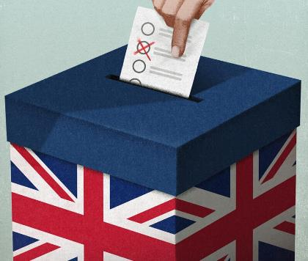
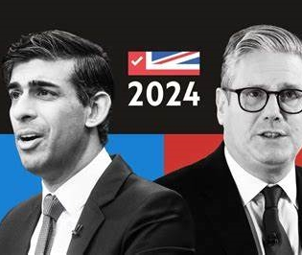
Thursday 4th July 2024
Why do people vote in a General Election?

Slide 3
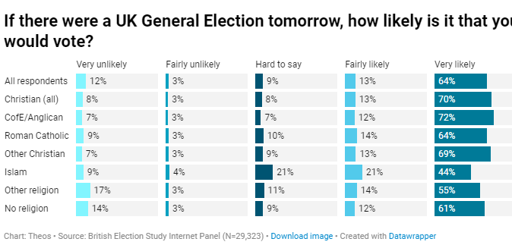
Religion Counts: Do the religious vote? - Theos Think Tank - Understanding faith. Enriching society.

Slide 4
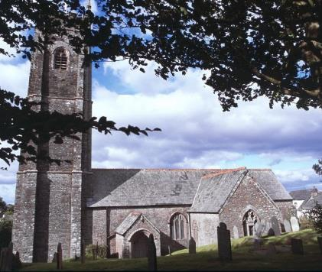
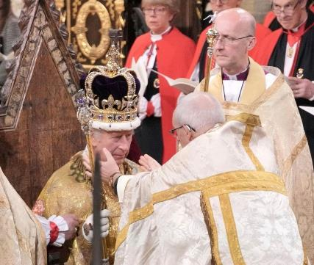
Anglican
Church of England

Slide 5
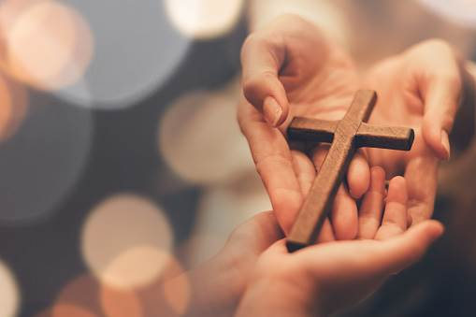
So…why are Christians who attend an Anglican church more likely to say that they will vote in a General Election than anyone else?

Slide 6
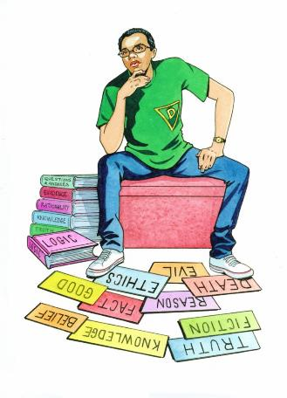
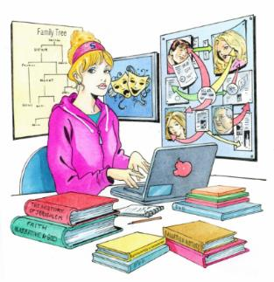
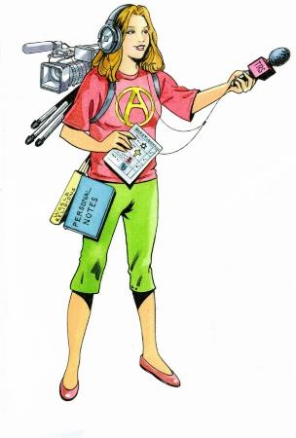
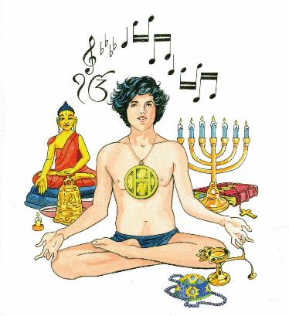

Who could help us most?

Slide 7

Have-a-go Hugo – A reminder
CAN I JOIN YOU WHEN YOU...
LET ME FEEL WHAT IT IS LIKE TO...
LET ME IMAGINE WHAT IT MUST BE LIKE TO BELIEVE…

Slide 8
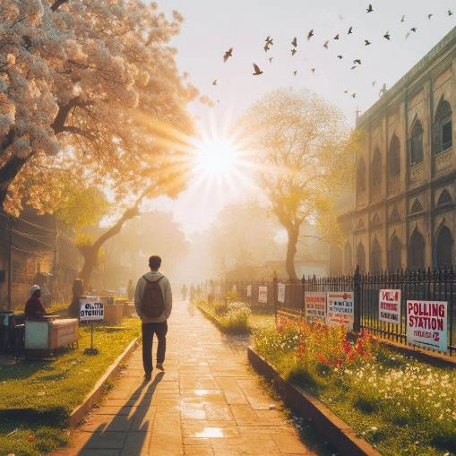
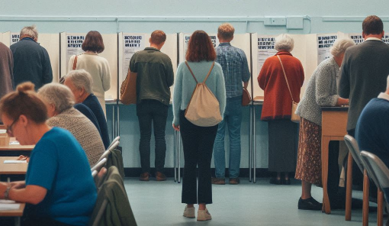

What would it be like to vote as an Anglican? Can we imagine it? EXAMPLE 1: Audrey the Anglican
See the guided meditation in the chat.
Notes:
Let's begin by finding a comfortable position sitting / lying down. Close your eyes gently and take a deep breath in through your nose, feeling your chest rise as you fill your lungs with air. Hold it for a moment, and then exhale slowly through your mouth, letting go of any tension or worries.
Imagine yourself on a bright, sunny morning. You're walking through a bustling town towards the polling station. The air is crisp and carries the scent of freshly cut grass and blooming flowers. Birds chirp merrily in the trees, adding a symphony of natural sounds to the atmosphere.
As you approach the school hall that been transformed into a polling station, notice the buzz of conversation around you. People of all ages and backgrounds are gathered, each person with their own thoughts and hopes about the election. You feel a sense of anticipation mixed with determination, knowing that today, your vote will reflect your beliefs as a Christian, as a member of the Church of England - an Anglican.
As you stand in line, ready to cast your vote, consider your beliefs about keeping communities safe. Jesus said, "blessed are the peacemakers." You support community policing and helping criminals live better lives. Imagine feeling a optimistic about giving people second chances and making a positive change.
It's your turn to vote. Imagine stepping into the booth with a sense of purpose and gratitude for the opportunity to participate in democracy.
Imagine reading through the list of names on the left side of the paper. Look for the name of the candidate who said they would build more hospitals to ensure everyone can get free healthcare when they need it. You remember the teachings of Jesus, who healed every disease and sickness and know that he would share your views.
As you run your finger down the list of names, pause on a name you have considered voting for. A party who have spoken passionately about protecting the environment and stopping pollution. You recall the words from Genesis: "God saw all that he had made, and it was very good." Imagine wondering if you should choose this name instead.
Imagine picking up the small pencil and put your X next to the name you had planned to choose. Feel confident because this is the person who also said they would support the poor with affordable housing and money for food. Remember the Bible passage that reminds you to "uphold the cause of the poor” (Psalm 82:3-4).
Imagine taking a moment to silently offer a prayer asking God to guide others in their choices. Trust that your voice matters and that your vote contributes to shaping a compassionate and fair community.
As you leave the polling station, feel a sense of accomplishment and peace. You have done what the Lord would have wanted you to.
Slowly bring your awareness back to the present moment. Wiggle your fingers and toes, gently open your eyes, and take a deep breath in, feeling refreshed and empowered.

Slide 9

Ask-it-all Ava – A reminder
TELL ME WHAT YOU DO…
TELL ME WHY IT IS IMPORTANT TO YOU
TELL ME WHAT YOU BELIEVE…

Slide 10
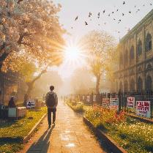






What could we learn about it from interviewing Anglicans?
Tell me what it was like going to vote.
What was it like in the polling station?
Why did you vote? How did your beliefs about HEATHCARE / THE ENVIRONMENT / POVERTY / CRIME affect who you voted for?
GIVE
BUILD
SPEND
HELP
“God saw all that he had made, and it was very good." Genesis
“Uphold the cause of the poor”
(Psalm 82:3-4)
Jesus healed people’s diseases and sickness.
Jesus said, "Blessed are the peacemakers"

Slide 11


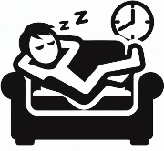

What can we learn by interviewing EXAMPLE 2 Angus the Anglican?
Why did you vote? How did your beliefs about HEATHCARE / THE ENVIRONMENT / POVERTY / CRIME affect your choice?
TEACH
BALANCE
MAKE
PUNISH
Look out for your own interests and the interests of others. - Philippians
“A good person leaves an inheritance for their children’s children." - Proverbs
"The one who is unwilling to work shall not eat." - 2 Thessalonians 3:10
“When justice is done, it brings joy to the righteous but terror to evildoers.” Proverbs

Slide 12

Debate-it-all Derek – A reminder
WHAT DO YOU BELIEVE?
WHY DO YOU BELIEVE THIS?
WHY ARE PEOPLE YOU DISAGREE WITH WRONG?

Slide 13
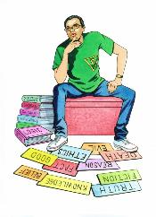
Of the two perspectives we have looked at, which argument is stronger?
GIVE
Anglican Audrey
BUILD
SPEND
HELP
“God saw all that he had made, and it was very good." Genesis
“Uphold the cause of the poor”
(Psalm 82:3-4)
Jesus healed people’s diseases and sickness.
Jesus said, "Blessed are the peacemakers"
Anglican
Angus
BALANCE
TEACH
MAKE
PUNISH
Look out for your own interests and the interests of others. - Philippians
“A good person leaves an inheritance for their children’s children." - Proverbs
"The one who is unwilling to work shall not eat." - 2 Thessalonians 3:10
“When justice is done, it brings joy to the righteous but terror to evildoers.” Proverbs

Slide 14



Of the three RE-searchers we have used, who do you think has helped us most with this?
Which character did you find it hardest to be?

Slide 15
A Quiz
According to the survey, which religious or non-religious group was most likely to vote in a General Election?
Based on the examples in today’s lesson, does knowing someone’s religion help you predict what views they hold?
What steps could we take next to check and test our understanding?

Slide 16
Learning Objectives
I know which religious group is more likely to say they will vote and can suggest reasons why.
I can explain what knowing someone’s religion might tell us about their political views.
I can research like three RE-searcher characters and decide which has been (and will be) most help answering our inquiry question

