Slide 1
Research Data Management
Dr. Chris Tibbs
Research Data Officer
rdm@exeter.ac.uk
31st October 2018

Slide 2
Open Data
Open Data = a new paradigm across all disciplines, providing benefits to individual researchers, institutions, and funders
Good research data management habits are essential to creating data that are suitable for sharing
Free
Immediate
Research Data
Open Data
Online
Re-use Rights
Availability

Slide 3
What is Research Data Management?
Research data = all information collected/created and used in research
structured data (e.g., databases, tables, etc.)
unstructured data (e.g., textual sources, images, audio recordings, personal notes, emails, etc.)
Data management = effective management of the information lifecycle
planning for data
working with data
preserving and sharing data

Slide 4
Importance of Good Data Management
Data are the cornerstone of research
Good quality data leads to good quality research
To protect data from loss, destruction, corruption
Ensure that data remain accurate and reliable
Increase research productively
Enables compliance with ethical codes, data protection laws, journal requirements and funder/institutional policies

Slide 5
UoE Requirements – Key Points
Research data management is the joint responsibility between PI(s) and researcher(s)
All research proposals must include data management plans
Research data management is a valid cost for research proposals
Researchers are responsible for ensuring that data are deposited in an appropriate repository after project completion
Publications should include a short data access statement
Full details: http://hdl.handle.net/10871/26168

Slide 6
Funder Requirements – Key Points
Funders are increasingly requiring researchers to meet certain data management criteria
Submission of a technical or data management plan when applying for funding
Open data sharing after project completion
Deposit data in a data repository
Minimal or no access restrictions
Long term preservation of the data
Most funders require 10+ years
Further details on specific funder policies: http://v2.sherpa.ac.uk/juliet/

Slide 7
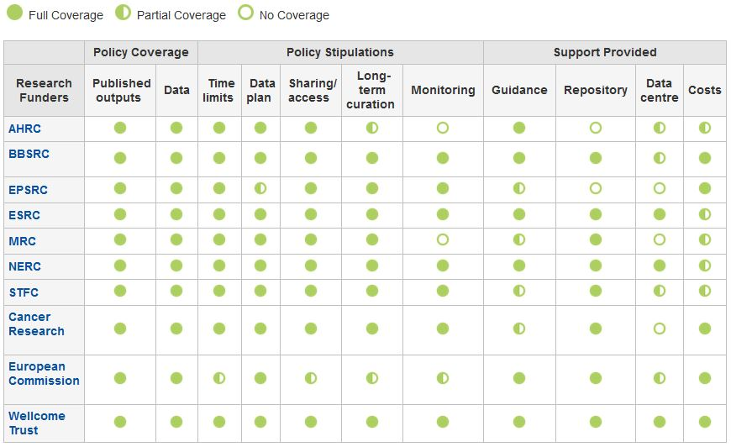
Data-related policies
http://www.dcc.ac.uk/resources/policy-and-legal/overview-funders-data-policies

Slide 8
UKRI Common Principles
Publicly funded research data are a public good, produced in the public interest, which should be made openly available with as few restrictions as possible in a timely and responsible manner.
To enable research data to be discoverable and effectively re-used by others, sufficient metadata should be recorded and made openly available to enable other researchers to understand the research and re-use potential of the data. Published results should always include information on how to access the supporting data.
It is appropriate to use public funds to support the management and sharing of publicly-funded research data. To maximise the research benefit which can be gained from limited budgets, the mechanisms for these activities should be both efficient and cost-effective in the use of public funds.
https://www.ukri.org/funding/information-for-award-holders/data-policy/

Slide 9
Data Management Planning

Slide 10
Research Data Lifecycle

Slide 11
What is a data management plan (DMP)?
A DMP is a formal statement describing how research data will be managed and documented throughout a research project and the terms regarding the subsequent deposit of the data in a data repository for long-term management and preservation.
What data will be collected/created (format, types, and size) and how?
How will the data be documented and described?
How will data ethics and Intellectual Property be managed?
What are the plans for data sharing and access?
What is the strategy for long-term data preservation?

Slide 12
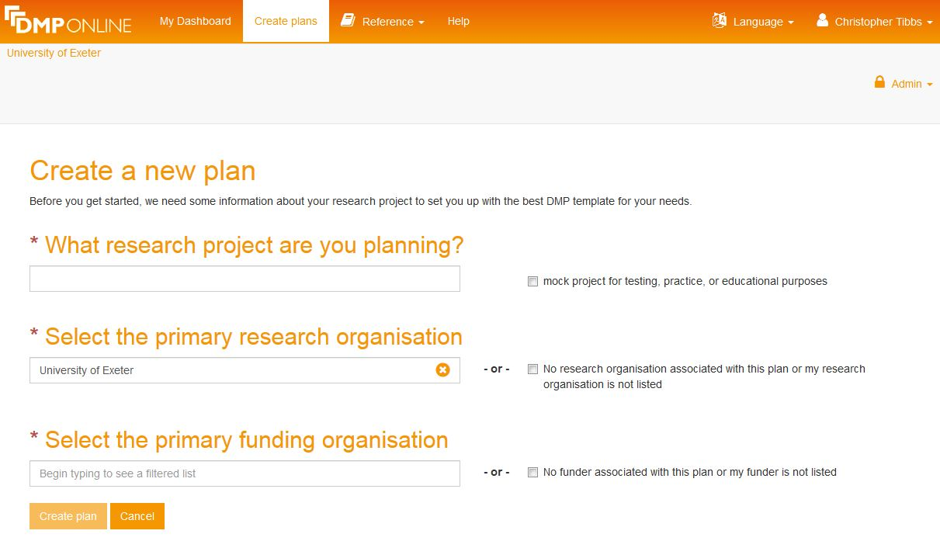
DMP Online
DMP Online is an web-based tool, developed by the Digital Curation Centre (DCC), to help write data management plans
https://dmponline.dcc.ac.uk

Slide 13
What does DMP Online do?
A web-based tool that enables users to
Create, store, and update multiple versions of DMPs throughout the research lifecycle
Collaboratively work on the DMP with multiple people able to access the DMP
Meet a variety of specific data-related requirements (from funders, institutions, etc.)
Get tailored guidance on best practice and helpful contacts, at the point of need
Customise, export, and share DMPs in a variety of formats in order to facilitate communications within and beyond research projects

Slide 14
Preserving And Sharing Data

Slide 15
FAIR Data
To meet the funder requirements, you should make your data:
Image: CC BY-SA 4.0 Sangya Pundir
https://www.force11.org/group/fairgroup/fairprinciples

Slide 16
Research Data Repositories
Digital research data are best preserved and published using a research data repository
A repository is an online database service, an archive that manages the long-term storage and preservation of digital resources and provides a catalogue for discovery and access
Most data repositories do not charge to deposit research data, though many require registration
Registry of research data repositories: http://www.re3data.org/

Slide 17
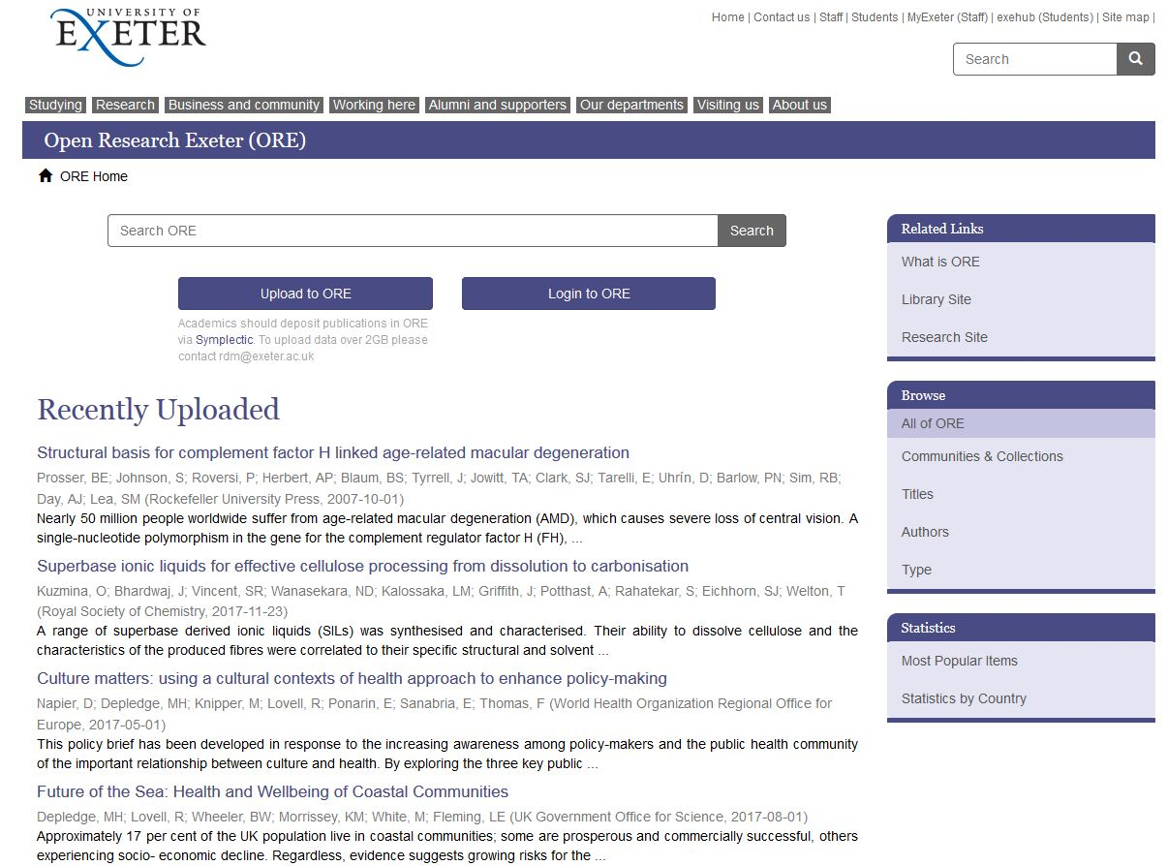
Open Research Exeter (ORE)
ORE is the University of Exeter’s institutional repository, suitable for both publications and data
ORE offers long-term data preservation and curation
https://ore.exeter.ac.uk/repository/

Slide 18
Depositing Data In ORE
Is the size of your data <2GB?
Yes
No
Deposit your data in ORE via Symplectic
Deposit your data in ORE using the ORE deposit tool
ORE

Slide 19
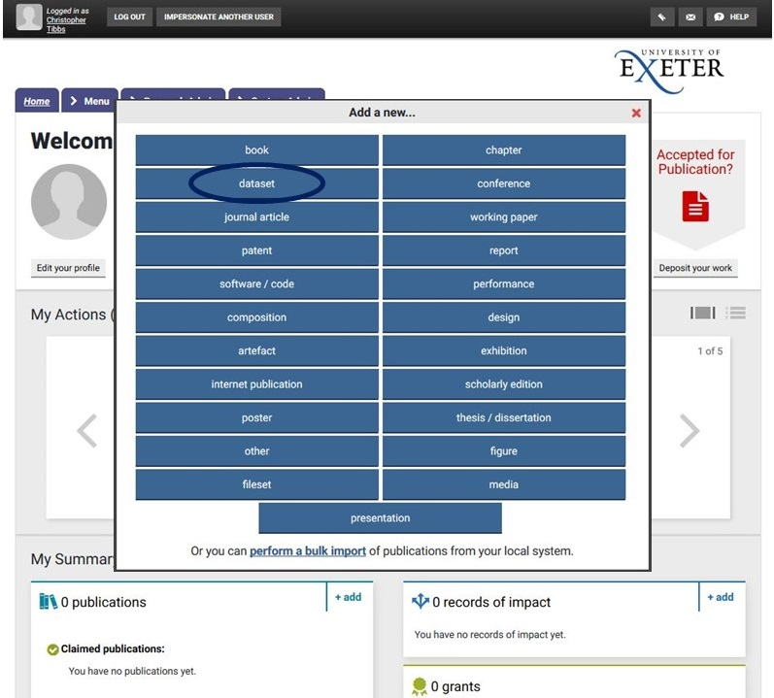
Depositing Data In ORE (<2GB)
Datasets can be deposited to ORE via Symplectic using the same procedure as the one used to deposit journal articles – simply select the type “dataset” rather than “journal article”
https://researchpubs.exeter.ac.uk/

Slide 20
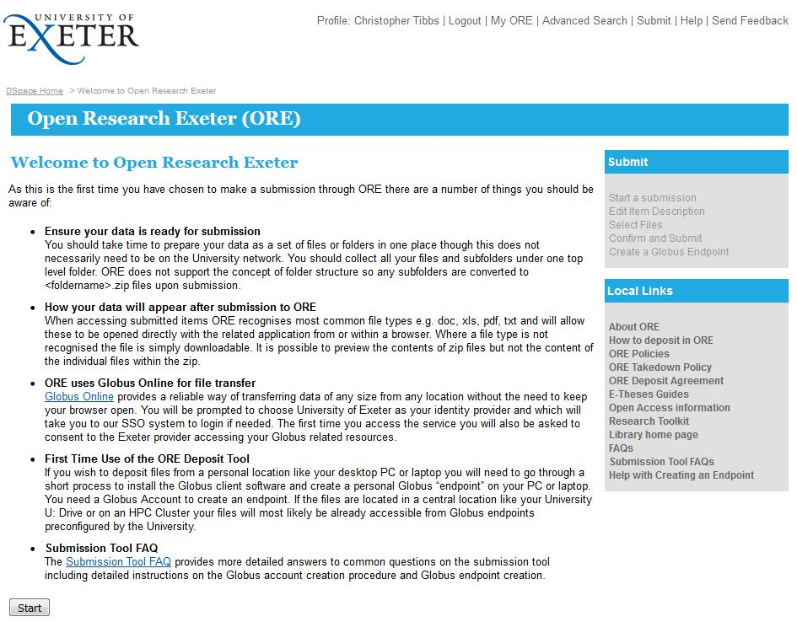
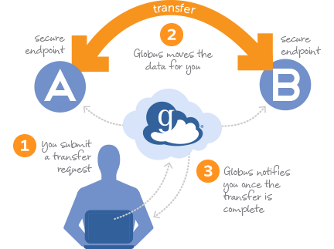
Depositing Data In ORE (≥2GB)
The ORE Deposit Tool can be used to deposit large datasets into ORE
https://ore.exeter.ac.uk/oredeposit/
Uses Globus Connect to transfer the data in the background without having to store the data on an intermediate server

Slide 21
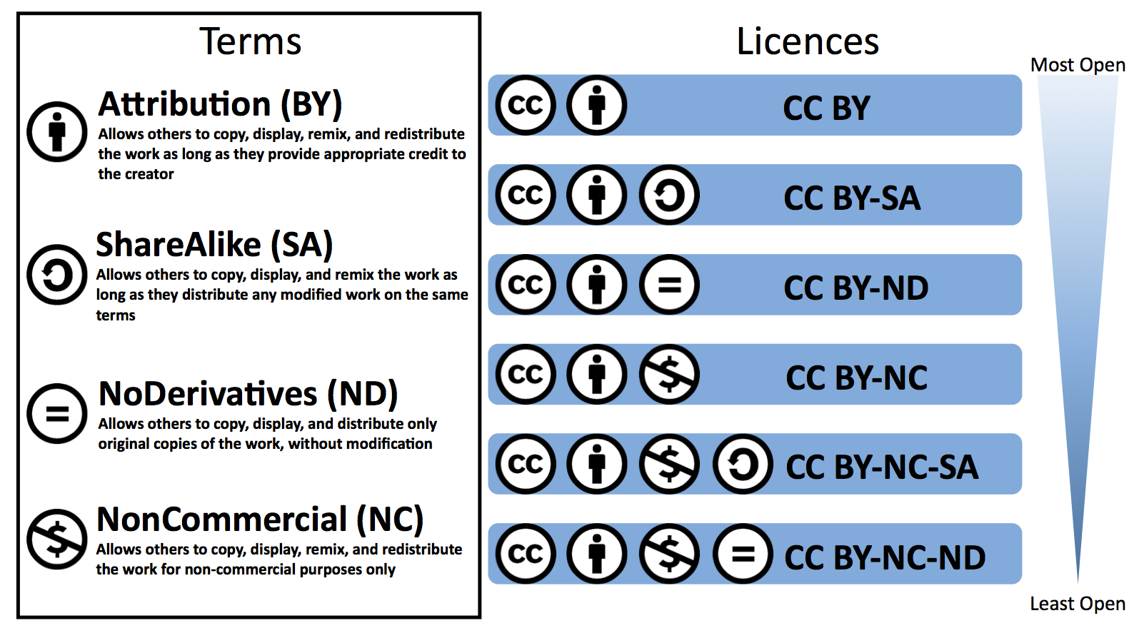
Licensing Your Data
Licences to share, remix, and distribute legally, while ensuring authors get credit for their work
C.T. Tibbs
https://creativecommons.org/licenses/

Slide 22
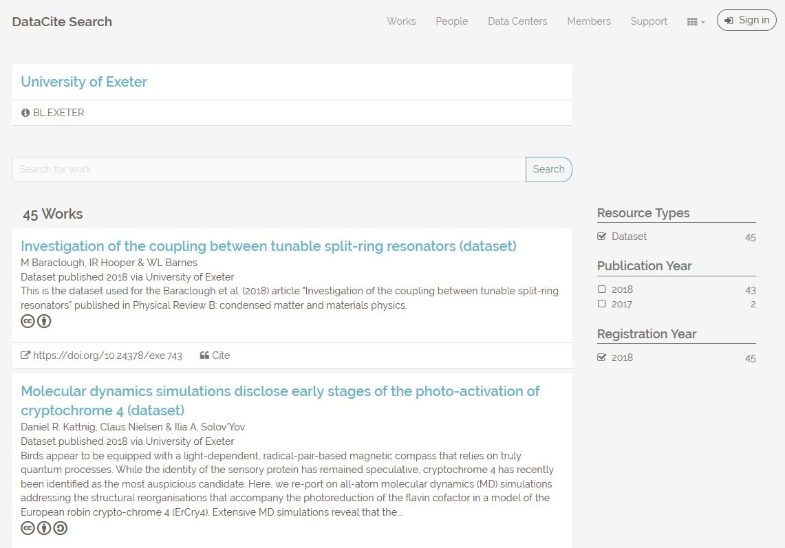
Digital Object Identifiers (DOIs)
To effectively share research data, it must be uniquely identified with a persistent identifier
All datasets deposited in ORE are allocated a DataCite DOI
University of Exeter DOIs are of the format: https://doi.org/10.24378/exe.XXXXX

Slide 23
Data Access Statements
All research publications should include a statement on how the underlying data can be accessed (a "data access statement").
How the data can be accessed?
Web link
Digital Object Identifier (DOI) or other persistent identifier
Who must be contacted to request access?
Departmental/group email address (not a personal email address)
On what terms are the data available?
a general licence
a data sharing agreement must be entered into before access to the data is granted

Slide 24
Example Data Access Statements
No new data generated
e.g., “This study did not generate any new data.”
Openly available data in a repository
e.g., “The research data supporting this publication are openly available from the University of Exeter’s institutional repository at: https://doi.org/10.24378/exe.XXXXX”
Sensitive data with restricted access
e.g., “Due to ethical concerns, the research data supporting this publication can only be made available to bona fide researchers subject to a data access agreement. Details of how to request access are available from the University of Exeter's institutional repository at: https://doi.org/10.24378/exe.XXXXX”

Slide 25
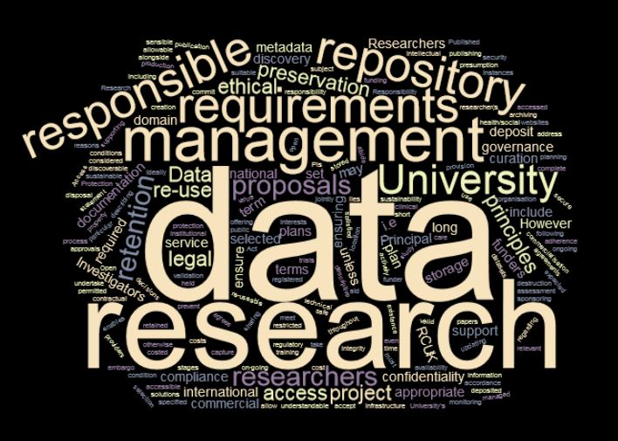
Need to know more?
Contact:
Chris Tibbs – Research Data Officer
rdm@exeter.ac.uk
https://www.exeter.ac.uk/research/researchdatamanagement/

