Slide 1
Mentorship
November 2024 WiC meeting

Slide 2
Overview of today's session
Menti quiz
What is mentorship?
How does mentorship differ from coaching?
Different forms of mentorship and the pros and cons of each
Proposal for WiC group mentorship trial
Discussion and Q&A with Rachel McInnes
Open discussion & sharing of experiences
“A lot of people have gone further than they thought they could because someone else thought they could.|”

Slide 3
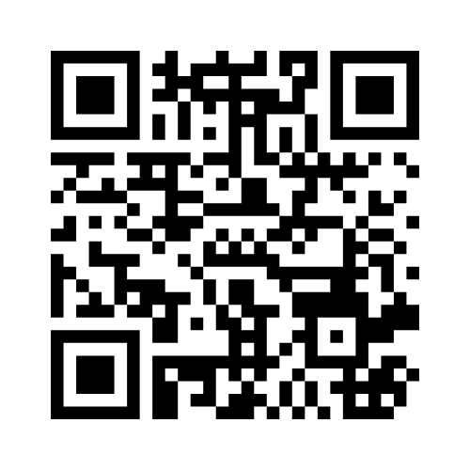
Menti Quiz
https://www.menti.com/alecitpdwp65 _ participation link
www.menti.com

Slide 4
What is mentorship?
Mentoring is a learning relationship, involving the sharing of skills, knowledge and expertise between a mentor and mentee through developmental conversations, experience sharing and role modelling.
A form of employee development whereby a trusted and respected person - the mentor - uses their experience to offer guidance encouragement and support to another person - the mentee.
What is mentoring ?

Slide 5
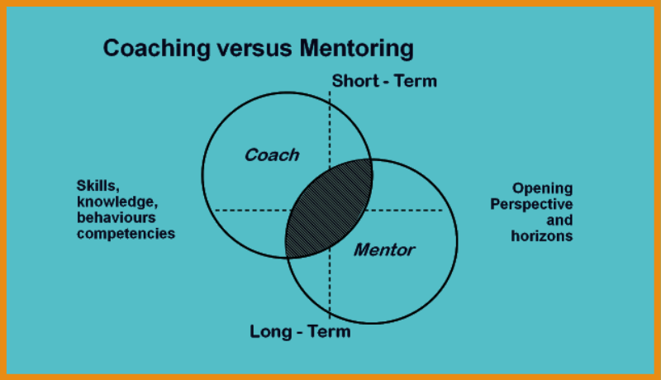
Mentorship vs Coaching
Coaching and mentoring are different practices. Although there’s a lack of agreement among professionals about precise definitions.
Coaching | Mentorship
Focus of developing skills for short to medium term objectives | Personal growth & continuous improvement of individuals capabilities so they can make intelligent career decisions for themselves
Coaches don’t generally expect to learn from coachees | Mentoring is a more reciprocal relationship where both parties can learn from each other
Coach = authority & responsible for managing the objectives that need to be achieved (coach driven) | Mentor = guide and supporter NOT authority. Both work together to identify goals, development needs. Mentee usually drives agenda and seeks insights (Mentee driven)
Coaches measure performance | Performance is not measured
Coaching can be standardised | Mentoring is personalised

Slide 6
Types of mentorship
Traditional One-on-One: A senior mentor helps guide a junior mentee
Peer Mentorship: Colleagues at the same level provide mutual support.
Reverse Mentorship: opportunity for more senior leaders and/or those in the later stages of their career to understand and learn from less-senior employees and/or employees in the earlier stages of their careers.
Group Mentorship: One mentor leads a group of mentees.
What is mentoring ?

Slide 7
Traditional One-on-one mentorship
Pros | Cons
Personalised guidance: Tailored support that addresses the specific needs and goals of the mentee. | Time commitment: Requires time commitment from both the mentor and mentee.
Trust: Builds a deep, trusting relationship, allowing for open communication and honest feedback. | Risk of Mismatch: If mentor and mentee don’t have good chemistry or aligned goals, the relationship may not be as effective.
More scheduling flexibility – just 2 peoples calendars to manage | Limited Perspectives: The mentee may only be exposed to one viewpoint, which can limit learning diversity.

Slide 8
Peer mentorship
Pros | Cons
Mutual Support: Both individuals benefit from the exchange, creating a more balanced, collaborative relationship. | Limited Experience: Peers may not have the deep experience or insight that a senior mentor could provide.
Relatable Experiences: Since they are at similar career stages, peer mentors often understand each other’s challenges more | Ability to help: Peers may not have the same influence or ability to help with significant career advancements.
Less Hierarchical: Less formal structure, which can make mentees feel more comfortable asking questions and being vulnerable.

Slide 9
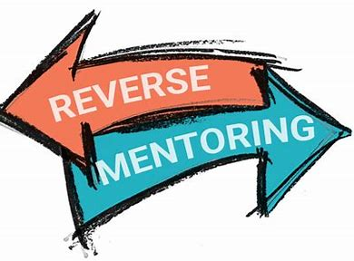
Reverse Mentorship
Pros | Cons
Inclusive culture that values all employees | Mentor may lack the experience to provide valuable insights on certain topics.
Foster mutual respect and bridge gaps between different levels of seniority | Resistance to new dynamics
Gain fresh perspectives
Notes:
metoffice.sharepoint.com/sites/TheMetOfficeMentoringNetwork/Shared Documents/Forms/AllItems.aspx?id=%2Fsites%2FTheMetOfficeMentoringNetwork%2FShared Documents%2F8%2E Reverse Mentoring%2Epdf&parent=%2Fsites%2FTheMetOfficeMentoringNetwork%2FShared Documents&p=true&ga=1

Slide 10
Group Mentorship
Pros | Cons
Support network: It fosters a sense of community and support among mentees | More organisational requirement (e.g., managing schedules)
Increased Access to Mentorship: One mentor can reach multiple mentees at once, making it a more efficient & allows more people to benefit from the mentor’s expertise, especially when the mentor’s time is limited. | Less personalized attention: Mentees may receive less individualized guidance compared to one-on-one mentorship
Collaborative Learning: collaboration among mentees, allowing them to learn from each other’s Qs, experiences, and approaches to challenges. | Potential for imbalance: Some mentees may dominate the conversation, while others may feel overshadowed or reluctant to participate
Diverse Perspectives: mentees gain insights from multiple peers & mentor, exposing them to a variety of perspectives, ideas, & experiences. Can lead to richer discussions and creative problem-solving.
MPOWIR program – example of successful group mentoring program
31-4_mouw.pdf (tos.org)

Slide 11
Ways of accessing mentorship
Allocated
Through mentoring schemes
Formal - participants are matched based on criteria
Informal – more flexibility
Line manager matching - line managers might facilitate the process
ADHOC matching
More flexible
Individuals may reach out to potential mentors on an as-needed basis, often for short-term or project-specific advice.
Finding your own mentor
Proactive approach

Slide 12
Met Office mentoring schemes and resources
Partnerships mentoring program: Partnerships Mentoring Program
Met office mentoring community: How do I get involved ?
Mentoring handbook: Mentoring handbook
Civil Service Blog about Mentoring by Bernadette Thompson,18 February 2021
“Mentoring is a brain to pick, an ear to listen, and a push in the right direction.” - John C. Crosby

Slide 13
Career Mentor Scheme
6 months of 1:1 mentoring with an experienced professional who can provide sector-specific advice
Applicants list their 1st and 2nd choice of mentor when they apply
Available to all students (incl. PGRs) and up to 3 years post graduation
Runs 2x per year (Jun – Nov & Dec – May)
https://www.exeter.ac.uk/students/careers/employability-schemes/careermentorscheme/

Slide 14
Proposal for WiC group mentorship trial
3-6-month trial
Groups each with one senior scientist as a mentor and about 3/4/5 mentees
Groups can meet online, in-person, or in a hybrid format, depending on availability.
Meet once a month over the trial
The trial will include participants from both the Met Office and the University of Exeter, with the potential to combine members from both organisations into one group
We will organise the groups from the volunteers and assist with the first meeting, after which the groups will manage their own sessions.
Feedback will be collected after the trial, but groups can continue meeting after if they so wish.

Slide 15
Thank you!
Thank you!
Please fill out this microsoft form to register interest and leave feedback
Email ideas & thoughts
“The delicate balance of mentoring someone is not creating them in your own image but giving them the opportunity to create themselves.” - Steven Spielberg
https://forms.office.com/Pages/ResponsePage.aspx?id=YYHxF9cgRkeH_VD-PjtmGaX7KjKvTiFHgzLYPwRDIEFUQ0c2VjJRQ0lOSldZU1I3V0VBWVhKTzRTSy4u
Notes:
https://forms.office.com/Pages/ResponsePage.aspx?id=YYHxhttps://forms.office.com/Pages/ResponsePage.aspx?id=YYHxF9cgRkeH_VD-PjtmGaX7KjKvTiFHgzLYPwRDIEFUQ0c2VjJRQ0lOSldZU1I3V0VBWVhKTzRTSy4uF9cgRkeH_VD-PjtmGaX7KjKvTiFHgzLYPwRDIEFUQ0c2VjJRQ0lOSldZU1I3V0VBWVhKTzRTSy4u

